Slide 1

Energy-Aware Multi-Agent Patrol Environment with Meta-Learning
Made by :
Hadj Sassi Emen
Vizi Márk

Slide 2
Motivation & Research Questions :
Standard MPE environments allow unlimited movement
Agents often learn unrealistic high-speed behaviors
No long-term planning or resource management
Can agents learn energy-aware patrolling strategies?
Can agents adapt quickly to unseen maps?
Does memory-based meta-learning improve generalization?
⇒ Goal: introduce realism and adaptability

Slide 3
Initial Environment State :
The original environment was not stable enough for learning
Training failures were caused by dependency and version conflicts

Slide 4
Engineering & Environment Stabilization :
Key Fixes Applied:
  Docker containerization for reproducibility
  Fixed single-core execution for debugging
  Resolved NaN observations caused by agent overlap
  Fixed missing energy station spawning
  Corrected collision handling to prevent overlap
⇒ Environment dynamics became stable and consistent

Slide 5
Environment Overview :
Patroller vs intruder scenario
Continuous 2D navigation
Procedurally generated maps
Obstacles, goal, energy stations

Slide 6
Energy-Aware Design (Method)
Patrollers have limited energy
Energy drain proportional to velocity
Zero energy ⇒ agent immobilized
Recharging at energy stations
⇒ Transforms movement into a strategic decision

Slide 7
Partial Observability
Limited sensing range
Line-of-sight blocked by obstacles
No global map information
Sensor noise added
⇒ Prevents unrealistic optimal behavior

Slide 8
Meta-Learning Approach
RL²-style meta-learning
Recurrent PPO with LSTM policy
Memory persists within episodes
No explicit map encoding
⇒ Adaptation emerges from experience

Slide 9
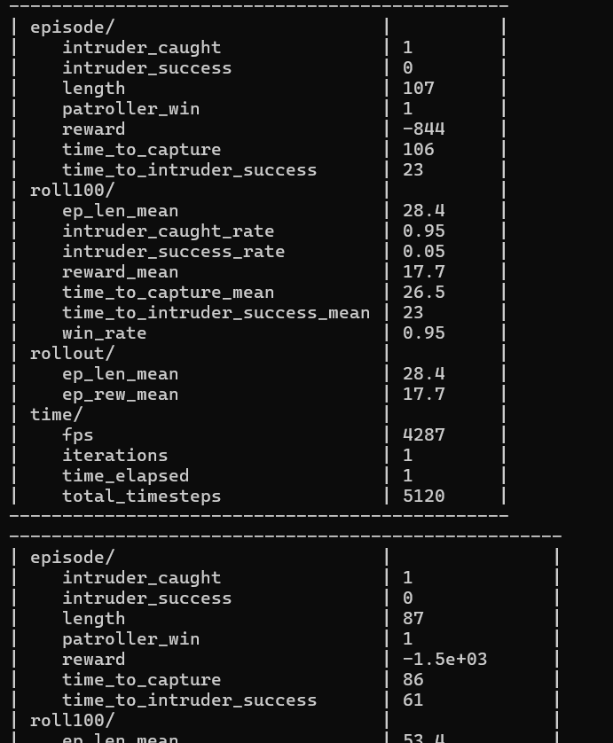
Training Setup
Parallel environments with different seeds
New map sampled at each reset
Energy stations & obstacles randomized
Encourages general strategies

Slide 10
Metrics
Average episode reward
Win rate (intruder caught)
Time to capture
Episode length

Slide 11
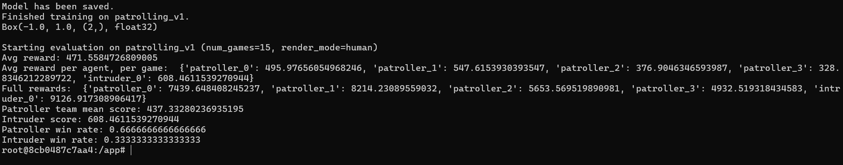
Results (Unseen Maps)
Evaluated on 15 unseen maps
Average reward: 471.56
Win rate: 66.7%
Stable behavior without retraining

Slide 12
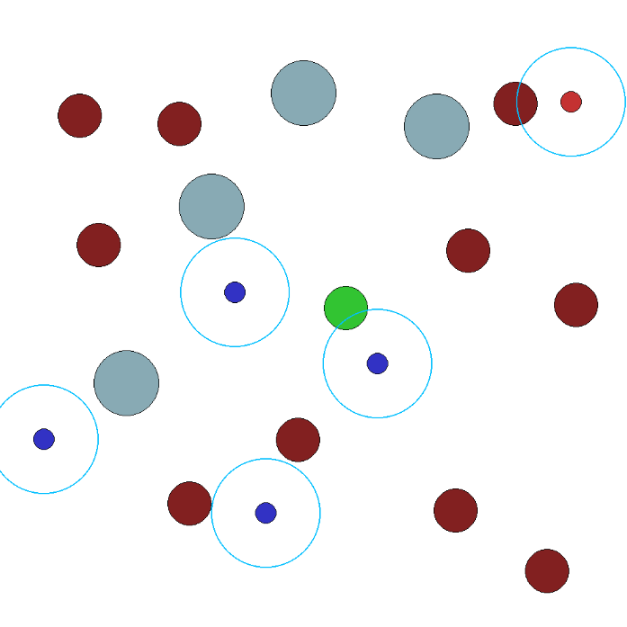
Plots

Slide 13
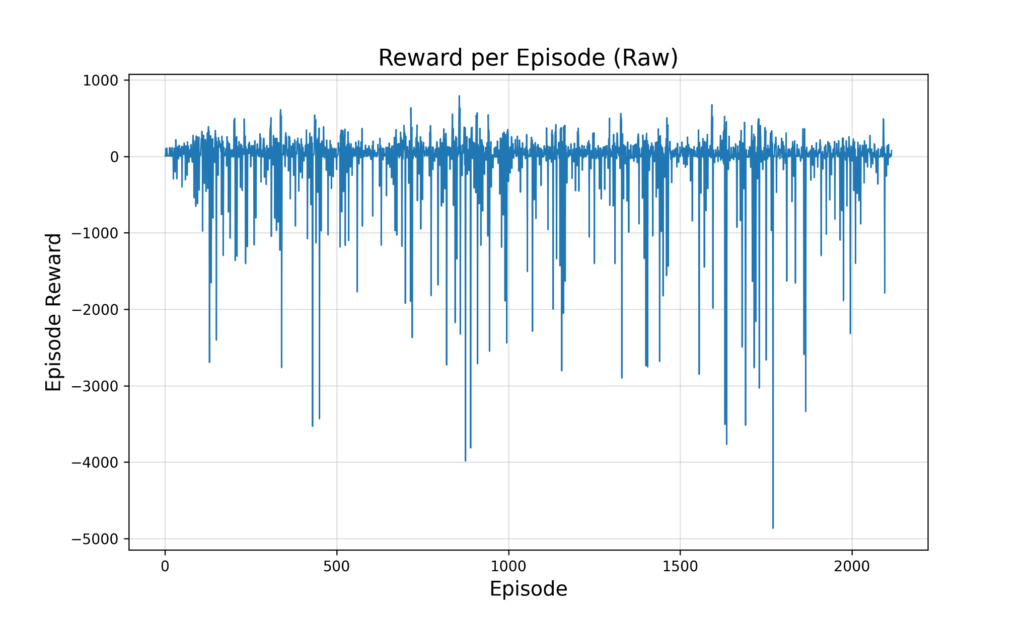
Plots

Slide 14
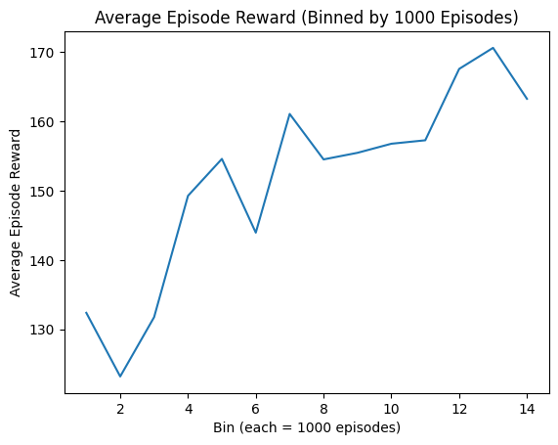
Plots

Slide 15
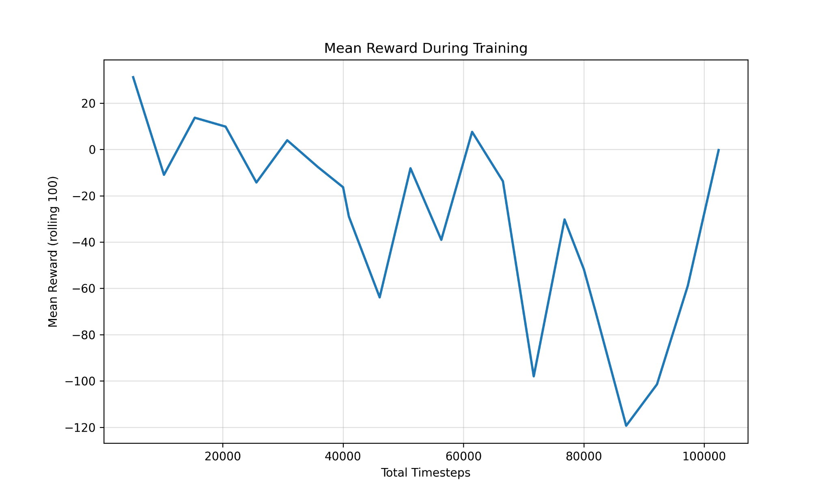
Plots

Slide 16
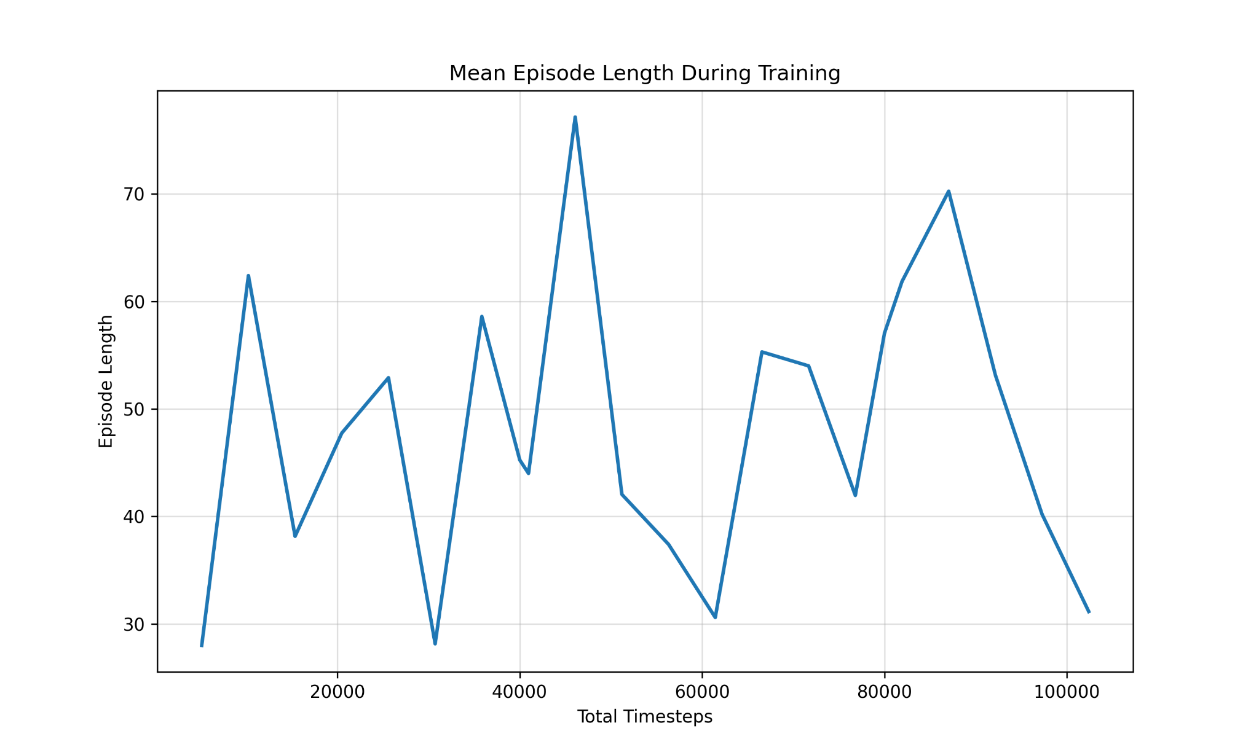
Plots

Slide 17
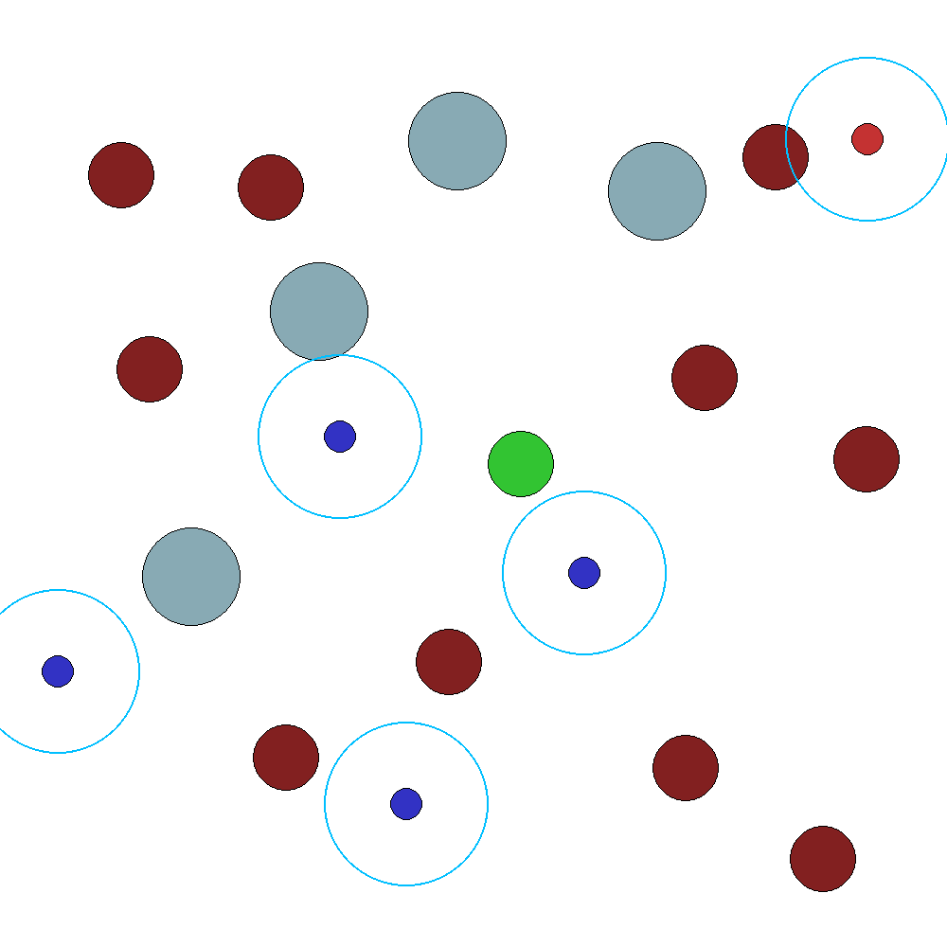
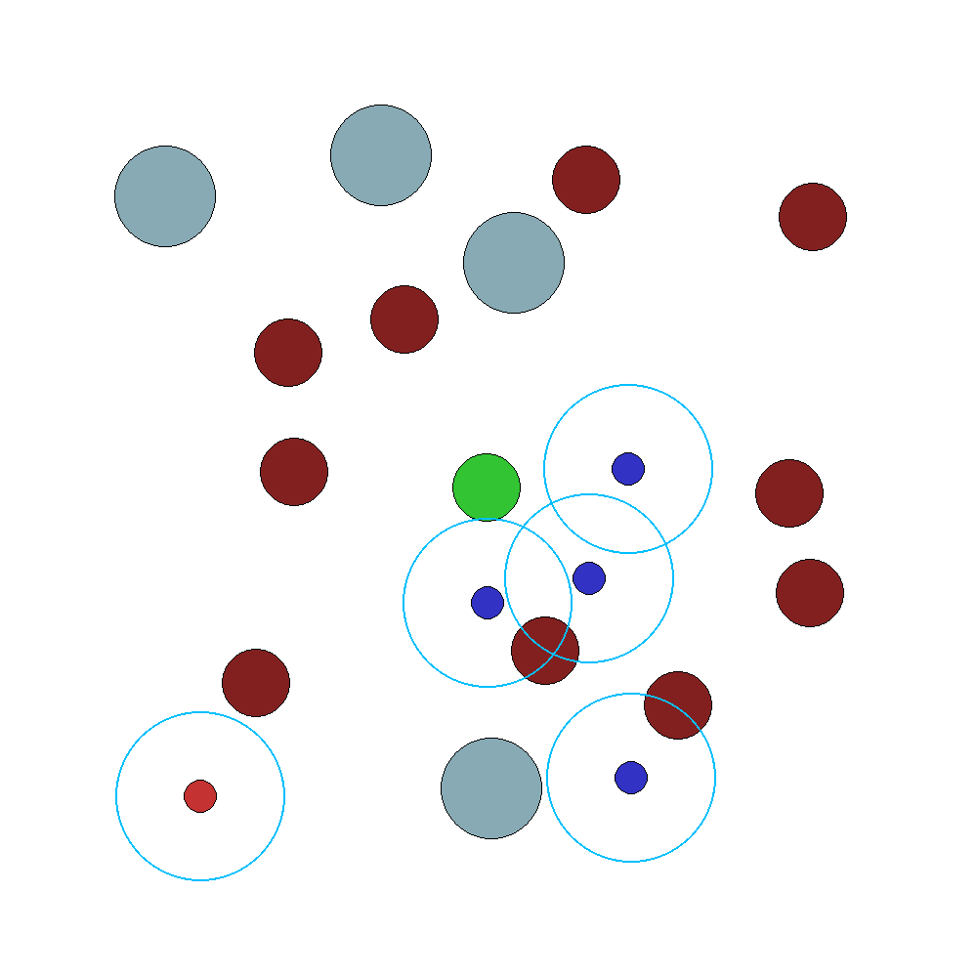
Gifs

Slide 18
Conclusion
Energy constraints transform movement into a strategic decision and improve realism
Recurrent meta-learning enables fast adaptation to unseen, procedurally generated maps
The proposed environment supports robust evaluation of generalization and adaptive behavior

Slide 19
Thank you for your attention!

