Slide 1
Clustering Behavior in Multi-Agent Reinforcement Learning

Slide 2
Motivation
Multi-agent coordination is a fundamental challenge in reinforcement learning
Emergent clustering appears in real-world collective systems
Reinforcement learning enables cooperative behavior learning

Slide 3
Project Goals
Implement a custom multi-agent environment
Train agents using PPO
Ensure reproducibility and modular design

Slide 4
Environment
Grid-based AntSorting environment
Multiple agents act simultaneously
Local observations and cooperative rewards

Slide 5
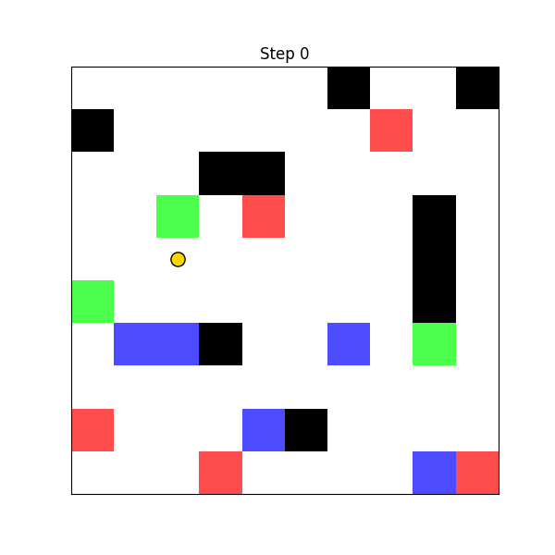
Environment Visualization

Slide 6
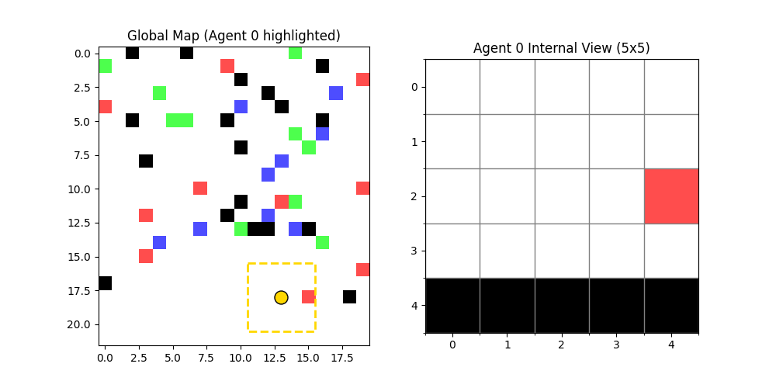
Agent Perception

Slide 7
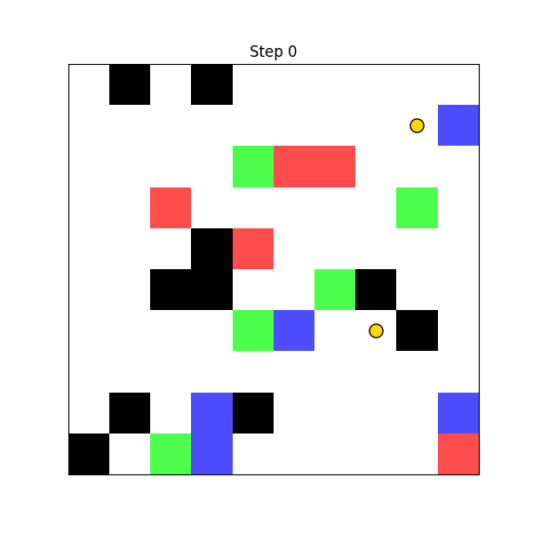
Pheromone-Based Dynamics

Slide 8
Learning Setup
Proximal Policy Optimization
TorchRL framework
Centralized training, decentralized execution

Slide 9
Reproducibility
Dockerized execution
Version-pinned dependencies
Hydra configuration management

Slide 10
Conclusion
Complete MARL pipeline implemented
Emergent cooperative clustering achieved
Fully reproducible experimental setup

