Slide 1
Dynamic Weighted Majority DWM
Abdullah Al Zoabi
Eötvös Loránd University, Budapest, Hungary
December 2019

Slide 2
Introduction
Concept Drift or sudden change in data stream makes it hard for the ordinary machine learning algorithms to work.
New methods that could work with the concept drift should be proposed to handle the drift and adapt with the changing environment.
Dynamic weighted Majority (DWM) is a model management technique to detect and handle the concept drift in a data stream.

Slide 3
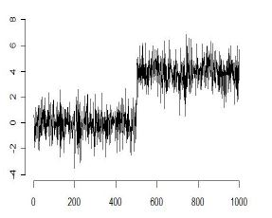
Problem
The ordinary machine learning algorithms are supposed to be working in a stationary environment i.e. the coming data are generated according to a stationary probability distribution.
When this assumption fails due to a change in the concept then the algorithms will fail as well.
Sudden Change in Data Stream

Slide 4
Objective
The objective is to adapt the ordinary machine learning algorithms to fit the sudden changes in the data and handle the drift.
There are many techniques:
Data Management.
Model Management.
Detection Methods.
Adaption Methods.
The Model management methods maintain a number of separate models in the memory in order to adapt the changes, and here where the DMW belongs.

Slide 5
DWM
It’s an Ensemble Method for handling the concept drift.
It maintains separate number of base learners/experts at the same time.
It dynamically adds and removes experts in response to local and global performance.
Each expert has a weight, every time an expert makes a mistake the algorithm decays its weight till it’s removed.
Every time – or within a period – the global algorithm makes a mistake it adds a new expert.
The global prediction is given based on the voting of the experts.

Slide 6
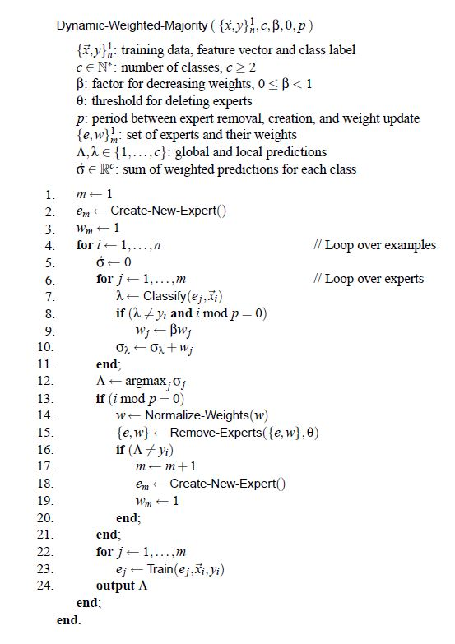
DWM (Cont.)

Slide 7
Experiments
STAGGER Concept.
SEA Concept.
Additional Generated Concept.

Slide 8
STAGGER Concept
120 samples.
3 attributes :
Color = { blue, green, red}
Size = {small, medium, large}
Shape = {triangle, circle, rectangle}
3 concepts, 40 samples each :
Concept 1 : color is red and size is small.
Concept 2 : color is green or shape is circle.
Concept 3 : size is medium or large.

Slide 9

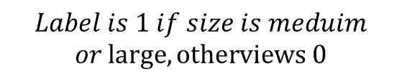

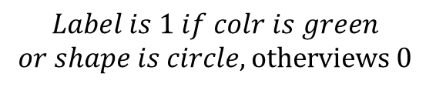
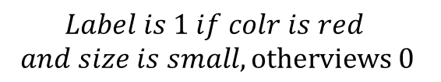

STAGGER Concept (Cont.)
Color
Size
Shape
Label
$$Label is 1 if colr is red$$
$$and size is small, otherviews 0$$
$$t=40$$
$$Label is 1 if colr is green$$
$$or shape is circle, otherviews 0$$
$$t=80$$
$$Label is 1 if size is meduim$$
$$or large, otherviews 0$$
$$t=120$$

Slide 10




STAGGER Concept – Using Ordinary Classifier
Experiment with one ordinary classifier:
Split the stream into training (80%) and testing (20%).
Pick two testing samples from each ten elements in the stream.
$$Data Stream$$
$$……………………………………..$$
$$8 Training Samples$$
$$2 Testing Samples$$
$$8 Training Samples$$
$$2 Testing Samples$$

Slide 11



STAGGER Concept – Using Ordinary Classifier (Cont.)
Experiment with one ordinary classifier:
Split the stream into training (80%) and testing (20%).
Pick two testing samples from each ten elements in the stream.
Accuracy using Naive Bayes classifier : $60\%$
Accuracy using Logistic Regression classifier : $67\%$
$$Data Stream$$
$$Training Dataset$$
$$Testing Dataset$$

Slide 12


STAGGER Concept Using NB-DWM
Use the Naive Bayes as base learner/expert:
Test on the coming 10 samples before including it in the training.
Do this process every 10 samples.
$$Data Stream$$
$$10 Training Samples$$
$$10 Testing Samples$$

Slide 13

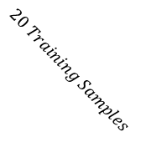
STAGGER Concept Using NB-DWM
Use the Naive Bayes as base learner/expert:
Test on the coming 10 samples before including it in the training.
Do this process every 10 samples.
$$Data Stream$$
$$……………………………………..$$
$$20 Training Samples$$
$$10 Testing Samples$$

Slide 14
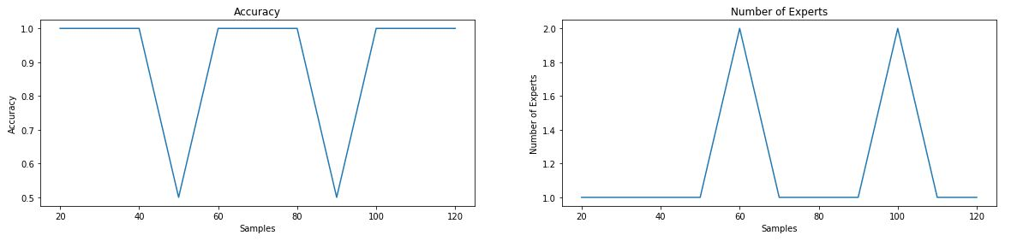

STAGGER Concept Using NB-DWM (Cont.)
Run the algorithm 3 times and take the average, set $P=1$ :
f
Accuracy : $90\%$
Average Number of Experts : $1.18$
One Pass Time : $0.0017 m$

Slide 15
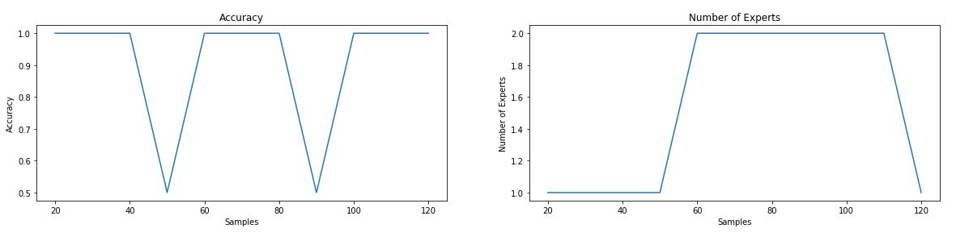
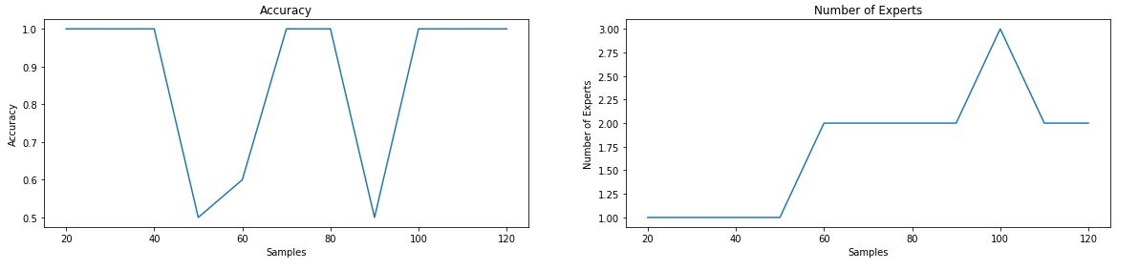



STAGGER Concept Using NB-DWM (Cont.)
Run the algorithm 3 times and take the average, set $P=2, 4$ :
$$Accuracy :90\%$$
$$Pass Time :0.007 m$$
$$Mean Number$$
$$of Experts :1.5$$
$$Accuracy :87\%$$
$$Pass Time :0.008 m$$
$$Mean Number$$
$$of Experts :1.7$$

Slide 16

STAGGER Concept Using NB-DWM (Cont.)
Outcomes :
The synchronize between the accuracy drop and the expert raise decreases by increasing $P$.
Thus, the mean number of experts increases by increasing $P$.
The total accuracy drops after $P$ exceeds a certain number.

Slide 17
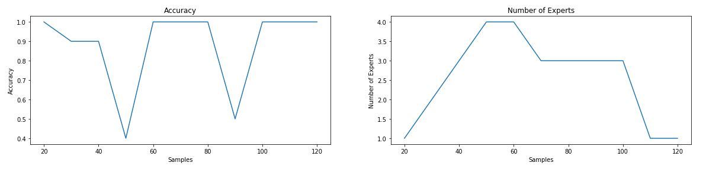

STAGGER Concept Using LR-DWM
Use the Logistic Regression as base classifier, set $P=1$ and take the average of 3 runs :
Accuracy : $88\%$
Average Number of Experts : $2.5$
One Pass Time : $0.016 m$

Slide 18
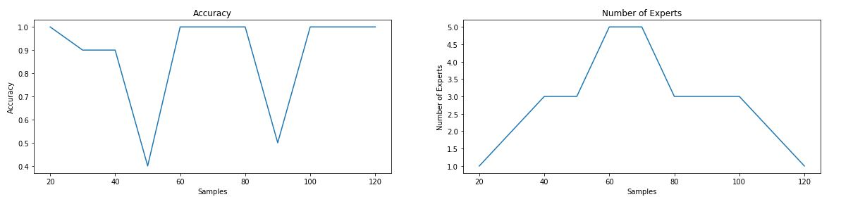

STAGGER Concept Using LR-DWM (Cont.)
Use the Logistic Regression as base classifier, set $P=2$ and take the average of 3 runs :
Accuracy : $88\%$
Average Number of Experts : $2.8$
One Pass Time : $0.016 m$

Slide 19
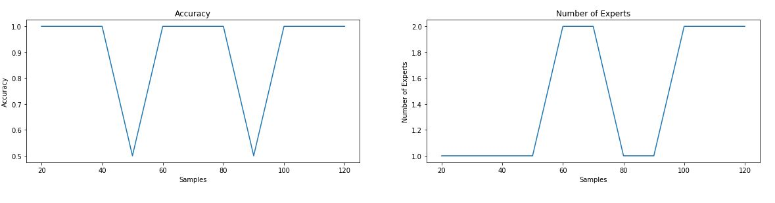

STAGGER Concept Using LR-DWM (Cont.)
Use the Logistic Regression as base classifier, set $P=4$ and take the average of 3 runs :
Accuracy : $90\%$
Average Number of Experts : $1.45$
One Pass Time : $0.01 m$

Slide 20

STAGGER Concept Using LR-DWM (Cont.)
Outcomes :
In general the NB gives better results.
Less synchronize between the accuracy drop and the experts raise comparing with the NB base learner (LR generalize more).
LR fits the data better when $P$ is large.

Slide 21
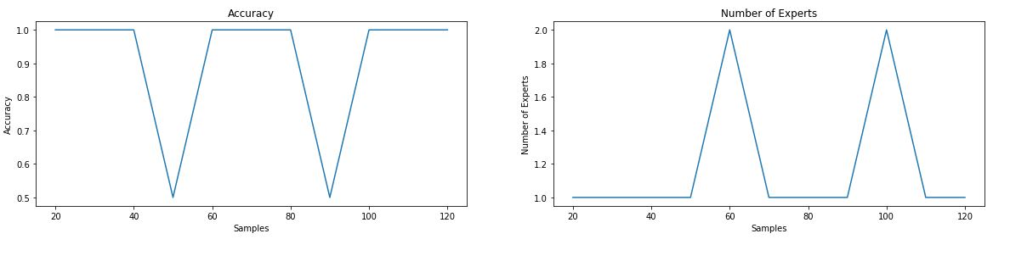

STAGGER Concept Using LR and NB-DWM
Use the NB and LR randomly, set $P=1$ and take the average of 3 runs :
Accuracy : $90\%$
Average Number of Experts : $1.18$
One Pass Time : $0.008 m$

Slide 22
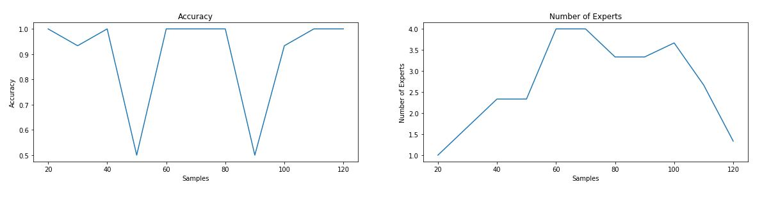

STAGGER Concept Using LR and NB-DWM (Cont.)
Use the NB and LR randomly, set $P=2$ and take the average of 3 runs :
Accuracy : $89.6\%$
Average Number of Experts : $2.6$
One Pass Time : $0.013 m$

Slide 23
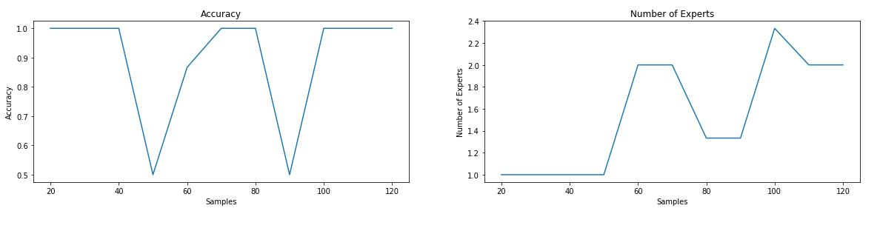

STAGGER Concept Using LR and NB-DWM (Cont.)
Use the NB and LR randomly, set $P=4$ and take the average of 3 runs :
Accuracy : $89.6\%$
Average Number of Experts : $1.54$
One Pass Time : $0.009 m$

Slide 24

SEA Concept
50000 samples.
3 float attributes : $X_{1}, X_{2}, X_{3}∈(0, 10)$
$X_{3}$ is irrelative feature.
4 concepts, 12500 samples each :
Concept 1 : $X_{1}+ X_{2} ≤7$.
Concept 2 : $X_{1}+ X_{2} ≤8$.
Concept 3 : $X_{1}+ X_{2} ≤9$.
Concept 4 : $X_{1}+ X_{2} ≤9.5$.

Slide 25

SEA Concept (Cont.)
Reduce the size to 16000 for faster experiments.
16000 samples.
3 float attributes : $X_{1}, X_{2}, X_{3}∈(0, 10)$
$X_{3}$ is irrelative feature.
4 concepts, 4000 samples each :
Concept 1 : $X_{1}+ X_{2} ≤7$.
Concept 2 : $X_{1}+ X_{2} ≤8$.
Concept 3 : $X_{1}+ X_{2} ≤9$.
Concept 4 : $X_{1}+ X_{2} ≤9.5$.

Slide 26







SEA Concept (Cont.)
$$X_{1}$$
$$X_{2}$$
$$X_{3}$$
Label
$$Label is 1 if{ X}_{1}+ X_{2} ≤7, otherviews 0$$
$$t=4000$$
$$Label is 1 if X_{1}+ X_{2} ≤8, otherviews 0$$
$$t=8000$$
$$Label is 1 if X_{1}+ X_{2} ≤9, otherviews 0$$
$$t=12000$$
$$Label is 1 if{ X}_{1}+ X_{2} ≤9.5, otherviews 0$$
$$t=16000$$

Slide 27



SEA Concept – Using Ordinary Classifier
Experiment with one ordinary classifier:
Split the stream into training (80%) and testing (20%).
Pick 20 testing samples from each 100 elements in the stream.
$$Data Stream$$
$$……………………………………..$$
$$20 Testing Samples$$
$$20 Testing Samples$$
$$80 Training Samples$$
$$80 Training Samples$$

Slide 28

SEA Concept – Using Ordinary Classifier (Cont.)
Experiment with one ordinary classifier:
Split the stream into training (80%) and testing (20%).
Pick 20 testing samples from each 100 elements in the stream.
Accuracy using Naive Bayes classifier : $91.7 \%$
Accuracy using Logistic Regression classifier : $93.5 \%$
$$Data Stream$$
$$Training Dataset$$
$$Testing Dataset$$

Slide 29


SEA Concept Using NB-DWM
Use the Naive Bayes as base learner/expert:
Test on the coming 100 samples before including it in the training.
Do this process every 100 samples.
$$Data Stream$$
$$100 Training Samples$$
$$100 Testing Samples$$

Slide 30

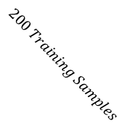
SEA Concept Using NB-DWM (Cont.)
Use the Naive Bayes as base learner/expert:
Test on the coming 100 samples before including it in the training.
Do this process every 100 samples.
$$Data Stream$$
$$……………………………………..$$
$$200 Training Samples$$
$$100 Testing Samples$$

Slide 31
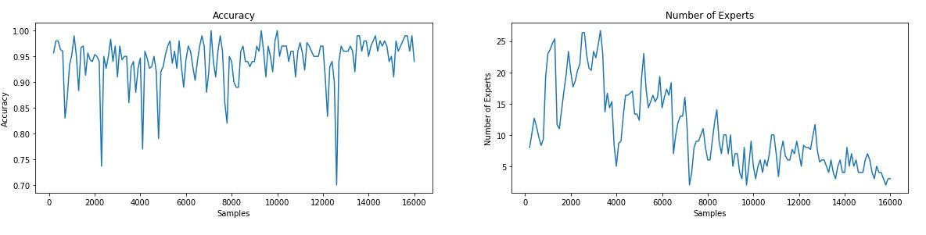

SEA Concept Using NB-DWM (Cont.)
Use the Naive Bayes as base learner/expert.
Set $P=1$, and take the average of 3 runs :
Accuracy : $94.2\%$
Average Number of Experts : $10.7$
One Pass Time : $2.4 m$

Slide 32
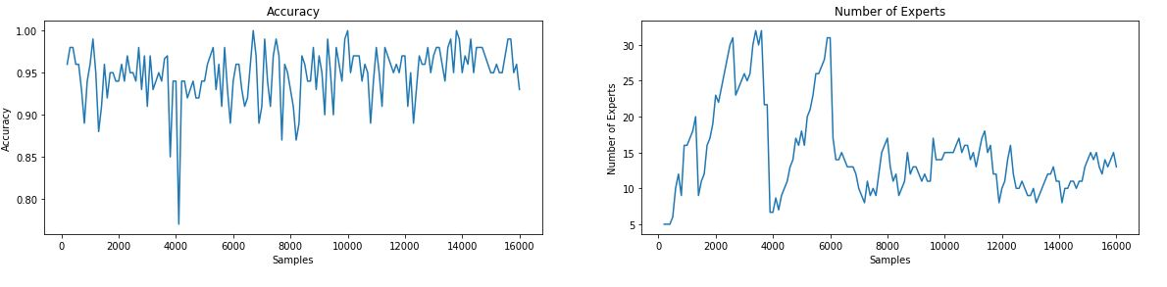

SEA Concept Using NB-DWM (Cont.)
Use the Naive Bayes as base learner/expert.
Set $P=2$, and take the average of 3 runs :
Accuracy : $94.8\%$
Average Number of Experts : $14.8$
One Pass Time : $3.7 m$

Slide 33
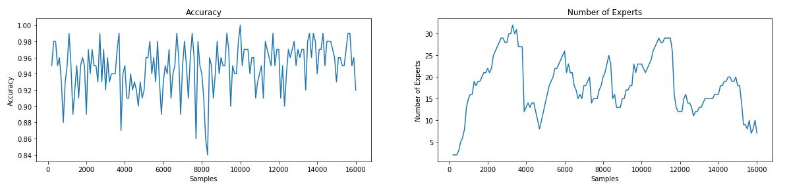

SEA Concept Using NB-DWM (Cont.)
Use the Naive Bayes as base learner/expert.
Set $P=4$, and take the average of 3 runs :
Accuracy : $94.8\%$
Average Number of Experts : $18.1$
One Pass Time : $5.2 m$

Slide 34
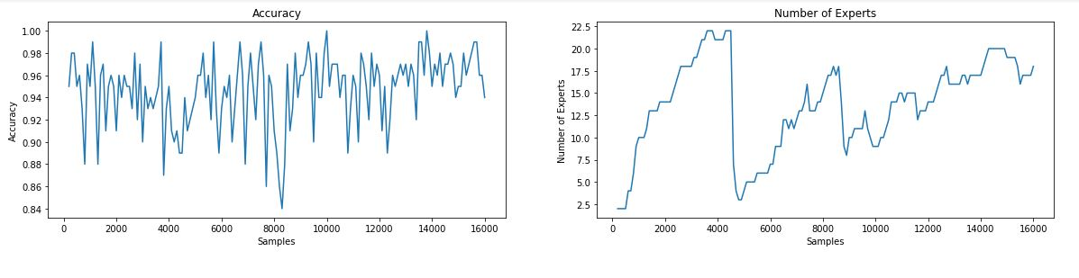

SEA Concept Using NB-DWM (Cont.)
Use the Naive Bayes as base learner/expert.
Set $P=8$, and take the average of 3 runs :
Accuracy : $94.6\%$
Average Number of Experts : $13.7$
One Pass Time : $4.7 m$

Slide 35

SEA Concept Using NB-DWM (Cont.)
Outcomes :
The best accuracy around $94 \%$ not so much improvement from the ordinary classifier.
The two curves are not suitable and drift points are not clear.
Changing $P$ does not change the accuracy.
The number of experts exceeds 30 sometimes since the accuracy is not suitable.

Slide 36
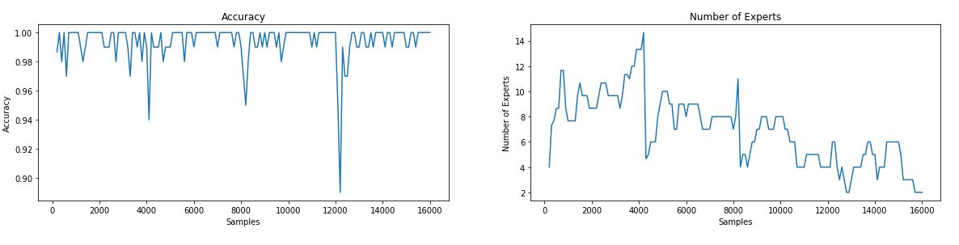

SEA Concept Using LR-DWM (Cont.)
Use the Logistic Regression base learner/expert.
Set $P=1$, and take the average of 3 runs :
Accuracy : $99.3\%$
Average Number of Experts : $6.9$
One Pass Time : $16.1 m$

Slide 37
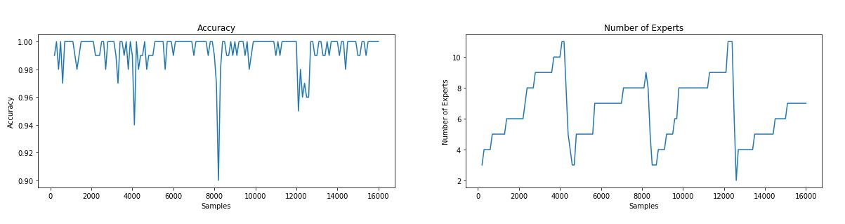

SEA Concept Using LR-DWM (Cont.)
Use the Logistic Regression base learner/expert.
Set $P=2$, and take the average of 3 runs :
Accuracy : $99.3\%$
Average Number of Experts : $6.6$
One Pass Time : $16.9 m$

Slide 38
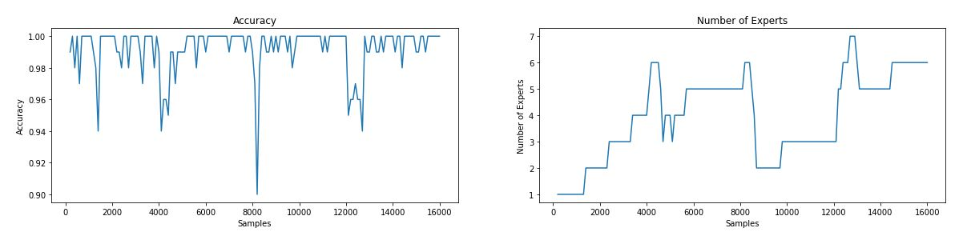

SEA Concept Using LR-DWM (Cont.)
Use the Logistic Regression base learner/expert.
Set $P=4$, and take the average of 3 runs :
Accuracy : $99.1\%$
Average Number of Experts : $3.9$
One Pass Time : $10.9 m$

Slide 39

SEA Concept Using LR-DWM (Cont.)
Outcomes :
Huge improvement in the accuracy comparing with the ordinary classifier.
The two curves are suitable and drift points are clear.
Changing $P$ does not change the accuracy.
The number of experts stay in a small range since the accuracy is suitable.

Slide 40
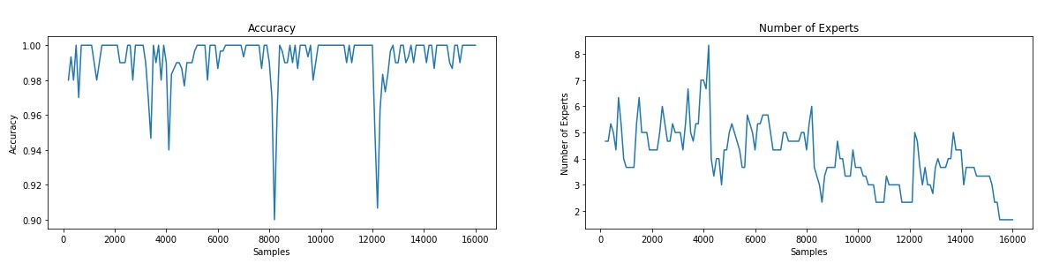

SEA Concept Using LR and NB-DWM (Cont.)
Use the NB and LR randomly.
Set $P=1$, and take the average of 3 runs :
Accuracy : $99.2 \%$
Average Number of Experts : $4$
One Pass Time : $9.5 m$

Slide 41
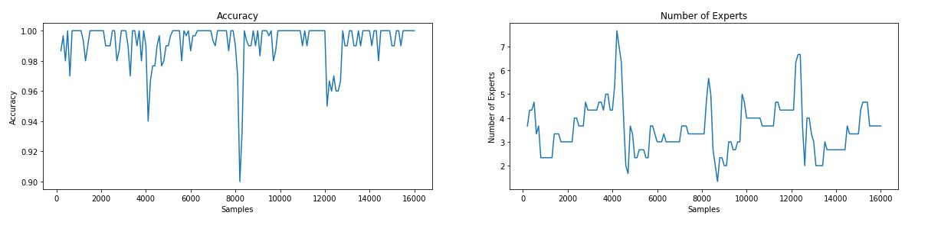

SEA Concept Using LR and NB-DWM (Cont.)
Use the NB and LR randomly.
Set $P=2$, and take the average of 3 runs :
Accuracy : $99.2 \%$
Average Number of Experts : $3.5$
One Pass Time : $8.3 m$

Slide 42
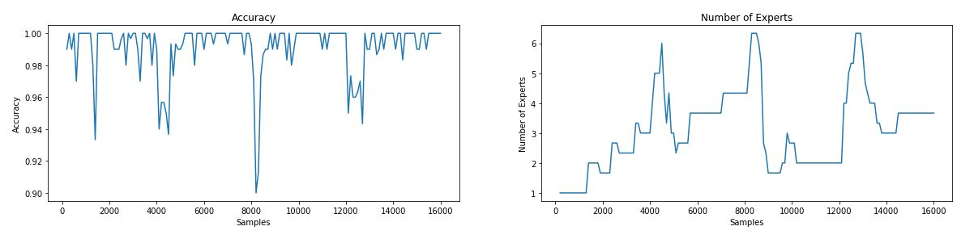

SEA Concept Using LR and NB-DWM (Cont.)
Use the NB and LR randomly.
Set $P=4$, and take the average of 3 runs :
Accuracy : $99.1 \%$
Average Number of Experts : $3.05$
One Pass Time : $8.0 m$

Slide 43
SEA Concept Using LR and NB-DWM (Cont.)
Outcomes :
Not so much difference comparing with the NB base classifier.

Slide 44

Generated Concept
6000 samples.
2 float attributes : $X_{1}, X_{2}∈(0, 10)$
3 concepts, 2000 samples each :
Concept 1 : $X_{1}∗ X_{2}>50$.
Concept 2 : $X_{1}∗ X_{2}<50$.
Concept 3 : $X_{1}∗ X_{2}>50$.

Slide 45




Generated Concept (Cont.)
$$X_{1}$$
$$X_{2}$$
Label
$$t=2000$$
$$Label is 1 if{ X}_{1}∗ X_{2}>50, otherviews 0$$
$$t=4000$$
$$Label is 1 ifX_{1}∗ X_{2}<50, otherviews 0$$
$$t=6000$$
$$Label is 1 ifX_{1}∗ X_{2}>50, otherviews 0$$

Slide 46
Generated Concept (Cont.)
Experiment with one ordinary classifier:
Split the stream into training (80%) and testing (20%).
Pick 20 testing samples from each 100 elements in the stream.
$$Data Stream$$
$$……………………………………..$$
$$20 Testing Samples$$
$$20 Testing Samples$$
$$80 Training Samples$$
$$80 Training Samples$$

Slide 47

Generated Concept (Cont.)
Experiment with one ordinary classifier:
Split the stream into training (80%) and testing (20%).
Pick 20 testing samples from each 100 elements in the stream.
Accuracy using Naive Bayes classifier : $64 \%$
Accuracy using Logistic Regression classifier : $65 \%$
$$Data Stream$$
$$Training Dataset$$
$$Testing Dataset$$

Slide 48
Generated Concept (Cont.)
Use the Naive Bayes as base learner/expert:
Test on the coming 100 samples before including it in the training.
Do this process every 100 samples.
$$Data Stream$$
$$100 Training Samples$$
$$100 Testing Samples$$

Slide 49
Generated Concept (Cont.)
Use the Naive Bayes as base learner/expert:
Test on the coming 100 samples before including it in the training.
Do this process every 100 samples.
$$Data Stream$$
$$……………………………………..$$
$$200 Training Samples$$
$$100 Testing Samples$$

Slide 50
Generated Concept Using NB-DWM
Use the Naive Bayes as base learner/expert:
Test on the coming 100 samples before including it in the training.
Do this process every 100 samples.
$$Data Stream$$
$$……………………………………..$$
$$200 Training Samples$$
$$100 Testing Samples$$

Slide 51
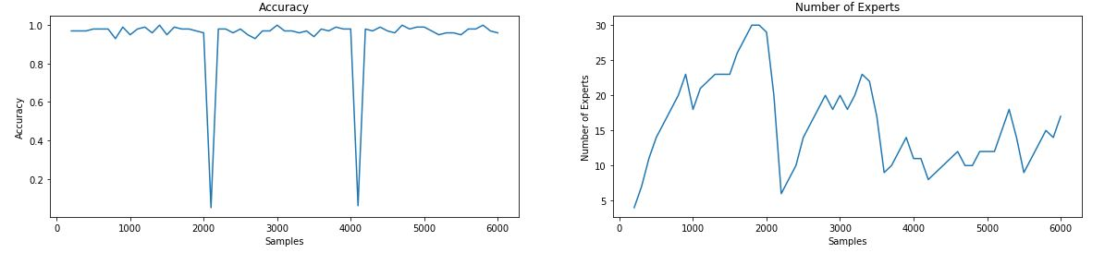

Generated Concept Using NB-DWM (Cont.)
Use the Naive Bayes as base learner/expert.
Set $P=1$, and take the average of 3 runs :
Accuracy : $94.1\%$
Average Number of Experts : $15.8$
One Pass Time : $1.2 m$

Slide 52
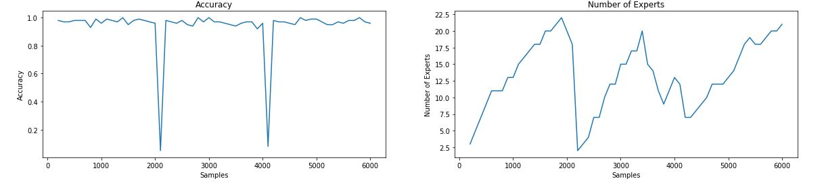

Generated Concept Using NB-DWM (Cont.)
Use the Naive Bayes as base learner/expert.
Set $P=2$, and take the average of 3 runs :
Accuracy : $93.9\%$
Average Number of Experts : $13.3$
One Pass Time : $1.18 m$

Slide 53
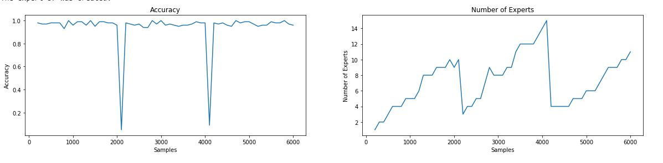

Generated Concept Using NB-DWM (Cont.)
Use the Naive Bayes as base learner/expert.
Set $P=4$, and take the average of 3 runs :
Accuracy : $94.2\%$
Average Number of Experts : $7.2$
One Pass Time : $0.6 m$

Slide 54

Generated Concept Using NB-DWM (Cont.)
Outcomes :
Huge improvement in the accuracy comparing with the ordinary classifier.
The two curves are suitable and drift points are clear.
Changing $P$ does not change the accuracy so much.

Slide 55
Conclusion
DWM could detect and handle the concept drift.
The base learner and P are both hyperparameters depend on the nature of the concept.

Slide 56
References
Kolter J. Z. and Maloof M. A., Dynamic Weighted Majority: An Ensemble Method for Drifting Concepts, 2007.
Gama J., Knowledge Discovery from Data Streams.

Slide 57
Questions ?

Slide 58
Thank You ☺

