Slide 1

Streaming Data classification using VFDT
By: Amjad Balawi
Supervised By: Dr. Chandresh Maurya

Slide 2
The problem
Many organizations today have more than very large databases they have
databases that grow without limit at a rate of several million records per day.
Mining these continuous data streams brings new challenges. Since we have low memory ,low processing time and we have a single pass over the data.

Slide 3
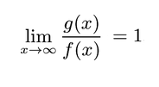
How VFDT handle these problems?
VFDT was proposed by Domingos, P. and Hulten, G. (2000).
“Mining high-speed data streams”
VFDT can incorporate tens of thousands of examples per second using off-the-shelf hardware.
It uses Hoeffding bounds to guarantee that its output is asymptotically nearly identical to that of a batch learner.
Two functions are asymptotically equivalent to if

Slide 4
Cont.
VFDT is incremental and anytime.
New examples can be quickly incorporated as they arrive.
A usable model is available after the first few examples and then progressively defined.
Does not store examples in main memory.

Slide 5
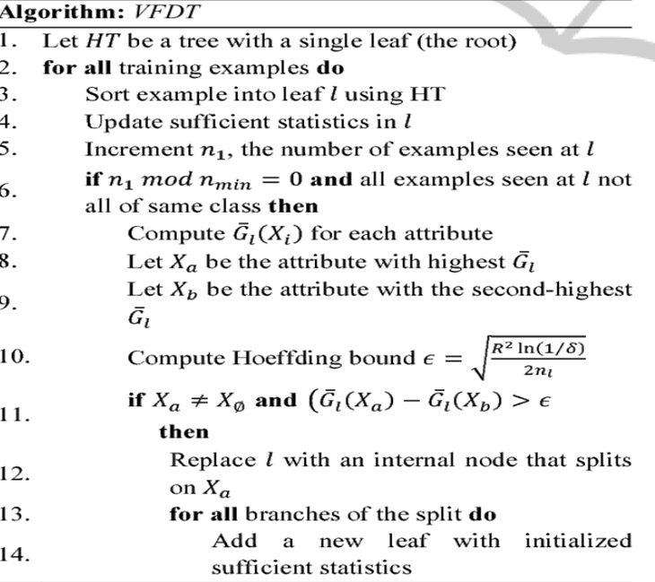
How VFDT works?

Slide 6
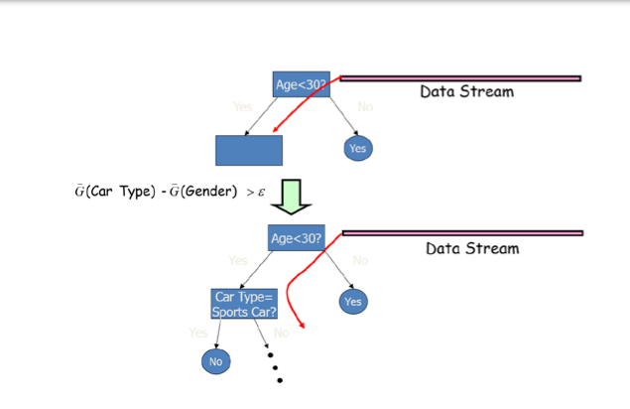
Cont.

Slide 7
Experiments and results
Dataset used: Default of credit card clients from UCI
(30000 examples , 24 features)
Predict the likelihood of credit card default for customers of the Bank.
(Yes = 1, No = 0)
binary classification problem

Slide 8
The Dataset was splitted into training and testing.
To simulate a streaming data , the training set divided into 4 sets.
The result reported on the test set.

Slide 9
Cont.
Training set: 10000, ACCURACY: 0.825
Training set: 15000, ACCURACY: 0.829
Training set: 20000, ACCURACY: 0.831
Training set: 24000, ACCURACY: 0.830
Running time:4.149 secs

Slide 10
A conventional batch tree was implemented to compare it with VFDT
here is the result for the batch tree:
Accuracy: 0.829
Running time: 9.37 secs

Slide 11
Conclusions
The VFDT performs well as it gives an accuracy similar to the A conventional batch tree which used all the examples at once.
VFDT running time was much faster than the batch tree.
It's Anytime algorithm which means you can stop the algorithm anytime with the same performance guarantee.

Slide 12
Demo
Thank you!

Slide 13
References
Pedro Domingos, Geoff Hulten. Mining High Speed Data Streams. In the ACM International Conference on Knowledge Discovery and Data Mining (SIGKDD) 2000.
A Statistical Decision Tree Algorithm for Data Stream Classification
(Mirela Teixeira Cazzolato, Marcela Xavier Ribeiro)

