Slide 1


Stream Mining
Student: Majd Al Okeh
Neptun code: E4LJP2

Slide 2
Project idea
The project idea is about handling user reviews on different app store apps, to help the owners to meet the users demands.
Users write reviews on apps to present:
Feelings (like, dislike)
Report a bug
Suggest a new feature to add.
First classify the reviews into categories e.g. (sentiment, bug report, suggestion, etc.)
Then, we are interested in clustering these reviews in similar groups.
Another approach is to cluster the reviews directly.

Slide 3
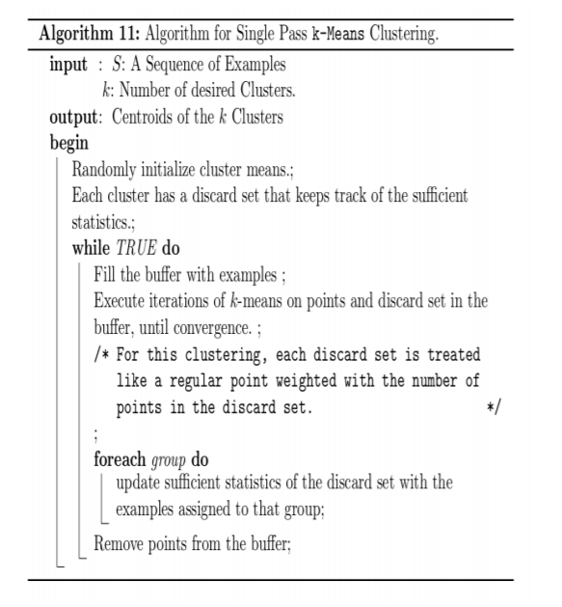

Single pass K-means
K-MEANS algorithm for data stream.

Slide 4
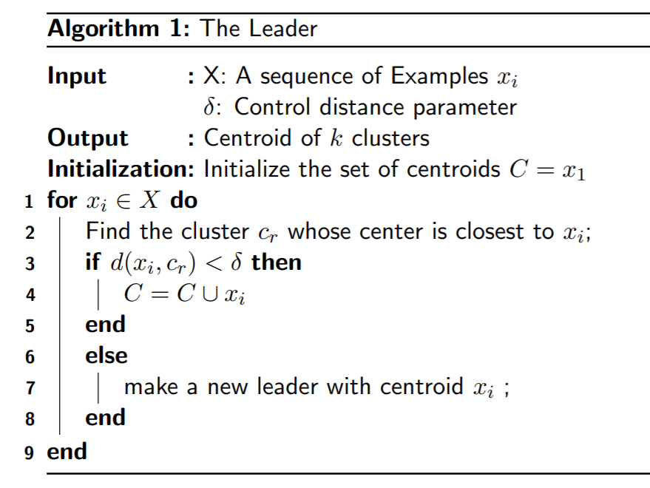
Leader
Clustering algorithm for data stream.

Slide 5
Edited Leader
The idea here is to create a weighted average center for the clusters.
When a new point came and fit in an existing cluster. then assign it to that cluster
Update the cluster center to be the weighted mean of the old center and the new point.
The weights are 1 to the new point, number of points in the cluster for the old center.

Slide 6
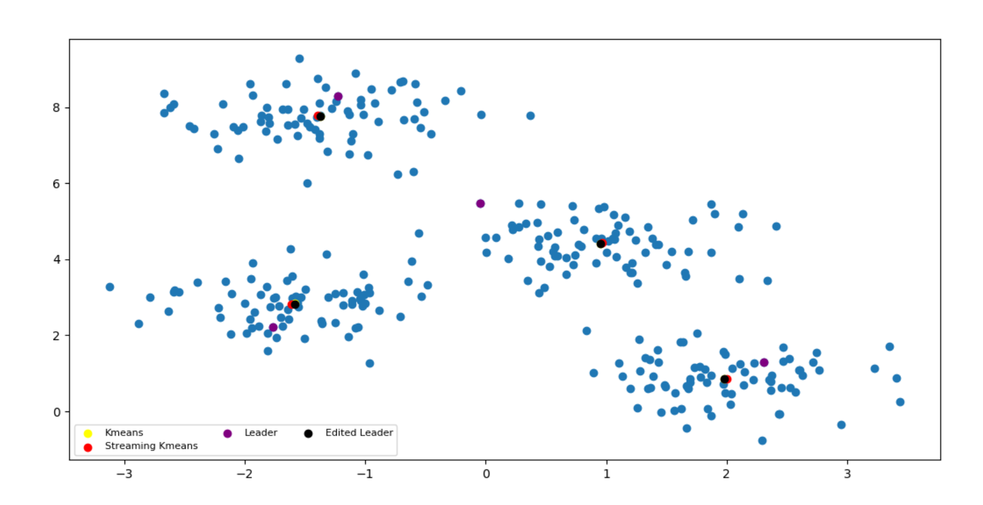
comparison
Generating 300 random points around 4 centers.
K-Means
Single pass K-Means
Leader
Edited Leader

Slide 7
WhatsApp reviews (feature suggestion)

