Slide 1


Stream Mining
Student: Majd Al Okeh
Neptun code: E4LJP2

Slide 2
Project idea
The project idea is about handling user reviews on different app store apps, to help the owners to meet the users demands.
Users write reviews on apps to present:
Feelings (like, dislike)
Report a bug
Suggest a new feature to add.
First classify the reviews into categories e.g. (sentiment, bug report, suggestion, etc.)
Then, we are interested in clustering these reviews in similar groups.
Another approach is to cluster the reviews directly.

Slide 3
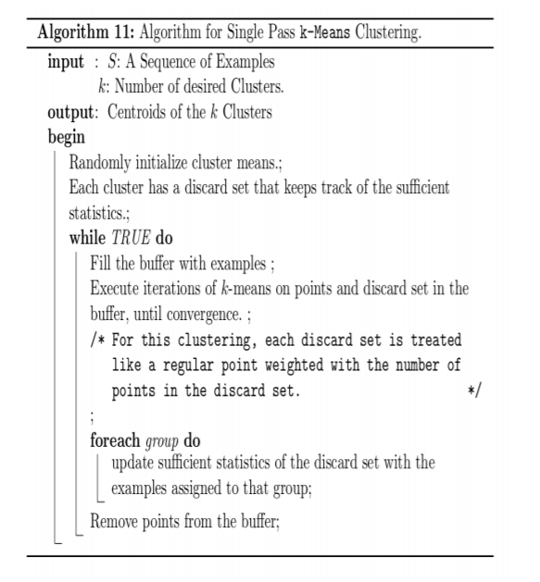

Single pass K-means
K-MEANS algorithm for data stream.

Slide 4
Edited K-means
The idea here is to create a weighted average center for the clusters.
In the pass add the old clusters with weights represent clusters sizes
Run weighted K-Means passes
The weights are 1s to the new points and clusters sizes for the old centers.

Slide 5
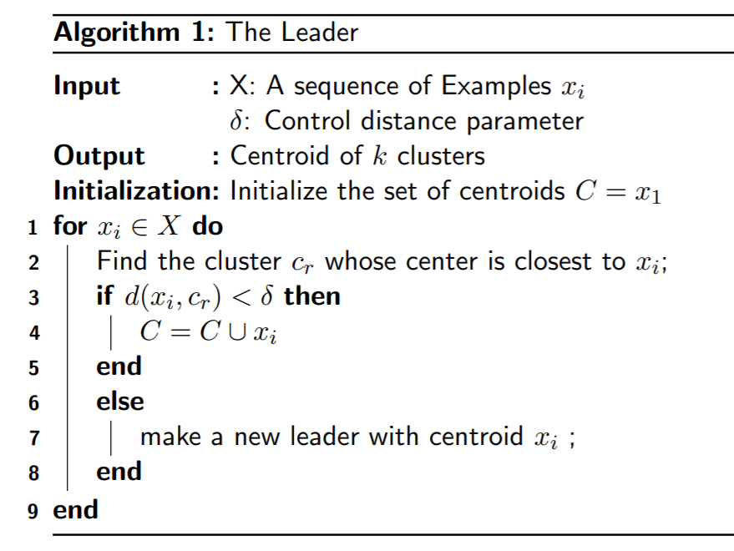
Leader
Clustering algorithm for data stream.

Slide 6
Edited Leader
The idea here is to create a weighted average center for the clusters.
When a new point came and fit in an existing cluster. then assign it to that cluster
Update the cluster center to be the weighted mean of the old center and the new point.
The weights are 1s to the new points and the clusters sizes for the old centers.

Slide 7
comparison
Generating 300 random points around 4 centers.
K-Means
Single pass K-Means
Leader

Slide 8
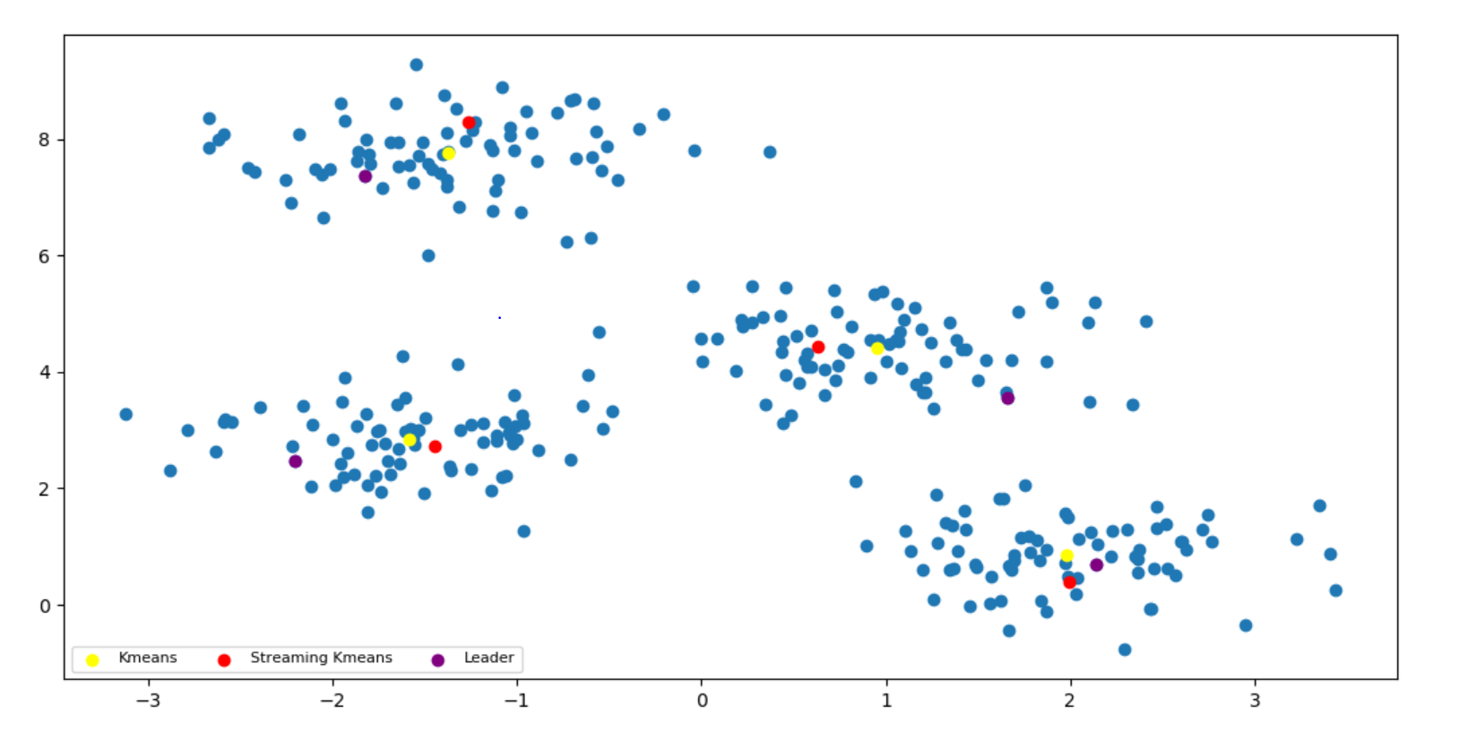

Slide 9
comparison
Generating 300 random points around 4 centers.
K-Means
Single pass K-Means
Edited Single pass K-Means
Leader
Edited Leader

Slide 10
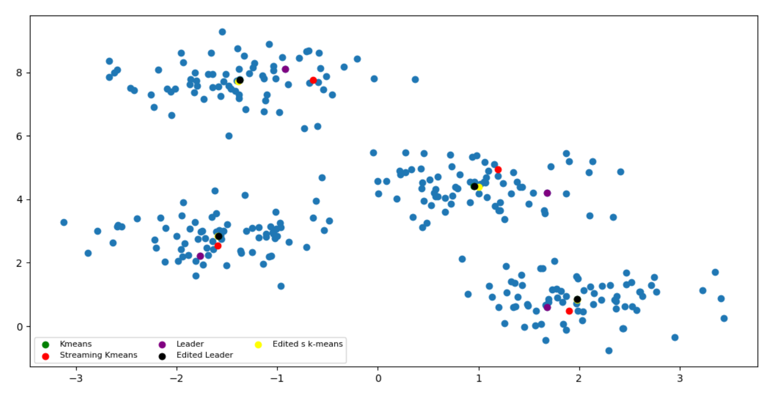

Slide 11
Key word extractions
For each cluster we save list of k key words
With each keyword we save the occurrences, and last seen
For each new review in the cluster we update its keywords by multiplying the old words occurrences by 0.9 if it hasn’t appeared in the last 10 reviews entered that cluster.
If the cluster keywords list size reached the limit, then sort it and delete the least frequent word.

Slide 12

K-means
WhatsApp reviews

Slide 13
K-MEAN stream WhatsApp reviews (feature suggestion)
'message', 'phone', 'option', 'add', 'great', 'time', 'update', 'chat', 'videos'
'people', 'group', 'status', 'add', 'u', 'sir', 'need', '5peole', 'great'
'group', 'option', 'great', 'chat', 'status', 'number', 'update', 'people', 'video'
'option', 'chat', 'add', 'group', 'status', 'number', 'great', 'online', 'ringtone'

Slide 14
K-MEAN stream WhatsApp reviews (All reviews)
'thank', 'fixing', 'love', 'message', 'working', 'usefull', 'feature', 'description', 'happens', 'voice'
'quality', 'people', 'chat', 'usefull', 'calling', 'pls', 'feature', 'update', 'recently', 'profile'
'awesome', 'nice', 'fixing', 'group', 'great', 'feature', 'usefull', 'status', 'description', 'happens'
'love', 'service', 'usefull', 'great', 'phone', 'message', 'excellent', 'community', 'lots', 'ok'

Slide 15
K-MEAN stream WhatsApp reviews (All reviews)
'quality', 'people', 'apps', 'backup', 'chats', 'phone', 'needs', 'number', 'option', 'day'
'usefull', 'calling', 'pls', 'nice', 'useful', 'facilities', 'working', 'superb', 'great', 'wats'
'admins', 'day', 'great', 'add', 'chat', 'fh', 'chats', 'status', 'remove', 'kick'
'quality', 'people', 'status', 'best', 'chats', 'usefull', 'option', 'needs', 'groups', 'easy'

Slide 16
Edited Leader
WhatsApp reviews

Slide 17
LEADer WhatsApp reviews (feature suggestion)
'group', 'groups', 'option', 'number', 'status', 'video', 'send', 'people', 'time', 'able'
'status', 'video', 'option', 'update', 'feature', 'videos', 'audio', 'add', 'picture', 'share'
'message', 'delete', 'deleted', 'option', 'status', 'messages', 'mistake', 'chat', 'edit', 'spam'
'chat', 'feature', 'plz', 'add', 'option', 'group', 'people', 'look', 'update', 'online'

Slide 18
LEADer WhatsApp reviews (feature suggestion)
'message', 'messages', 'sending', 'option', 'status', 'time', 'notifications', 'feature', 'notification', 'update'
'group', 'groups', 'add', 'admin', 'members', 'option', 'delete', 'feature', 'admins', 'time'
'mode', 'dark', 'night', 'use', 'option', 'daily', 'great', 'feature', 'tone', 'issue'
'update', 'sir', 'security', 'need', 'phone', '5peole', 'n', 'send', 'people', 'request'

Slide 19
LEADer WhatsApp reviews (all reviews)
'video', 'status', 'sound', 'playing', 'audio', 'nt', 'issue', 'play', 'background', 'videos'
'phone', 'wifi', 'network', 'hear', 'time', 'updates', 'sim', 'data', 'support', 'calls'
'mode', 'night', 'dark', 'option', 'status', 'use', 'phone', 'feature', 'great', 'theme'
'download', 'version', 'update', 'phone', 'nt', 'tab', 'help', 'issue', 'tried', 'playstore'

Slide 20
LEADer WhatsApp reviews (all reviews)
'feature', 'option', 'message', 'status', 'add', 'chat', 'update', 'disturb', 'calls', 'messages'
'nice', 'awsm', 'super', 'harshit', 'purohit', 'super', 'awsme', 'mukhiya', 'mynewapp', 'supar'
banned', 'number', 'time', 'years', 'nt', 'reply', 'account', 'reason', 'got', 'support'
'phone', 'calls', 'message', 'notification', 'issue', 'earphones', 'work', 'update', 'working', 'screen'

Slide 21
Word level
WhatsApp reviews

Slide 22
Clustering reviews words
'dark', 'flashing', 'blue', 'light', 'dot', 'blind', 'unseen', 'color', 'colors', 'lighting'
'swipe', 'fingerprint', 'fingerprints', 'checking', 'check', 'scanner', 'test', 'monitor', 'duplicate', 'verification'
'privacy', 'security', 'personal', 'private', 'identity', 'stalker', 'legal', 'rights', 'freedom', 'sensitive'
'limited', 'limitation', 'limit', 'limitations', 'limiting', 'limits', 'ban', 'banned', 'restricting', 'provision'
'sad', 'impressive', 'happy', 'disappointed', 'shocked', 'sincere', 'dissatisfied', 'thrilled', 'disappointing', 'appreciated'

