Slide 1
Project Presentation
Dynamic Weighted Majority: An Ensemble Method for Drifting Concepts
Eötvös Loránd University, Budapest, Hungary
Ramil GULUZADA

Slide 2
INTRODUCTION
four mechanisms to cope with concept drift
trains online learners of the ensemble
weights those learners based on their performance
removes them (based on performance)
Adds new experts (based on global performance of ensemble)
Better able to respond in non-stationary environments.
Stagger and SEA Concepts
Performs no worse than a single base learner

Slide 3
Background and Related work
Concept Drift
Ensemble Methods
Ensemble Methods for Concept Drift

Slide 4

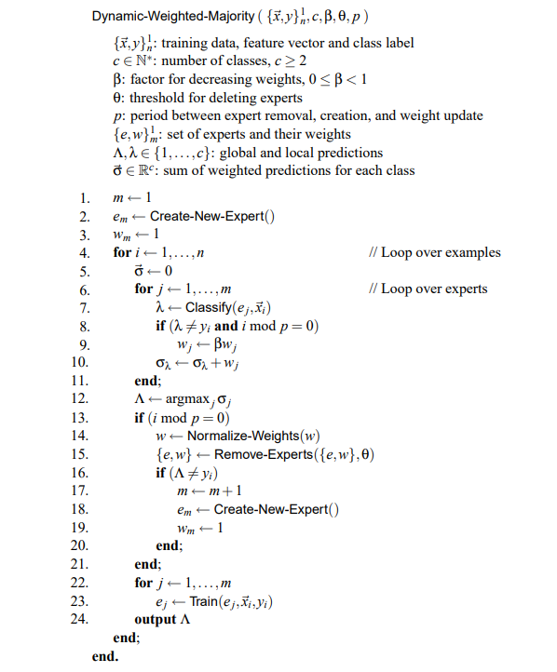
DWM: An Ensemble Method for Concept Drift
Algorithm for dynamic weighted majority

Slide 5
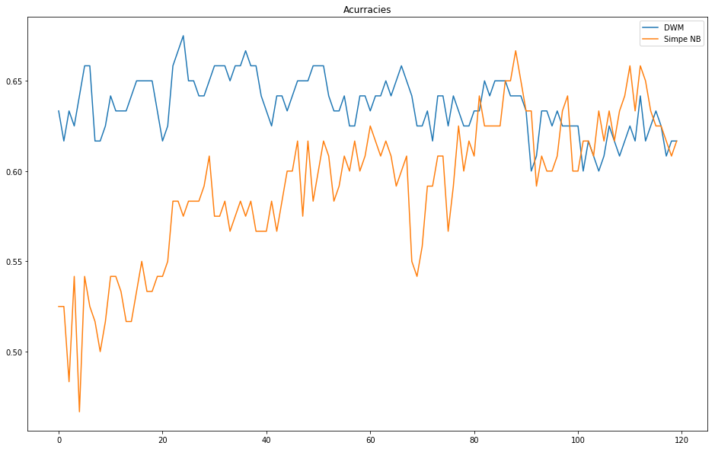
Stagger Concept

Slide 6
Empirical Study and Results
The STAGGER Concepts
Performance on a Larger Data Set with Concept Drift
Electricity Pricing Domain
Evaluation on Static Concepts

Slide 7


