Slide 1
VFDT
Implementation of Hoeffding Trees

Slide 2
VFDT
incremental decision tree learner for large data streams, that assumes that the data distribution is not changing over time.
I/O bound
Does not store any examples in the main memory
asymptotically nearly identical to the traditional learner, if the no. of training instances is large enough.
Notes:
VFDT is I/O bound in the sense that it mines examples in less time than it takes to input them from disk. It does not store any examples (or parts thereof) in main memory, requiring only space proportional to the size of the tree and associated sucient statistics. It can learn by seeing each example only once, and therefore does not require examples from an online stream to ever be stored. It is an anytime algorithm in the sense that a ready-to-use model is available at any time after the rst few examples are seen, and its quality increases smoothly with time.
If d is the number of attributes, v is the maximum number of values per attribute, and c is the number of classes, the Hoeding tree algorithm requires O(dvc) memory to store the necessary counts at each leaf. If l is the number of leaves in the tree, the total memory required is O(ldvc).
This is independent of the number of examples seen, if the size of the tree depends only on the \true" concept and is independent of the size of the training set.

Slide 3
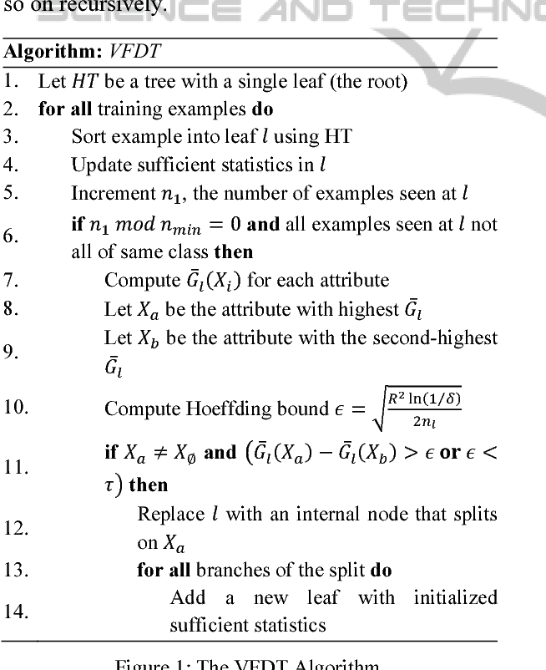
VFDT Algorithm
Notes:
VFDT is I/O bound in the sense that it mines examples in less time than it takes to input them from disk. It does not store any examples (or parts thereof) in main memory, requiring only space proportional to the size of the tree and associated sucient statistics. It can learn by seeing each example only once, and therefore does not require examples from an online stream to ever be stored. It is an anytime algorithm in the sense that a ready-to-use model is available at any time after the rst few examples are seen, and its quality increases smoothly with time.
If d is the number of attributes, v is the maximum number of values per attribute, and c is the number of classes, the Hoeding tree algorithm requires O(dvc) memory to store the necessary counts at each leaf. If l is the number of leaves in the tree, the total memory required is O(ldvc).
This is independent of the number of examples seen, if the size of the tree depends only on the \true" concept and is independent of the size of the training set.

Slide 4
Problem Solved
Classification of the genuine and the forged bank notes from specimens.

Slide 5
Dataset description
Data were extracted from images that were taken from genuine and forged banknote-like specimens. For digitization, an industrial camera usually used for print inspection was used. The final images have 400x 400 pixels. Due to the object lens and distance to the investigated object gray-scale pictures with a resolution of about 660 dpi were gained. Wavelet Transform tool were used to extract features from images.

Slide 6
Dataset
Attributes Information:
variance of Wavelet Transformed image (continuous)
skewness of Wavelet Transformed image (continuous)
curtosis of Wavelet Transformed image (continuous)
entropy of image (continuous) class (integer)
Total Instance: 1372, Training Instance: 1000, Validation Instance: 372

Slide 7
Model Evaluation
Training set: 0-250, ACCURACY: 0.9299
Training set: 250-500, ACCURACY: 0.9623
Training set: 500-750, ACCURACY: 0.9704
Training set: 750-1000, ACCURACY: 0.9650
precision | recall | f1
0.965149 | 0.96496 | 0.96499

Slide 8
Comparison
VFDT
Running Time: 0.0351
Accuracy: 0.9650
TRADITION DECISION TREE
Running Time : 0.00404s
Accuracy: 0.96495

Slide 9
Conclusion
VFDT works as efficiently as a traditional Decision Tree Classifier keeping in mind that the training set is large enough.

