Slide 1
Assignment # 3
Algorithm: Re-di Algorithm
Name: Vikas Pandey
Neptun ID: I11Z6U

Slide 2
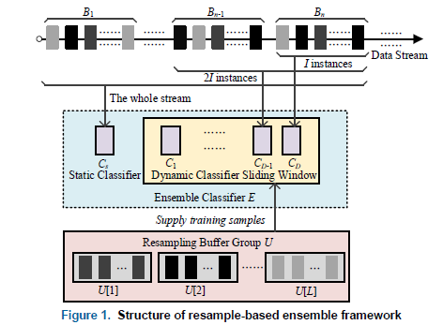
Figure: General overview

Slide 3

Four main steps:
Ensemble Learning Procedure
Train On Instance
Reinforcement Weight Adjustment
Create New Base Classifier
Calculate DCIR

Slide 4
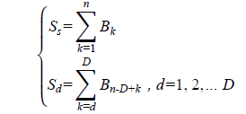
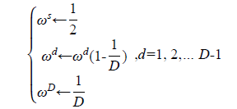


Relevant Equations:

Slide 5
Parameters:
Agrawal is used to generate data streams with sudden concept drift and class imbalance.
D=10, I=500, and ε=0.20
Number of classes were 2: (1,0)
Features were 9.
stream = AGRAWALGenerator()
HoeffdingTree classifier: ht = HoeffdingTree()
Evaluator = EvaluatePrequential(show_plot=False, pretrain_size=500, max_samples=500)
Run: evaluator.evaluate(stream=stream, model=ht)

