Slide 1
/dev/input/event#
/dev/graphics/fb0
ScreenCoordsService
ScreenCaptureService
eng.traineddata
TessTwoAdapter
MotionEvent
Bitmap
String
SpellProofreader
wordnet.db
SuffixTree
String
Translator
WordEntry

Slide 2
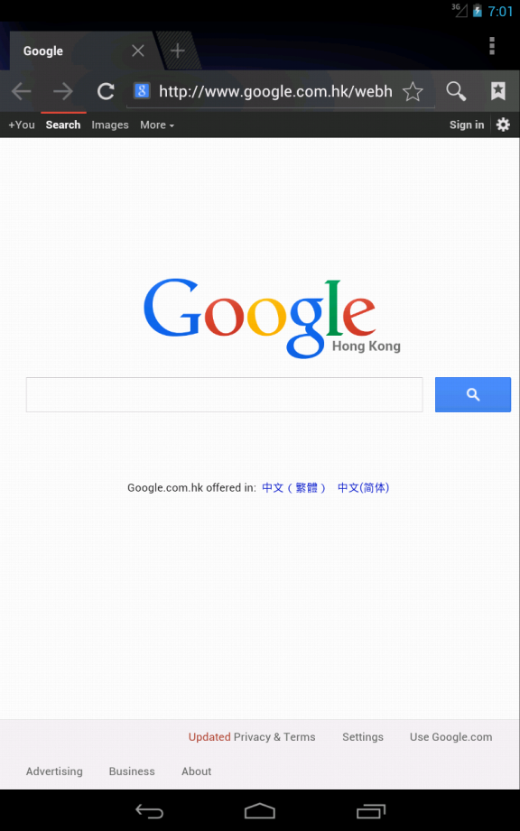
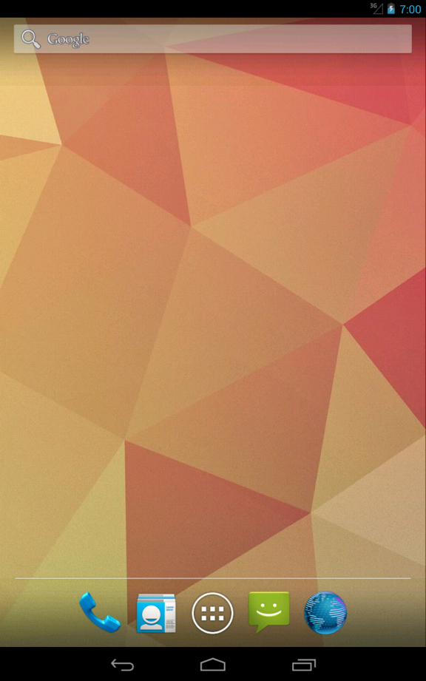
4.5"
System UI
com.android.brower.BrowerActivity
com.android.launcher2.Launcher

Slide 3
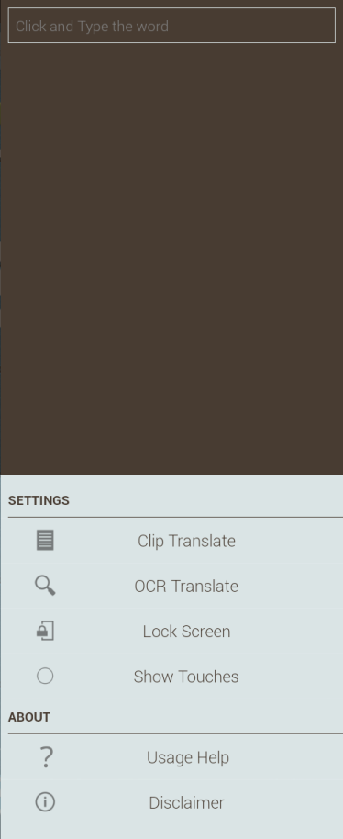
DroidPop#SlideDockView
DroidPop#Hotspot
System UI
com.android.brower.BrowerActivity

