Slide 1
GNNs meet self-play Reinforcement Learning
How to leverage relational inductive biases present in board games with a scalable Graph Neural Network architecture.

Slide 2
State of the art board game AI
The current state of the art for two-player zero-sum games such as Chess, Shogi, Go or Hex can be summarized like this:
Approximate a policy and value function with convolutional neural networks and train them using an AlphaGo style algorithm.
This is the part that I want to improve on

Slide 3
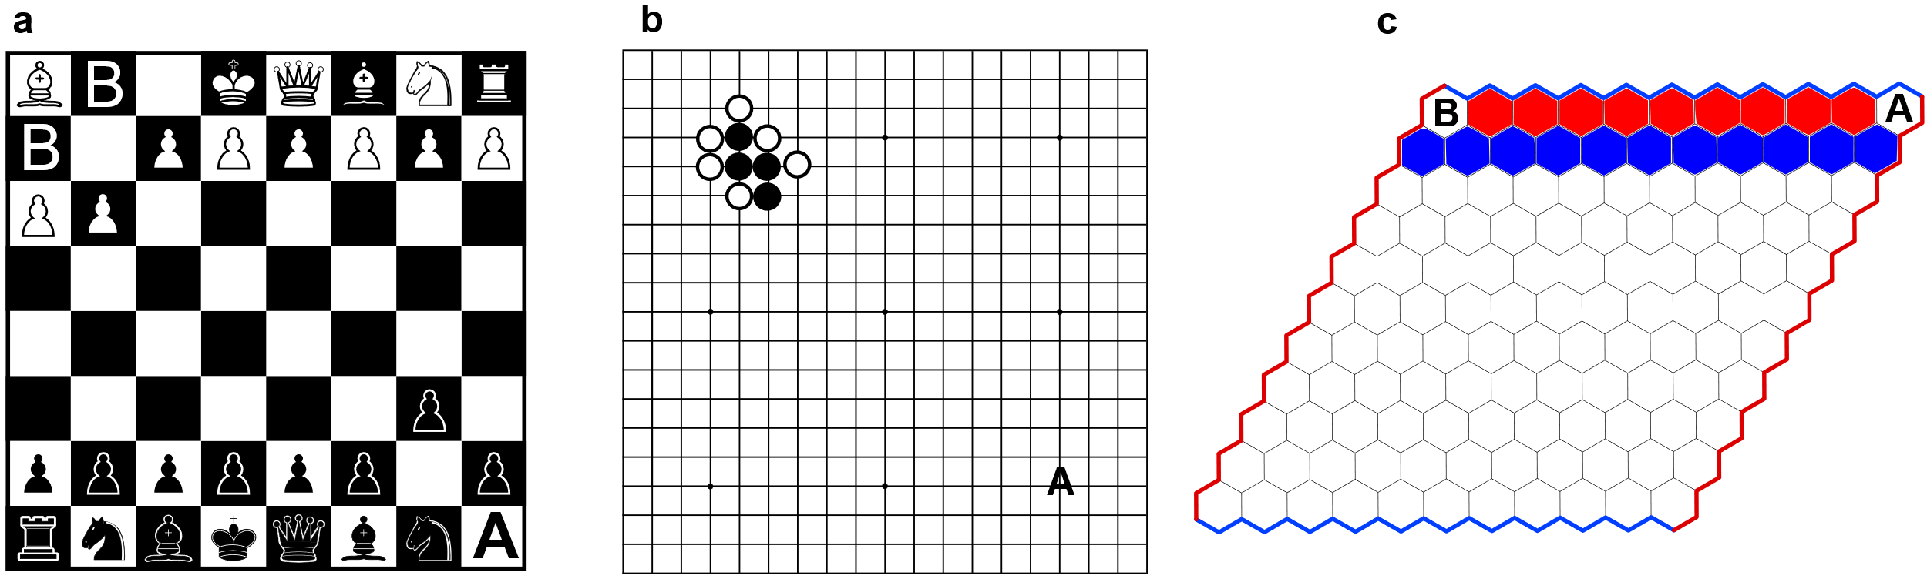
The problem with CNNs
CNNs have relational inductive biases towards spatial locality and translational invariance
This is great while patterns are local. However, when they are not, CNNs are a bad choice
Chess
Go
Hex
Long bishop diagonal
“Ladder”
Long distance connected nodes

Slide 4
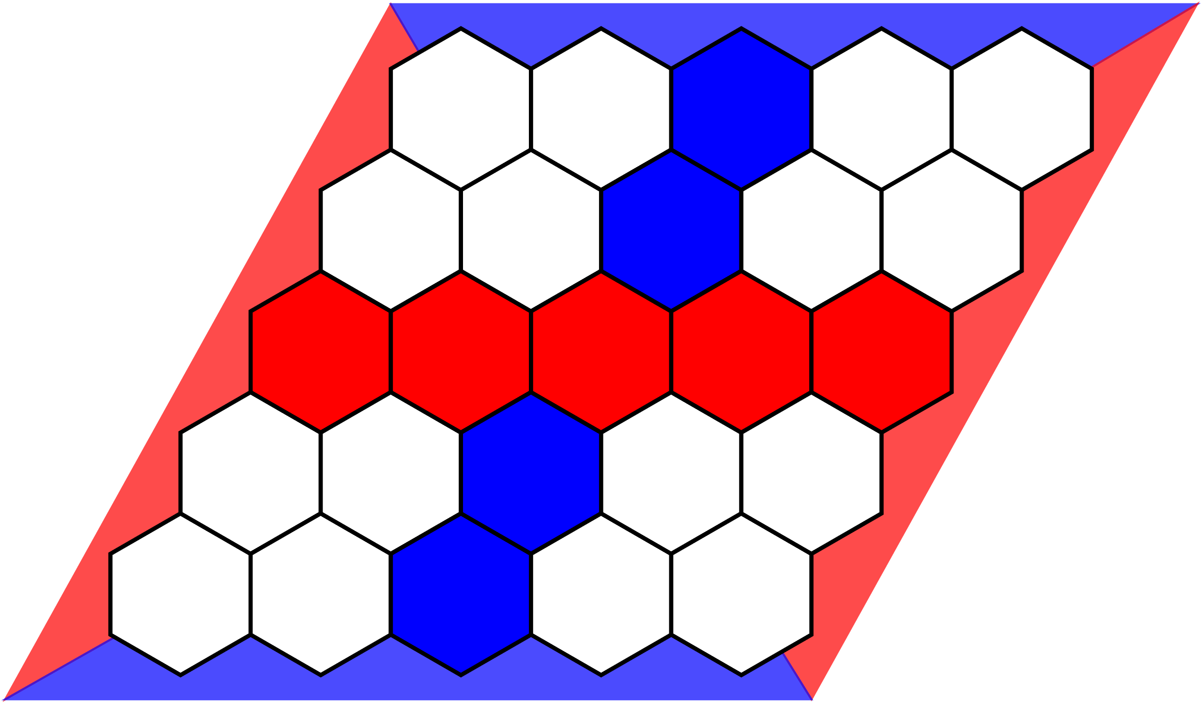
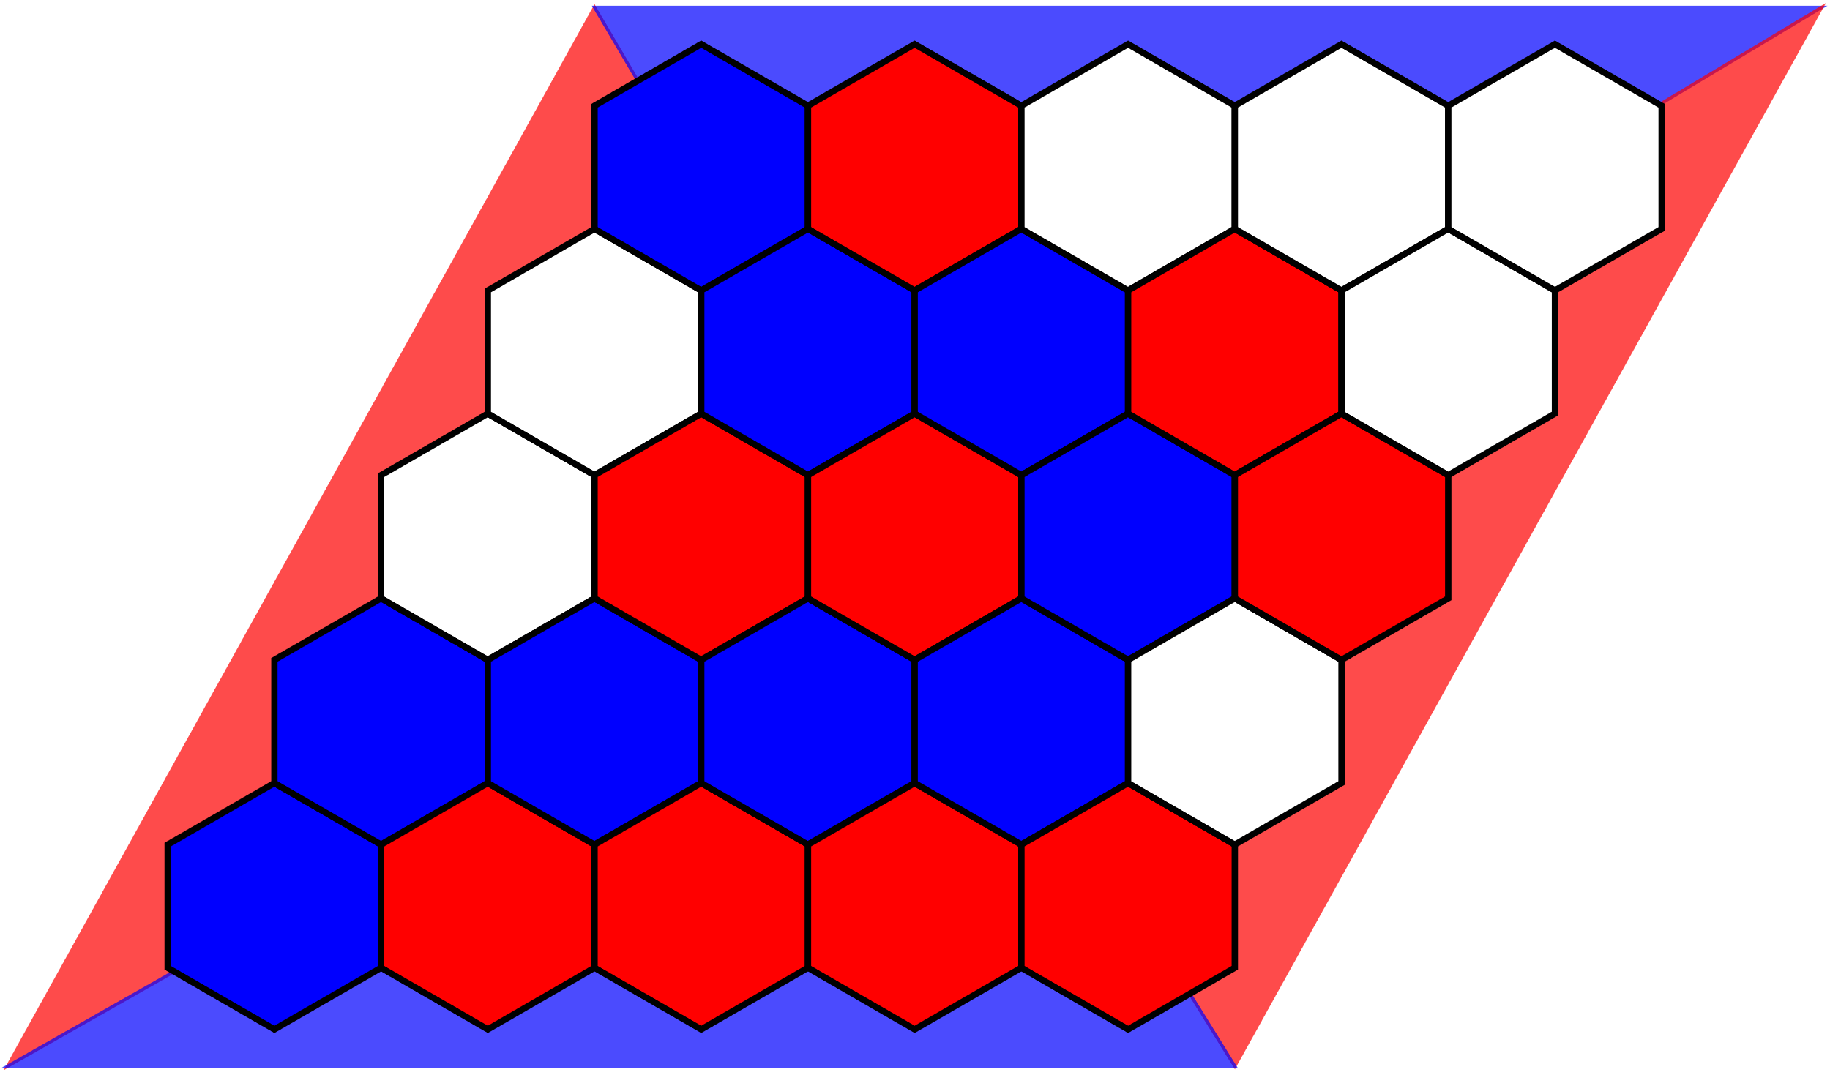
Hex (the focus of my thesis)
Red and Blue players fill tiles on alternating turns.
Red wins by connecting the left and right sides with a continuous path of red tiles while blue wins by connecting the top and bottom with blue tiles.
On a filled board, exactly one player will achieve his goal (No draws)
Red wins
Blue wins

Slide 5
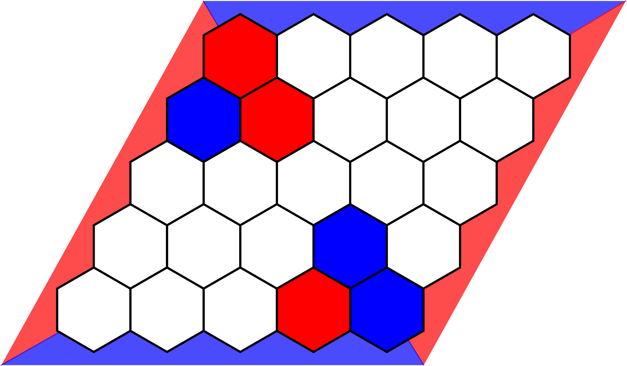
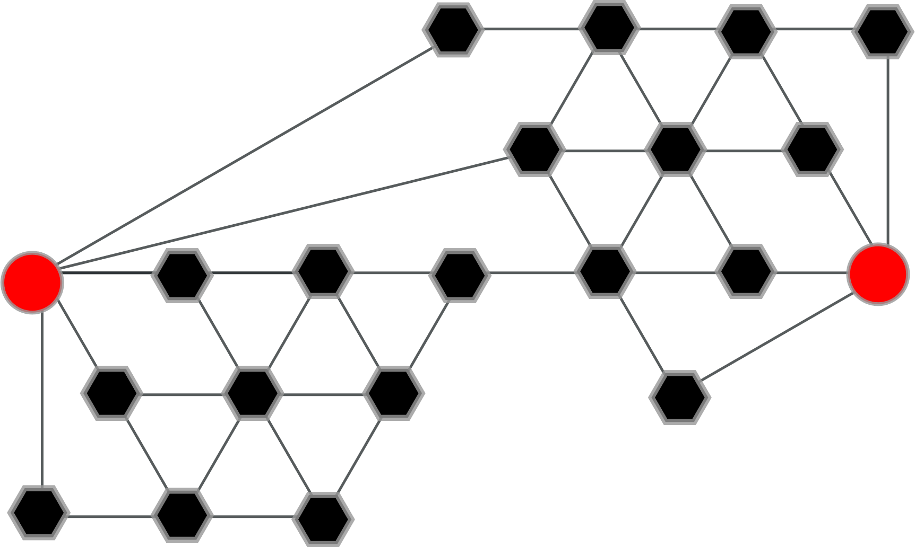
Hex Graphs
Hex has an alternative graph representation, which makes Hex a prime candidate for Graph Neural Networks
The short player connects neighbours after removing vertices and wins by creating a direct connection between the two terminal nodes
The cut player removes vertices and wins by cutting the two terminal nodes
Each board has two equivalent graphs, with red or blue as the short player

Slide 6
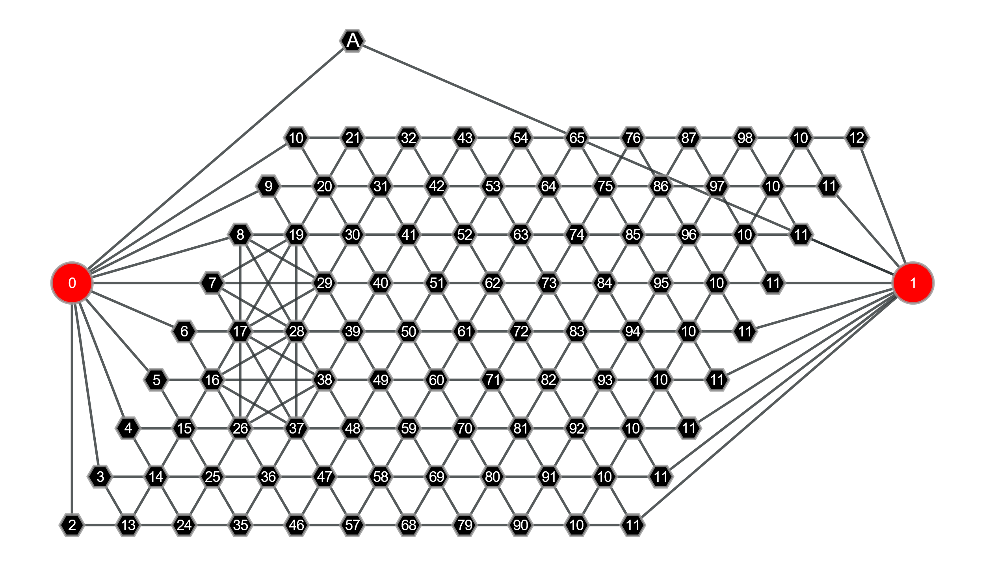
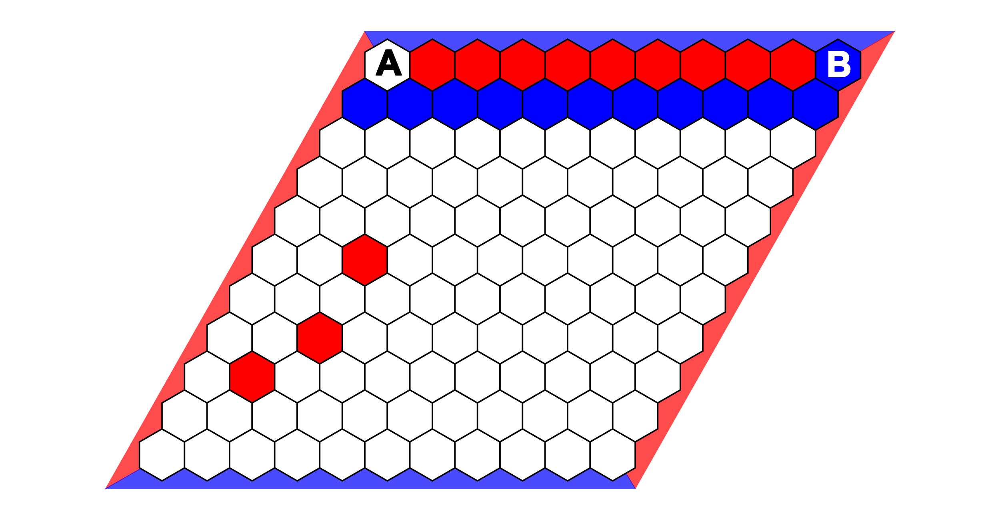
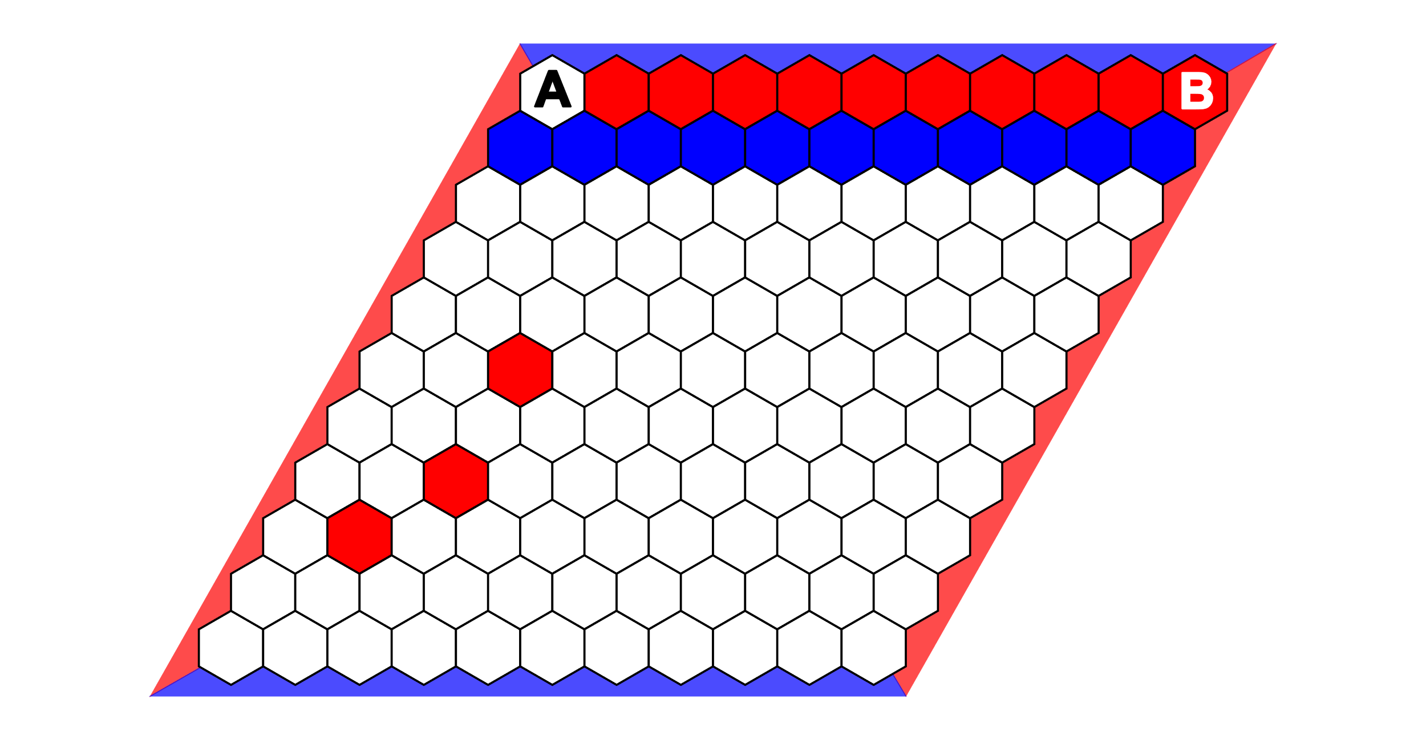
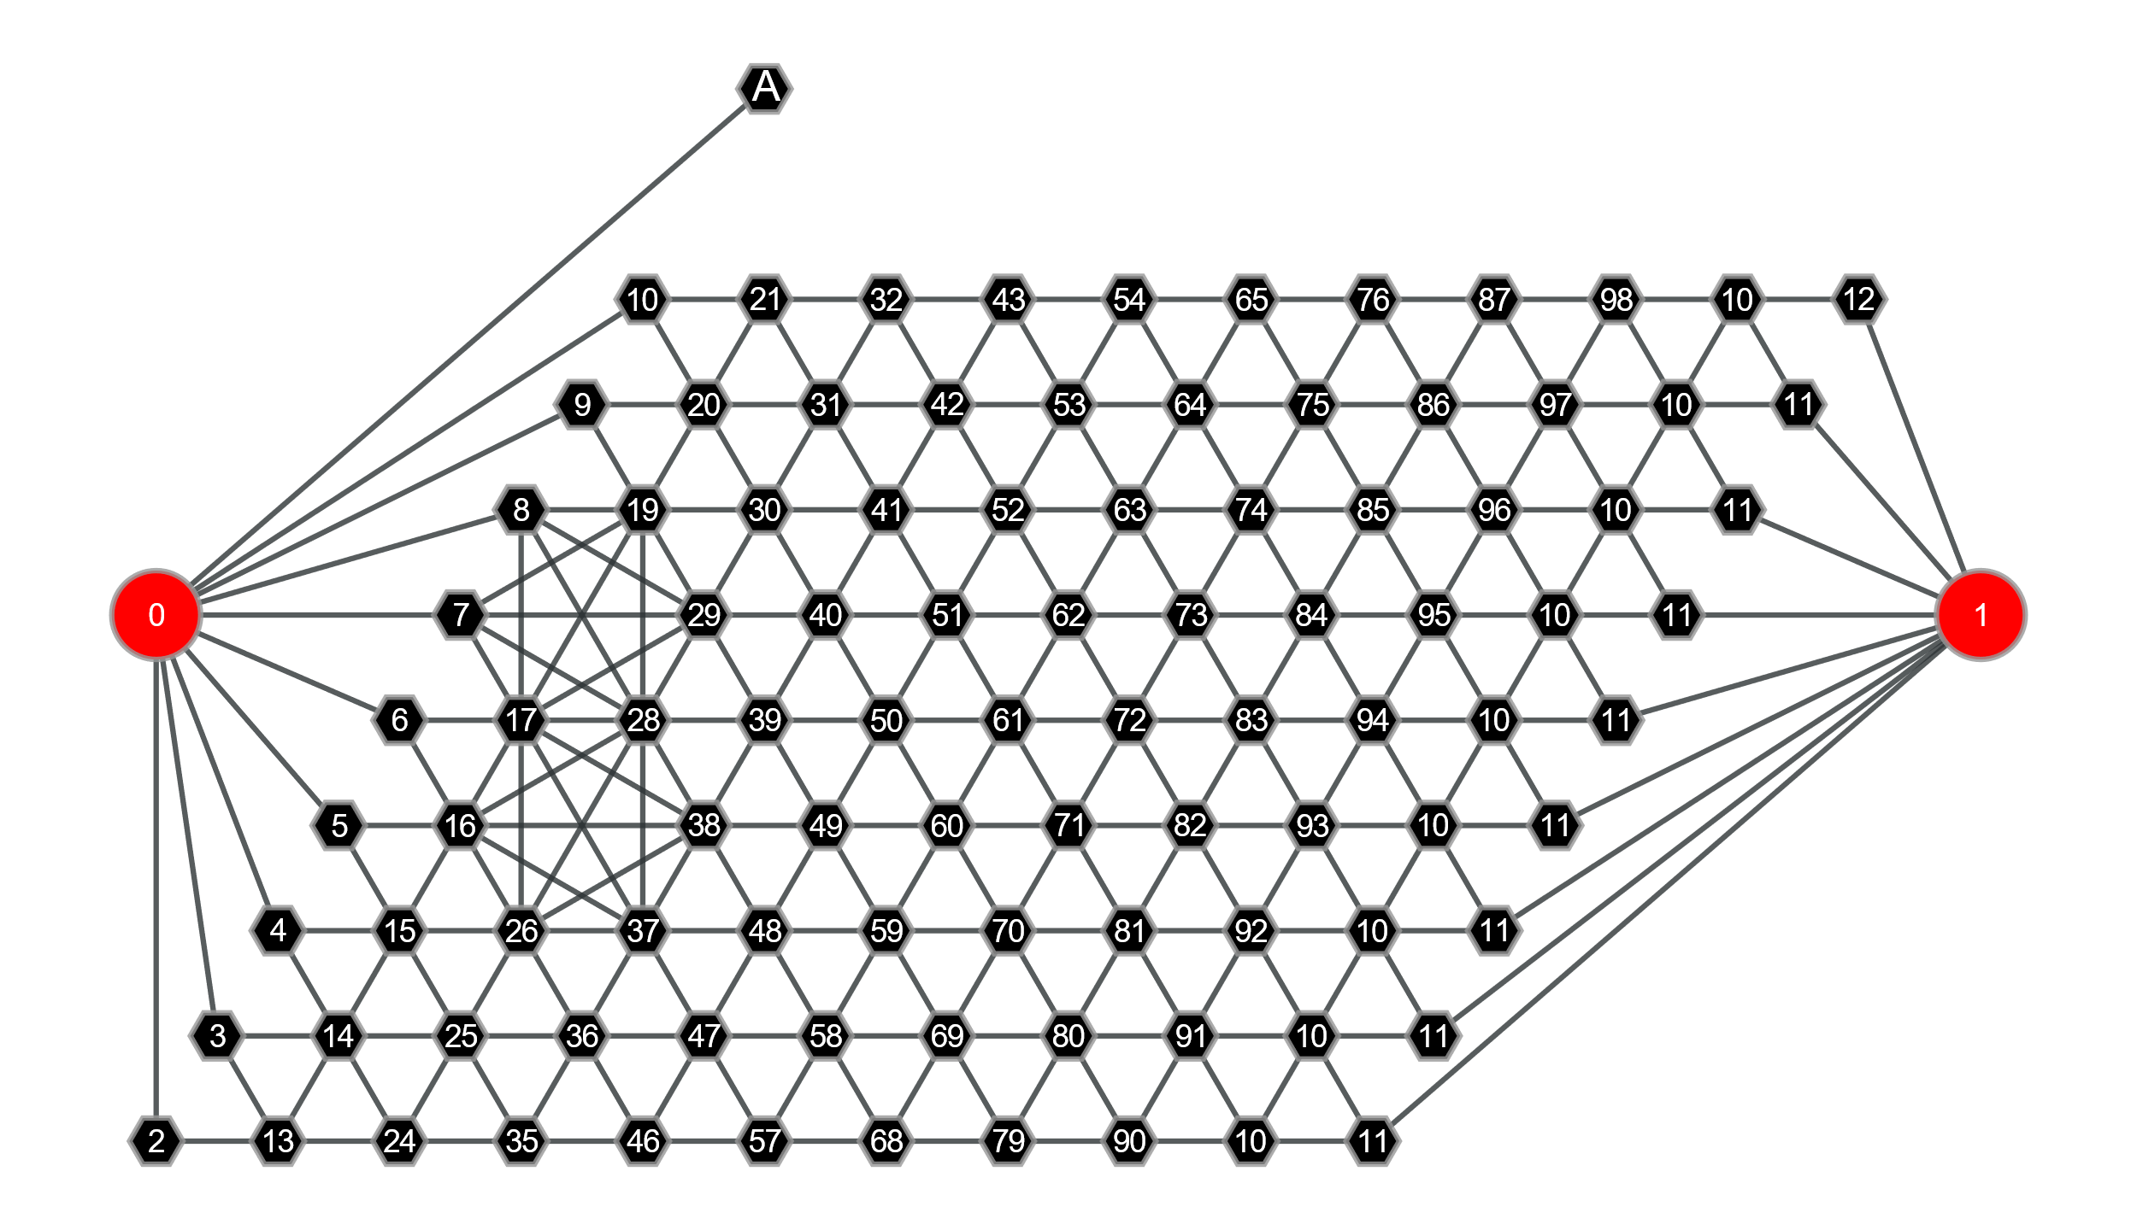
Grid
VS
Graph
A and B are spatially far apart, but they have a direct relation. If B is red, playing at A immediately wins for Red, while B being blue would make A irrelevant.
In the graph, we can just check if A is connected to both terminal nodes.

Slide 7
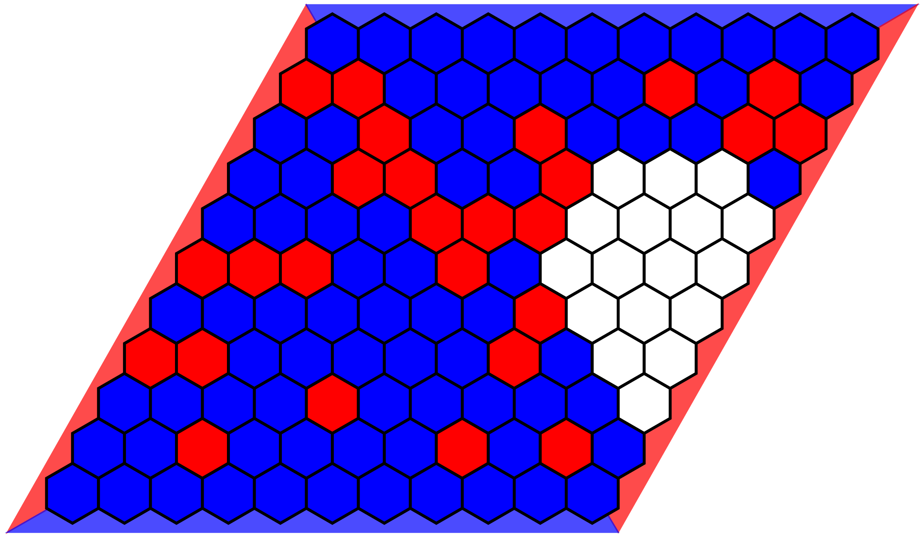
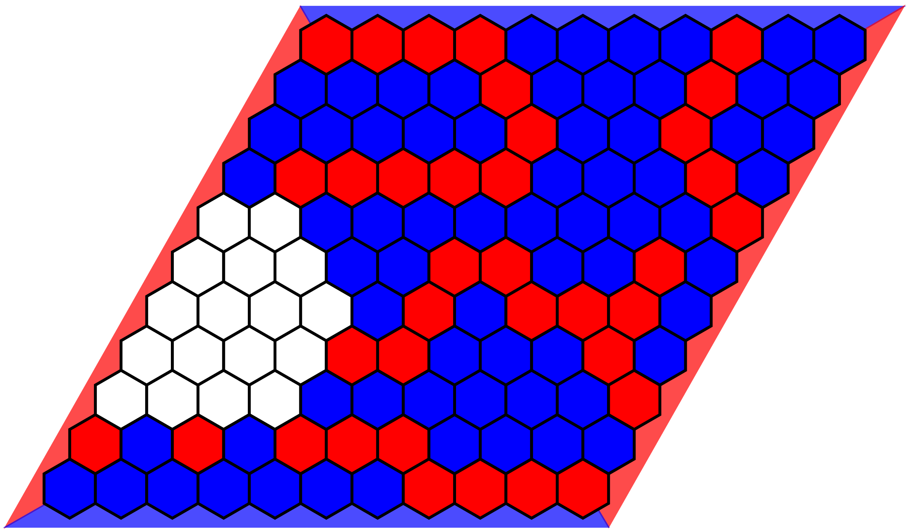
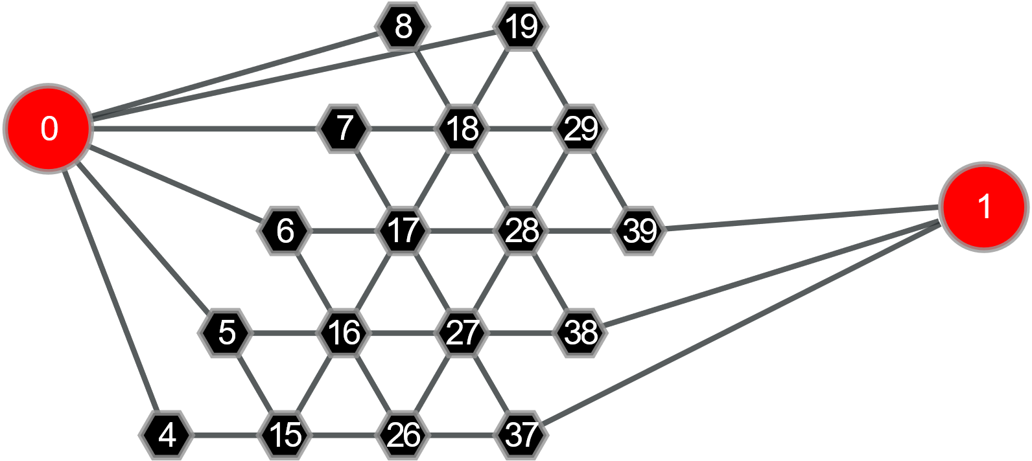
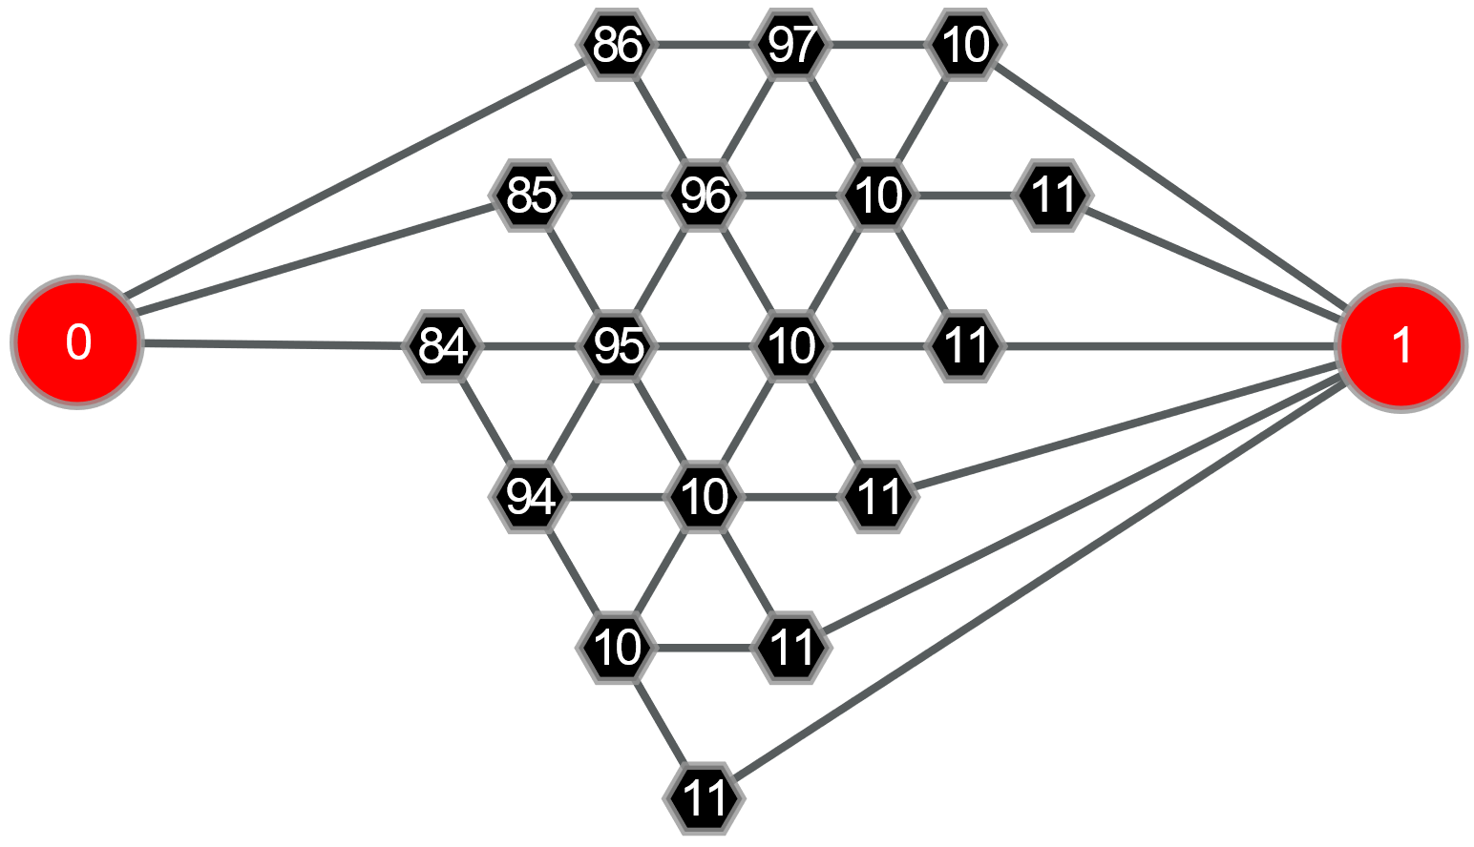
Grid
VS
Graph
Equivalent endgames may look very different in the grid representation. A CNN might output very different values/policies for left and right.
Isomorph graphs will always result in the same GNN output.

Slide 8
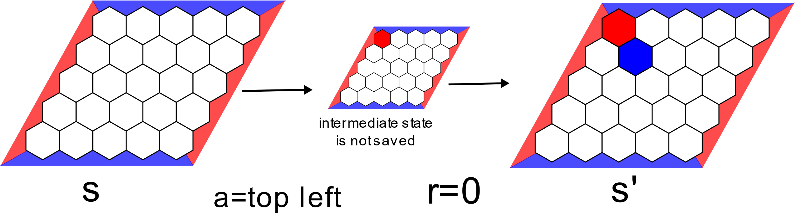
Method 1: Train GNN with RainbowDQN
DQN adapted to self-play: Treat opponents move as part of the environment.
Agent plays games against itself using epsilon greedy policy and collects samples state, action, next state when it is the same players turn, reward (-1 or 1 at the end of the game).
Rainbow features: Duelling Double DQN with 2-step returns and prioritized replay buffer
Collecting a one-step state, action, reward, state (s,a,r,s’) tuple during self-play

Slide 9
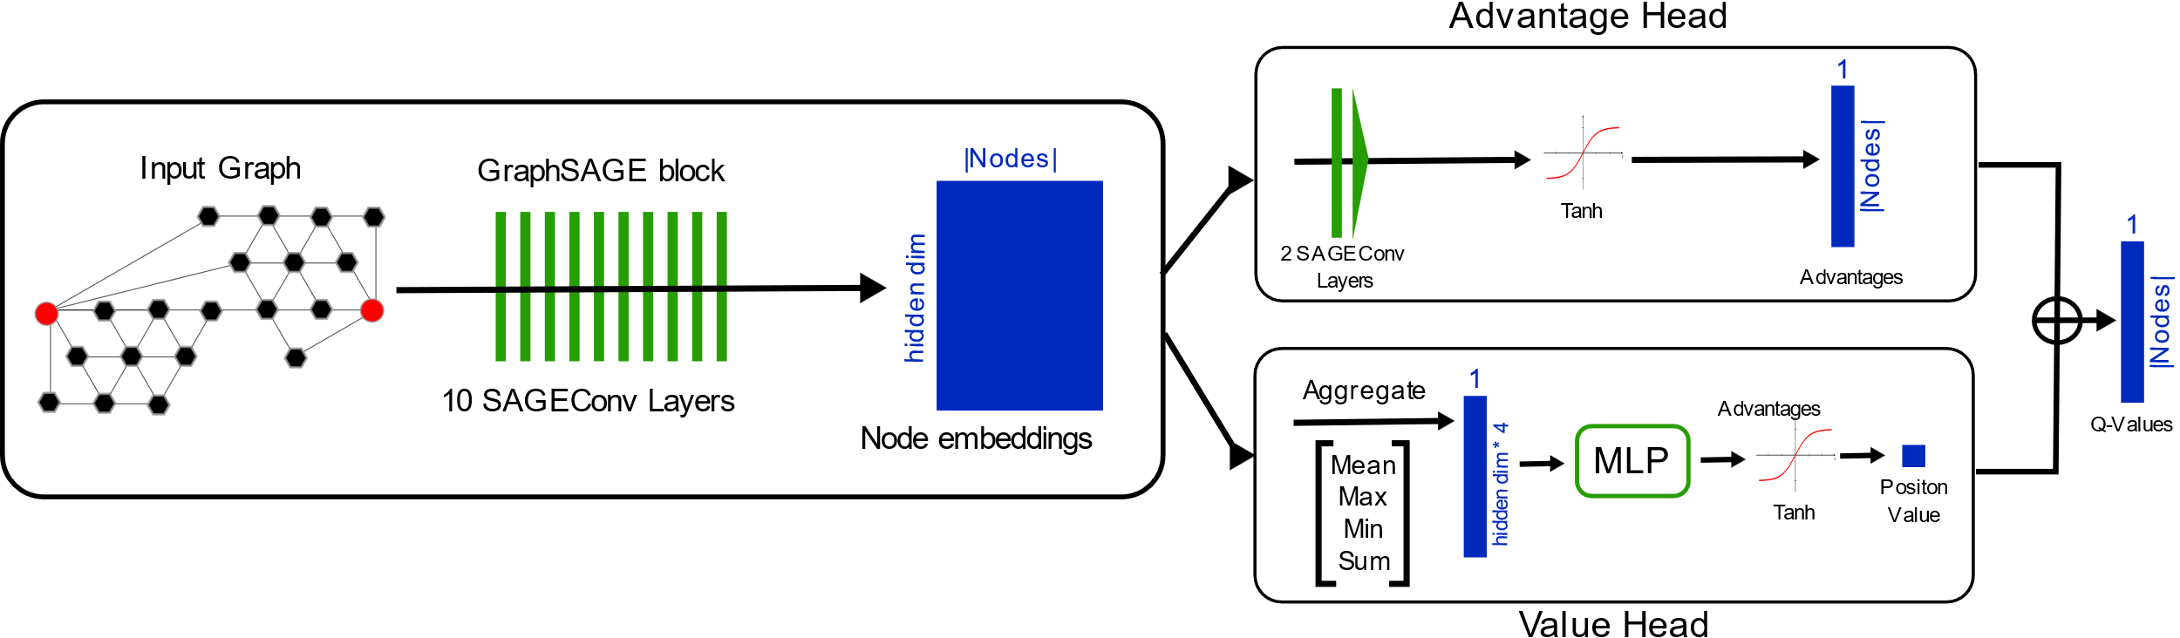

GNN architecture
GraphSAGE message passing $x_{i}^{′}=W_{i}x_{i}+W_{2}⋅{\text{mean}}_{j∈N\left(i\right)}x_{j}$
Duelling architecture, one head for advantage, one for value

Slide 10
Train on small, learn about large
GNNs can by design handle input graphs of any size.
This makes transfer of knowledge learned on a smaller board to a larger board much easier than with CNNs, which require a fixed input size.
I start training on small boards and then jointly grow the size of the Hex board and the number of SAGEConv layers / hidden dimension in my GNN

Slide 11
Some RainbowDQN results

Slide 12
Method 2: Adapt CrazyAra
I created a C++ Hex Graph environment and adapted the CrazyAra C++ implementation to work with Hex Graphs and Graph Neural Networks
I generate training samples using the MCTS-search from the adapted CrazyAra binary
I run multiple self-play games in parallel for large batch neural network inputs in MCTS and use multiprocessing
Training is handled by another process with another GPU in pure python
GNN architecture is similar to RainbowDQN, but now with a policy head with softmax activation in the end.

Slide 13
Status of CrazyAra approach
I had some success training GNNs for 5x5 and 7x7 Hex. However, as the generation of each training sample requires a whole MCTS, it takes longer to get to a reasonable result than with RainbowDQN.
Currently in somewhat of a buggy state. Working on it …

Slide 14
Future direction
There is a lot of things still worth trying I think, however my thesis submission date is in two months …
What I definitely still want to do during my Thesis:
Get CrazyAra approach working again and run some experiments on DGX
Investigate / quantify transfer from smaller boards to larger boards with GNNs
Do an as fair as possible comparison between GNNs and CNNs in self-play RL.
Other things that would be nice to do
Try other GNN architectures. GraphSAGE likely is not the absolute best
Hex Graphs are actually a special case of Shannon-vertex switching graphs. How do GNNs generalize to them.
Write a paper about this and submit to a peer reviewed journal / conference.

