Slide 2
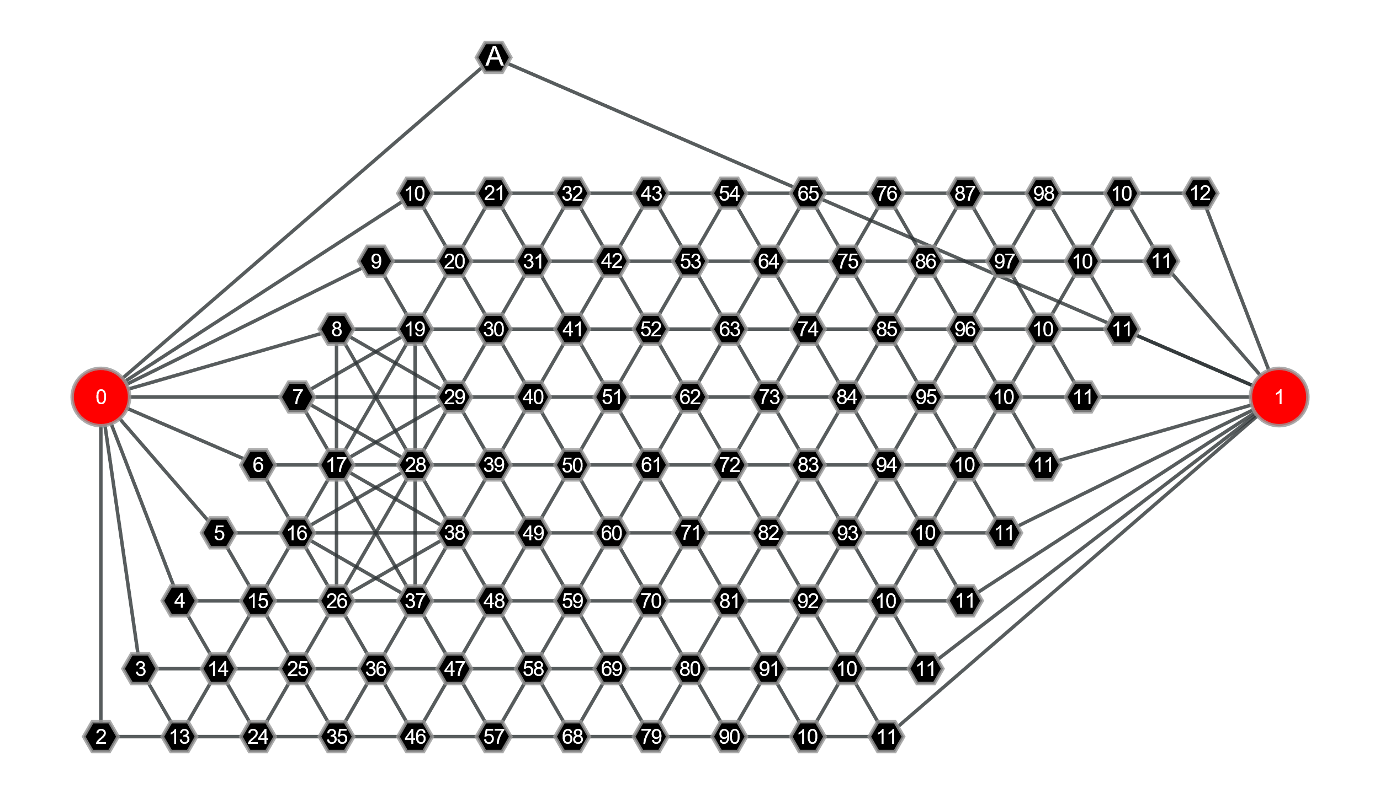
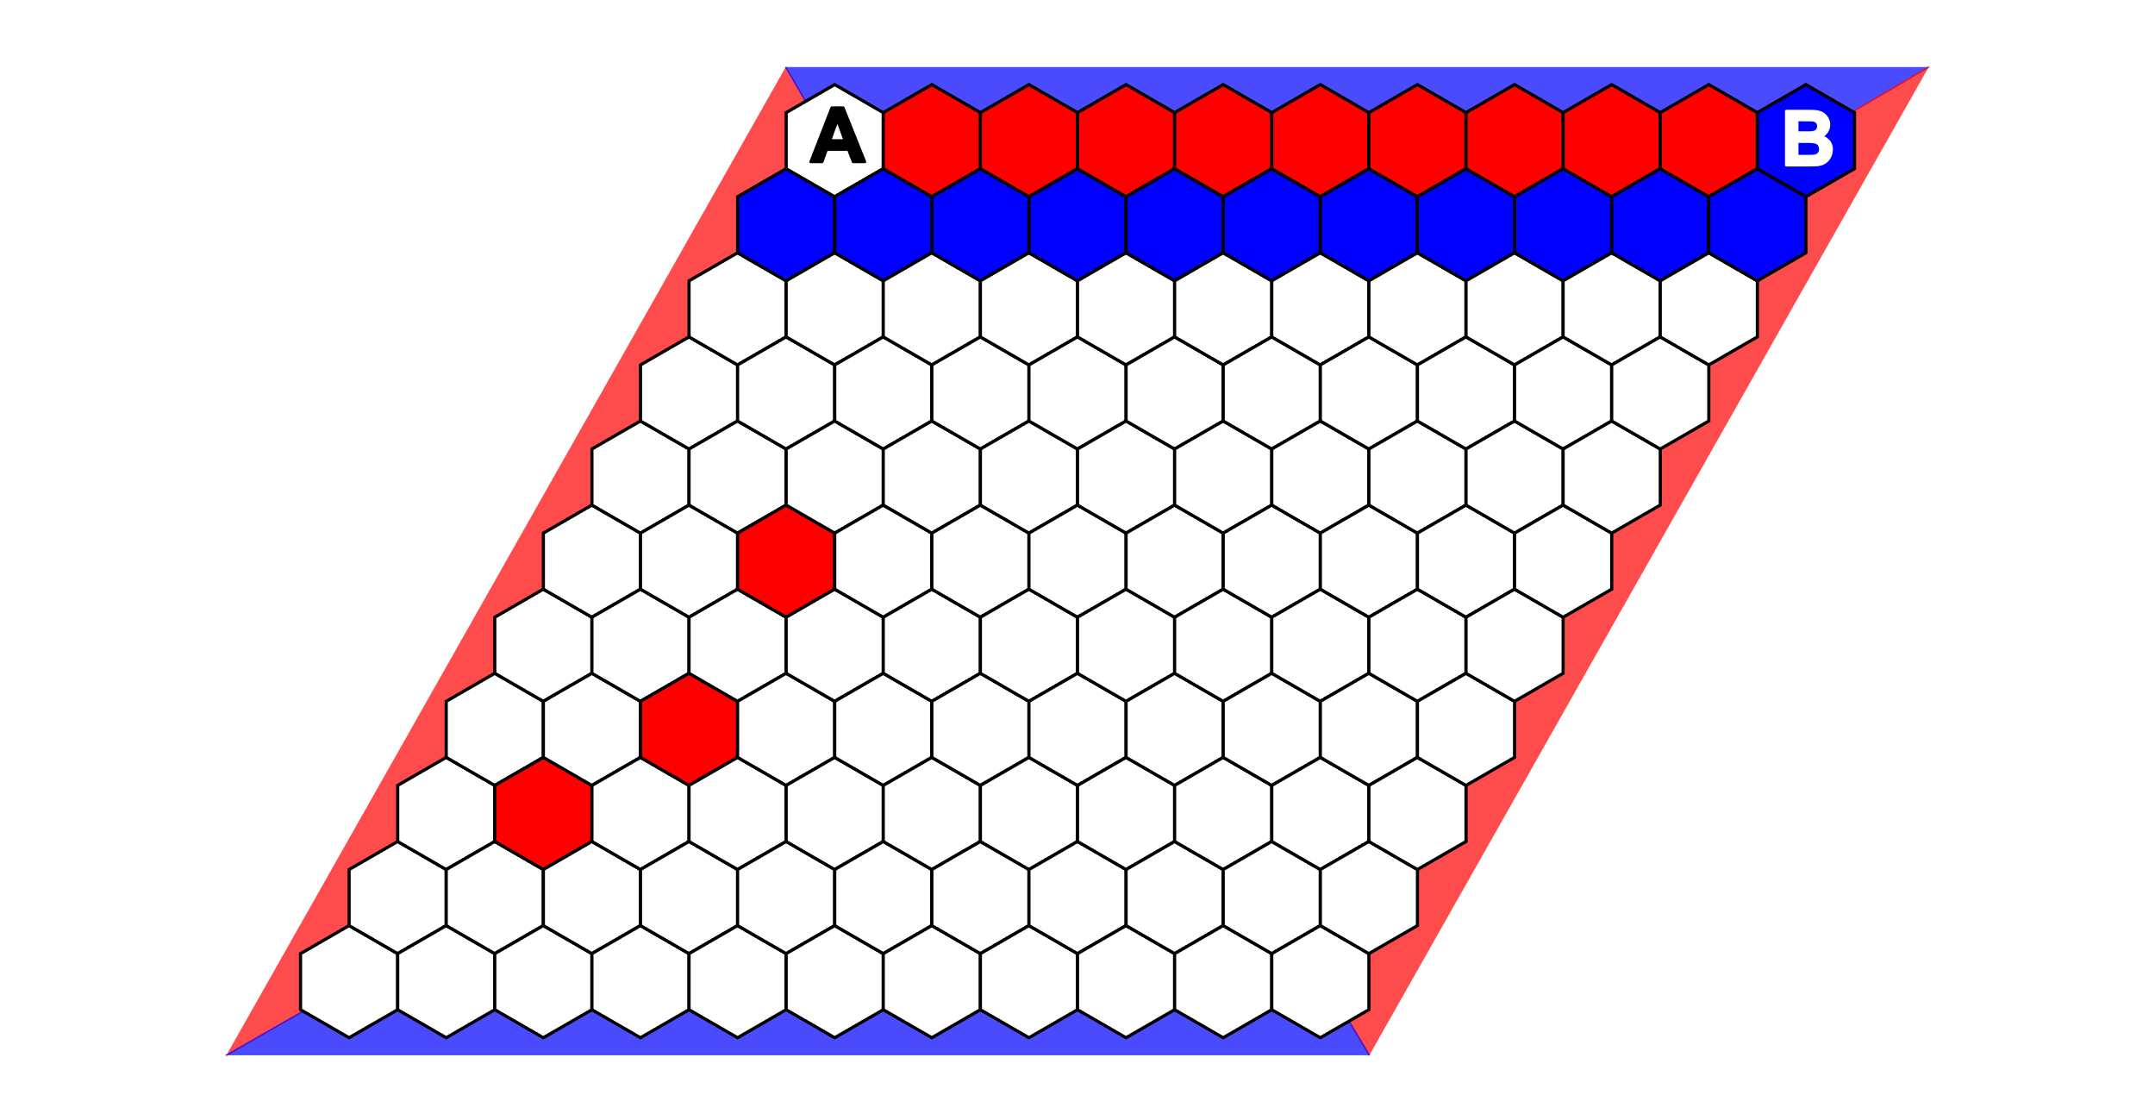
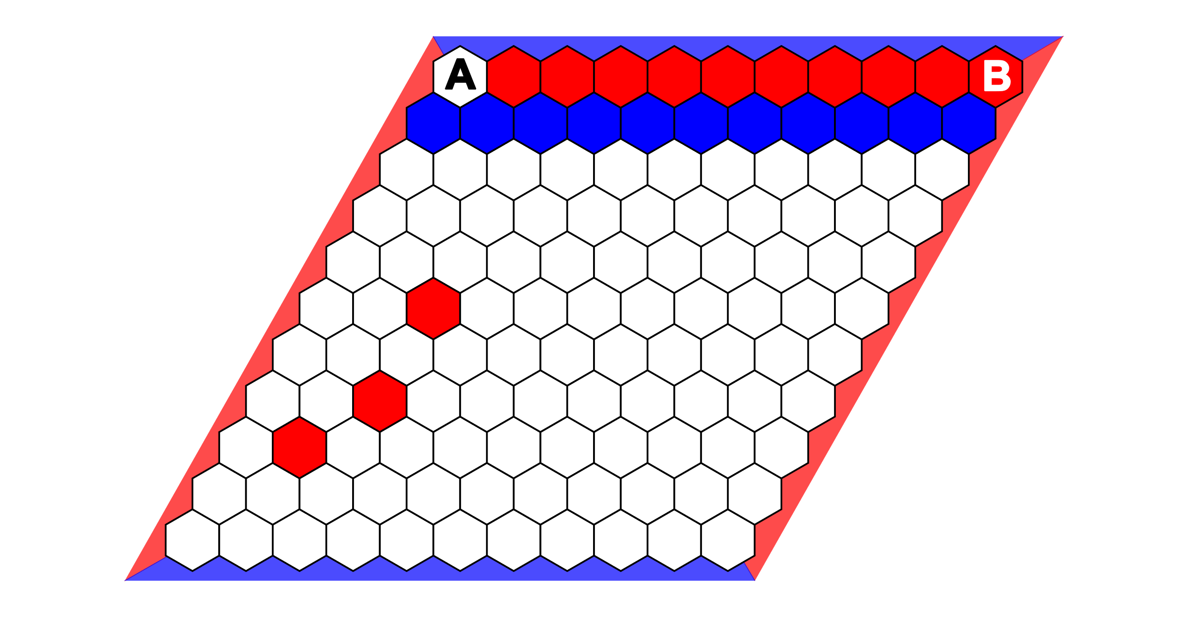
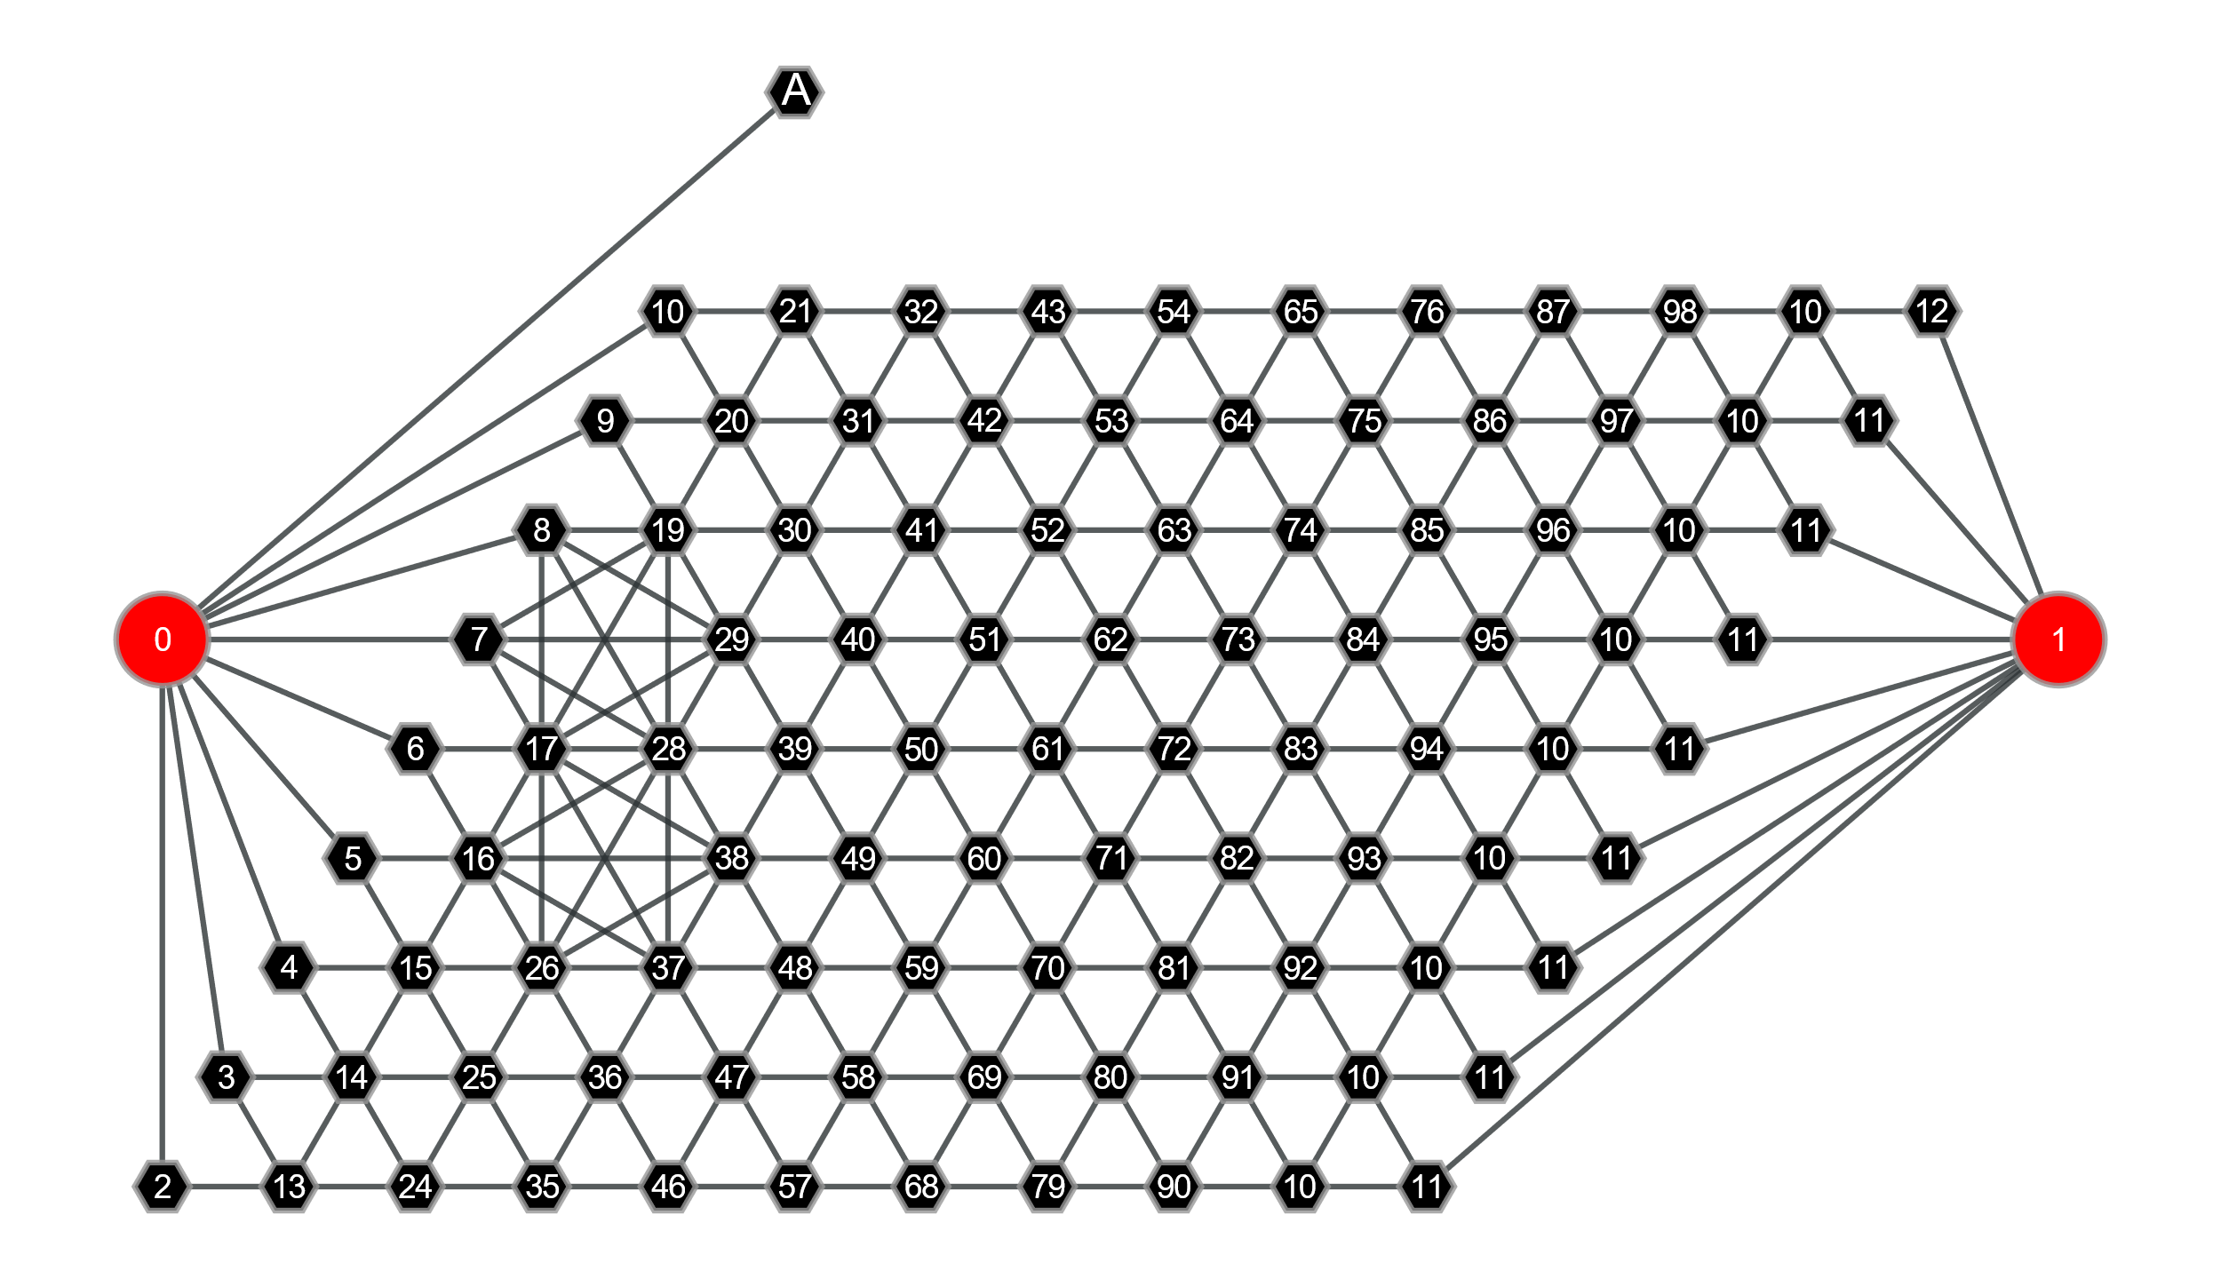
GNN
CNN
VS
Damn, I have to propagate information all the way from B to A through convolutional layers to understand if I should play at A.
This might work if I am large and trained long enough, but I am biases towards detecting local correlation.
Too easy, I just have to check if node A is connected to one or both terminal nodes -> Single propagation step.

Slide 3
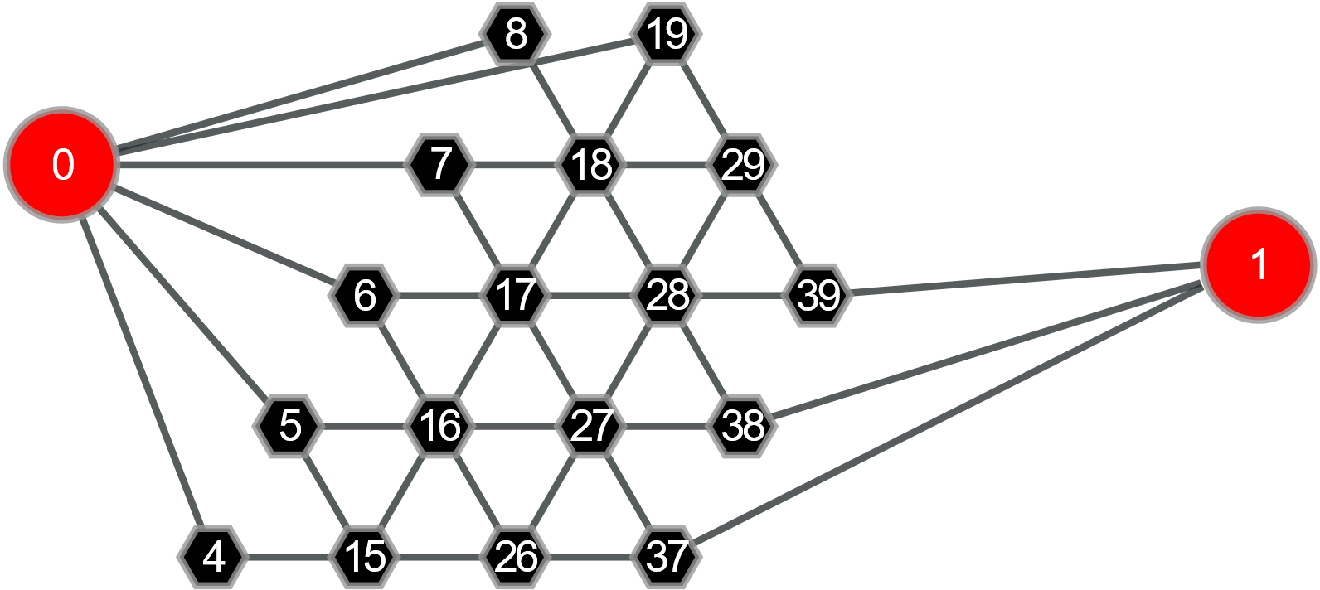
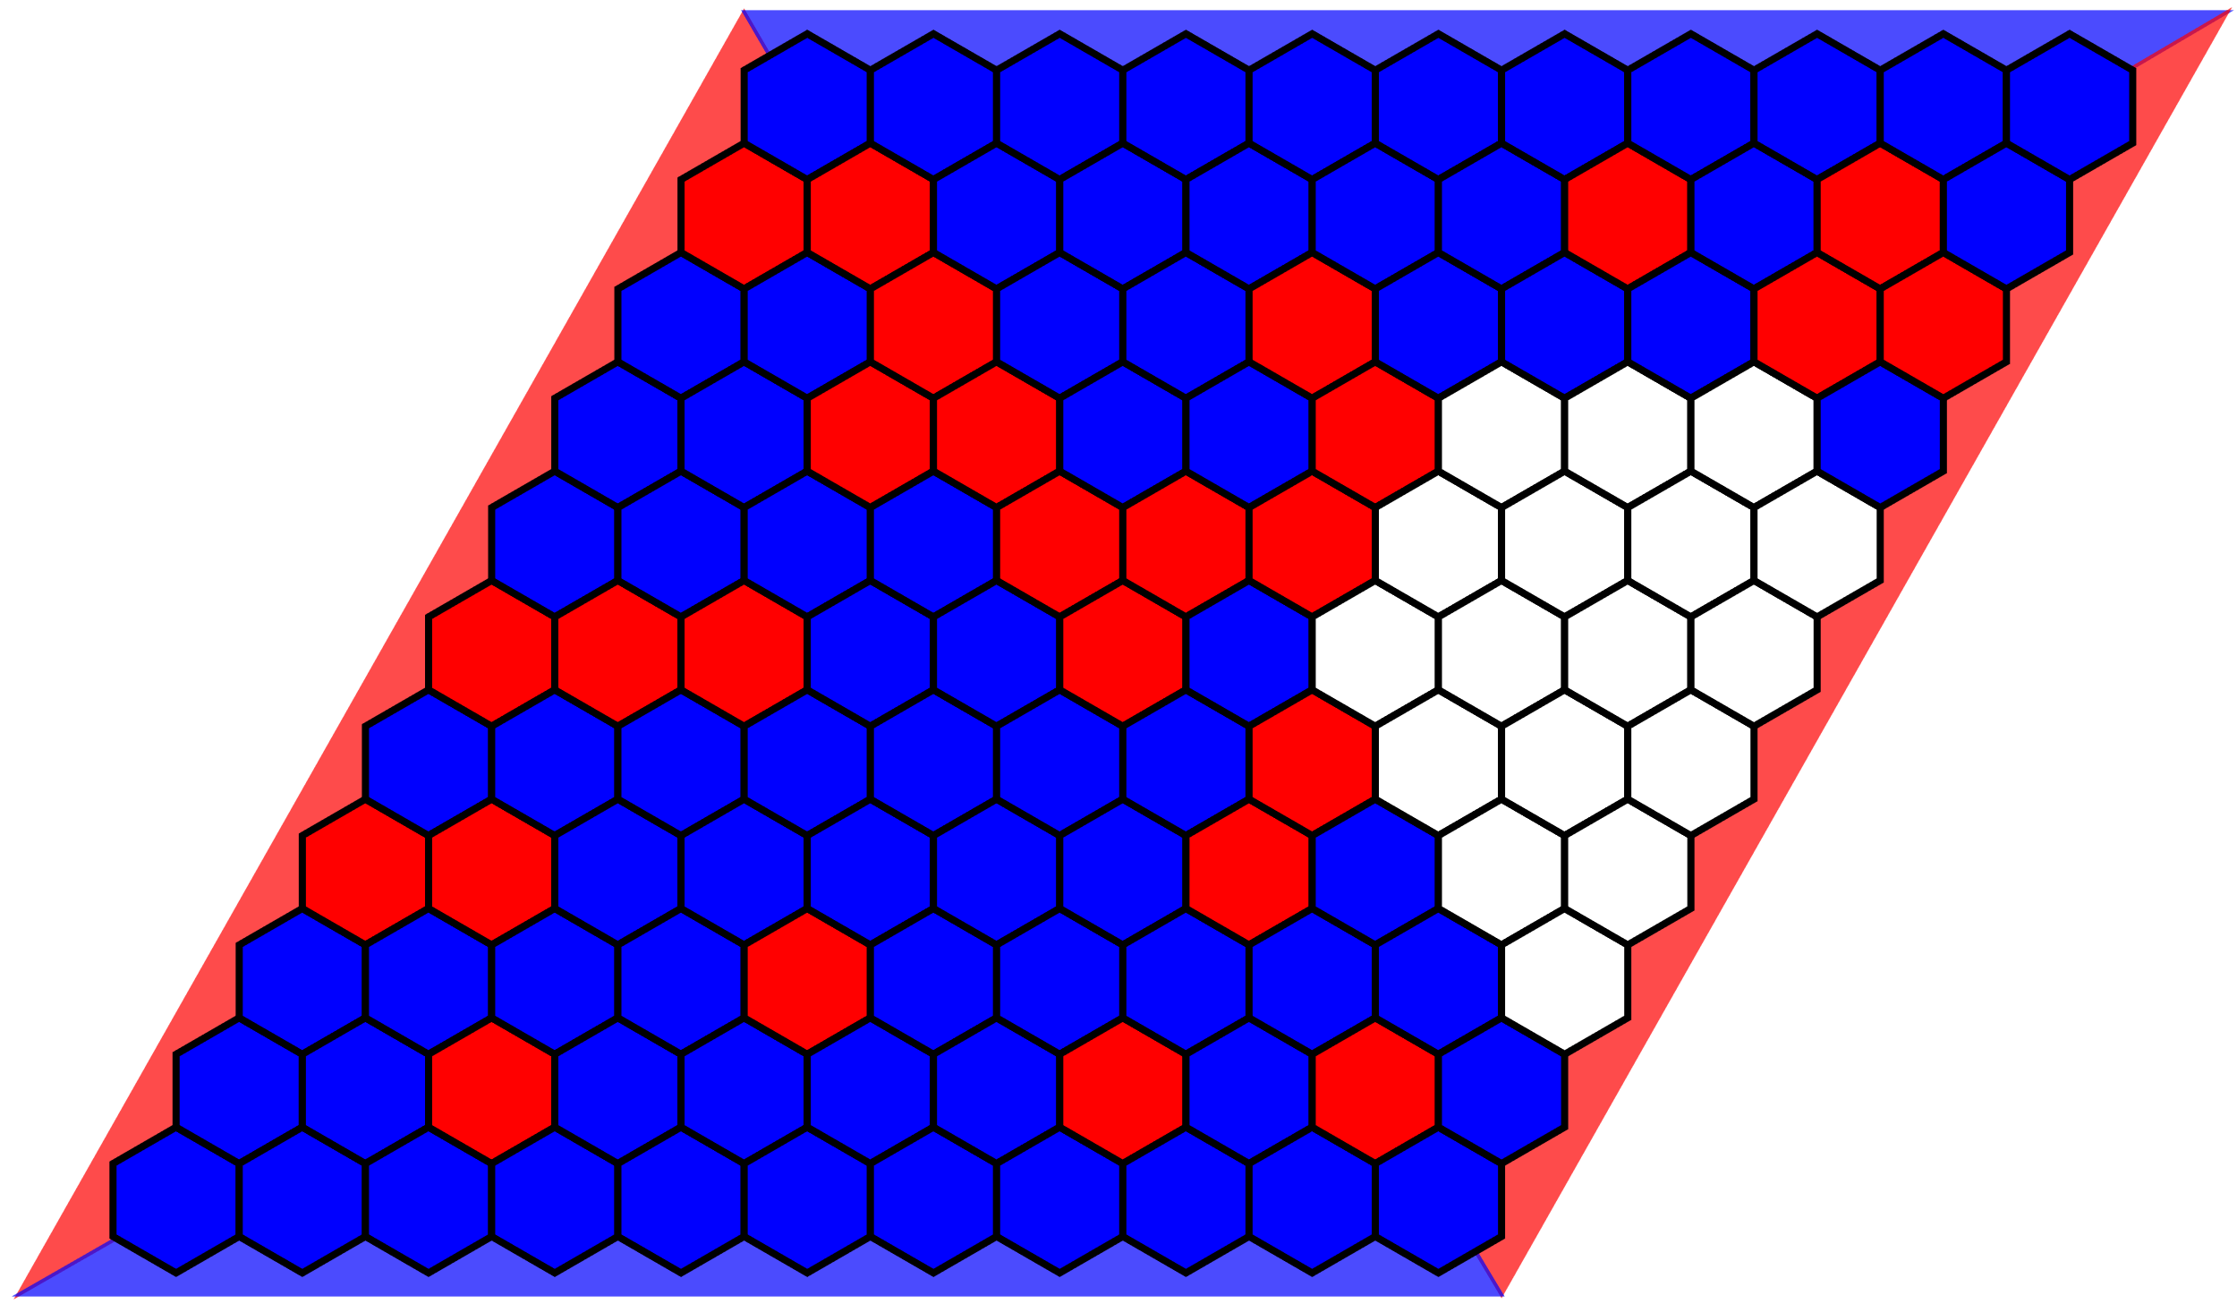
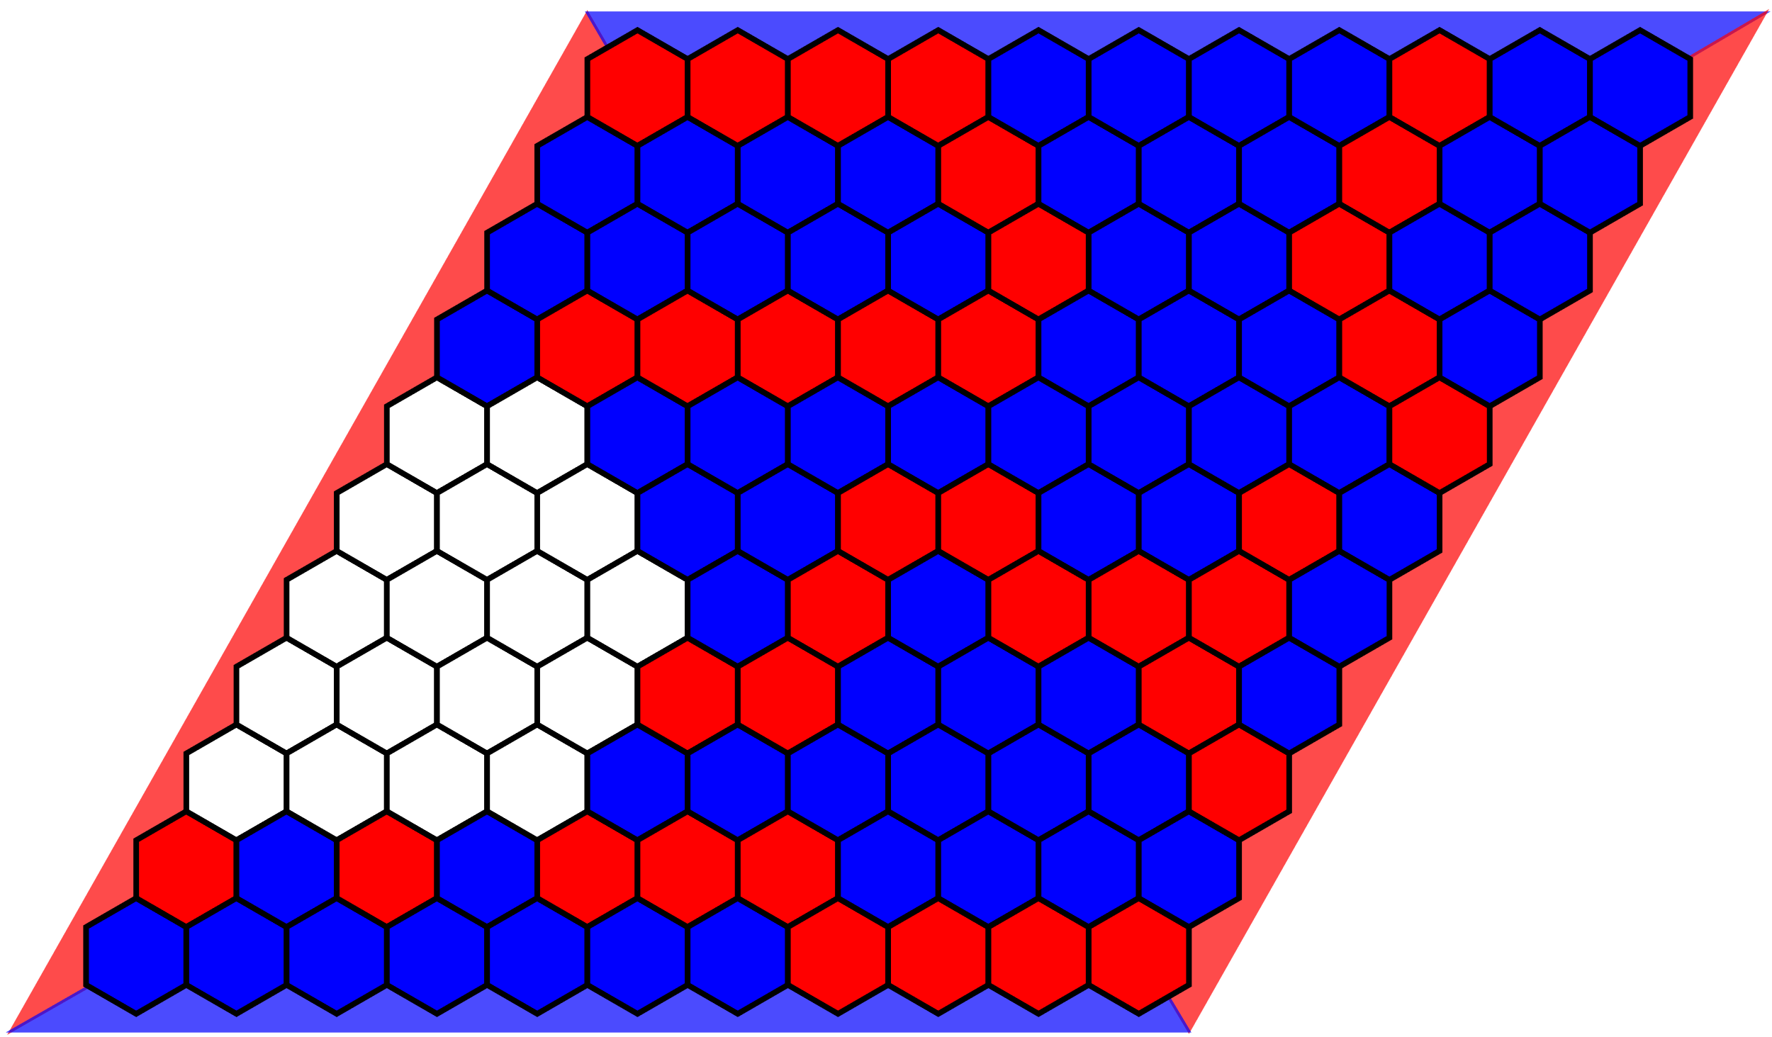
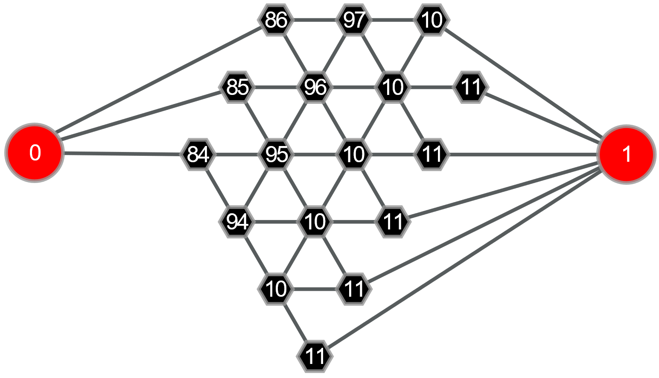
GNN
CNN
VS
I’ve seen the left endgame during training, however, the right one looks very different. While I am certain about the best move in the position on the left, I don’t know what to do on the right.
Easy: These two endgame graphs are isomorphic. So when I learn to play the left one perfectly, I automatically know how to play the right one.

