Slide 1
Introduction
Problem Statement:
Use transactional data to develop models that predict which products a user will buy again
Dataset Information:
The dataset consists of a relational set of files describing customers' orders over time.
The goal is to predict which products will be in a user's next order.
The dataset is anonymized and contains a sample of over 3 million grocery orders from more than 200,000 Instacart users.

Slide 2
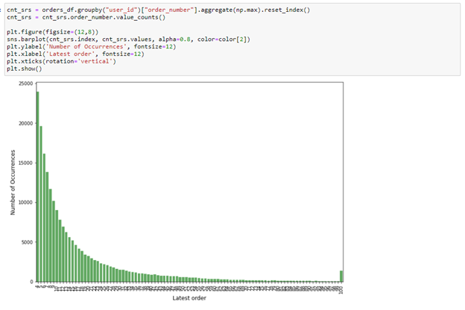
Exploratory Data Analysis (EDA)
We can clearly see based on the latest order that most orders are small and large orders are less frequent, which makes the job of predicting slightly easy for the most part.
Latest Order vs Occurrence

Slide 3
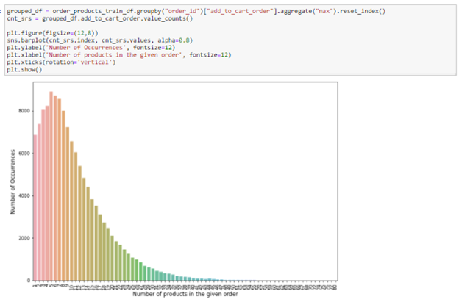
Exploratory Data Analysis (EDA)
Overall size of an order and the number of products in each order are shown above, we can see that the most frequent size of the order is between 3-10 items per order.
No. of Products vs Occurrence

Slide 4
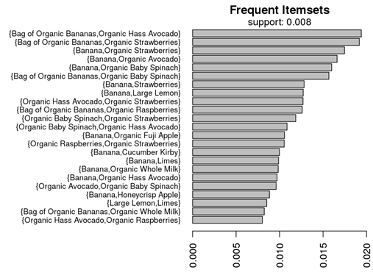
Exploratory Data Analysis (EDA)
We can use this information to train the model based on the popularity of the items being ordered to improve the performance.
Frequently Ordered Items

Slide 5
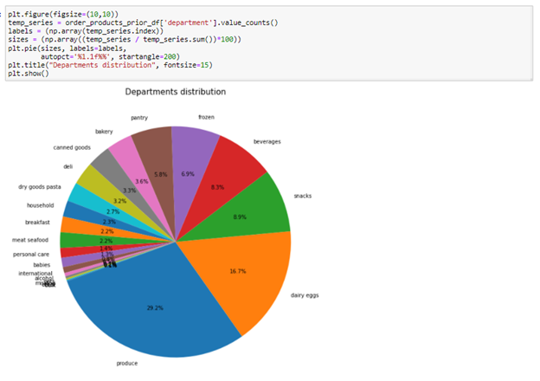
Exploratory Data Analysis (EDA)
The most popular products by department are shown above and we can see that FMCG items dominate the chart with more than two thirds of the ordered quantity.
Department wise popularity of products

Slide 6
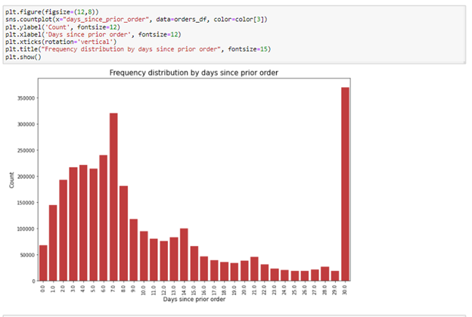
Exploratory Data Analysis (EDA)
We can figure out the frequency of orders by customers. But caution has to be advised as this column has missing values, also all the orders made past the 30 day mark are being shown along with the orders made on the 30 day mark.
Days since previous order

Slide 7
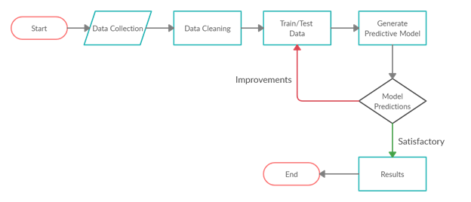
Methodology
Architecture

Slide 8
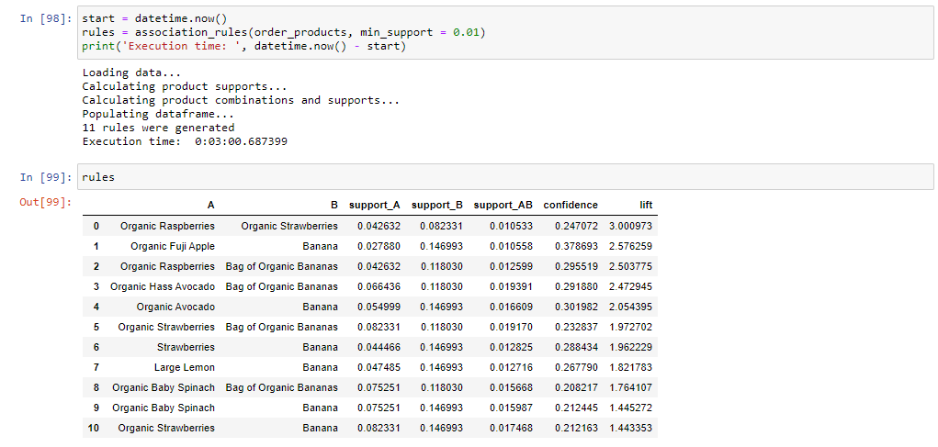
Modeling Results (Association Rules Mining)
Final snapshot of Association Rules

Slide 9
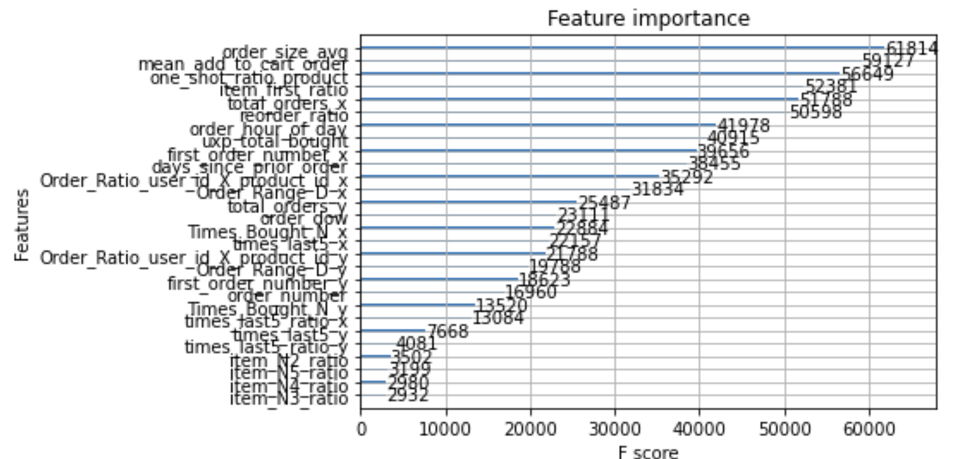
Modeling Results (XGBoost)
Features

Slide 10
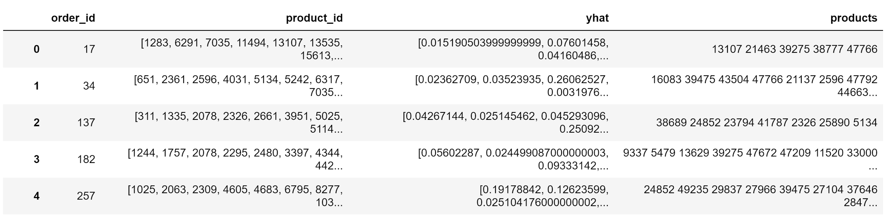
Modeling Results (XGBoost)
Snapshot of final predictions of products

Slide 11
References
1) https://www.kaggle.com/c/instacart-market-basket-analysis/data
2) https://towardsdatascience.com/a-gentle-introduction-on-market-basket-analysis-association-rules-fa4b986a40ce
3) http://dataanalyticsedge.com/2019/11/23/xgboost-using-python/
4) https://towardsdatascience.com/exploratory-data-analysis-8fc1cb20fd15
5) https://machinelearningmastery.com/evaluate-gradient-boosting-models-xgboost-python/
6) https://www.kaggle.com/kokovidis/ml-instacart-f1-0-38-part-two-xgboost-f1-max
7) https://steelkiwi.com/blog/python-for-ai-and-machine-learning/#:~:text=Python%20
8) https://towardsdatascience.com/association-rule-mining-be4122fc1793

Slide 12

Thank You

