Slide 1
Churn phenomenon analysis for telco sector and target retention commercial campaign proposal
24 December 2018
Team members:
Arreza Elton
Demyanenko Elizaveta
Kniaginin Aleksandr
Todorovic Nemanja

Slide 2
Introduction
Companies operating in telco, insurance or banking sector are often interested in knowing who of the customers will leave the company soon (churn), so they can try and prevent it, given that their business models are directly related to the number of active users/subscribers.
Customer churn is the loss of customers or clients. Churn analysis is conducted because of the underlying assumption that acquiring a new customer is more costly than retaining an old one. We will try to analyze given Telco data to understand its client base.
We can distinguish between two different churn types: involuntary and voluntary. Involuntary churn occurs when the client is forced to stop a relationship due to relocation, sickness, death, or similar circumstances. Voluntary churn happens when the client could continue to use the company's services, but it decides to stop. The analysis should focus only on voluntary churn as this type can be addressed by the company's policies.

Slide 3
First look at the data
Variable names | Possible answers
'customerID' | Combination of numbers and letters
'gender' | Female/male
'SeniorCitizen' | 1/0
'Partner', 'Dependents', 'PhoneService', 'PaperlessBilling', 'Churn' | Yes/no
'tenure', 'MonthlyCharges', 'TotalCharges' | Quantitative variables
'MultipleLines' | Yes/no/no phone service
'InternetService' | DSL/fiber optic/no
'OnlineSecurity', 'OnlineBackup', 'DeviceProtection', 'TechSupport', 'StreamingTV', 'StreamingMovies' | Yes/no/no internet service
'Contract' | Month-to-month/one year/two years
'PaymentMethod' | Electronic check/mailed check/bank transfer (automatic)/credit card (automatic)
21 variables: 3 quantitative, 17 categorical, and 1 ID variable
Heterogenic data

Slide 4
Data preparation (1)
Since 'customerID' data points are unique combination of numbers and letters, they do not convey useful information for further analysis, therefore we delete its column.
'TotalCharges' has string values, even though 'TotalCharges' is a numerical variable. This may be due to the presence of missing values that are not encoded as numbers. We deleted observations containing missing values, which represents 11 data points (out of 7,043 starting data points; 0.16%).

Slide 5
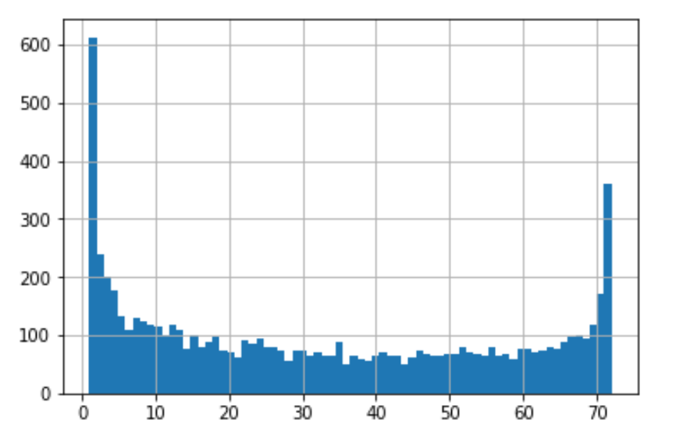
Data preparation (2)
Distribution of variable ‘tenure’ varies between 1 and 72 months, having modes at the borders of the interval.
The mode at 1 month is predictable since a lot of customers will churn soon after their first involvement. However, the mode at 72 months (3 years) might take place only because of the data collection process. Since we know that the company exists for more than 3 years, some of the observations with tenure equal to 72 might actually refer to the clients who have been with the company for more than 3 years. If these observations consist mostly of remaining customers, maybe it would be better to drop these observations so as not to overestimate the impact of tenure. So, we should check the quality of model with and without dropping these observations.

Slide 6
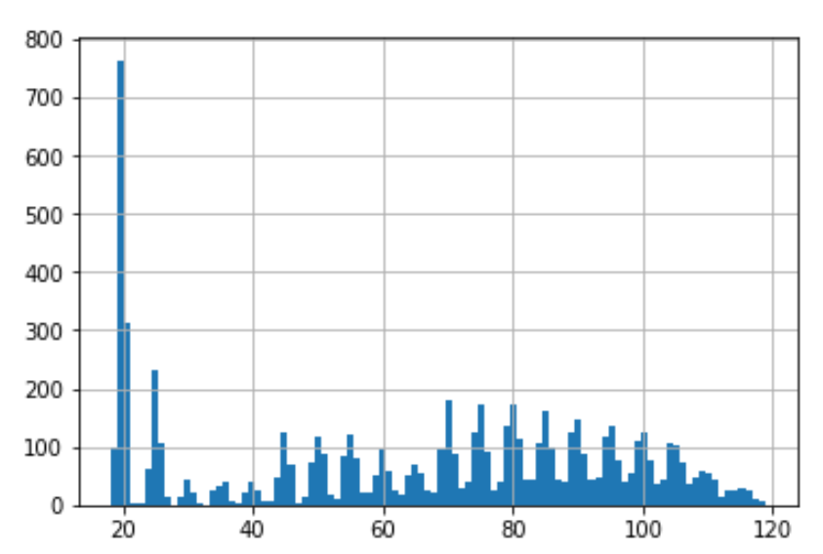
Data preparation (3)
‘MonthlyCharges’ has no outliers and has a mode in the area of 20.

Slide 7
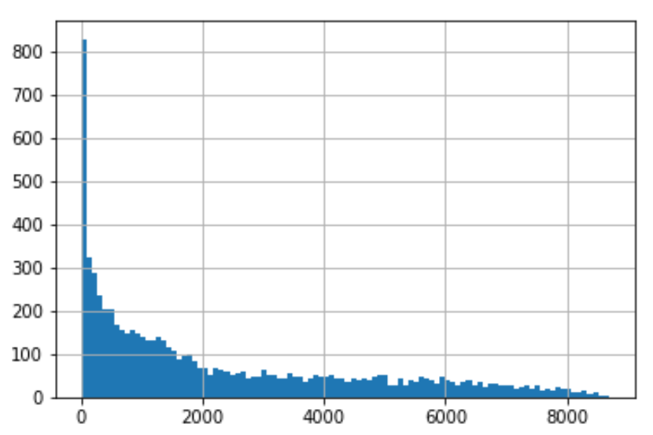
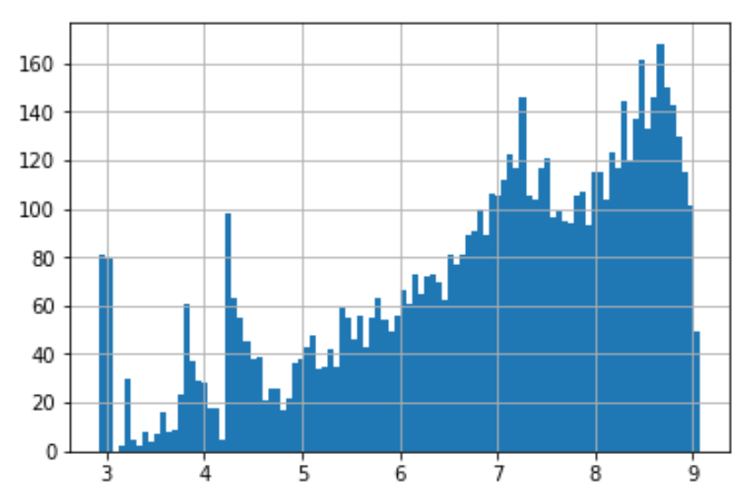
Data preparation (4)
Before:
Variable ‘TotalCharges’ is significantly skewed
Peak on the left looks very thin so that it looks like the mode includes only one value which occurs more than 800 times. However, this is not the case. Actual modal value occurs only a few times, which indicates that our distribution here has an exponential form.
We apply the logarithmic transformation to capture the effect of relative rather than absolute increase in the variable which is more reasonable when the density of values decreases rapidly with respect to their size, furthermore the model quality after transformation gets better.
After logarithmic transformation:

Slide 8
Data preparation (5)
The last step is the transformation of categorical variables into dummy variables.
All data manipulation has yielded dataset containing 7032 observations and and 26 variables (increase in absolute number of columns is due to introducing dummy variables and some of the categorical variables contained several different answers which needed to be codified).

Slide 9
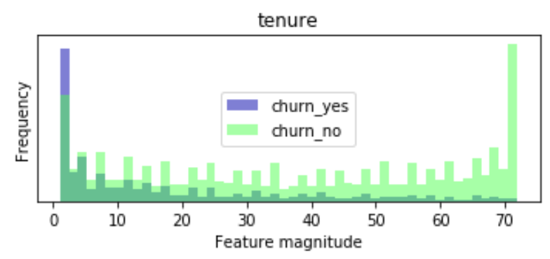
Using conditional graphs to understand the data (1)
Lower and darker part of each column represents the clients who churned, while the upper and light green portion represents the ones who stayed with the company.
→ Clients with lower tenure churn much more than the clients with higher tenure.

Slide 10
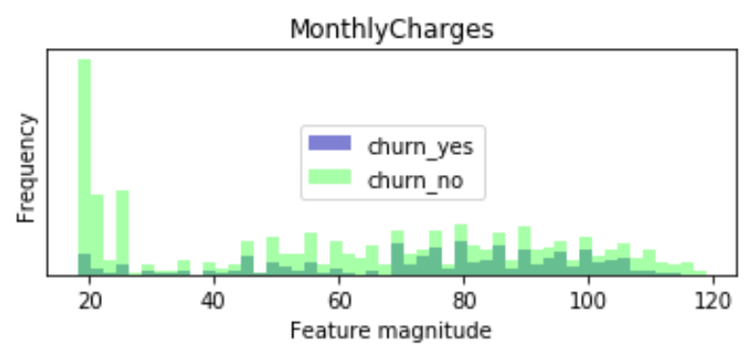
Using conditional graphs to understand the data (2)
Lower and darker part of each column represents the clients who have churned, while the upper and light green portion represents the ones who stayed with the company.
→ Clients who pay in between 70 and 110 churn more often than the clients outside this range.

Slide 11
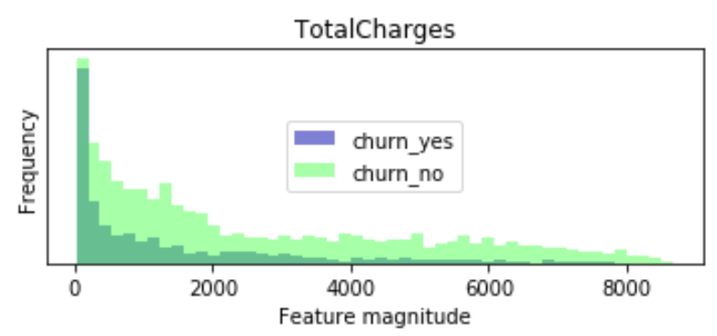
Using conditional graphs to understand the data (3)
Lower and darker part of each column represents the clients who have churned, while the upper and light green portion represents the ones who stayed with the company.
→ Clients who paid higher total charges churn less than the clients who paid lower total charges.

Slide 12
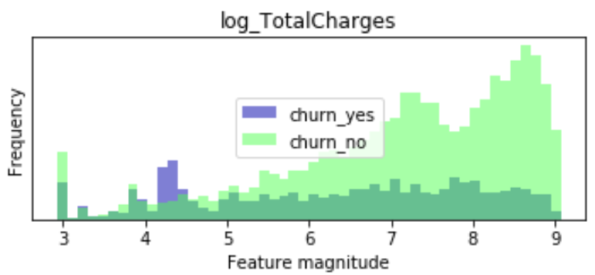
Using conditional graphs to understand the data (4)
Lower and darker part of each column represents the clients who have churned, while the upper and light green portion represents the ones who stayed with the company.
→ Clients who have lower values of log(TotalCharges) churn more than the clients who have higher respective values.

Slide 13
Using conditional graphs to understand the data (5)
Since the following graphs represent binary variables, we can organize them in 3 groups:
Higher churn in group 1 (‘yes)
Higher churn in group 0 (‘no’)
No (or low level) differences among the respective groups

Slide 14
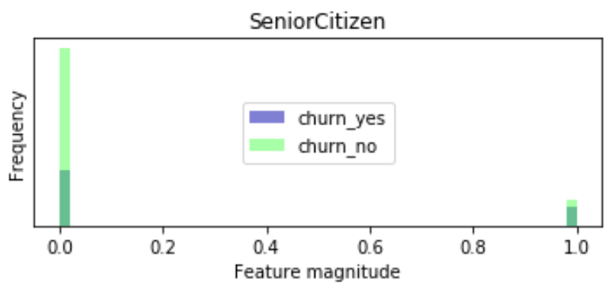
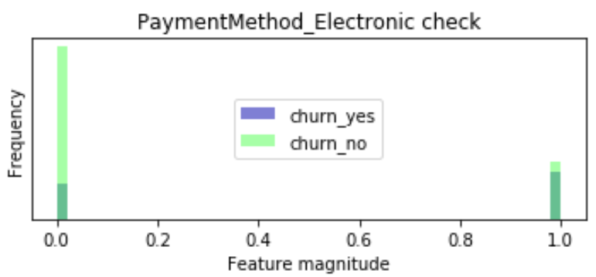
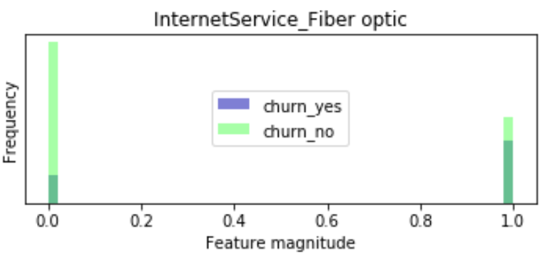
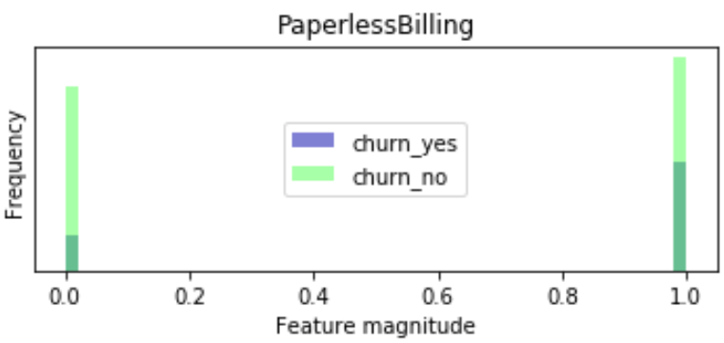
Using conditional graphs to understand the data (6)
Higher churn in group 1
→ Clients who belong to group 1 churn more often than clients in group 0.

Slide 15
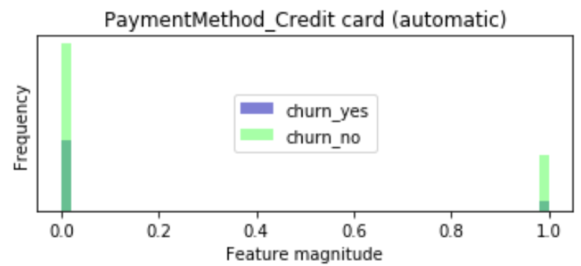
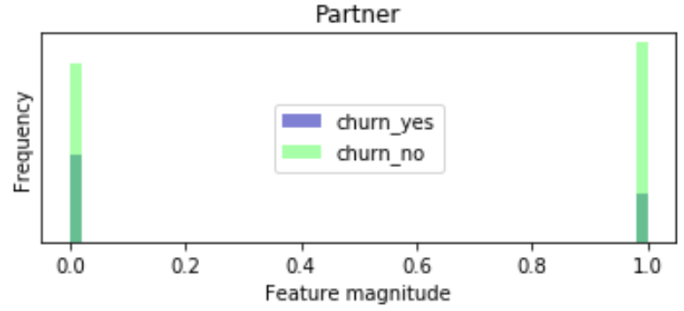
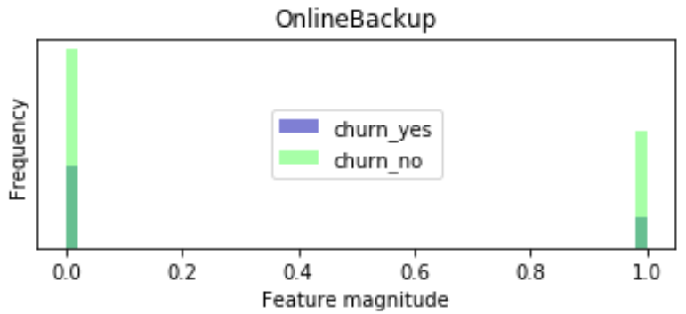
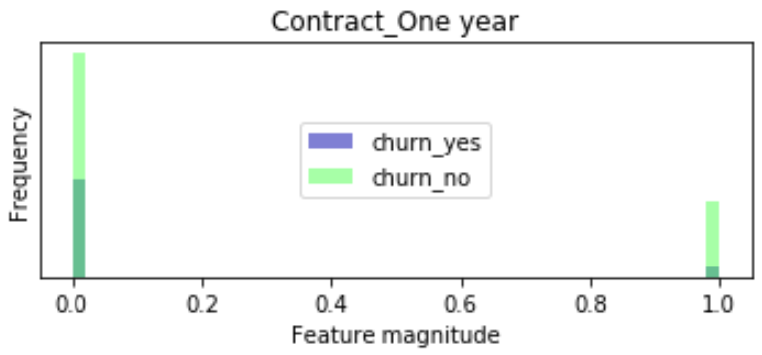
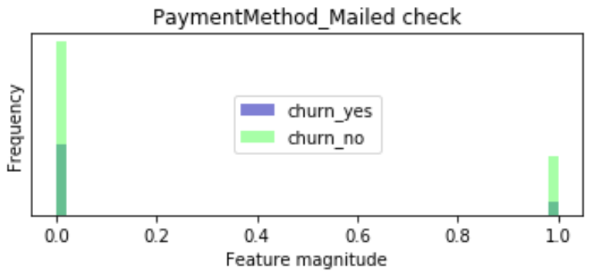
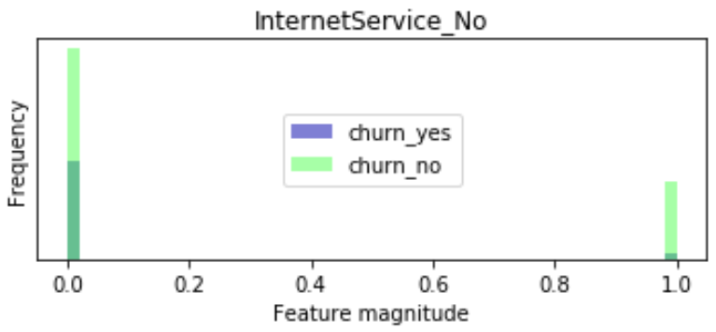
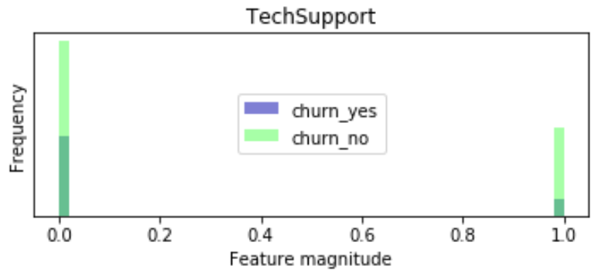
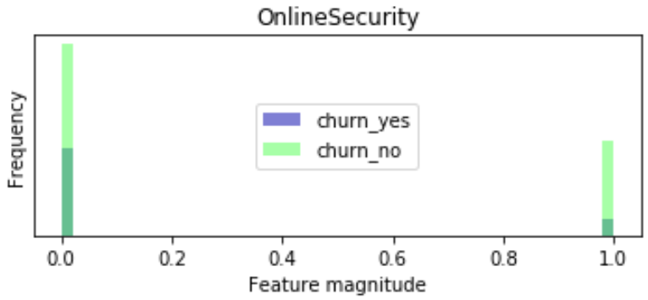
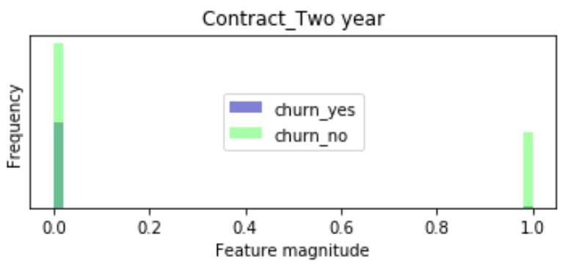
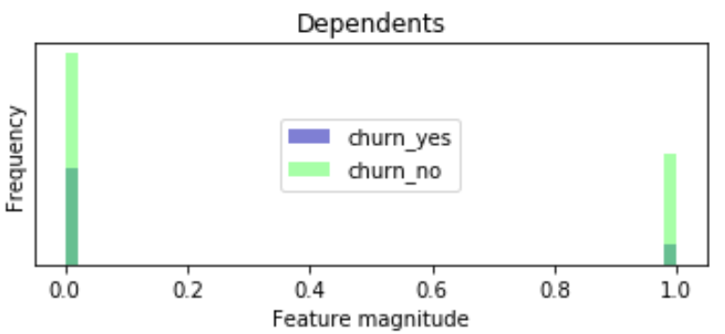
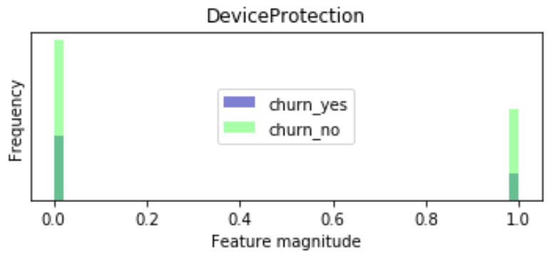
Using conditional graphs to understand the data (7)
Higher churn in group 0
→ Clients who belong to group 0 churn more often than clients in group 1.

Slide 16
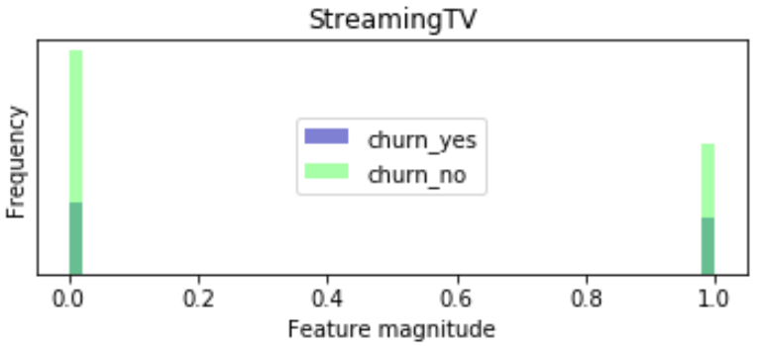
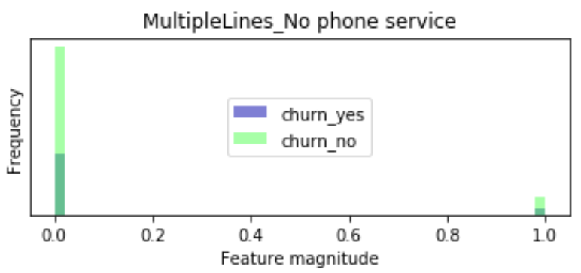
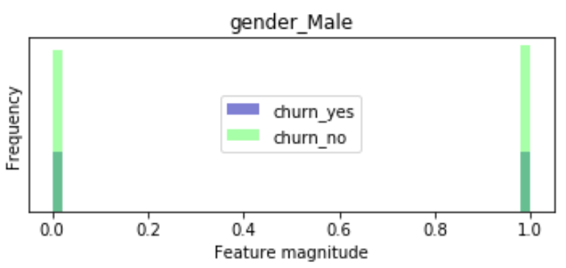
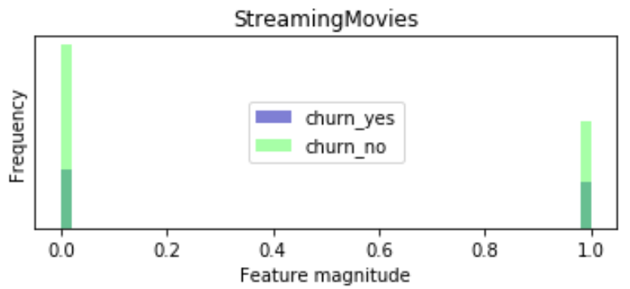
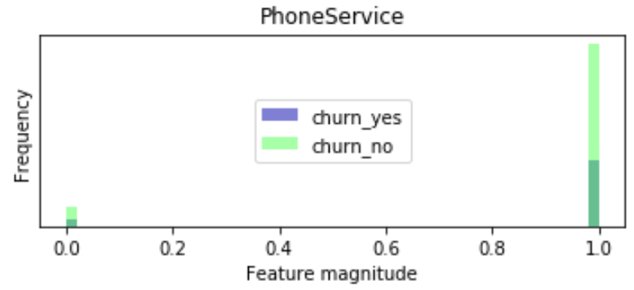
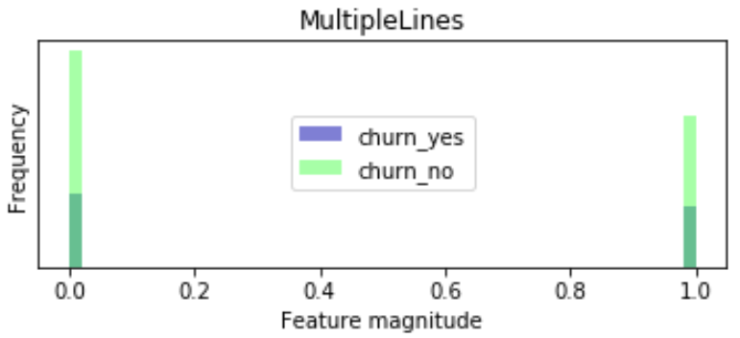
Using conditional graphs to understand the data (8)
No (or low level) differences among the respective groups
→ Clients who belong to group 1 churn approximately as often as clients in group 0.

Slide 17
Optimal model proposal – Logistic Regression (1)
We are dropping observations with the maximum value of tenure (not to overestimate the impact of tenure).
It is important to mention that our variables have different scales. Regularization methods work properly when variables have the same scale and, therefore, if we want to apply Lasso or Ridge regression, we should rescale our quantitative variables. Our quantitative variables are scaled in the range (0,1).
Since we do not know which specification is better: logarithmic or original total charges, we start with testing linear specification.
To test the quality of our data we split data into train and test in order to avoid overfitting and improve generalization of our model.

Slide 18
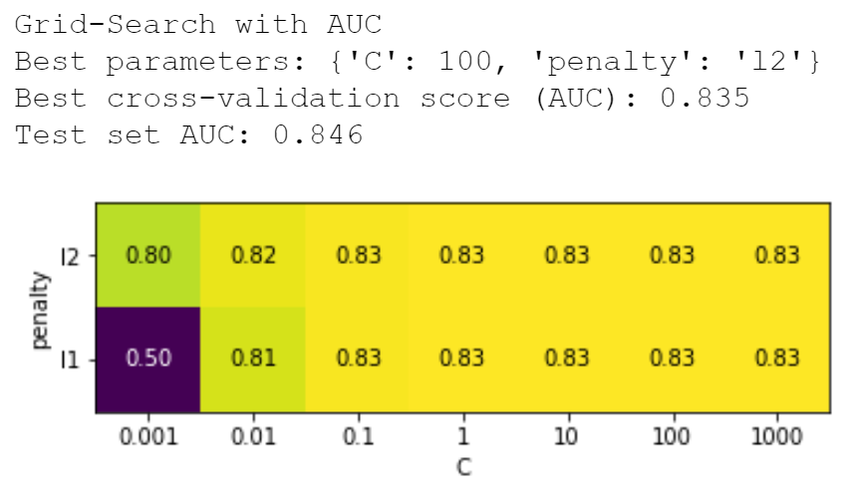
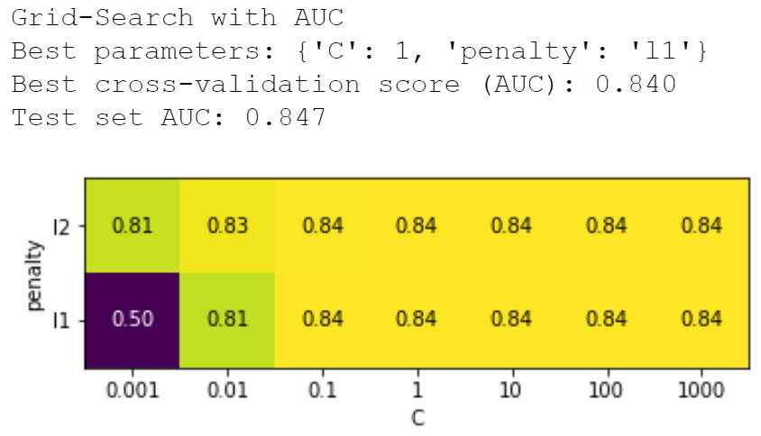
Optimal model proposal – Logistic Regression (2)
We trained our model on train set using cross-validation while choosing hyperparameters.
Using original total charges:
Using log(total charges):
We see that the best quality can be obtained with l1 penalty and C = 1 and logarithmic transformation of total charges.
→ We choose log(total charges) to proceed the analysis.

Slide 19
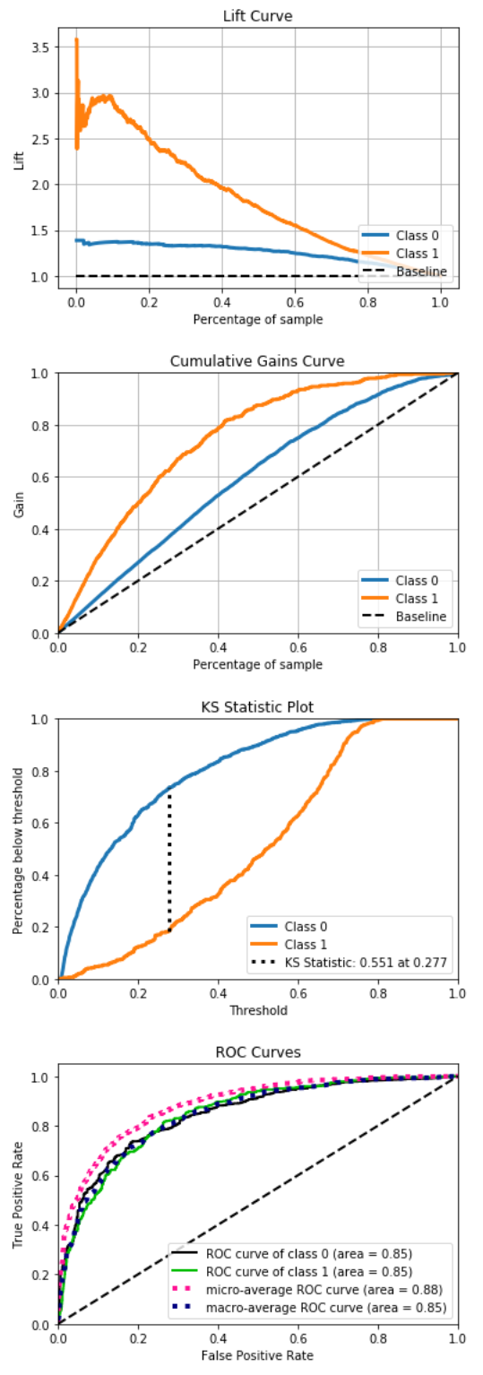
Optimal model proposal – Logistic Regression (3)
Lift curve drops steeply from around 0 % to around 5 % of the sample, and then declines at approximately the same rate.

Slide 20
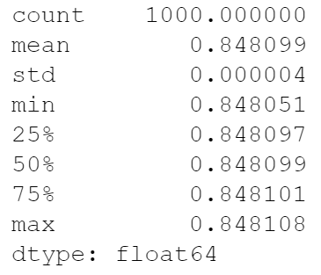
Using bootstrap for building CI of predictions (1)
We created a function which calculates CI for predictions and coefficients of the model, and also computes some statistics of our metrics using bootstrap.
Training score statistics (AUC):

Slide 21
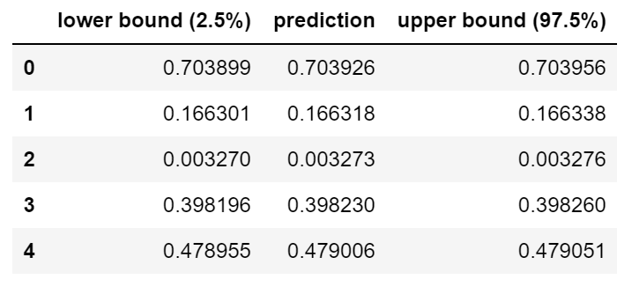
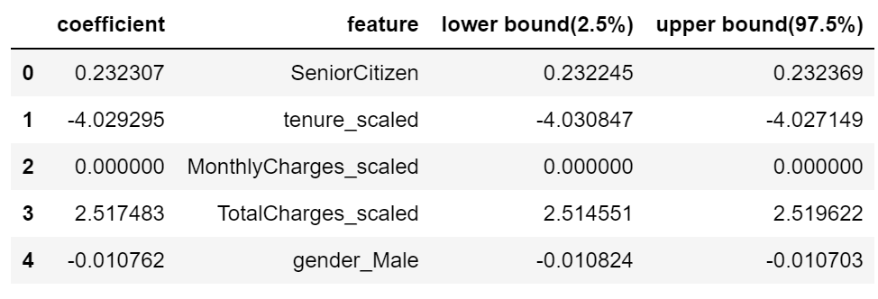
Using bootstrap for building CI of predictions (2)
95% confidence intervals for our predictions and coefficients of the model using bootstrap:
95% confidence intervals for coefficients:

Slide 22
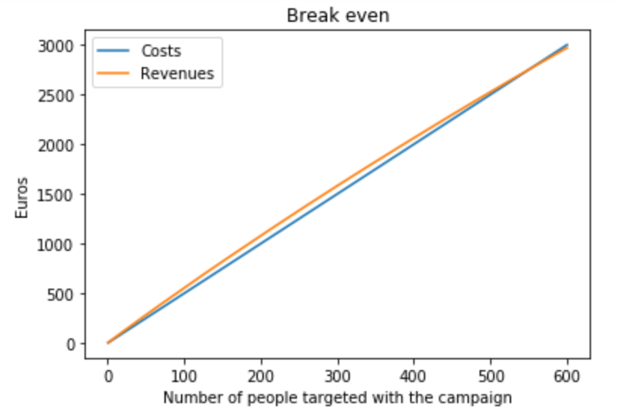
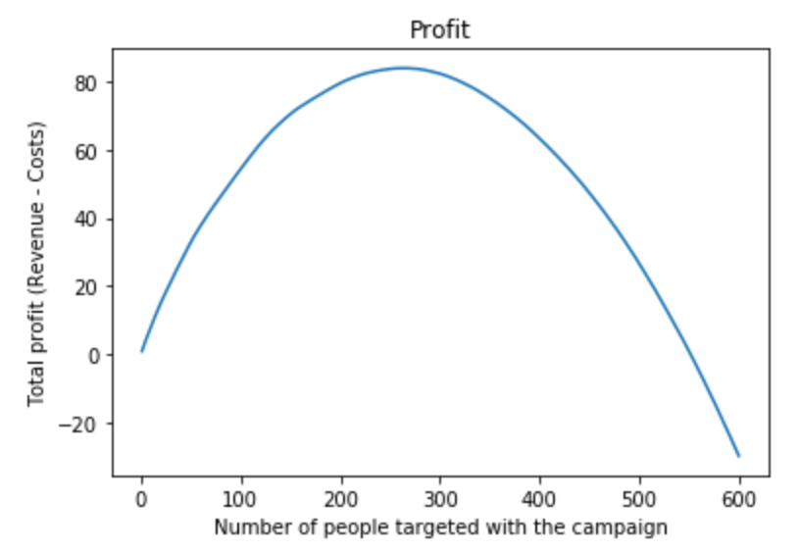
Cut-off selection (1)
To find the break-even point, we have defined a function that predicts the probability of churning for each client by 'customerID' number, sorts the list by the probability of churning in descending order, calculates the expected revenue from retention campaign for each customer, and finally calculates the total revenues, cost and profit.
Results:
Maximal number of customer to be targeted without losing money: 479 (Break-even point)
Maximal number of customer to be targeted for maximal profit: 219
The function returns a list of customers to be contacted by the retention campaign

Slide 23
PCA (1)
We tried to make linear combinations of our features (PCs) and see whether it improves the quality of our model.
Note: we cannot transform categorical variables, so we test the quality of the model with PCA only transforming numeric features.

Slide 24
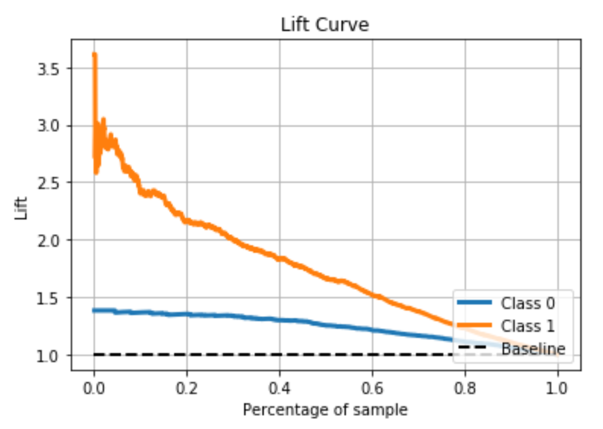
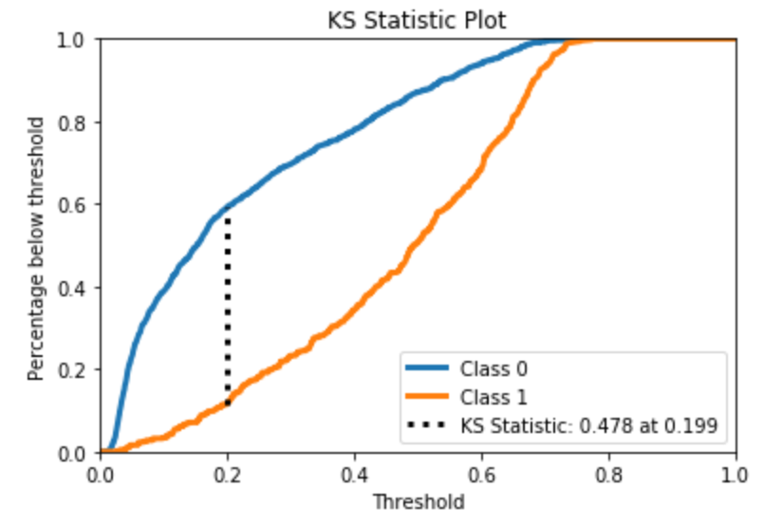
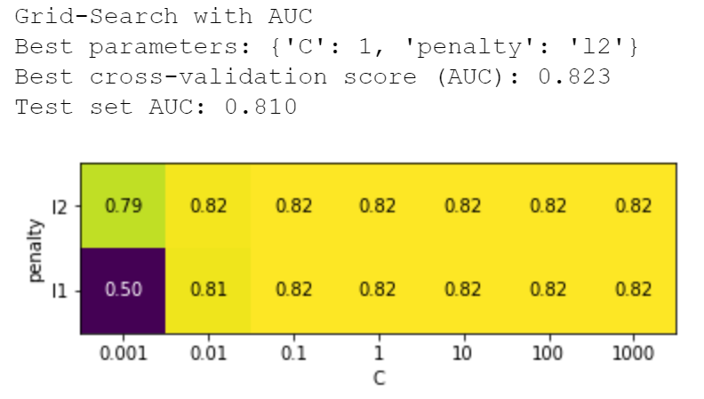
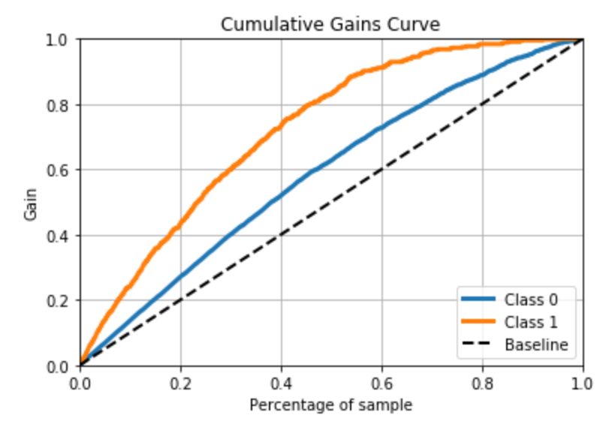
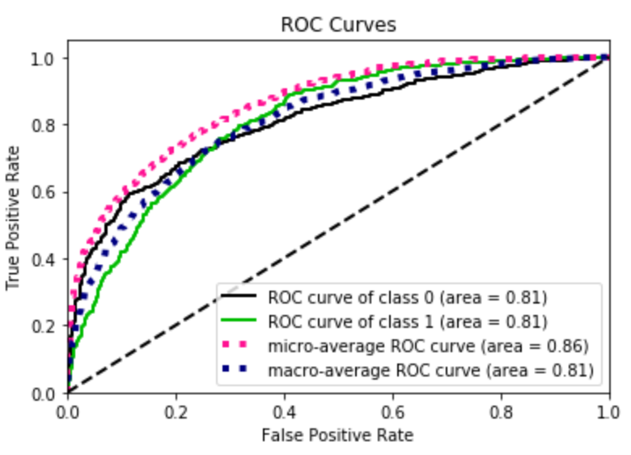
PCA (2)
Firstly, we wanted to test replacing numeric variables with only one PC (out of 3).
Results of logistic regression are presented via graphs

Slide 25
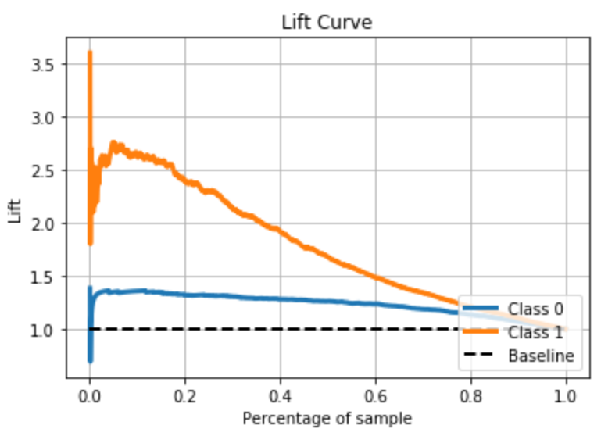
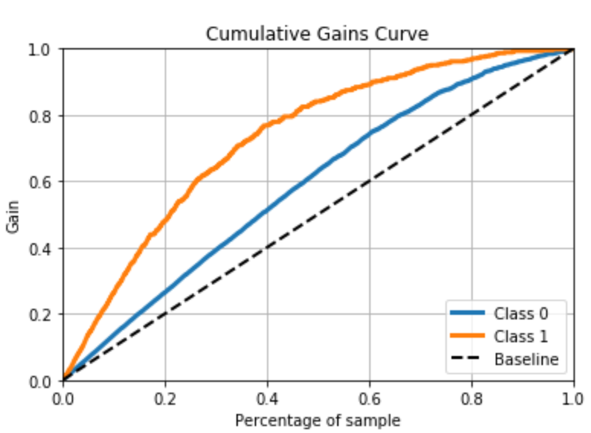
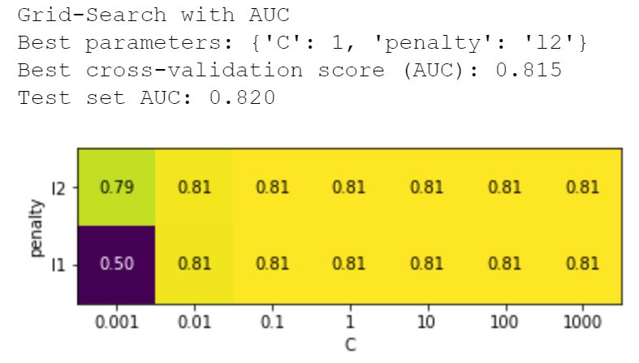
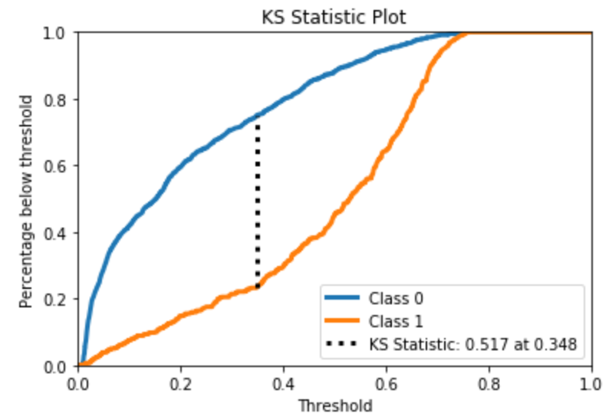
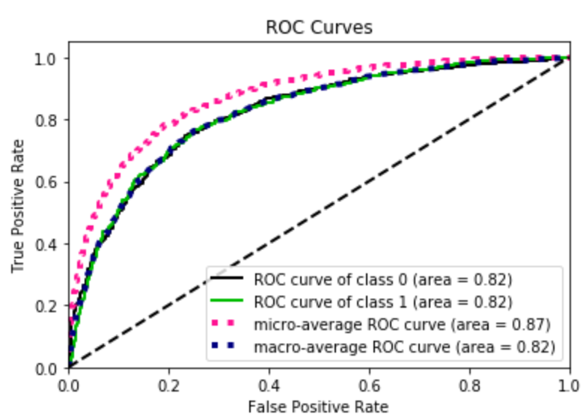
PCA (3)
Secondly, we wanted to test replacing numeric variables two PCs (out of 3).
Results of logistic regression are presented via graphs
→ The results got worse in both cases.

Slide 26
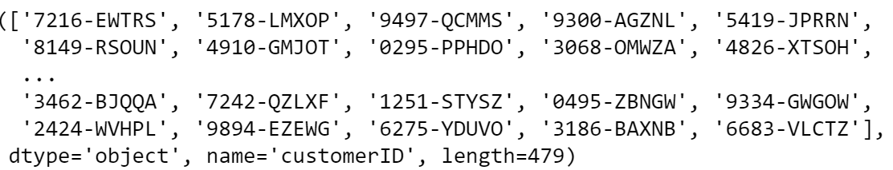
Conclusion
The list of customers to be targeted by the retention campaign

Slide 27
K-Prototypes Clustering (Appendix)
We have also looked for insights using cluster analysis. In order to split clients into groups we used K-prototypes technique, which allows us to account for dissimilarities among both categorical and numeric types of features.
We need to stress that common K-means/KNN techniques are not applicable here due to almost all of the features are categorical, which makes calculation of distances between observations non-feasible.
We defined a function that calculates means of Gower distances between observations in the same cluster and looked at how mean distances change conditional on the number of clusters (k).
We obtained that optimal number of clusters is 8 and grouped all observations into these clusters, namely, for each cluster we calculated representative observation with the most frequent value for each of the categorical features and mode value for each of the quantitative features.
Thus, we can interpret each of the clusters and get some descriptive information about our data. For example, we can see which customers are less or more prone to churn.
Though, we need to stress that this algorithm won’t allow us straightly to make predictions of churn and it can be used mostly for EDA purpose.

Slide 28
Thank you for your time and attention!

