Slide 1
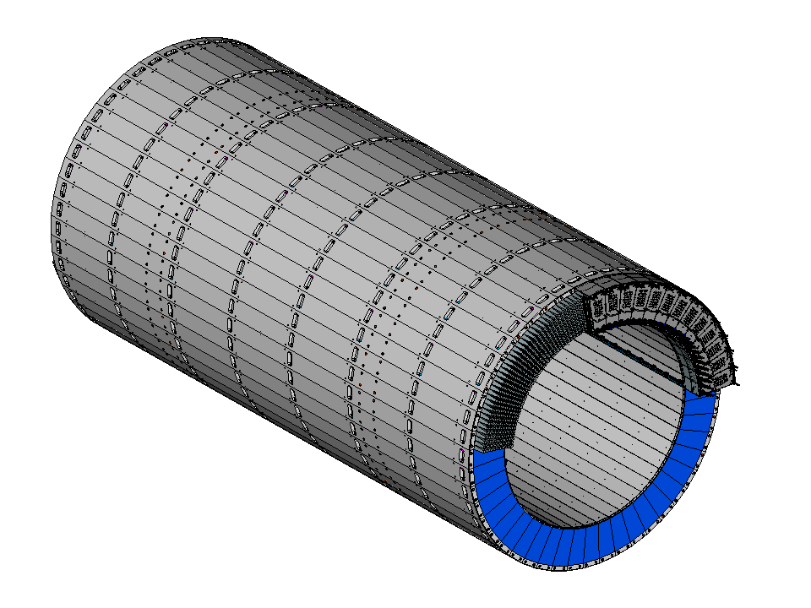
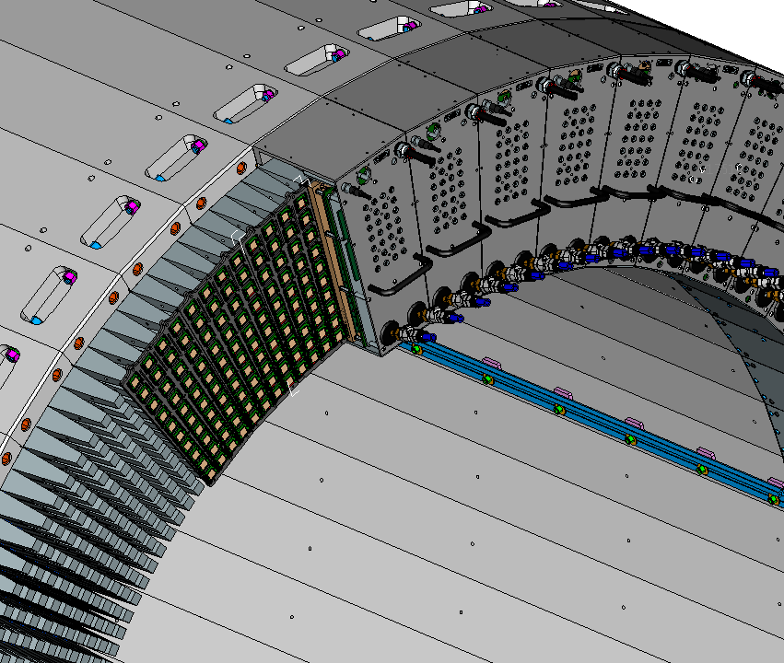
detail
Readout assembly
SiPM light sensors
Light guides

