Slide 1
VISION & COGNITIVE SERVICES
A.A. 2020/2021
Elton Stafa
Niccolo’ Vettorello

Slide 2
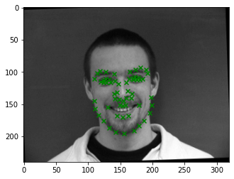
Facial Keypoints Detection
Crime prevention
Search for missing people
Various security applications:
  Phones
  Security cameras
  Other devices
Medical diagnosis

Slide 3


Tools
Language
Environment

Slide 4

Dataset
7049 training images 1783 test images
Up to 30 keypoints’ coordinates per example

Slide 5
WestGate

Slide 6
Data augmentation

Slide 7
WestGate with augmented data

Slide 8
Inception Network

Slide 9
WestGate with Inception Network

Slide 10
Evaluation Metrics

Slide 11
WestGate results

Slide 12
WestGate with augmented data results

Slide 13
WestGate with Inception Network results

Slide 14
Conclusions

Slide 15
Project code

