Slide 1
Building a Root Cause Analytics Engine
with Prometheus, Grafana, and MCP
El Muhammad Cholid H. · Founder, DevOps Focus Group
Kubernetes Community Days Indonesia 2026
1
Notes:
GOAL: Frame the talk and set immediate expectations.
TALK TRACK:
• Welcome everyone. This architecture started at a real fintech client with strict regulatory constraints.
• Today's demo runs on synthetic data and fits in a public repo you can test on your laptop.
• Two clear non-goals: this is NOT autonomous remediation, and it does NOT replace on-call engineers.
TRANSITION: Let's look at what actually happens when an incident wakes you up.

Slide 2
When an alert fires at 3am, the clock starts ticking
Alerts tell you users are hurting, but never why
The hardest part of on-call isn't typing the fix:
What changed first in the distributed system
Which service is the real root cause versus cascade victim
How far the blast radius has spread across dependencies
What exact hypothesis to verify next without guessing
The on-call reality:
You spend 40 minutes jumping across 12 dashboard tabs, grep-ing endless logs, and hoping your intuition holds.
2
Notes:
GOAL: Connect with the audience's shared pain of on-call triage.
TALK TRACK:
• Ask the room: who has spent 40 minutes at 3am clicking 12 dashboard tabs while Slack explodes?
• Typing a kubectl command or applying a patch takes 2 minutes. Finding WHAT to fix takes 40 minutes.
• Alerts tell you symptoms, never the root cause.
TRANSITION: The natural reaction today is: why not just hand the logs to an LLM?

Slide 3
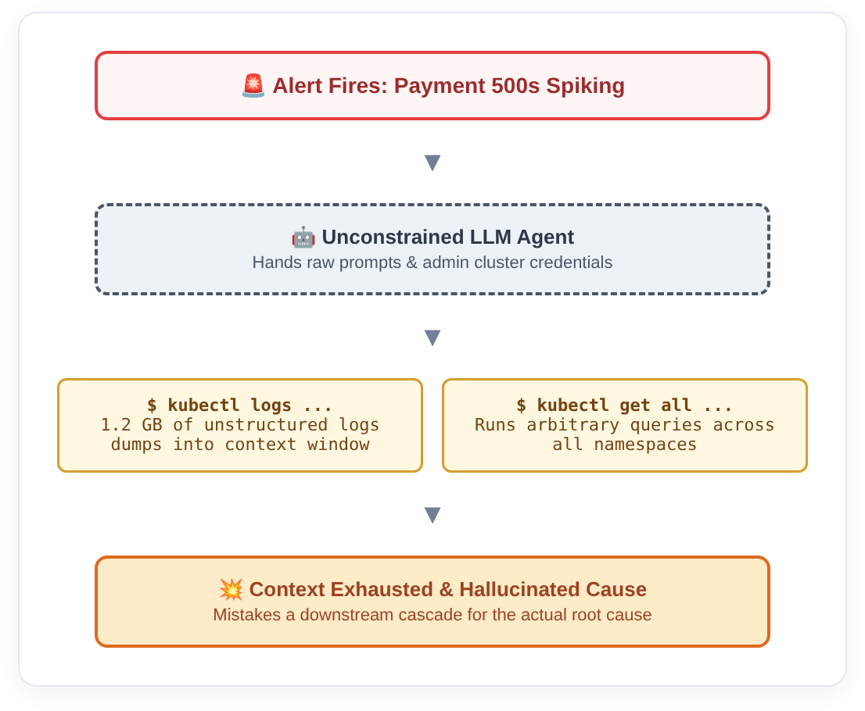
The obvious instinct is to
point an LLM at your logs
Why unconstrained diagnostic agents break down:
Massive context waste: Dumping gigabytes of raw logs floods context windows with irrelevant noise.
Hallucinated causality: Models mistake downstream cascade symptoms for primary root causes.
Unbounded latency & cost: Open-ended exploration spins on endless log streams.
Security hazard: Broad kubectl or cluster-admin privileges handed to model prompts.
3
Notes:
GOAL: Deconstruct why naive LLM debugging fails in production.
TALK TRACK:
• Walk through the diagram: alert triggers -> LLM gets broad kubectl access -> dumps gigabytes of logs.
• Result: 100k tokens burned, context exhausted, and the model confuses cascade noise for the real bug.
• Worse: giving an unconstrained prompt cluster-admin credentials is a critical security hole.
TRANSITION: So how do disciplined SREs actually solve this? They bound the evidence first.

Slide 4
Instead of searching blindly, bound the evidence first
Answer the first five minutes with three disciplined layers of proof:
1. Metrics (RED)
Rate, Errors, Duration & Saturation
Metrics establish correlation, not causation.
Their job is to isolate when the anomaly began and narrow candidate services to a small set.
2. Traces (Path)
Distributed Call Graph
Traces bound the path across services.
They identify which upstream caller triggered which failing downstream dependency in the call tree.
3. Logs (Targeted)
Exception & Stack Proof
Targeted error signature proof.
Queried ONLY after metrics and traces isolate the time window to seconds and target to one pod. Used for confirmation, never discovery.
4
Notes:
GOAL: Explain the strict evidence hierarchy: Metrics -> Traces -> Logs.
TALK TRACK:
• Step 1: Metrics isolate the anomaly window and narrow candidates. They prove correlation, not causation.
• Step 2: Traces bound the exact distributed path. Who called who, where did the latency spike?
• Step 3: Logs are queried last, for confirmation, never discovery. Querying 30 seconds of targeted logs costs nothing.
TRANSITION: Where do we correlate all three? Grafana.

Slide 5
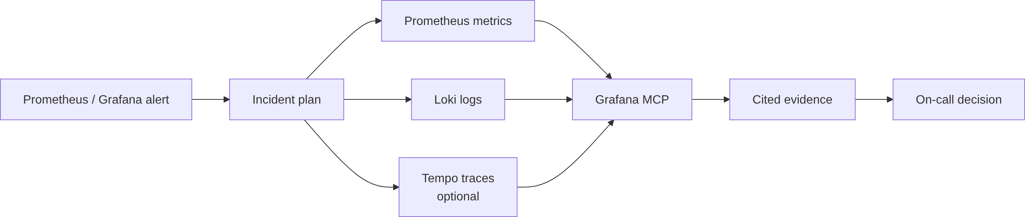
Grafana is where telemetry turns into correlation
Prometheus, Loki, and Tempo hold the data. Grafana correlates them, and MCP exposes read-only questions.
5
Notes:
GOAL: Establish Grafana, not the AI, as the center of evidence correlation.
TALK TRACK:
• Many expect MCP or an LLM to be the core architecture. It isn't.
• Grafana is already your federation engine: it connects Prometheus, Loki, and Tempo with unified dashboards.
• MCP is simply a thin read-only interface letting our engine query existing Grafana datasources safely.
TRANSITION: Here is how we translated this enterprise pattern into an open repo.

Slide 6
Taking an enterprise pattern and making it reproducible
How we rebuilt proprietary production controls into an open demo
Evidence Queries: Client: internal telemetry / Repo: fixed templates over 3 services
Correlation Plane: Client: enterprise Grafana / Repo: public starter dashboard
MCP Gateway: Client: internal auth proxy / Repo: standalone read-only server
Incident State: Client: full incident ticketing / Repo: clean persisted state machine
Validation: Client: canary check suite / Repo: one-click fault toggle
6
Notes:
GOAL: Show that the demo retains genuine enterprise design principles.
TALK TRACK:
• Everything in proprietary production has a 1-to-1 open equivalent in the repo.
• Client auth proxies become standalone MCP servers; internal telemetry becomes synthetic RED metrics.
• You get the exact same state machine and validation loops in a simple Docker Compose setup.
TRANSITION: Now, rule number one for production safety.

Slide 7
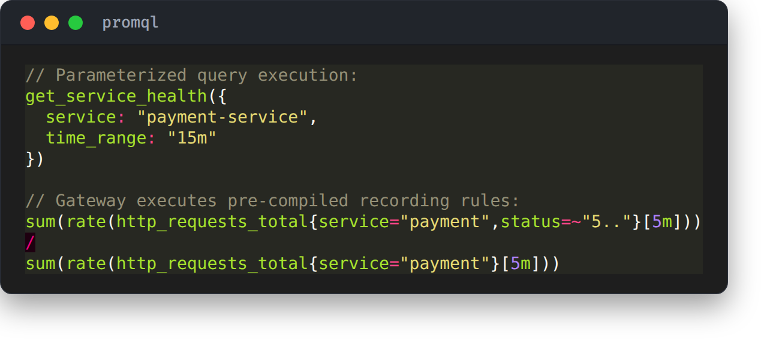
Never let an LLM write
raw PromQL in production
The gateway translates intent into verified recording rules
Hallucination Risk: Models hallucinate metric names and label keys under incident stress.
Cluster Safety: Unguarded regex PromQL can easily crash production Prometheus instances.
Deterministic RED: Vetted recording rules pre-compute RED metrics deterministically.
Parameter Injection: The model supplies parameters; the gateway executes verified templates.
7
Notes:
GOAL: Explain why dynamic PromQL generation is banned.
TALK TRACK:
• Never give an LLM an open PromQL prompt in production.
• Why? Complex regex or unindexed label queries can crash your Prometheus cluster right during an active incident.
• Instead, SREs pre-vetted recording rules. The engine exposes named tools, and the gateway fills parameters into fixed queries.
TRANSITION: And we enforce this boundary with strict schemas.

Slide 8
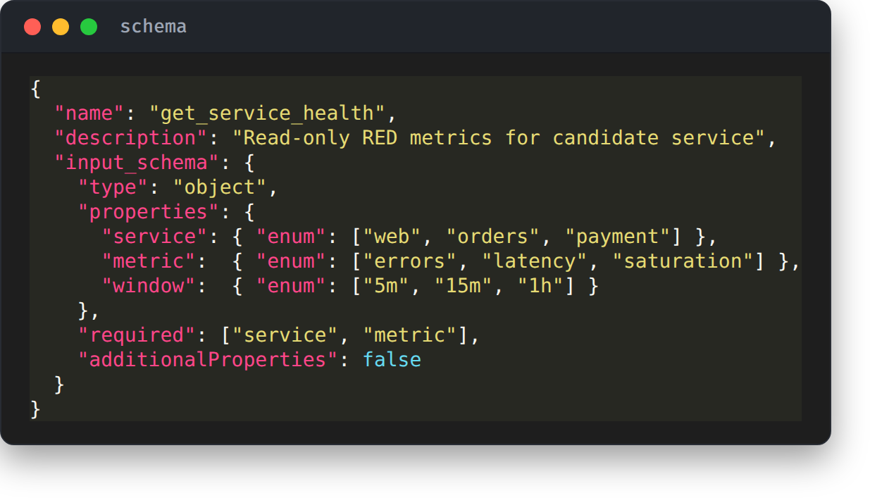
Enforce security in schemas,
not in prompts
Tool schemas act as executable, hard-coded guardrails
No Extra Properties: additionalProperties: false rejects injected unexpected arguments.
Enum Constrained: Enums constrain targets to verified service catalog entries only.
Bounded Windows: Time windows are bounded: impossible to query full year history.
Immediate Rejection: Violations reject instantly at MCP layer before touching datasources.
8
Notes:
GOAL: Show how JSON Schema provides deterministic policy enforcement.
TALK TRACK:
• Prompt instructions like 'please do not query broad time windows' fail under pressure.
• Schemas don't negotiate: 'additionalProperties: false', enum-constrained service names, and bounded duration limits.
• If an argument doesn't validate, the MCP gateway rejects it before the packet ever hits Grafana.
TRANSITION: Once tools are safe, how do we structure the investigation flow?

Slide 9
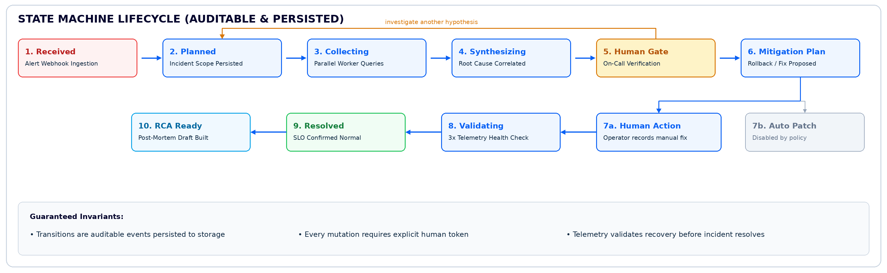
Every state change must be an auditable human decision
An explicit state machine where transitions require proof, and automated actions remain locked.
9
Notes:
GOAL: Walk the 10-stage auditable state machine.
TALK TRACK:
• State transitions are persisted records in a database, not internal loops in an agent's memory.
• Follow the flow: Received -> Planned -> Collecting -> Synthesizing -> Human Gate.
• Notice node 5: rejecting a hypothesis explicitly returns to planning. Notice 7b: automated patching is disabled by policy.
TRANSITION: Let's look at how that initial plan is scoped.

Slide 10
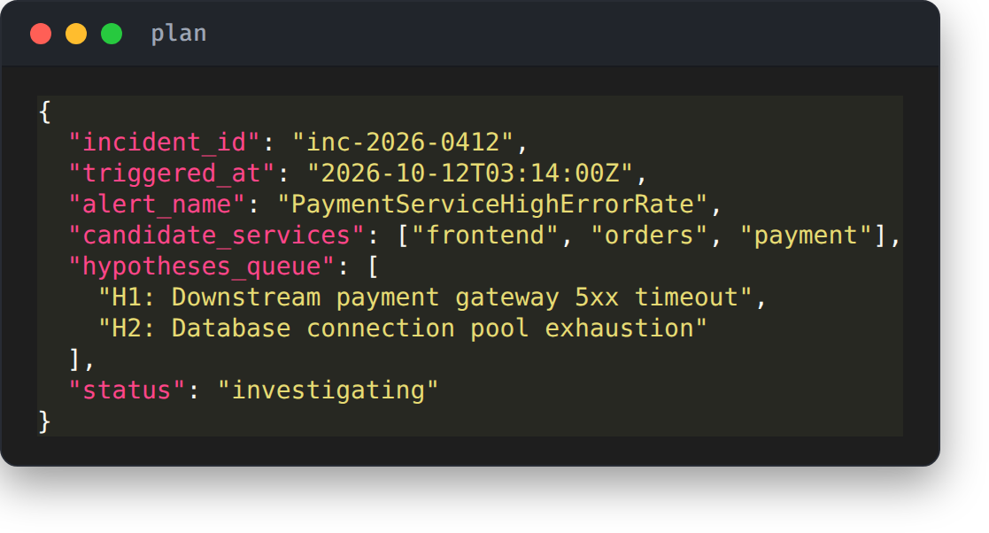
The alert builds a shared plan
before anyone runs queries
Persisted incident scope created immediately upon trigger
Persisted State: Plan is persisted to storage before any worker executes diagnostic queries.
Live Collaboration: Engineers can view and edit the hypothesis queue live in incident chat.
No Runaway Loops: Prevents duplicate queries and runaway investigation branches.
10
Notes:
GOAL: Explain why planning happens before execution.
TALK TRACK:
• When the alert fires, it first builds a visible plan: services in scope, time boundaries, and initial hypotheses.
• This plan is posted into the incident channel immediately.
• If an on-call engineer joins 10 minutes late, they read a clear checklist instead of guessing what the bot is doing.
TRANSITION: Who actually runs the checks? Five narrow workers.

Slide 11
Five focused workers asking five narrow questions
Parallel investigation without ambient cluster authority
Worker Boundaries:
Metrics Worker: Queries RED metrics & saturation. Zero PromQL.
Logs Worker: Queries error signatures in a 3-minute window.
Trace Worker: Inspects top 5 slowest/failing spans only.
Topology Worker: Resolves service dependency tree from catalog.
Changes Worker: Checks recent deployments & config diffs in past 30m.
11
Notes:
GOAL: Present the division of labor across specialized workers.
TALK TRACK:
• Instead of one massive agent that does everything, we deploy five bounded workers.
• Each worker answers one question: Metrics checks RED; Logs checks 3 minutes; Traces checks top 5 spans; Topology checks dependencies; Changes checks recent deploys.
• None of them has ambient access to explore outside their lane.
TRANSITION: And what do they return? Structured verdicts.

Slide 12
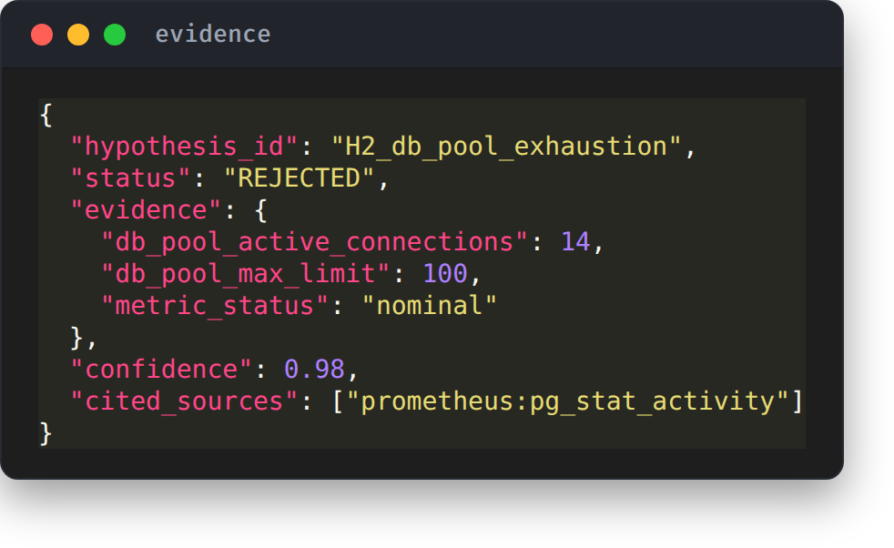
Ruling out a false lead is
just as valuable as the fix
Structured evidence verdicts eliminate subjective debate
Equally Valuable: A rejected hypothesis is as valuable as a confirmed one.
Clear Auditing: Engineers immediately see what was ruled out and why.
No Circular Logic: Prevents circular arguments and re-testing known good subsystems.
Restricted Context: Coordinator receives structured verdicts, never raw dumps.
12
Notes:
GOAL: Highlight that negative evidence stops engineers from wasting time.
TALK TRACK:
• Proving that the database is healthy is just as valuable as finding an error in the auth pod.
• Workers return structured JSON verdicts: 'status: rejected', with exact metric proofs.
• This eliminates circular arguments and prevents people from re-checking components that are operating normally.
TRANSITION: Here is the complete sequence in motion.

Slide 13
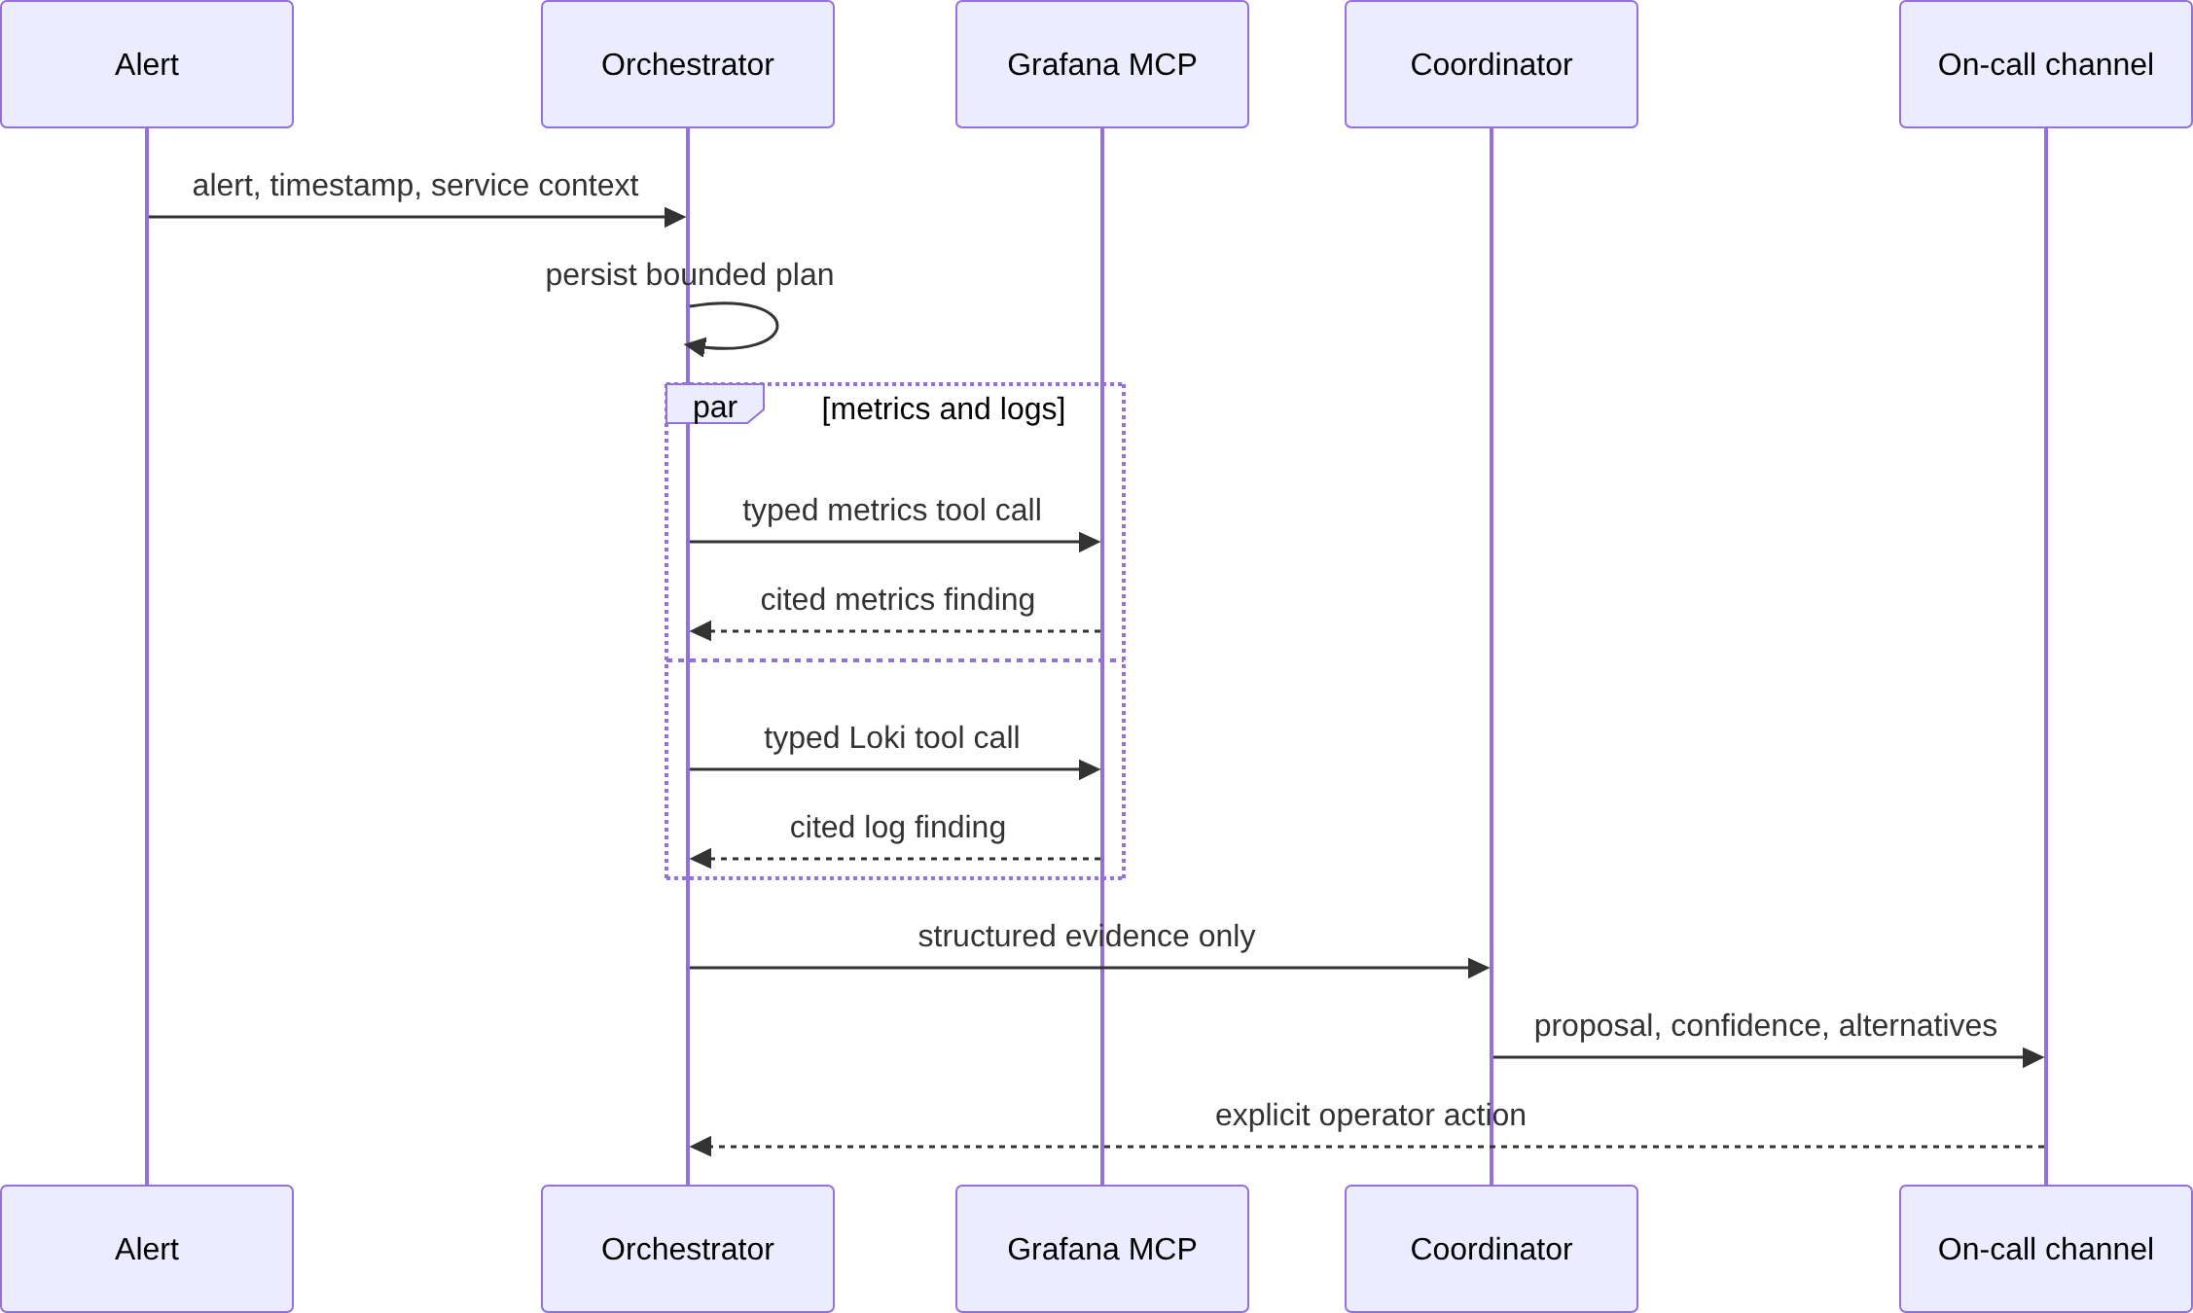
How the entire investigation unfolds end to end
Alert ➔ Incident plan ➔ Parallel workers ➔ Synthesized root cause ➔ Human gate
13
Notes:
GOAL: Walk the end-to-end timeline smoothly.
TALK TRACK:
• Walk through the steps: Alert fires -> Coordinator creates incident record -> 5 workers fan out concurrently.
• Results collect -> Synthesis correlates timeline -> Root cause proposed -> Human approval gate.
• Total elapsed time: under 45 seconds from initial trigger to actionable verdict.
TRANSITION: Now let's examine the security boundaries that make this safe.

Slide 14
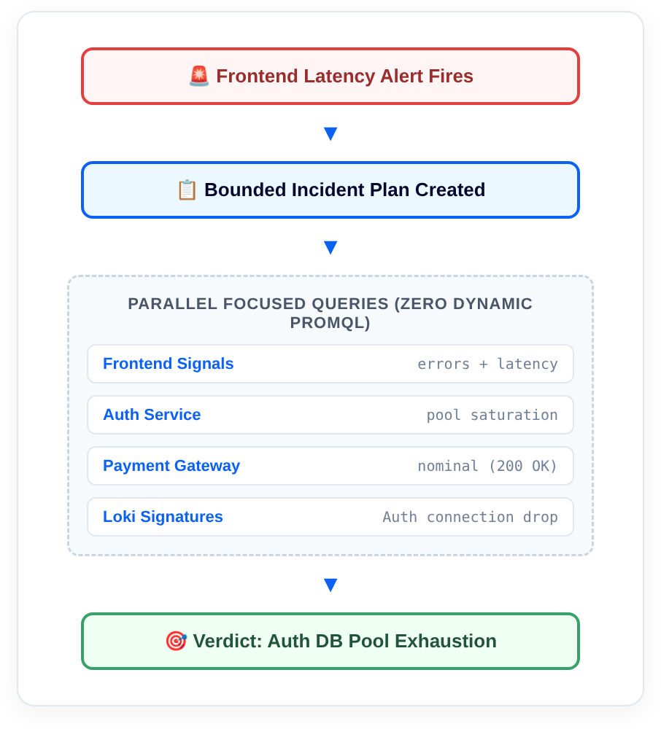
Architecture enforces trust,
not polite prompts
Strict least-privilege security controls across four layers:
Orchestrator: Schedules tasks & state. Has ZERO Grafana source credentials.
MCP Gateway: Read-only access to Grafana. Rejects all mutations and write calls.
Workers: Ephemeral processes with single-purpose schema tokens.
Mitigation Engine: Requires explicit cryptographic token from human chat approval.
14
Notes:
GOAL: Explain why prompt injection cannot compromise cluster infrastructure.
TALK TRACK:
• Notice how permissions are isolated across all four tiers:
• The Orchestrator holds no Grafana credentials. The MCP Gateway has zero write endpoints.
• Even if someone injected malicious text into an application log, the gateway physically cannot execute write commands.
TRANSITION: What about Slack and Teams interaction? How do chat buttons work?

Slide 15
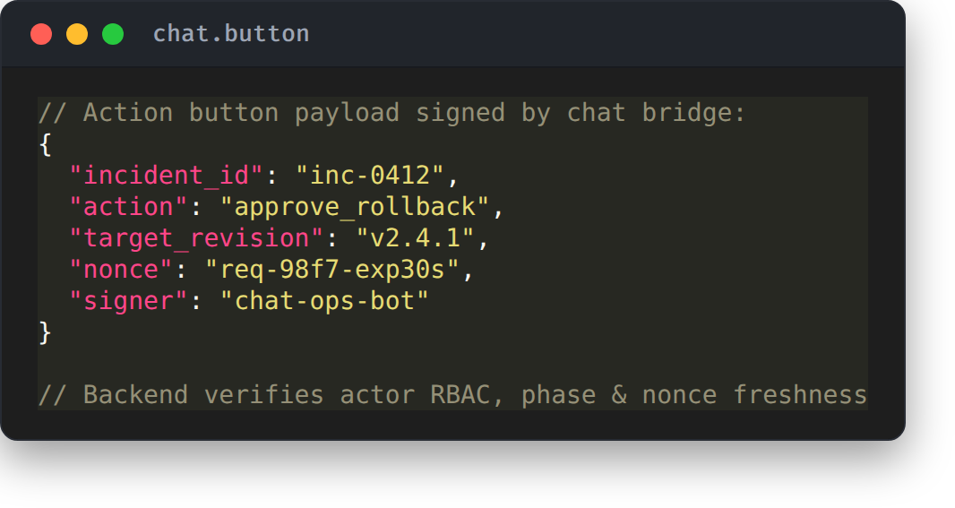
Chat buttons request actions,
but the backend verifies
Slack and Teams ChatOps pattern with cryptographic nonces
No Direct Execution: A chat button never triggers an action or shell script directly.
Server-Side RBAC: The server validates actor identity, incident phase, and nonce freshness.
Replay Protection: Stale or duplicate button clicks are rejected harmlessly.
Cryptographic Tokens: Approved actions receive single-use scoped execution tokens.
15
Notes:
GOAL: Explain secure ChatOps button handling.
TALK TRACK:
• A Slack button click never runs a script directly.
• It sends an intent payload to the backend server with a single-use cryptographic nonce.
• The server verifies caller RBAC, ensures the incident is in the correct state, and rejects duplicate or stale clicks.
TRANSITION: Once mitigation is approved and applied, how do we confirm recovery?

Slide 16
A human applies the fix, but telemetry proves it worked
Closing the loop with automated verification cycles
Post-Mitigation Validation Cycle:
Mitigation Applied: Engineer approves deployment rollback or traffic re-route.
Automated Health Check: Gateway monitors 3 consecutive evaluation cycles (3x 60s).
Error Rate Re-check: Verifies payment-service error rate drops below 0.1% SLO threshold.
Auto-Resolution: Transitions state to Resolved only when telemetry proves recovery.
16
Notes:
GOAL: Describe closed-loop validation after applying a fix.
TALK TRACK:
• Applying a fix isn't the end of an incident.
• The engine waits for 3 consecutive evaluation windows (3x 60s) to verify error rates return below SLO thresholds.
• Only when metrics confirm recovery does the state machine transition to Resolved.
TRANSITION: And when it resolves, the post-mortem is already finished.

Slide 17
The post-mortem assembles itself while you fix the incident
The draft builds deterministically from the audit trail, waiting for human sign-off.
Automated Post-Mortem Assembly Lifecycle:
1. Resolution Acknowledged: Incident recovery event freezes evidence collection and triggers post-mortem generation.
2. Structured Record Pull: Gathers alert timestamps, hypotheses tested/rejected, and confirmed telemetry verdicts.
3. Template Merge: Renders the data into the standardized incident report format without manual copy-pasting.
4. Draft Created: Stores draft in designated incident review location with immutable audit links.
5. Human Review: Engineer verifies accuracy, adds organizational context, and signs off.
6. Distribution: Publishes final post-mortem report to incident channels and stakeholder teams.
17
Notes:
GOAL: Showcase the immediate practical benefit: zero manual post-mortem writing.
TALK TRACK:
• Nobody likes writing post-mortems days later when memory fades and metric charts have expired.
• Because our engine recorded every step as an auditable state transition, the post-mortem compiles automatically upon resolution.
• All timestamps, rejected hypotheses, and metric proofs are already organized for final human sign-off.
TRANSITION: Let's summarize the architecture comparison side-by-side.

Slide 18
Why bounding the evidence beats dumping the logs
Comparing the two architectures across five production dimensions
Query Scope: Raw Log: unbounded dump / RCA Engine: bounded RED rules
Plan State: Raw Log: implicit model thoughts / RCA Engine: persisted, auditable state
Token Cost: Raw Log: 100k+ tokens / RCA Engine: < 4k structured tokens
Security Privileges: Raw Log: kubectl cluster-admin / RCA Engine: read-only scoped MCP
Human Control: Raw Log: hope model behaves / RCA Engine: state machine approval gates
18
Notes:
GOAL: Compare raw log dumping against bounded evidence.
TALK TRACK:
• Be transparent about the trade-off: this requires building clean telemetry and recording rules.
• In exchange, you cut token usage from 100k down to 4k tokens, drop query latency from minutes to seconds, and eliminate cluster-admin security risks.
TRANSITION: And this drastic token reduction transforms what AI models you can run.

Slide 19
Small models win when the evidence is pre-filtered
Because the gateway returns structured findings under 4k tokens, model choice becomes flexible:
Local / Air-Gapped
Ollama / vLLM (Private)
• Runs 100% inside your Kubernetes cluster
• Models: Llama 3.3 70B, Qwen 2.5 32B
• Zero production telemetry leaves your VPC
• Ideal for banking, healthcare, and air-gapped gov clouds
Lightweight Cloud
Fast Reasoning Tier
• Fast, cheap cloud API integration
• Models: Claude 3.5 Haiku, GPT-4o-mini
• Entire incident triage costs < $0.01
• Latency: sub-second synthesis response times
Zero-Dependency Rule
Deterministic Fallback
• Pure Go / TypeScript heuristics engine
• Zero LLM dependency or API keys required
• Evaluates RED anomalies and regex signatures deterministically
• Included in our open-source demo today
19
Notes:
GOAL: Clarify the model selection strategy and dispel the myth that incident AI requires giant cloud LLMs.
TALK TRACK:
• When people hear 'AI incident engine', they assume you need a massive 128k context frontier model.
• Because our MCP gateway pre-filters evidence down to 4k tokens, you can run small, fast models like Claude Haiku or GPT-4o-mini for less than a penny.
• Even better: you can host local Llama 3.3 or Qwen 2.5 on Ollama inside your VPC—zero telemetry ever leaves your cluster.
• And in our open-source repo today, the synthesis engine even has a pure deterministic rule fallback that works with zero external AI dependencies.
TRANSITION: And we should be equally honest about what this engine cannot do.

Slide 20
Where this design deliberately stops
Clear boundaries that maintain engineering credibility
Hard Limits of the Engine:
Metrics give correlation, not causation: Proving services degraded together != physical proof of bug.
Cannot fix missing telemetry: If a service exports no RED metrics, the gateway cannot invent data.
Unmaintained dependency graphs fail: Stale service catalogs cause the coordinator to miss cascade paths.
Not autonomous remediation: Does not restart pods or alter routing without explicit human signoff.
20
Notes:
GOAL: Earn trust with senior engineers by stating hard limitations plainly.
TALK TRACK:
• State these upfront: correlation is never causation, and no AI can invent metrics you didn't collect.
• If your service catalog is outdated or missing RED metrics, the engine cannot help you.
• Most importantly: this is NOT autonomous remediation. Humans stay in the loop.
TRANSITION: How can teams start implementing this today?

Slide 21
How to build this incrementally without boiling the ocean
A 4-step adoption roadmap that delivers value from day one
Phased Adoption Roadmap:
Phase 1: Telemetry & Rules: Standardize RED metrics and Prometheus recording rules on tier-1 services.
Phase 2: Grafana Correlation: Build single-pane dashboard linking metrics, Loki logs, and Tempo traces.
Phase 3: Read-Only MCP Gateway: Wrap dashboard queries in structured, parameterized tool schemas.
Phase 4: State Machine & RCA: Add incident state machine, hypothesis queue, and chat approval gates.
21
Notes:
GOAL: Provide a pragmatic, low-risk adoption path.
TALK TRACK:
• Do not start by deploying AI agents.
• Phase 1 and Phase 2 are standard observability engineering: RED recording rules and correlated dashboards.
• Once human engineers have fast correlation dashboards, adding the MCP gateway and state machine is easy.
TRANSITION: Here are the three big takeaways to bring home.

Slide 22
Three principles to take back to your team
1. Put Grafana at the evidence plane: Prometheus and Loki hold truth; Grafana correlates them. Build tooling at the correlation layer, not individual datasources.
2. The model never writes queries: Tool schemas are executable policies. Expose narrow, parameterized questions with zero dynamic query syntax.
3. Persist the plan and the state: Keep humans in control with auditable state transitions, visible hypotheses, and explicit approval gates.
22
Notes:
GOAL: Deliver three clear takeaways slowly and deliberately.
TALK TRACK:
• 1. Put Grafana at the evidence plane: don't build integrations on raw Prometheus and Loki directly.
• 2. Never let models write queries: schemas are hard policies that prevent crashes.
• 3. Persist the plan and the state: keep humans in control with auditable transitions.
TRANSITION: You can run the entire system on your laptop right now.

Slide 23
Try the entire stack locally on your machine
Clone the repo and run the three-service demo with Docker Compose
Everything in this talk is runnable in the demo repo:
Prometheus recording rules & alert configurations
Grafana correlation dashboard with RED metric panels
Read-only Model Context Protocol (MCP) gateway server
Contained fault-injection switch to trigger synthetic incidents
Step-by-step Makefile: make up && make fault
Repo: github.com/eltrovert/root-cause-analytics-engine
23
Notes:
GOAL: Point audience to the working implementation.
TALK TRACK:
• Everything shown today is open source: Prometheus configs, Grafana dashboards, and the MCP gateway.
• Run 'make up' to start the stack, and 'make fault' to simulate a real latency spike.
• Keep https://github.com/eltrovert/root-cause-analytics-engine on screen for Q&A.
TRANSITION: Thank you everyone!

Slide 24
24
Notes:
GOAL: Close smoothly and open for Q&A.
TALK TRACK:
• Thank the KCD Indonesia organizers, sponsors, and attendees.
• Open the floor for questions about Prometheus, MCP, or incident state machines.

