Slide 1
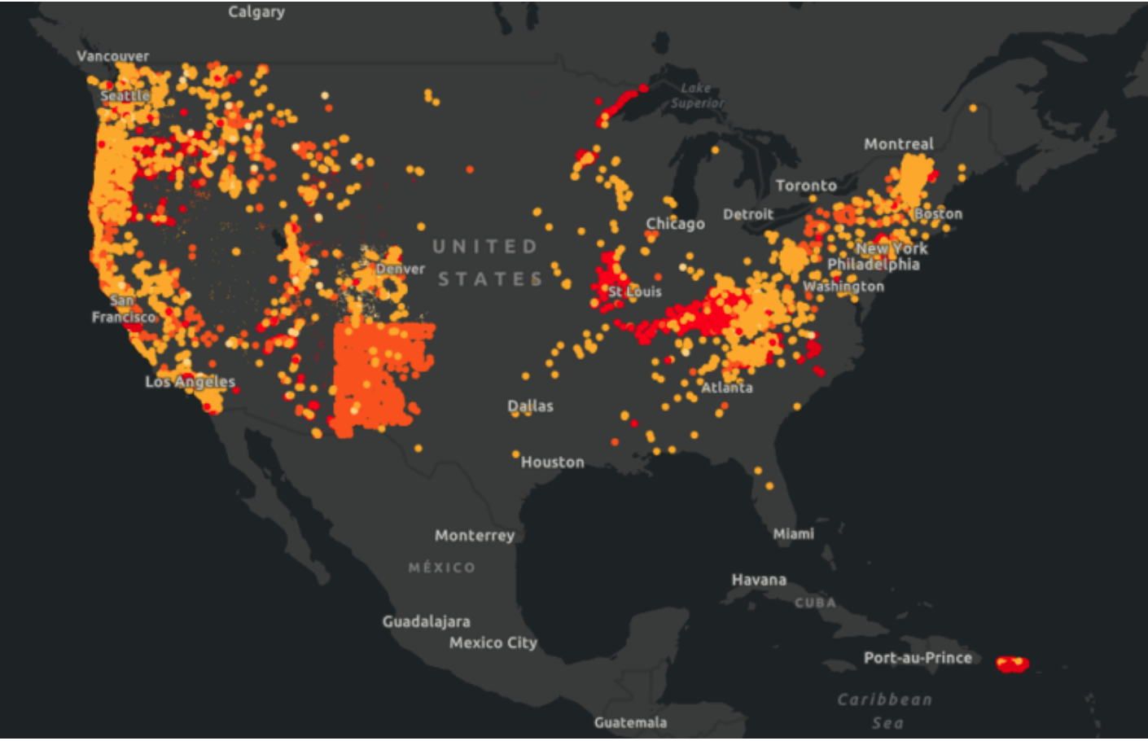
Landslide Prediction
Harold Haugen, Max Pearton, Daniel Sery, Elena Tsvetkova

Slide 2
Motivation
Background
Many research projects are focused on analyzing and identifying the susceptibility of landslides but they require accurate inventories
Statement of Purpose
Given increasing national and global attention on climate change, our team’s objective is to apply key deep learning architectures to identify landslide events in remote areas regardless of timing, and then to provide a timing classification based on visual markers.
Application
Help government and academic researchers build accurate inventories of landslides for susceptibility analysis

Slide 3
Data Collection
Data | Description
U.S. Geological Survey (USGS) | Provides confidence attribute to characterize the location and impact of each landslide.
NASA Cooperative Open Online Landslide Repository (COOLR) Catalog
ArcGIS: 100-200 images (high resolution) | Based on our assessment of highly confident landslide events identified in the inventory lists above, our team is preparing these images manually
HR-GLDD dataset: 1700 images | Taken from South Asia, East Asia, South America, and Central America
Diverse Mountainous Landslide Dataset | Multiple global mountain ranges
CAS Landslide: 22,049 images | Landslides covering Haiti, China, etc
Landslide Images Moxi Town | Moxi Town, Sichuan Province, a region prone to frequent landslides
Landslide Segmentation Data | Has pixel-wise annotations of landslide regions for segmentation tasks
Landslide4Sense | High-resolution images and metadata capturing various landslide events

Slide 4
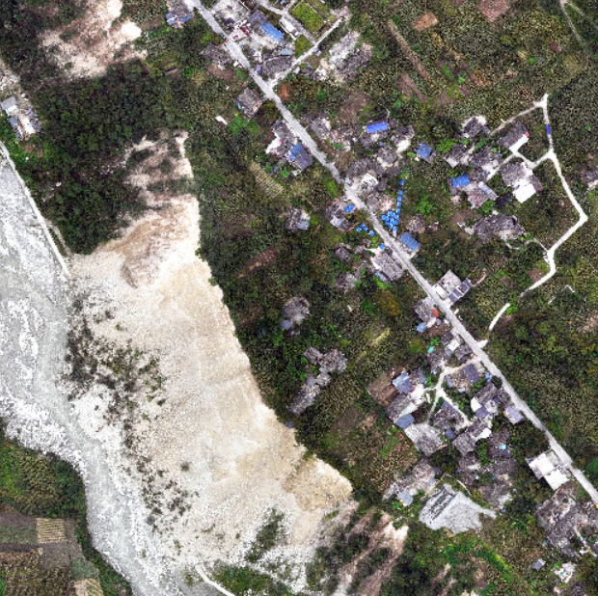
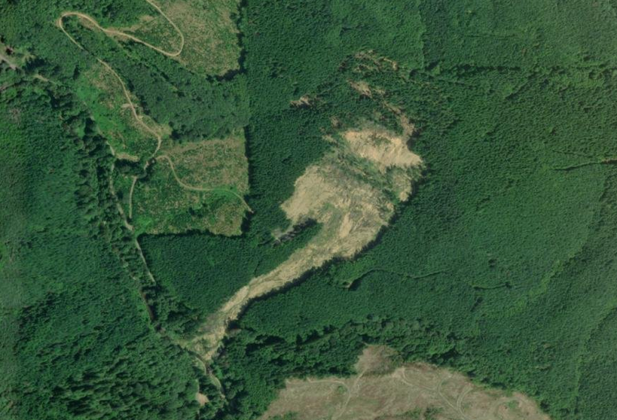
Examples of Images
Moxi-Town
High Resolution Image from ArcGIS

Slide 5
Related Literature
Nature article “A new strategy to map landslides with generalized CNN”: found that CNNs trained on a combination of inventories have a better generalization performance
In the Journal of Big Data article “Review of deep learning methods for remote sensing satellite images classification”, the researchers had established that the pre-trained deeper CNN models with more convolutional layers such as DenseNet121 and ResNet101 achieve better performance
This allowed us to methodize our key deep learning architectures…

Slide 6
Intended Method Primary Key Deep Learning Architectures
Start with training a CNN model to classify regions that are prone to landslides
Grad CAM to help us illustrate which areas contribute the most to the prediction.
Multi-modal CNN (i.e. bring in rainfall or other weather data to give us an idea of the moisture, data source to be confirmed).
ResNet for our implementation on transfer learning

Slide 7
Summary
Team will apply deep learning architectures to assign probabilities on where landslides are most likely to occur, generating more accurate inventories for researchers. Will apply:
CNN; Multi-modal CNN
Grad CAM
ResNet (transfer learning)
Data: Thousands of images of landslides from around the world. Higher resolution images captured manually using USGIS dataset for the location & impact, applying data augmentation due to only 100-200 of these high resolution images.

