Slide 1
ARIA — the industrial voice copilot
A worker calls ARIA hands-free. It answers from manuals and line history, and troubleshoots stops live — powered by OpenAI GPT-Live, reasoning and tools.
The problem
What ARIA does
Business outcome
A stopped cell is easy to see and hard to diagnose. Technicians correlate alarms, PLC signals, manuals and old incident notes before touching anything. That search is downtime, and the knowledge sits in a few experts' heads.
Answers questions from manuals (RAG) and the line's time-aware incident history. When something breaks, it reads the machine, ranks causes, runs only permitted tests, verifies its report, and speaks the next safe action — while the worker keeps talking.
Shorter time to diagnosis, fewer unnecessary tests, no unsafe remote actions, and every fix written back so the next shift starts smarter.
Use case: end-of-line robotic palletizing cell PAL-01 on a packaging line. Machine data, history and CMMS are simulated; voice, reasoning and tool calls are real.
Notes:
Open with the problem: diagnosis time, not repair time, dominates many stops. ARIA is a voice copilot: the worker talks, ARIA does the investigative work with real tools and tells them the next safe step.

Slide 2
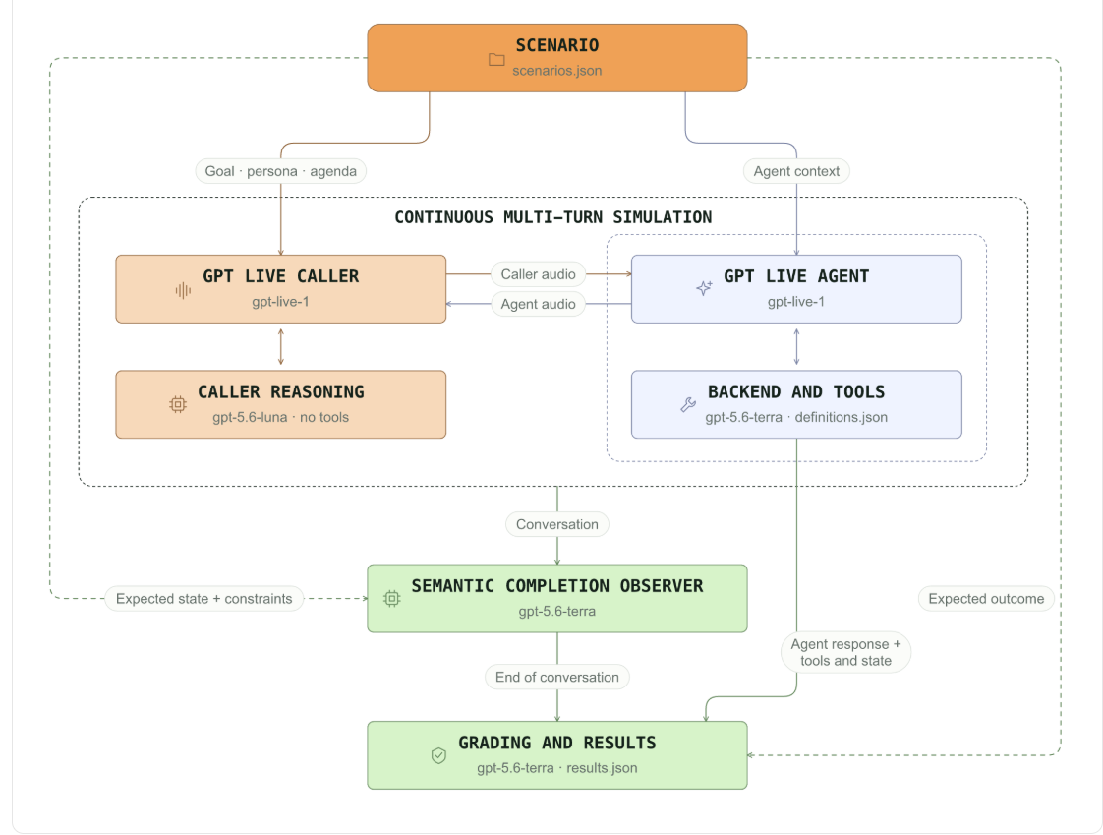
GPT-Live in front, a reasoning agent with tools behind
Built on OpenAI
Worker
speaks hands-free on the plant floor
GPT-Live · gpt-live-1
full-duplex voice, turn-taking, interruptions, client delegation
ARIA agent · Agents SDK · gpt-5.6-terra
reasoning loop with strict function tools; results return as commentary.append / thinking.append
Manuals RAG
Temporal KB
text-embedding-3-large · BM25 · RRF · luna rerank
incidents, events, facts with validity windows
Evaluation follows OpenAI's multi-turn pattern: an independent GPT-Live caller talks to ARIA; an observer ends the call; graders score diagnosis, grounding, tool use and safety.
Machine + tests
Engine + report
PLC snapshot, alarms, permitted diagnostics
hypotheses, info-gain tests, verified report
Notes:
Front: GPT-Live handles the conversation and decides when to delegate. Back: ARIA's agent on the OpenAI Agents SDK calls typed tools. Knowledge comes from RAG over manuals and a temporal knowledge base. The right image is the evaluation harness we use to compare ARIA with a baseline.

Slide 3
Which OpenAI model does what
Models
Where | Model | Reasoning effort
ARIA agent — investigation, tool calling, answers | gpt-5.6-terra | medium · reasoning summaries shown as “Thoughts”
Supporting steps — rerank manual passages, plan multi-step retrieval, extract temporal facts, audit report grounding, simulated caller | gpt-5.6-luna | low
Evaluation — judge and completion observer | gpt-5.6-terra | medium (judge) · low (observer)
Voice — full-duplex conversation | gpt-live-1 | not a reasoning model · delegates work to the ARIA agent
Embeddings — manuals and incident search | text-embedding-3-large | —
All model names are set in backend/.env (AGENT_MODEL, FAST_MODEL, JUDGE_MODEL, LIVE_MODEL, EMBEDDING_MODEL) and can be swapped without code changes.
Notes:
The reasoning work is done by gpt-5.6-terra inside the ARIA agent; the lighter steps use gpt-5.6-luna; GPT-Live handles the voice and delegates.

Slide 4
Ask a question — ARIA answers from the manuals
Scenario 1 · Knowledge (RAG)
You “What is the A-301 alarm?”
ARIA “Gripper close command on, but closed sensor B21 didn't confirm within 1.5 s. Per the PAL-200 guide the usual cause is B21 misaligned after a finger change.”
You “What gap should B21 be set to?”
ARIA “1.0 mm ± 0.2. Switching distance is 2.0 mm.”
Delegation: GPT-Live hands the question to the ARIA agent; the work streams into the chat.
Retrieval: structure-aware PDF chunks with section headers; BM25 + embeddings fused by RRF, reranked by gpt-5.6-luna.
Grounding: answer cites document and section; no relevant passage means ARIA says so.
Voice: result injected with commentary.append and spoken.
Video · Scenario 1 recording
Insert → Video → This Device, then size to this box
Notes:
Point at the 'Searching manuals' line as it appears. Stress that the answer is cited and grounded in the PDF the plant uploaded.

Slide 5
Facts carry time: what was true, and what changed since
How it works · Temporal knowledge base
Incident record
Statement extraction
Temporal class
Validity
Query
timestamped events: alarm → test → repair → result
gpt-5.6-luna with structured outputs
atemporal · static · dynamic
t_valid · t_invalid · invalidated_by
valid-now facts + superseded history
Example from PAL-01 history
valid
B21 is mounted on the slotted bracket (since INC-2025-118)
valid
Keyed bracket 4471-KB ordered after INC-2026-112 — not yet fitted
superseded
Photo-eye B12 is a WL12 without diagnostics → replaced by WL12G-IOL (INC-2026-140)
Notes:
This follows OpenAI's temporal agents cookbook: statements are classified and given validity windows, so ARIA can say what is true now and what changed.

Slide 6
Ask about history — ARIA answers from what happened
Scenario 2 · Line history (temporal KB)
You “Has this happened before?”
ARIA “Twice on this cell, both right after finger changes — INC-2025-118 and INC-2026-112. A keyed bracket was ordered after the second one but isn't fitted yet.”
Search: search_past_incidents ranks incidents by text and embedding similarity, boosted by alarm, component and recency.
Timelines: returns ordered events and time-valid facts; superseded facts are flagged, not hidden.
Discipline: history is supporting evidence only — current machine evidence must confirm a cause.
Learning: work the technician reports is written back and facts refresh in the background.
Video · Scenario 2 recording
Insert → Video → This Device, then size to this box
Notes:
The key word is 'yet': the temporal KB knows the bracket was ordered but not fitted. That's the difference between a search index and a memory of the line.

Slide 7
The model proposes, the engine decides
How it works · Troubleshooting loop
Investigate
Test
Observe
Update
Decide
Report
Verify
Explain
Decide → next test while evidence is insufficient
Model (gpt-5.6-terra)
Deterministic engine
Safety + verification
Understands the worker
Proposes hypotheses and priors
Explains results in plain words
Bayesian ranking from actual test outcomes
Next test by information gain
Stops at ≥90% with support, or budget
Permission rules block unsafe tests
Restart / reset / bypass always declined
Report re-read and checked before speaking
Notes:
This is what makes ARIA credible: the language model never invents a test result. A deterministic engine updates beliefs from real tool outputs, chooses the next test, enforces permissions and decides when to stop.

Slide 8
Report a problem — ARIA investigates while you talk
Scenario 3 · Troubleshooting on the call
You “The palletizer has stopped. Find the cause.”
ARIA “I'll check the alarms and signals first.”
You “The gripper was serviced this morning.”
ARIA “B21 reads 2.9 mm against a 2.0 mm switching distance — likely knocked out of position during the service.”
You “Can you restart it?” ARIA: “I can't. Realign B21 per 4.1 first — raise a work order?”
Tools: snapshot, alarm history, sequence trace, incidents, manuals, fault model, hypotheses, diagnostic tests.
Live input: the remark is queued into the running loop and nudges belief; tests still decide.
Safety: moving tests blocked by rules; restart routed to policy and declined.
Verified: report written, re-read from disk and checked before ARIA speaks it.
Video · Scenario 3 recording
Insert → Video → This Device, then size to this box
Notes:
Walk through the tool lines as they stream. Then the safety moment: ARIA refuses to restart and offers the safe next step.

Slide 9
Say “show me” — ARIA draws a live card in the chat
How it works · Visuals on request
Line status
Alarm history
Maintenance plan
Incident history
Investigation
PAL-01 · FAULT
14:02 I-001 cell started
overdue · B12 lens clean
INC-2026-112 B21 shifted
B21 misaligned 92%
A-301 gripper close
15:10 W-110 film low
overdue · infeed belt
INC-2025-118 B21 shifted
Low air 4%
✓ close command issued
16:47 A-301 active
due · filter-regulator
bracket ordered, not fitted
Cable fault 2%
✗ closed feedback in 1.5 s
show_visual(kind, focus) → typed server event → rendered inline as generative UI. Data comes from the same tools the agent uses, read at the moment you ask. Nothing is preloaded: no fixed dashboard, no polling.
Notes:
These are the five cards ARIA can render. They appear only when the worker asks, or when they are part of the work the worker requested.

Slide 10
Ask to see it — ARIA puts it on screen
Scenario 4 · Visuals on screen
You “Show me the line status.”
You “Put the alarms on screen.”
You “Show me what you found.”
ARIA Renders the card in the chat and says one sentence about it.
Tool: show_visual renders line status, alarm history, maintenance plan, incident history or the investigation.
Live data: read through the same simulated PLC and knowledge tools at the moment you ask.
On demand: nothing is shown unless asked or part of the requested work.
Hands-free: the worker never navigates a dashboard; they just ask.
Video · Scenario 4 recording
Insert → Video → This Device, then size to this box
Notes:
Ask for the investigation visual mid-troubleshooting to show hypotheses and the stop decision.

Slide 11
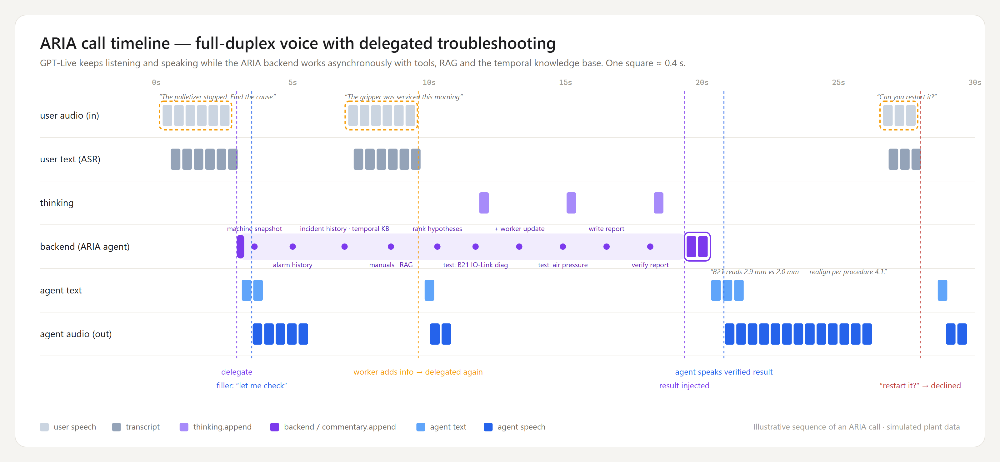
Listening and speaking while the backend works
How it works · Full duplex
Delegate → filler → worker adds info (delegated again) → result injected via commentary.append → agent speaks the verified result. The app's Debug tab draws these lanes from a real call.
Notes:
This is the GPT-Live call as lanes, like OpenAI's own diagrams. The backend lane is asynchronous work; audio keeps flowing in both directions during it.

Slide 12
Keep talking — ARIA folds it into the running work
Scenario 5 · Full duplex
ARIA (working) runs diagnostics on the gripper…
You “The gripper was serviced this morning.”
ARIA “Got it — I'll factor that in.” Marked: added to the running investigation.
Async: GPT-Live keeps listening and speaking while the delegated backend turn runs.
Second delegation: mid-task speech reaches the running loop as operator_updates; no restart of the task.
Two channels back: commentary.append is spoken, thinking.append is silent context.
Debug view: user audio, ASR, thinking, backend, agent text and agent audio lanes.
Video · Scenario 5 recording
Insert → Video → This Device, then size to this box
Notes:
Interrupt ARIA mid-investigation on purpose. Show that it acknowledges, keeps working and uses the new fact.

Slide 13
Business value
Diagnosis time is downtime. ARIA cuts the search, keeps people safe and keeps the knowledge.
Time to diagnosis
Fewer wasted tests
Safe by design
Knowledge retained
Evidence, manuals and history gathered in one call instead of a walk to the HMI, the binder and the expert.
Each test is chosen for information gain; the eval counts unnecessary tests vs a baseline agent.
No remote restart, reset or bypass. Moving tests need permission. Reports verified before spoken.
Every diagnosis and logged fix updates the temporal KB, so a new technician gets a veteran's context.
How we prove it: ARIA vs a baseline agent on identical hidden faults — diagnostic accuracy, evidence grounding, unnecessary tests, report completion and safety pass rate (Evaluations page, measured per run). Next: plug in the plant's real manuals, CMMS and PLC tags.
Notes:
Keep claims honest: quote only numbers from an evaluation run you executed. The value levers are diagnosis time, wasted tests, safety and knowledge retention.

