Slide 1
ARIA — get stopped lines running sooner
A hands-free voice copilot for the plant floor. Workers talk to it like an experienced colleague; it finds out why a machine stopped, shows the evidence, and says the next safe step.
Talk
Investigate
Act safely
no screens, no gloves off
real machine evidence, not guesses
next safe step, never a risky restart
Use case: the robotic palletizing cell at the end of a packaging line — where a short stop can block the whole line.
Notes:
One sentence: ARIA turns 'the machine stopped and nobody knows why' into a short spoken conversation that ends with the cause and the next safe step.

Slide 2
When a machine stops, finding out why is the slow part
The problem
A palletizing cell stacks cases onto pallets at the end of the packaging line. A controller (PLC) checks every step with sensors. If one check fails — say the gripper doesn't confirm it closed — the cell stops and raises an alarm. Everything upstream starts backing up.
Where the time and money go
Downtime is mostly diagnosis
The repair is quick; working out what to repair is not.
Know-how sits with a few experts
1
Operator sees the stop
…but not the reason
Night shifts and new technicians wait for the one person who has seen it before.
2
Technician is called
walks to the cell, reads the alarm
Trial-and-error testing
Parts get swapped and tests repeated 'just to check'.
3
The search begins
signals, manual, old incident notes
Pressure to restart early
4
Then the fix
often a 5-minute job
Restarting without the cause brings the stop back — or creates a safety risk.
Notes:
The business problem is not the repair — it is the time spent finding the cause, and the dependence on a few experts.

Slide 3
From a manual search to a short conversation
The difference
Today
With ARIA
1
Walk to the panel and read the alarm code
1
“ARIA, the palletizer stopped. Find the cause.”
2
Look up the code in a binder or PDF
2
ARIA reads the alarms and signals itself
3
Ask around: has anyone seen this before?
3
It checks the manual and the line's history
4
Check signals one by one
4
It runs only safe tests and weighs the evidence
5
Guess, swap a part, restart and hope
5
It says the cause and the next safe step — and logs it
Notes:
Left: the familiar scramble. Right: the same job done in one spoken conversation, with evidence and a safe recommendation.

Slide 4
One voice copilot, four everyday jobs
What ARIA does
Answers questions
Remembers the line
“What does alarm A-301 mean?” — answered straight from the equipment manuals, with the section it came from.
“Has this happened before?” — past incidents, what fixed them, and what has changed since.
Troubleshoots stops
Shows what matters
“It stopped — find the cause.” — reads the machine, runs safe tests, and names the cause with evidence.
“Show me the line status.” — puts the right picture on screen, only when asked.
Notes:
Everything is by voice. The worker never has to open a screen — but can ask ARIA to show something when it helps.

Slide 5
Talk naturally — ARIA works while you talk
How it works for the worker
1
2
3
4
5
You speak
ARIA starts at once
You keep talking
ARIA gathers evidence
ARIA answers
“The palletizer stopped. Find the cause.”
“Let me check.” Work begins immediately.
“The gripper was serviced this morning.” ARIA uses it.
alarms, signals, manual, history, safe tests
cause, evidence, next safe step — and a work order
Why this matters
Most voice assistants make you wait: speak, pause, wait for an answer. ARIA keeps the conversation going while the work happens in the background — so it feels like a colleague, not a phone menu. The worker's hands and eyes stay on the machine.
Notes:
This is the experience OpenAI GPT-Live makes possible: listening and speaking at the same time, with work delegated the moment it's needed.

Slide 6
Proven OpenAI technology, assembled for the plant floor
Built on OpenAI
GPT-Live
Reasoning model
Knowledge
The voice. Listens and speaks at the same time, handles interruptions, and hands work off the moment it's needed.
The investigator. Plans the investigation, calls the tools and weighs the evidence (gpt-5.6-terra on the OpenAI Agents SDK).
The memory. Searches the plant's own manuals and a time-aware history of every past incident on the line.
For the business this means: a natural hands-free experience, answers grounded in your own documents and history, and a clear audit trail of every check ARIA made. Models are configurable, so the stack can follow OpenAI's latest releases without rebuilding.
Notes:
Three pieces: GPT-Live for the voice, a reasoning model for the investigation, and the plant's own knowledge.

Slide 7
Inside one investigation
Under the hood
GPT-Live
ARIA reasoning loop
Equipment manuals
searched by meaning and keywords
listens · speaks · delegates · relays results back into the call
1
Read machine state and alarms
Line history
2
Propose possible causes
incidents, repairs, what changed
3
Rule out causes that contradict the machine's logic
Machine signals
4
Pick the most useful safe test
alarms, sensors, sequence step
5
Run it and read the real result
Safe diagnostic tests
Update the ranking — repeat until sure
only tests that are allowed
6
7
Write the report, re-check it, then speak
Maintenance system
PM plan and work orders
The model proposes; a rule engine decides. Every belief is updated only from real test results, unsafe tests are blocked, and the loop has a test budget and a time limit.
Notes:
GPT-Live talks; the reasoning loop investigates using the tools on the right; results flow back into the call.

Slide 8
Answers from your manuals and your line's history
Knowledge
Equipment manuals
Line memory
Your PDFs: operator guides, sensor and safety manuals, alarm lists
Every incident stored as a timeline: alarm → test → repair → result
Searched by meaning, not just keywords
Facts carry dates, so ARIA knows what is true today
Every answer cites the document and section
Changes are tracked: “bracket ordered, not yet fitted”
If it's not in the manual, ARIA says so
Each new fix is added automatically
Business effect: a new technician on night shift gets the same context as a 20-year veteran — and the knowledge stays when people move on.
Notes:
Two sources of truth: the documents the plant already has, and the line's own history — which grows with every fix.

Slide 9
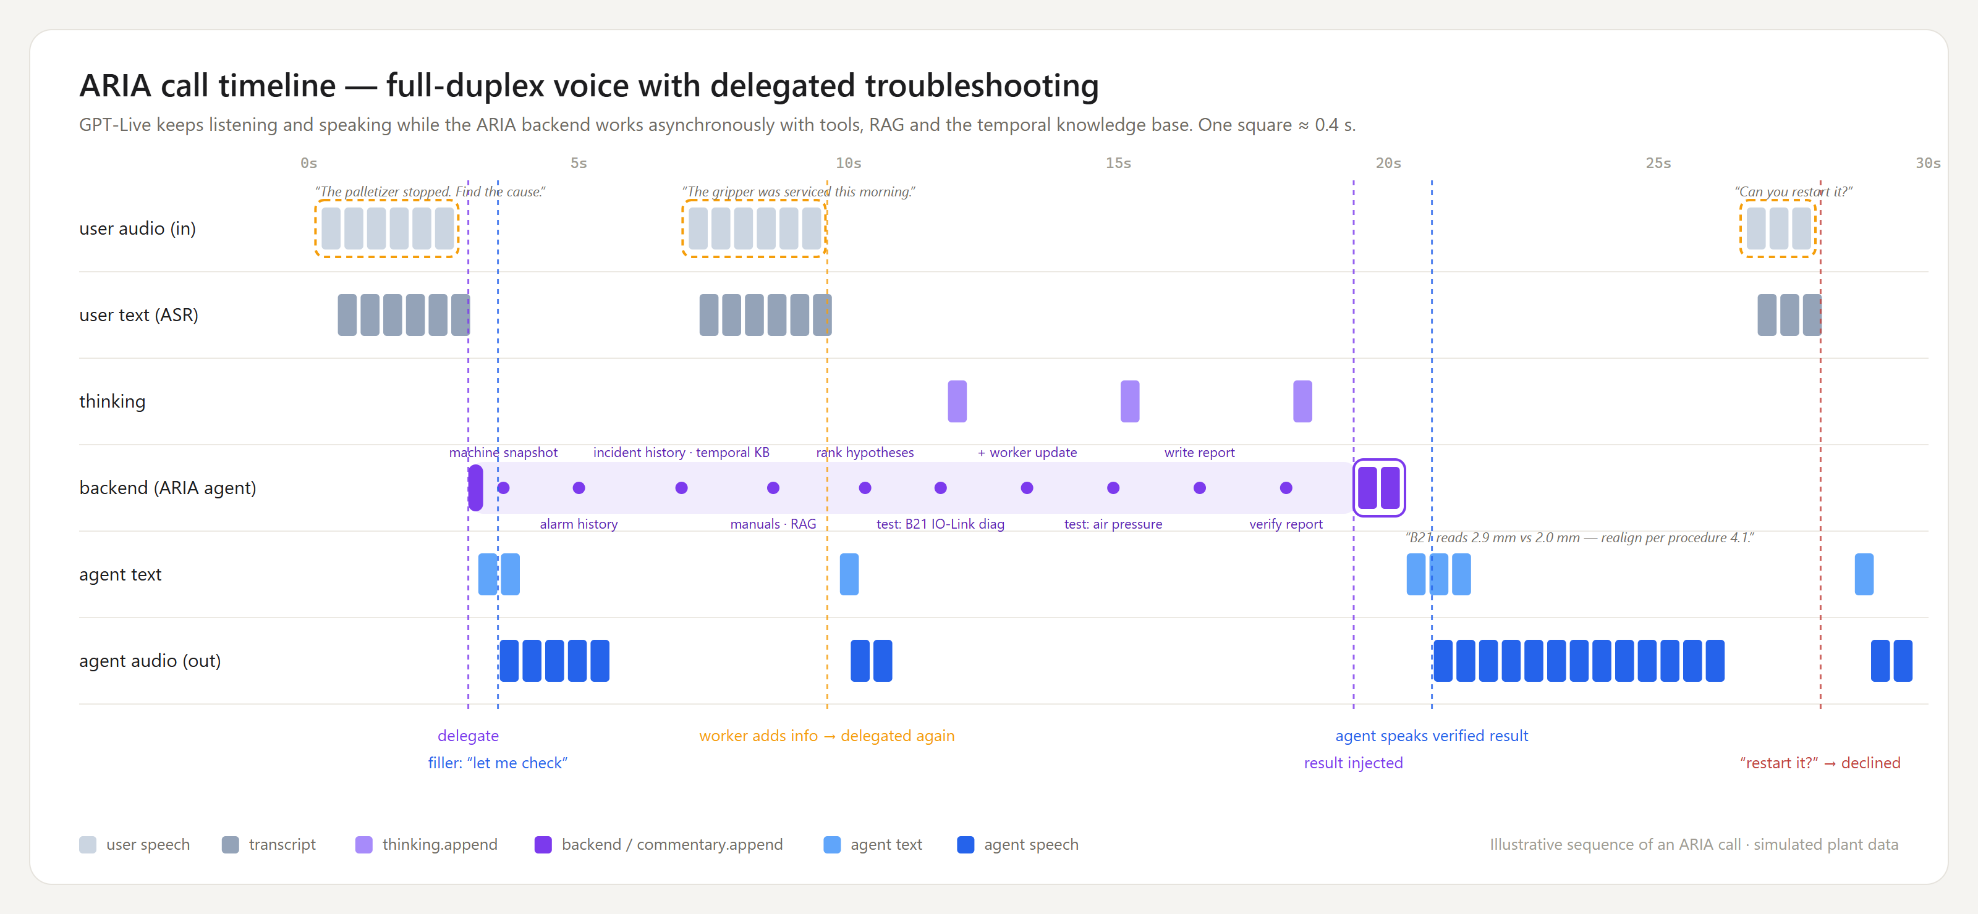
What happens inside one 30-second call
Proof in real time
Read left to right: the worker speaks, ARIA hands off the work and says “let me check”, the investigation runs in the background (purple), the worker adds a detail mid-way, and ARIA speaks the verified answer — then safely declines a restart.
Notes:
This is the app's debug view, drawn as lanes. The point for the business: the conversation never stops while the work happens.

Slide 10
Built so a plant can trust it
Safety and trust
Never touches the machine
ARIA cannot restart, reset, bypass or move equipment. People do the physical work.
Only safe tests
Tests that would move equipment are blocked unless conditions allow them.
Evidence, not guesses
Every cause is backed by real readings; if evidence is unclear, it says so and asks for a technician.
Checked before spoken
The report is written, re-read and verified against the evidence before ARIA says it is done.
Full audit trail
Every question, check, result and decision is recorded for review.
Notes:
For a buyer, trust is the gate. ARIA advises; people act. And everything is evidence-backed and auditable.

Slide 11
Business outcomes
Diagnosis time is downtime. ARIA shrinks it, keeps people safe and keeps the knowledge in the plant.
Faster recovery
Fewer wasted checks
Fewer repeat stops
Shorter time from stop to known cause (MTTR) — the evidence comes to the worker in one call.
Each test is chosen for what it reveals, so fewer parts are swapped on a hunch.
Fixing the real cause instead of restarting blindly stops the same alarm coming back.
Safer decisions
Experts, scaled
Knowledge that stays
No risky remote restarts; every recommendation is backed by evidence.
Every shift and every new hire gets veteran-level guidance, hands-free.
Each diagnosis and logged fix makes the next one faster.
Notes:
Six outcomes a plant manager cares about. We measure them by comparing ARIA with a baseline assistant on the same faults.

Slide 12
How we prove it, and how a plant starts
Proof and next steps
How we measure
Pilot on one cell
Right cause found (diagnostic accuracy)
Week 1
Load the cell's manuals and past incident notes
Every claim backed by evidence
Number of unnecessary tests
Week 2
Connect read-only to the PLC alarms and signals and the maintenance system
Report completed and verified
Safety: zero unsafe actions
Weeks 3–6
Run on one cell with the maintenance team, alongside today's process
Time from stop to cause
Week 7
Compare time-to-cause, repeat stops and wasted tests against the baseline
ARIA vs a baseline assistant on the same hidden faults, scored automatically.
Notes:
Close with a low-risk start: one cell, read-only connections, measured against today's process.

