Slide 1
Apollo Business Consulting Network Design Proposal
shana.
NETWORKS

Slide 2
Agenda
We’re here to touch base!
Proposed Hardware Choices
Proposed Cabling
Overview of Layout Design
Cost Estimate
All subject to change and open to your feedback!
shana.
NETWORKS

Slide 3
Hardware
Scott Richards
shana.
NETWORKS

Slide 4
Hardware
Cisco Business 350 series will be for the Access switches
Cisco Catalyst 9300 for Distribution and core switches
Optional VLAN could significantly reduce overhead
Multiple departments on a single switch
Number of PoE+ / UPOE+ may vary
Depends on individual department requirements
shana.
NETWORKS

Slide 5
Cabling
Neil Power
shana.
NETWORKS

Slide 6
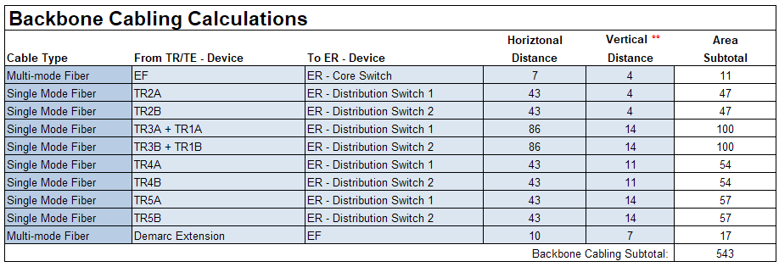
Cabling
Point
point
point
point
Summary
shana.
NETWORKS

Slide 7
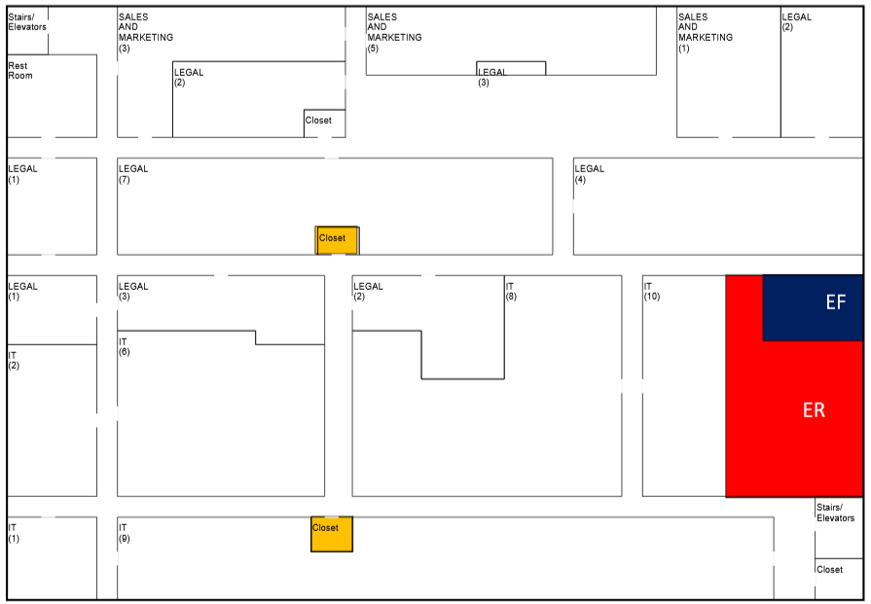
Floor 2
shana.
NETWORKS

Slide 8
Layout & Logic
Adam Lo Giudice
shana.
NETWORKS

Slide 9
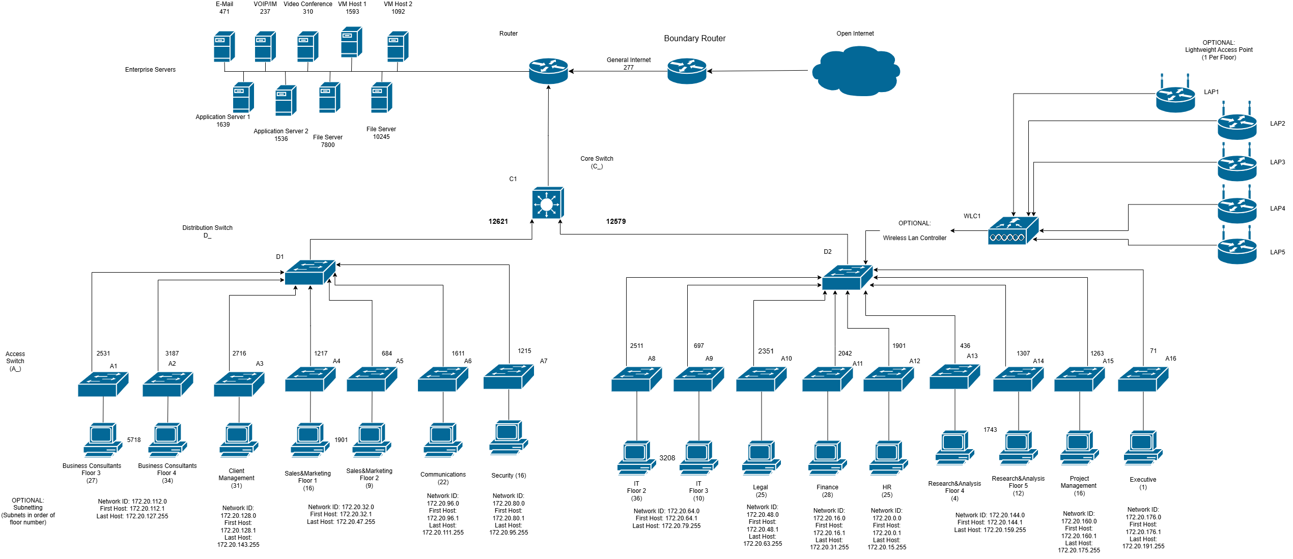
Logical Map
shana.
NETWORKS

Slide 10
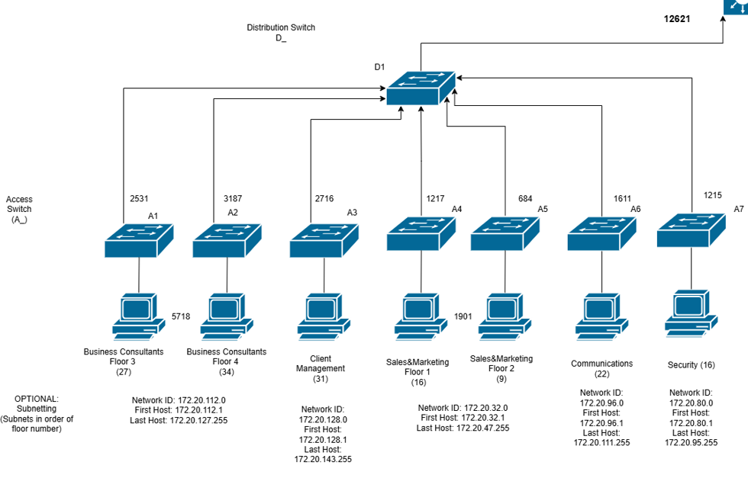
Logical Map
shana.
NETWORKS

Slide 11
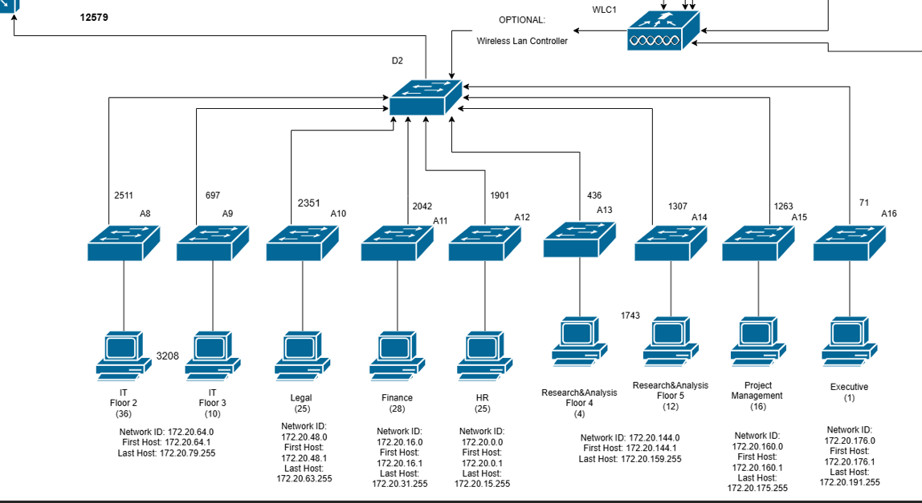
Logical Map
shana.
NETWORKS

Slide 12
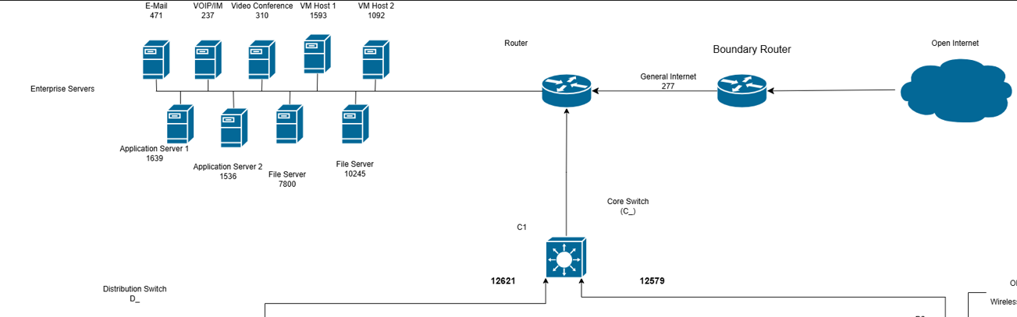
Logical Map
shana.
NETWORKS

Slide 13
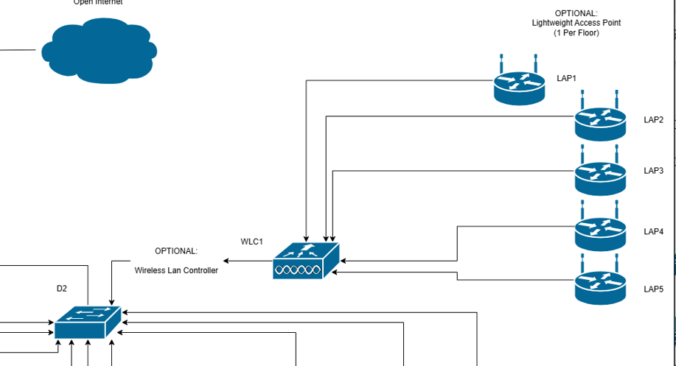
Logical Map
shana.
NETWORKS

Slide 14
Cost-Analysis
Henry Oyewole
shana.
NETWORKS

Slide 15
Cost-Analysis
Rough estimates:
~$31,700 Core/Distribution Switches
~$15,700 Access Level Switches
~$8100 Misc Hardware
~$TBD Cabling
Total: ~$60,000 (exact tbd)
shana.
NETWORKS

Slide 16
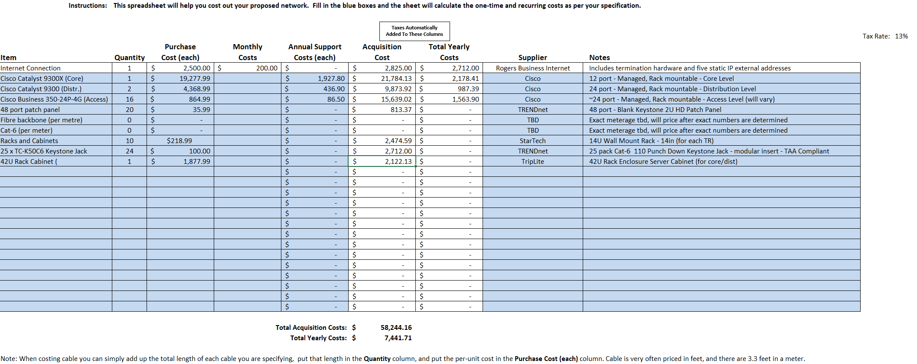
Preliminary Cost Table
shana.
NETWORKS

Slide 17
Conclusion
Antonio Giacchetti
shana.
NETWORKS

Slide 18
Thank You!
shana.
www.shana.com * business@shana.com *
NETWORKS
Network Infrastructure COMP 10019 Group 12 * not implemented

