Slide 1
FreeRTOS Simulation on Linux
Hossein Assaran

Slide 2
About Me
B.S. in Electrical Engineering: Shahed University
M.A. in Philosophy
Over 10 Years in Embedded System Design and Development
AVR, PIC ,ARM9, ARM7, CORTEX-M0, CORTEX-M3, CORTEX-M4, CORTEX-A5, CORTEX-A8
Startup Owner: Fibook, Khanebazia, Cpuban, Filink, Lernino, …
Linux
FreeRTOS
Kotlin
GitHub: https://github.com/HosseinAssaran

Slide 3
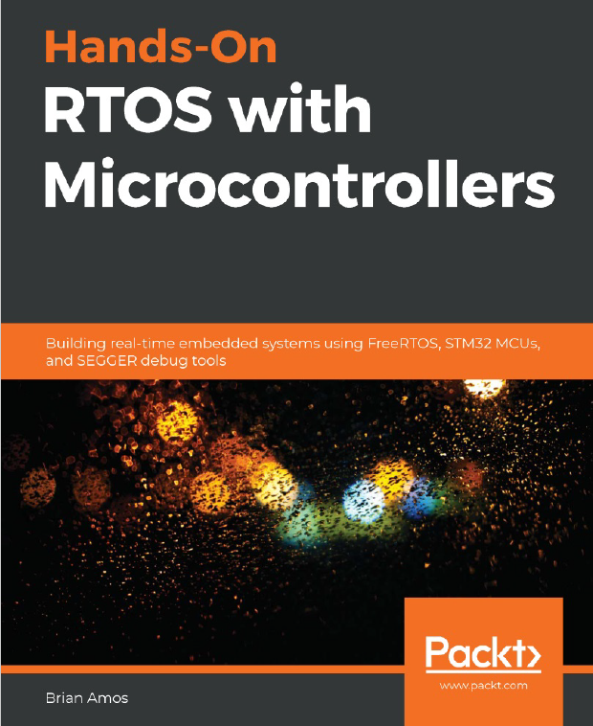
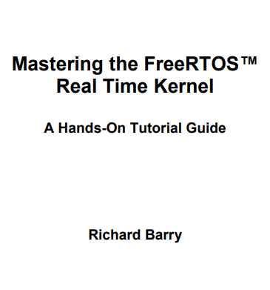

Resources
Hands-On RTOS With Microcontrollers
Brian Amos
Mastering the FreeRTOS™ Real Time Kernel
Richard Barry
FreeRTOS.org

Slide 4
What is Real-Time?
Any system that has a deterministic response to a given event can be considered "real-time."

Slide 5
Types Of Real Time Systems
Hardware
Bare-metal firmware
RTOS-based firmware
RTOS-based software
Carefully crafted OS software

Slide 6
What is Jitter?

Slide 7
What is FreeRTOS?
A lightweight, open-source real-time operating system for microcontrollers
Designed for embedded systems with limited resources
Compiled and linked directly with the application code

Slide 8
Bare Metal, Linux RT, and FreeRTOS – Ease of Use
Bare Metal | Linux RT | FreeRTOS
Low-Level Control | Familiar Environment | Modular Design
High Complexity | More Complex Setup and Configuration | Simpler Learning Carve And Easier To Setup Compared To Linux
More Development Time | Rich Ecosystem | Comprehensive Documentation

Slide 9
Bare Metal, Linux RT, and FreeRTOS – Performance and Resource Management
Bare Metal | Linux RT | FreeRTOS
Maximum Performance | Low Performance | Balanced Performance
Minimal Overhead | Higher Resource Demands - Requiring A Microprocessor With At Least 300mhz Speed | Efficient Resource Management
Smallest Footprint | A Kernel Size That Cannot Be Reduced Below Several Hundred Kilobytes | Minimal Footprint - RTOS Kernel Itself Required About 5 To 10 Kbytes Of ROM Space

Slide 10
Bare Metal, Linux RT, and FreeRTOS – Flexibility and Scalability
Bare Metal | Linux RT | FreeRTOS
High Flexibility | Highly Configurable | Modular And Portable
Limited Scalability, Typically Used For Very Specific Applications | Highly Scalable From Embedded Systems To Large Servers | Scalable For Small To Medium Embedded Systems

Slide 11
Bare Metal, Linux RT, and FreeRTOS – Use Case
Bare Metal | Linux RT | FreeRTOS
Suitable For Low-level System Development, Firmware, And Performance-critical Applications - Microcontroller-based applications, high-performance computing tasks, and real-time signal processing | Ideal For Complex Systems Requiring Both Real-time Performance And The Rich Features Of A General-purpose OS. Automotive systems, industrial automation, telecommunications, and mission-critical infrastructure. | Best For Embedded Systems With Real-time Requirements And Constrained Resources. IoT devices, consumer electronics, medical devices, and industrial control systems.

Slide 12
Why Simulate FreeRTOS on Linux?
Faster development cycles without the need for physical hardware.
Easier debugging and testing
Cost-effective and convenient
Ability to quickly iterate and test changes
Speeding Up Development Cycles

Slide 13
Setting Up FreeRTOS Simulation on Linux
Installing necessary software and tools
QEMU For Virtualization
GCC For Compiling
GDB For Debugging
Complete Guide on:
https://github.com/HosseinAssaran/FreeRTOS_Examples

Slide 14
Let’s Do It

