Slide 1
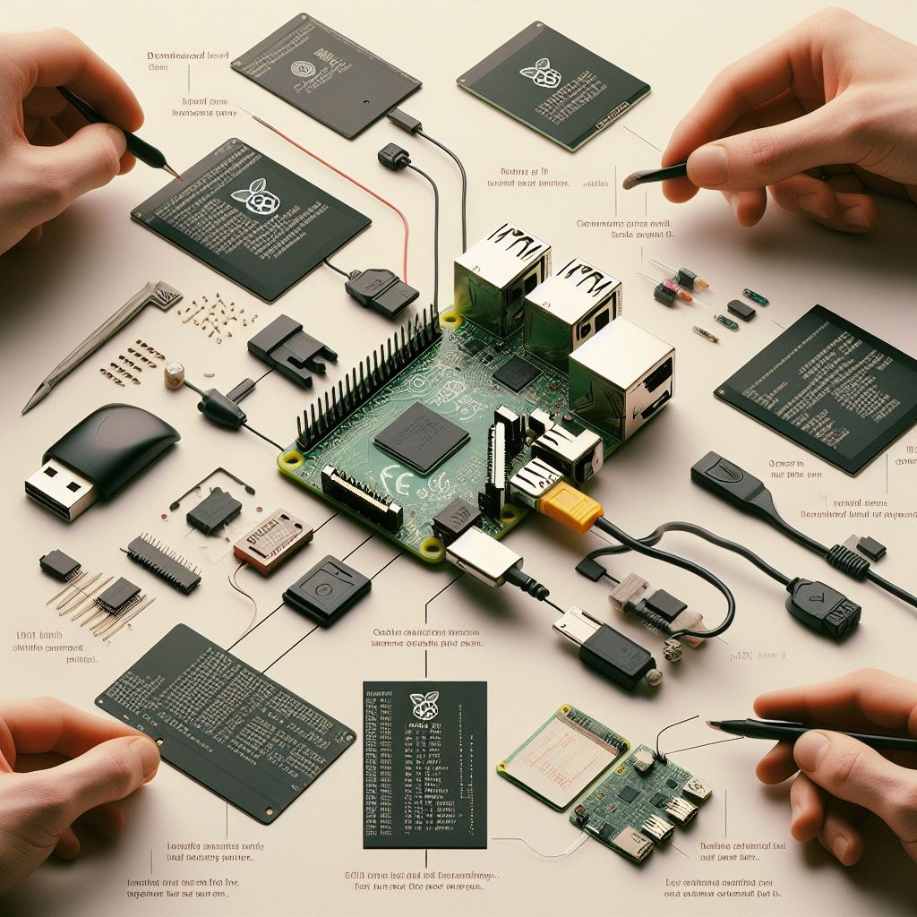

موضوع درس‌هایی از Android ارائه دهنده عبدالرحمن امانی
دومین دورهمی گروه کاربران لینوکس تعبیه شده E-LUG
28 فروردین ماه 1403

Slide 2
Who I am
#!/inTheNameOf/God
AbdoRahman Amani
A Software engineer.
Start Embedded journy with Nokia-sysmbian Smart phones
Then Android erea.
Continued with RPi in university.
Lots of Embedded project as freelancer.
Back to smart phones as security researcher.

Slide 3
TABLE OF CONTENTS
01
Security
02
Update
How we protect sensetive data.
How android does it.
Every software needs update ?

Slide 4
PROBLEMS
SECURITY
UPDATE
Protect Sensetive Data
Against
Unauthorized access
Delivering updates in more secure and efficient way

Slide 5

01
SECURITY
Embedded systems have become an integral part of various industries,These compact computing systems play a crucial role in modern technology, but they also pose unique security challenges.

Slide 6
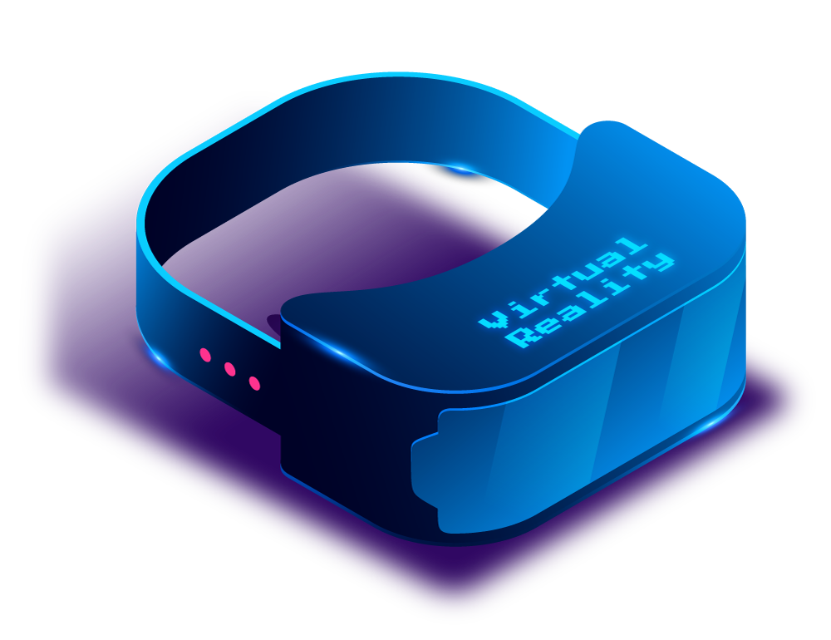
I want to protect my Data !
There are always a sensetive data
Lists like this :
Authentication Tokens
Business valuable data
En/Decryption keys
Personal data
And more ...
That needs to be protected.

Slide 7
Common Solutuions
External Storage
External Chip
Encryption
A NOR, NAND or SD/MMC flash that your program can access it securly
Use another IC along with your main SoC to store, generate or protect your data
Encrypt data using one of common solutions or combined with each other

Slide 8
Android’s Solution
Full Disk Encryption
Fully Encryp partitions that contains importand data
Like trueCrypt or bitLocker
File Based Encryption
Useing fscrypt to encrypt file names and thier content and metadata

Slide 9
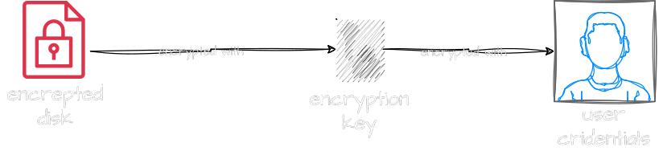
Android’s Solution
Full Disk Encryption

Slide 10
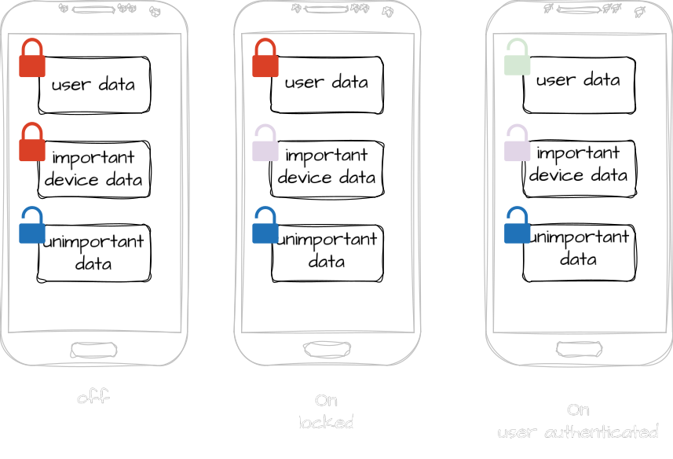
Android’s Solution
File Based Encryption

Slide 11
Android’s Solution
File Based Encryption
TEE
KeyMaster

Slide 12
Trusted Execution Environment

Slide 13
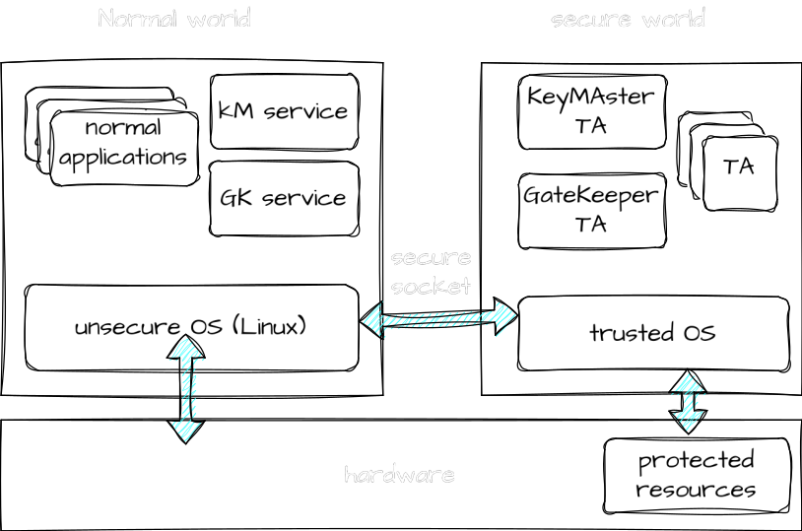
Trusted Execution Environment

Slide 14
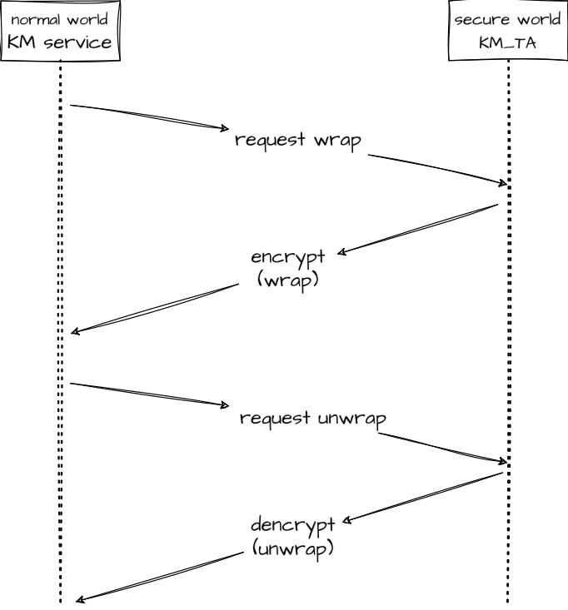
KeyMaster

Slide 15
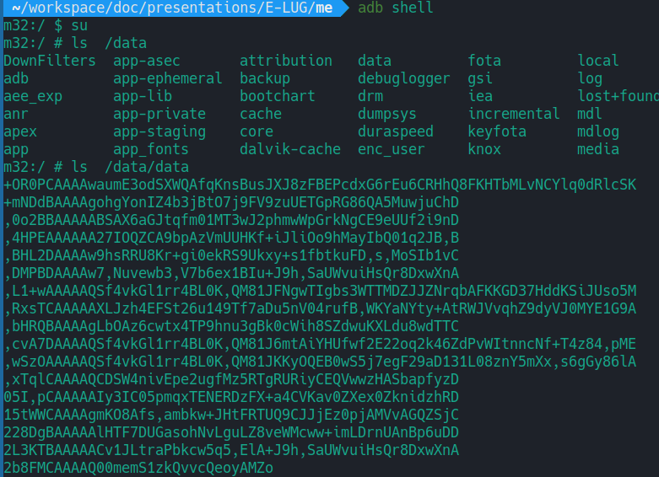
Try it your self
Get into your Phone
Android Debug Bridg
Root access

Slide 16
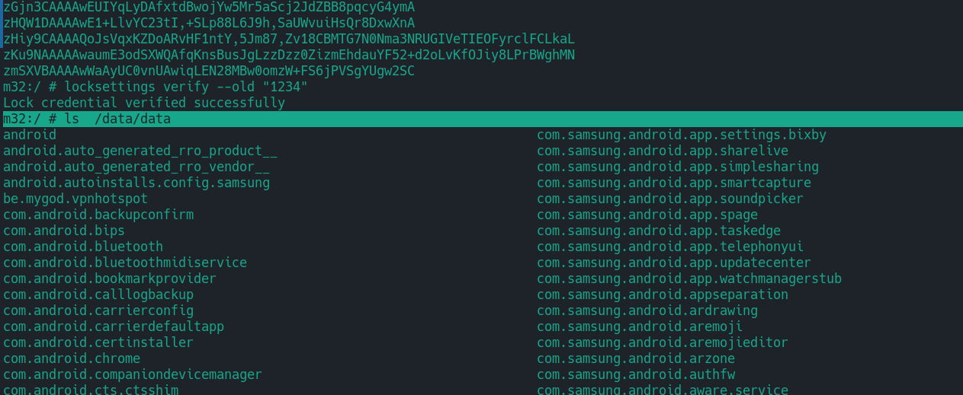
Try it your self
Get into your Phone
Android Debug Bridg
Root access

Slide 17
USE CASES
In an Embedded Project
Smart Home
Software defined vehicle
Crypto wallet
. . .

Slide 18
Some Idea
Use TEE for your Embedded Project
OP-TEE
opensource TEE designed for Arm Cortex-A cores using the TrustZone technology
Linux TEE framework
Registration of TEE drivers
Managing shared memory between Linux and the TEE
Providing a generic API to the TEE

Slide 19
02
UPDATE
What happens if your mission-critical control computer or retail kiosk gets an update and then fails?

Slide 20
Common UPDATE problems
Crash after update
High bandwidth consumption

Slide 21
common Solution
Immutable Linux
OSTree
LG WebOS
Transactional-update
openSUSE MicroOS
BTRFS snapshots

Slide 22
Android’s Solution
The old boot-chain

Slide 23
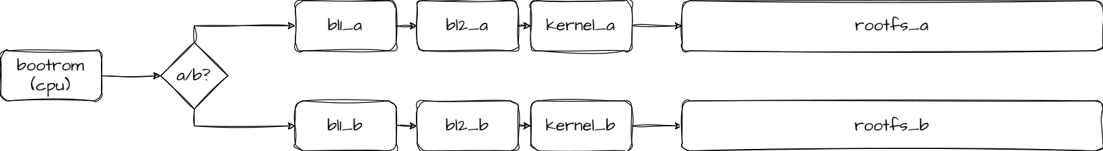
Android’s Solution
Securing update: the A/B solution

Slide 24
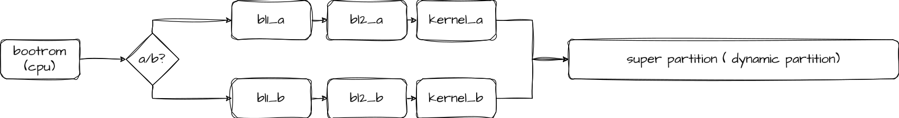
Android’s Solution
Reducing update size: Dynamic partitions

Slide 25
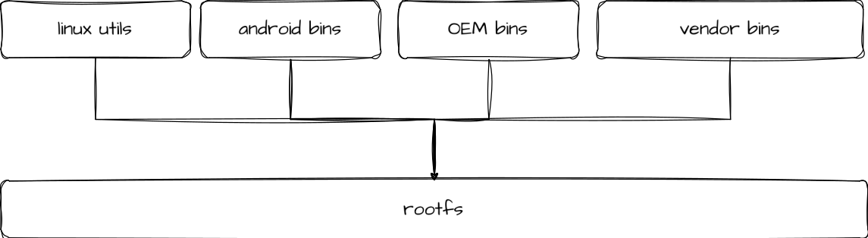
Android’s Solution
Reducing update size: Dynamic partitions

Slide 26
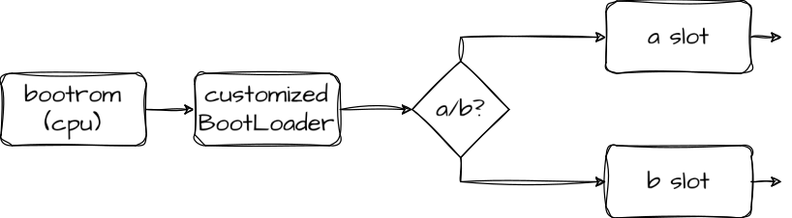
Try it your self
Customize your bootloader

Slide 27
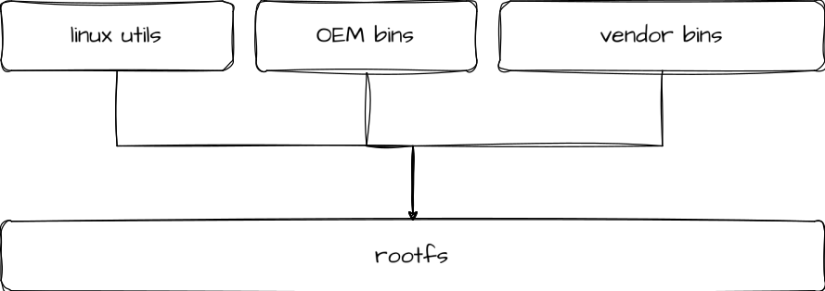
Try it your self
Config you build system

Slide 28




با تشکر
ما را در شبکه های اجتماعی دنبال کنید:

