Slide 1
An introduction to v4l2 (video capture)
By Arash Golgol

Slide 2
Agenda
Overview
You already knew it!
Not this way!
System view
Capture buffers
v4l2-ctl example
Next session

Slide 3
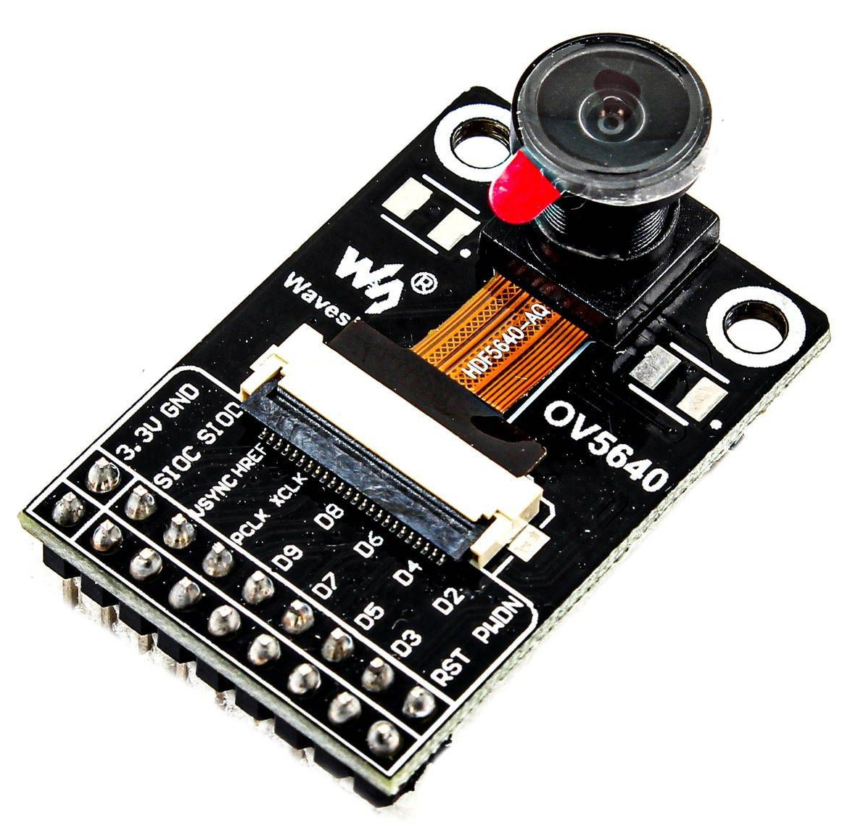
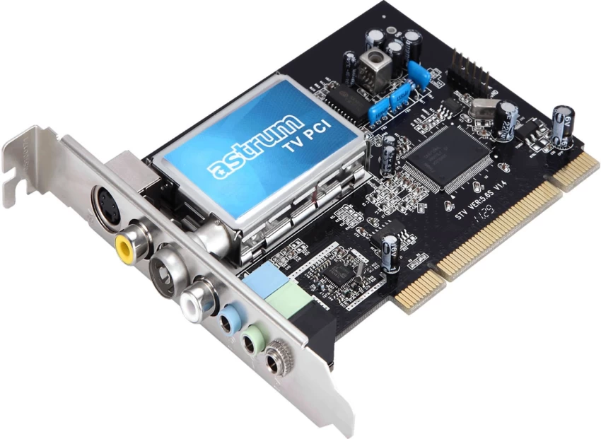
Overview
v4l2 stands for Video For Linux 2
It’s Linux kernel framework which abstract media streaming devices
Camera
Image Signal Processor (ISP)
Video codec
TV tuner
…
It abstract these device through Linux standard interfaces (syscall)

Slide 4
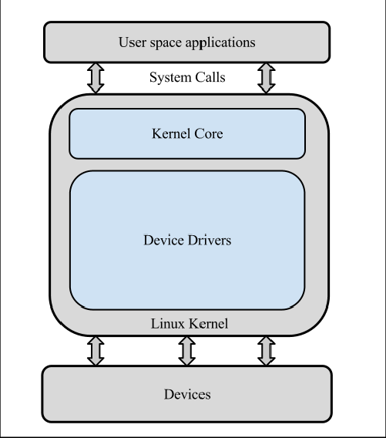
You already knew it!
v4l2 is a little complicated
Because media devices are complicated!
But all Linux kernel concepts still stands!

Slide 5
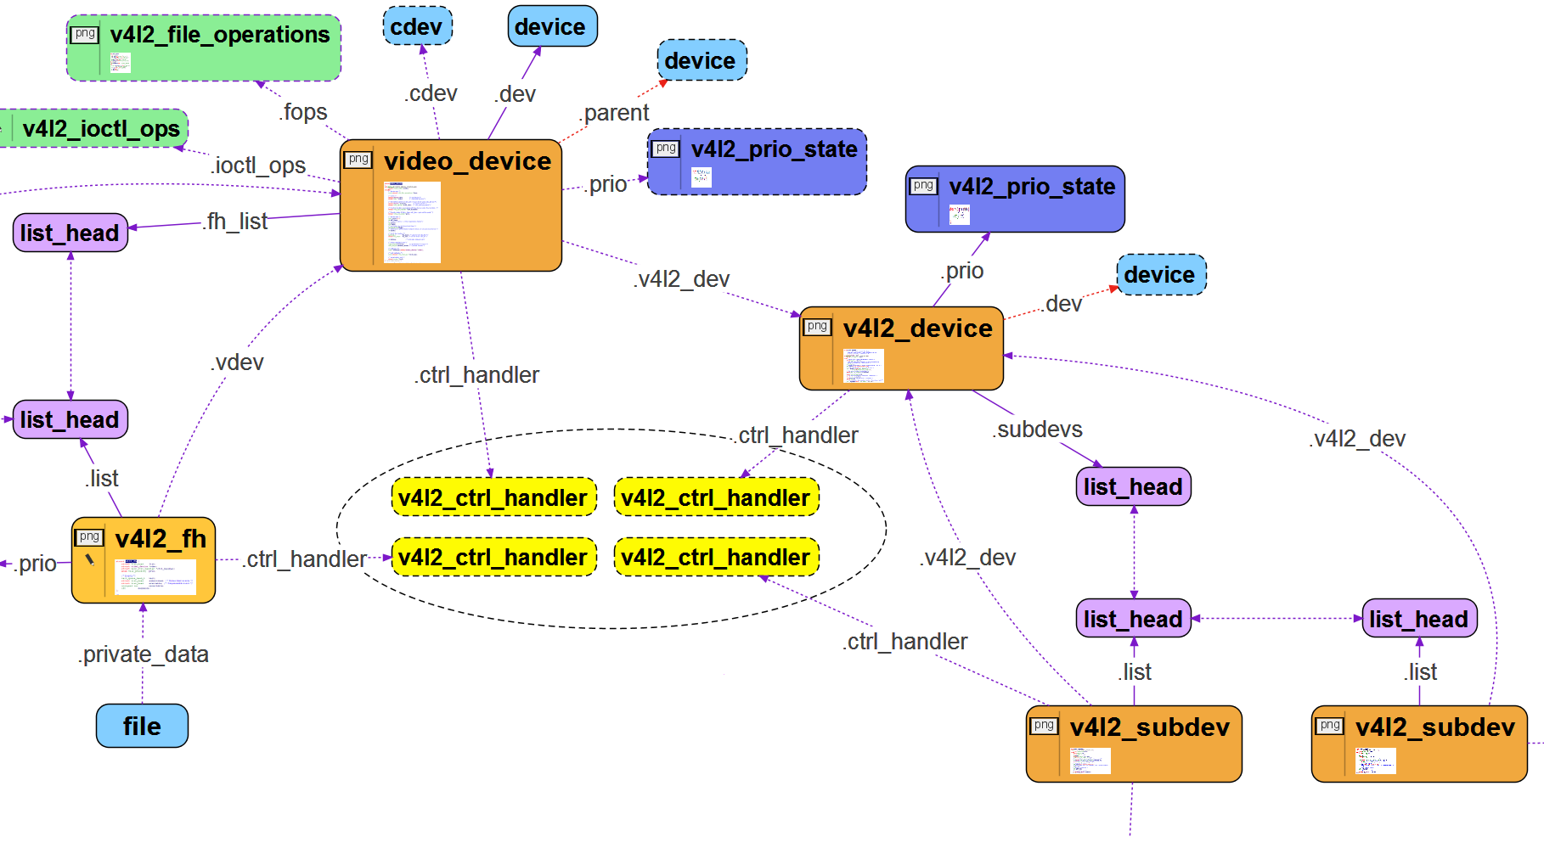
Not this way …

Slide 6
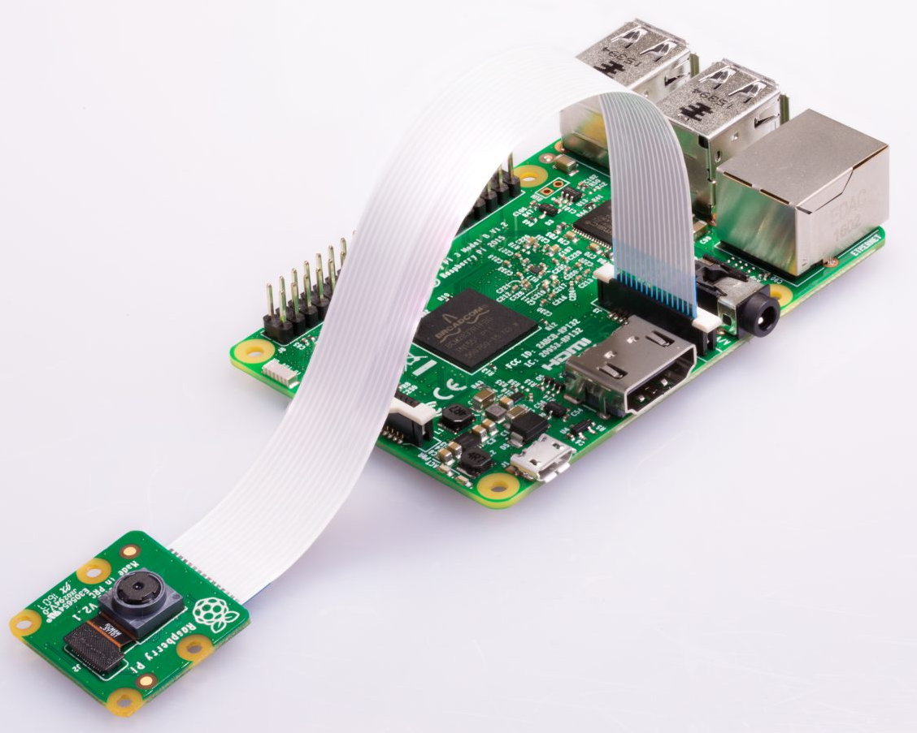
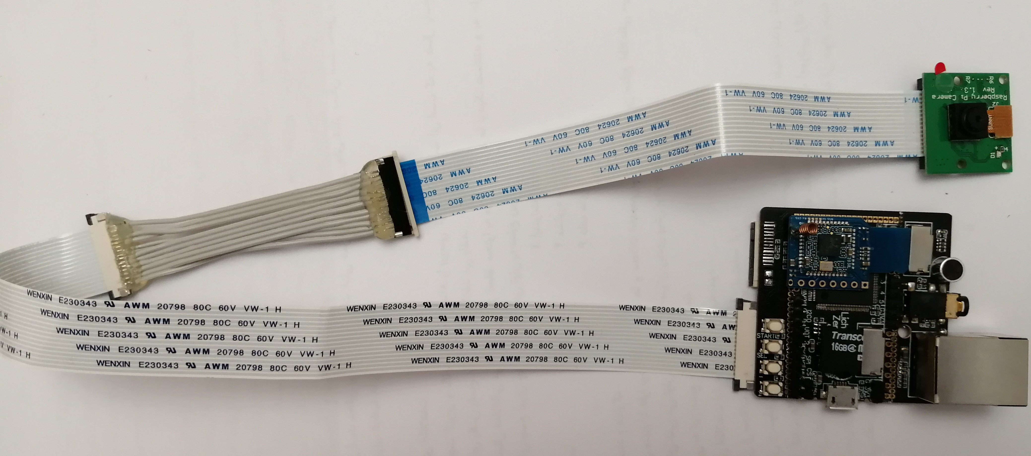
The problem
Taking a picture (frame) from camera module

Slide 7
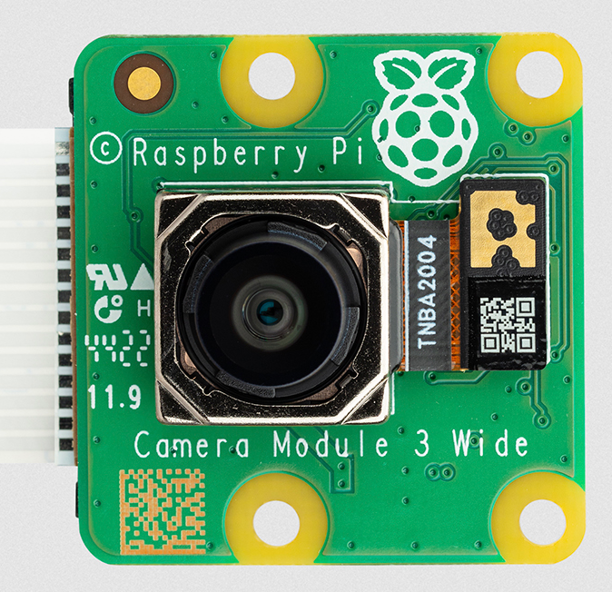
System view (HW)
CPUs
Image Signal Processor
(ISP)
Image Capture
Stream
Memory
DMA engines
I²C
master
configuration
SoC

Slide 8
System view (Kernel)
v4l2
Image Capture
subdev
ISP
/dev/video0
Memory
ioctl ops
video buffer
I²C / SPI
master
DMA
User Space
Kernel Space
Hardware

Slide 9
System view (v3s SoC)
v4l2
Image Capture
sun6i-mipi-csi2
ISP
/dev/video0
ov5647
sun6i-isp-proc
Memory
sun6i-csi-bridge
I²C / SPI
master
DMA
User Space
Kernel Space
Hardware

Slide 10
System view (User)
v4l2
open()
close()
read()
write()
ioctl()
select()
mmap()
subdev
ioctl ops
/dev/video0
video buffer
User Space
Kernel Space

Slide 11
mmap() syscall
0xFFFFFFFF
vb2 buffers
Mapped segment
(vb2 buffers)
PAGE_OFFSET
cma
RAM
process X
BSS
TEXT
0x0
process X address space
(virtual)
kernel / User address space
(virtual)
memory address space
(physical)
MMU

Slide 12
Capture
vb2 framework
VIDIOC_DQBUF
INPUT queue
Bridge Driver
(e.g atmel-isi)
Application
(e.g. Gstreamer)
Buf 0
Buf 1
Buf 2
Buf 3
OUTPUT queue
VIDIOC_QBUF
User space
Kernel space

Slide 13
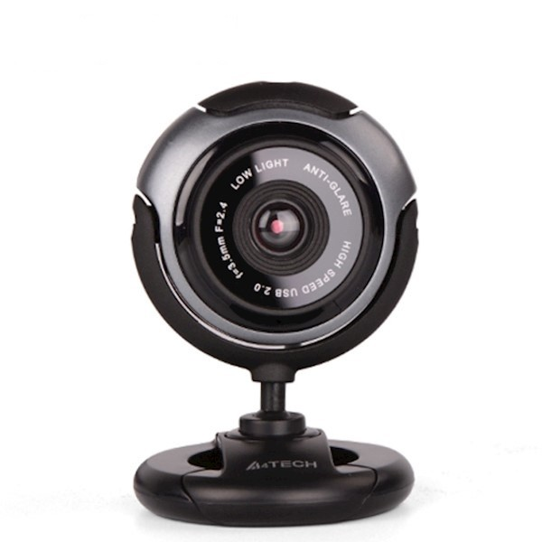
Taking a picture
List all v4l2 devices
v4l2-ctl --list-devices
Get current video format
v4l2-ctl -d /dev/video4 --get-fmt-video
Capture one frame
v4l2-ctl -d /dev/video4 \ --stream-mmap \ --stream-skip 5 \ --stream-count 1 \ --stream-to frame.yuyv422 \ --verbose
Convert to JPEG
ffmpeg -f rawvideo \ -pix_fmt yuyv422 \ -video_size 640x480 \ -i frame.yuyv422 \ -frames:v 1 \ frame.jpg

Slide 14
Next session
Understanding v4l2-ctl and media-ctl
Simple capture code review
Media pipeline
The vivid kernel module

Slide 15
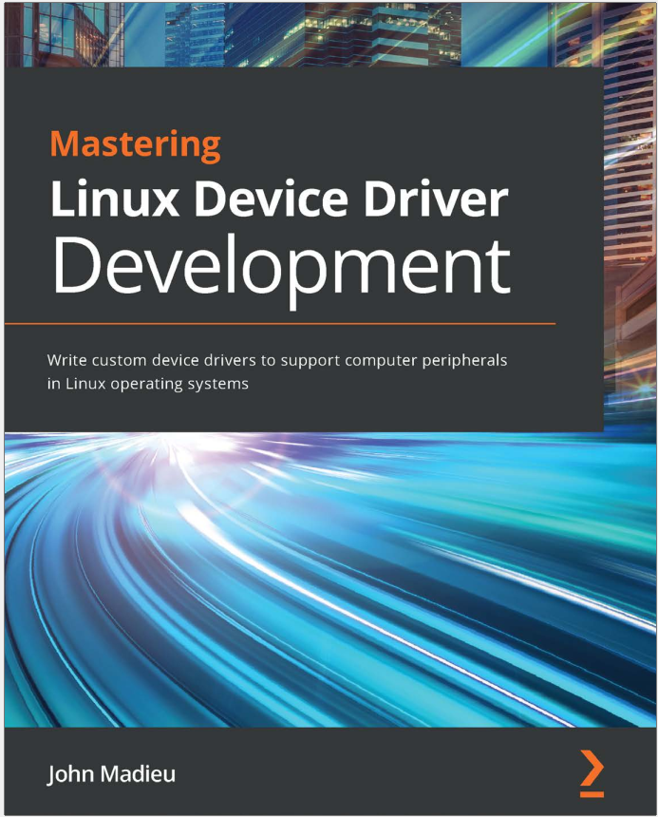
More information
Mastering Linux Device Driver Development by John Madieu (Chapter 9)
Linux V4L2 user API documentation: https://www.kernel.org/doc/html/v4.9/media/uapi/v4l/user-func.html

