Slide 1
v4l2 capture example in C (Step by Step)
By Arash Golgol

Slide 2
Agenda
The problem
A quick review of v4l2
Overview of solution

Slide 3
The problem
Write C program which
Capture single frame from webcam and save it
Don’t use any library (e.g. opencv, gstreamer, libcamera, … )
Resources
Check Linux man pages
Check videodev2.h file
Check v4l2 user space api documentation
Check Streaming I/O example

Slide 4
v4l2 overview
v4l2
Image Capture
subdev
open()
close()
read()
write()
ioctl()
select()
mmap()
ISP
/dev/video0
Memory
ioctl ops
video buffer
I²C / SPI
master
DMA
User Space
Kernel Space
Hardware
Notes:
اهداف اصلی
عدم وابستگی بین درایورهای مختلف
ارایه یک واسط کاربری یکپارچه
شرایط بغلی بگیر در پایپلاین

Slide 5
Solution materials
We only need C library
open() , close(): Every other system calls need file descriptor
select(): IO multiplexing and wait for frame to become ready
mmap(): Map kernel space buffers (containing frames) into user space
ioctl(): Configuration and control of v4l2 device
write(): ??
And lot’s of effort ☺

Slide 6

Capture process

Slide 7
Overview
Open target camera device (e.g. /dev/video0)
Check it’s capabilities for capture and streaming (VIDIOC_QUERYCAP)
Check / Configure it’s frame size, pixel format, … (VIDIOC_G_FMT)
Request at least 3 buffer (VIDIOC_REQBUFS)
Query buffers information and map them (VIDIOC_QUERYBUF)
Enqueue buffers into driver queue (VIDIOC_QBUF)
Start streaming (VIDIOC_STREAMON)
Loop over
Wait for buffer to become ready
Dequeue buffer and process frame (VIDIOC_DQBUF)
Enqueue buffer
Stop streaming, Unmap buffers and close camera device

Slide 8
ioctl() simple example
0x00000000
user space
process X
struct v4l2_capability
struct v4l2_capability cap = {0};
int ret = ioctl(fd, VIDIOC_QUERYCAP, &cap);
copy_to_user(…, _IOC_SIZE(VIDIOC_QUERYCAP));
int vidioc_querycap(… , struct v4l2_capability* cap);
PAGE_OFFSET
struct v4l2_capability
kernel space
kernel / User address space
(virtual)

Slide 9
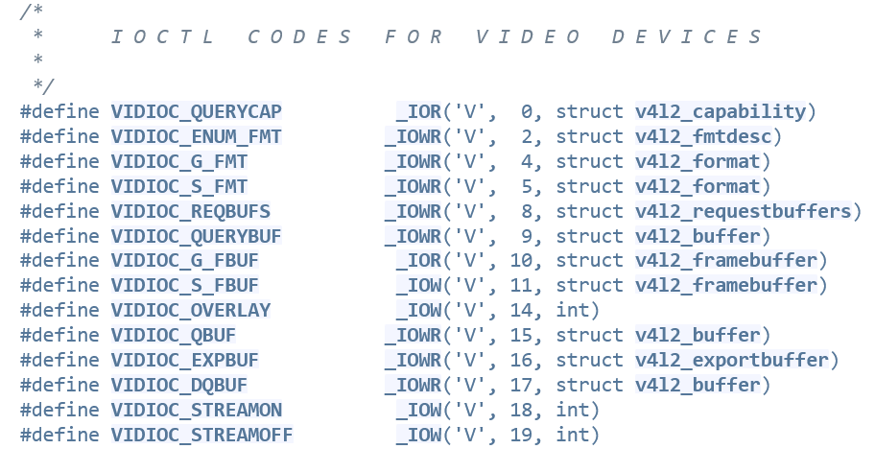
ioctl() directions
_IOR(): Read data from kernel
_IOW(): Write data to kernel
_IOWR(): Combination of writing and reading
_IO(): Direction less (Without argument)
https://elixir.bootlin.com/linux/v6.16.5/source/include/uapi/linux/videodev2.h

Slide 10
mmap() simple example
byte
addr
Memory mapped file
offset
length
int fd = open(“image.raw”, O_RDONLY);
char* addr = mmap(
NULL, // hint for addr
length, // length of mapping
PROT_READ, // read only
MAP_PRIVATE, // not sharable
fd, // file descriptor
offset); // offset in file
BSS
TEXT
process X address space
(virtual)
Regular file
(e.g image.raw)

Slide 11
mmap() in v4l2 streaming mode
0xFFFFFFFF
vb2 buffers
Mapped segment
(vb2 buffers)
PAGE_OFFSET
cma
RAM
process X
BSS
TEXT
0x0
process X address space
(virtual)
kernel / User address space
(virtual)
memory address space
(physical)
MMU

Slide 12
Mapping buffers
struct v4l2_frame_buff
struct v4l2_buffer_pool
.addr
.len
.addr
.len
.addr
.len
.addr
.len
.buffs
.count
buf0
buf1
buf2
buf3
BSS
TEXT
process X address space
(virtual)

Slide 13
Capture
vb2 framework
VIDIOC_DQBUF
INPUT queue
Bridge Driver
(e.g atmel-isi)
Application
(e.g. Gstreamer)
Buf 0
Buf 1
Buf 2
Buf 3
OUTPUT queue
VIDIOC_QBUF
User space
Kernel space

Slide 14
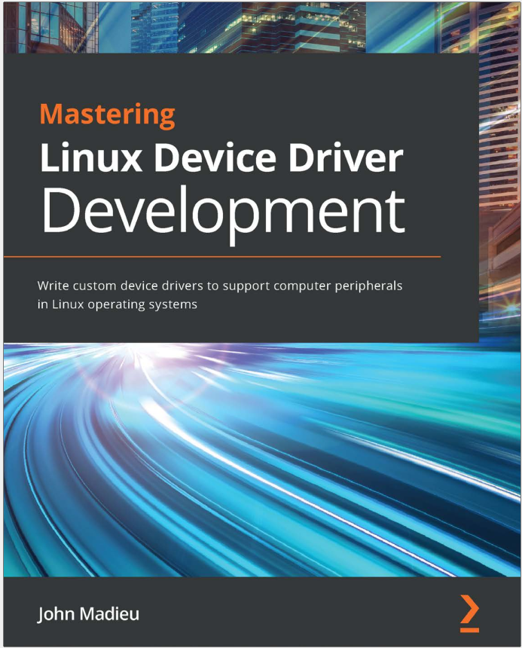
More information
Mastering Linux Device Driver Development by John Madieu (Chapter 9)
Linux V4L2 user API documentation: https://www.kernel.org/doc/html/v4.9/media/uapi/v4l/user-func.html

