Slide 1
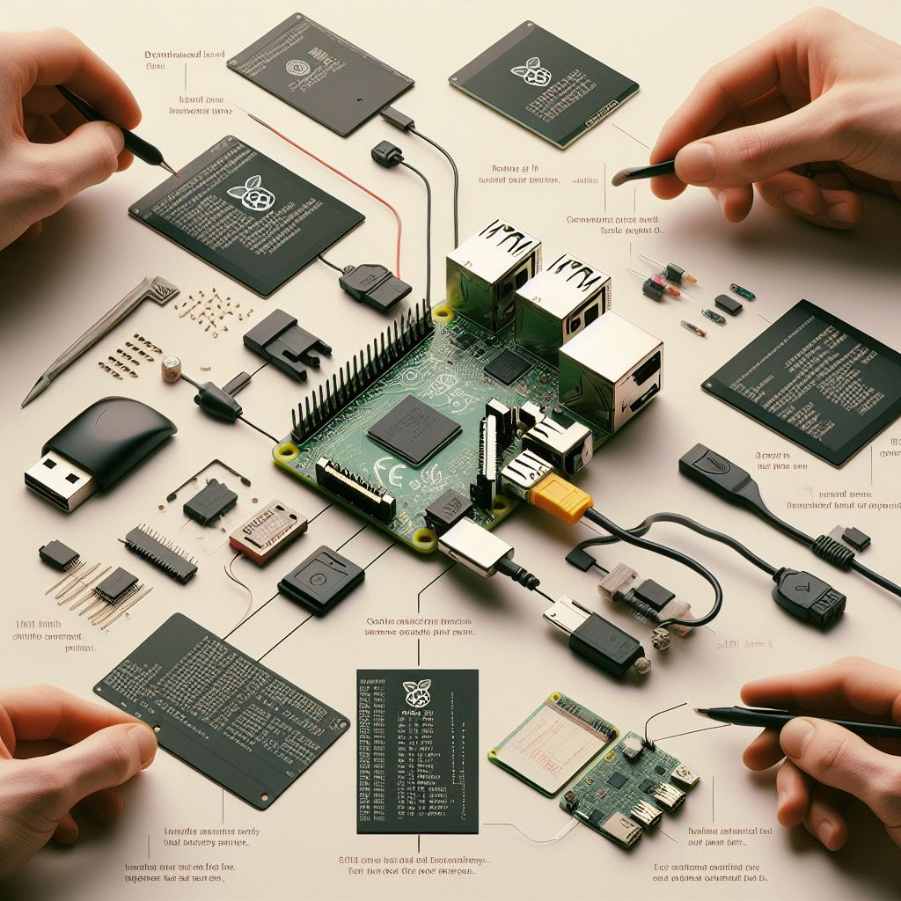

موضوع mdev ارائه دهنده حسین لاچینی
پنجمین دورهمی گروه کاربران لینوکس تعبیه شده E-LUG ) (
27 آذر ماه 1403

Slide 2
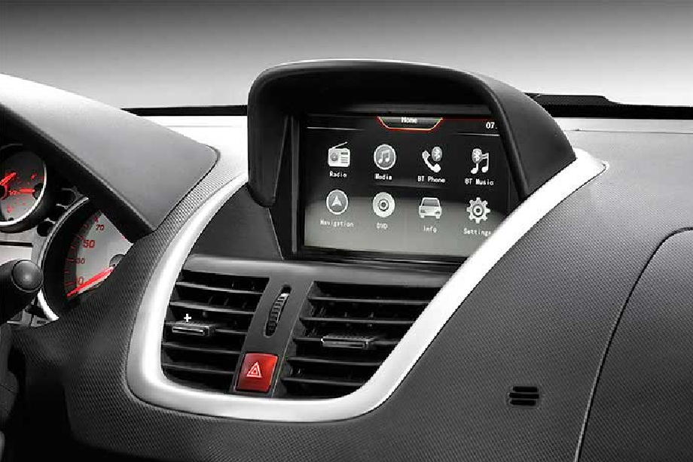
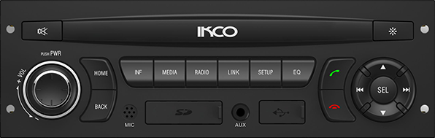

Slide 3
[ 488.709948] usb 1-1: new high-speed USB device number 2 using musb-hdrc [ 488.865772] usb 1-1: New USB device found, idVendor=054c, idProduct=06b1, bcdDevice= 1.00 [ 488.874062] usb 1-1: New USB device strings: Mfr=1, Product=2, SerialNumber=3 [ 488.881785] usb 1-1: Product: Storage Media [ 488.886186] usb 1-1: Manufacturer: Sony [ 488.890224] usb 1-1: SerialNumber: 3C5211402123340946 [ 489.014086] usb-storage 1-1:1.0: USB Mass Storage device detected [ 489.022338] scsi host0: usb-storage 1-1:1.0 [ 489.027610] usbcore: registered new interface driver usb-storage [ 489.045006] usbcore: registered new interface driver uas [ 490.787127] scsi 0:0:0:0: Direct-Access Sony Storage Media 0100 PQ: 0 ANSI: 4 [ 490.803189] sd 0:0:0:0: [sda] 63406080 512-byte logical blocks: (32.5 GB/30.2 GiB) [ 490.818572] sd 0:0:0:0: [sda] Write Protect is off [ 490.830597] sd 0:0:0:0: [sda] No Caching mode page found [ 490.837334] sd 0:0:0:0: [sda] Assuming drive cache: write through [ 490.852527] sda: sda1 [ 490.857524] sd 0:0:0:0: [sda] Attached SCSI removable disk

Slide 4
> ls /dev … sda sda1
…

Slide 5
> mkdir /media/usb
> sudo mount -t vfat /dev/sda1 /media/usb

Slide 6
> sudo umount /media/usb
> rm -d /media/usb

Slide 7
> ls /dev … mmcblk0 mmcblk0p1 …

Slide 8
> mkdir /media/sd > sudo mount -t vfat /dev/mmcblk0p1 /media/sd

Slide 9
> sudo umount /media/sd
> rm -d /media/sd

Slide 10
busybox mdev -h
Usage: mdev [-s]
mdev -s is to be run during boot to scan /sys and populate /dev.
Bare mdev is a kernel hotplug helper. To activate it:
echo /sbin/mdev >/proc/sys/kernel/hotplug
It uses /etc/mdev.conf with lines
[-][ENV=regex;]...DEVNAME UID:GID PERM [>|=PATH]|[!] [@|$|*PROG]
where DEVNAME is device name regex, @major,minor[-minor2], or
environment variable regex. A common use of the latter is
to load modules for hotplugged devices:
$MODALIAS=.* 0:0 660 @modprobe "$MODALIAS"
If /dev/mdev.seq file exists, mdev will wait for its value
to match $SEQNUM variable. This prevents plug/unplug races.
To activate this feature, create empty /dev/mdev.seq at boot.
If /dev/mdev.log file exists, debug log will be appended to it.

Slide 11
LINUX HOTPLUGGING
In hotpluggable busses like USB (and Cardbus PCI), end-users plug devices
into the bus with power on. In most cases, users expect the devices to become
immediately usable. That means the system must do many things, including:
- Find a driver that can handle the device. That may involve
loading a kernel module; newer drivers can use module-init-tools
to publish their device (and class) support to user utilities.
- Bind a driver to that device. Bus frameworks do that using a
device driver's probe() routine.
- Tell other subsystems to configure the new device. Print
queues may need to be enabled, networks brought up, disk
partitions mounted, and so on. In some cases these will
be driver-specific actions.

Slide 12
LINUX HOTPLUGGING
This involves a mix of kernel mode and user mode actions. Making devices
be immediately usable means that any user mode actions can't wait for an
administrator to do them: the kernel must trigger them, either passively
(triggering some monitoring daemon to invoke a helper program) or
actively (calling such a user mode helper program directly).
Those triggered actions must support a system's administrative policies;
such programs are called "policy agents" here. Typically they involve
shell scripts that dispatch to more familiar administration tools.
Because some of those actions rely on information about drivers (metadata) that is currently available only when the drivers are dynamically linked, you get the best hotplugging when you configure a highly modular system.

Slide 13
KERNEL HOTPLUG HELPER
There is a kernel parameter: /proc/sys/kernel/hotplug, which normally
holds the pathname "/sbin/mdev". That parameter names a program which the kernel may invoke at various times.
sysfs
/sys/
devtmpfs
/dev/
/proc/sys/kernel/hotplug
/sbin/mdev
/etc/mdev.conf
KERNEL MODE
USER MODE

Slide 14
mdev usage
mount –t sysfs none /sys
mount –t proc none /proc
echo /sbin/mdev > /proc/sys/kernel/hotplug
mdev -s

Slide 15
mdev usage
The behavior is specified by the /etc/mdev.conf
configuration file, with the following format
<device regex> <uid>:<gid> <octal permissions> [=path] [@|$|*cmd args…]
The special characters have the meaning:
@ Run after creating the device.
$ Run before removing the device.
* Run both after creating and before removing the device.
Example
sd.* 0:0 0755 */etc/usb_action $MDEV

Slide 16
mdev usage
The command is executed via the system() function (which means you're giving a
command to the shell), so make sure you have a shell installed at /bin/sh.
You should also keep in mind that the kernel executes hotplug helpers with stdin,
stdout, and stderr connected to /dev/null.
For your convenience, the shell env var $MDEV is set to the device name. So if
the device "hdc" was matched, MDEV would be set to "hdc".

Slide 17
FIRMWARE
Some kernel device drivers need to request firmware at runtime in order to properly initialize a device. Place all such firmware files into the /lib/firmware/ directory. At runtime, the kernel will invoke mdev with the filename of the firmware which mdev will load out of /lib/firmware/ and into the kernel via the sysfs interface. The exact filename is hardcoded in the kernel, so look there if you need to know how to name the file in userspace.

Slide 18
SEQUENCING
Kernel does not serialize hotplug events. It increments SEQNUM environmental variable for each successive hotplug invocation. Normally, mdev doesn't care. This may reorder hotplug and hot-unplug events, with typical symptoms of device nodes sometimes not created as expected.
However, if /dev/mdev.seq file is found, mdev will compare its contents with SEQNUM. It will retry up to two seconds, waiting for them to match. If they match exactly (not even trailing '\n' is allowed), or if two seconds pass, mdev runs as usual, then it rewrites /dev/mdev.seq with SEQNUM+1.
IOW: this will serialize concurrent mdev invocations.
If you want to activate this feature, execute "echo >/dev/mdev.seq" prior to setting mdev to be the hotplug handler. This writes single '\n' to the file. NB: mdev recognizes /dev/mdev.seq consisting of single '\n' character as a special case. IOW: this will not make your first hotplug event to stall for two seconds.
----
IOW : In Other Word , NB : Note Well

Slide 19
references
https://www.kernel.org/doc/Documentation/usb/hotplug.txt
https://git.busybox.net/busybox/tree/docs/mdev.txt
https://busybox.net/downloads/BusyBox.html
https://github.com/fff7d1bc/mdev-like-a-boss/blob/master/mdev.conf
https://bootlin.com/doc/legacy/udev/udev.pdf

Slide 20





با تشکر
ما را در شبکه های اجتماعی دنبال کنید:

