Slide 1

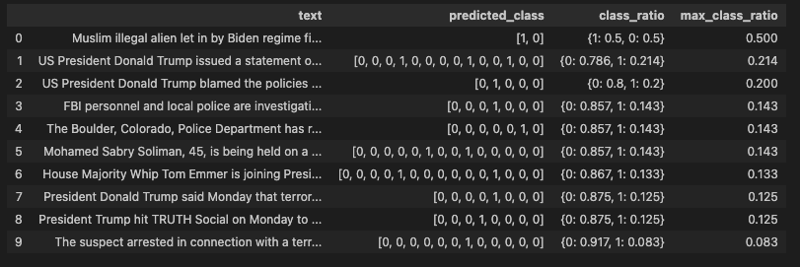


CO
FB:
Bert is poop
twitter
hatexplain

Slide 2



VA
fb
twitter
hateexplain
Notes:
twitter

Slide 3



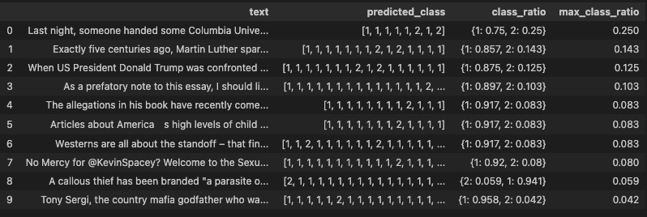
NY
Bert is poop
fb
twitter
hateexplain
Notes:
Run hatebert

Slide 4
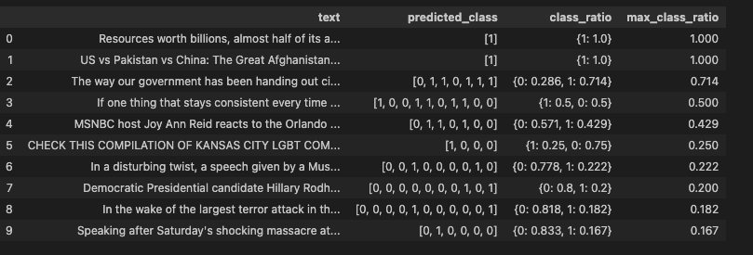



FL
fb
bertispoop
twitter
hateexplain
Notes:
hatebert

Slide 5

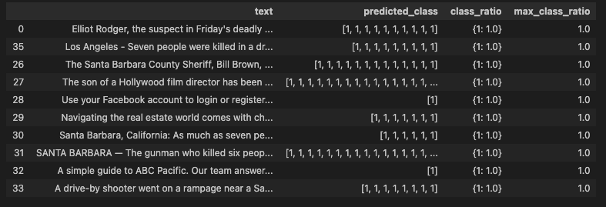

CA
fb
Hatebert
twitter
hateexplain
Notes:
Fb hatebert

