Slide 1
Event Similarity in GDELT via Semantic Search
Emily Lugos, Dr. Mauricio Gruppi

Slide 2
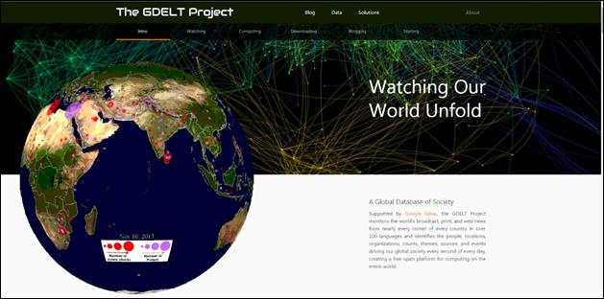
GDELT Database
Notes:
The GDELT Project (Global Database of Events, Language, and Tone) is an open database that continuously monitors the world’s news media in over 100 languages and transforms it into structured data for analysis.
It grabs news sources every 15 minutes and reports events, actors, location, tone, and news sources. It is a very large database.

Slide 3

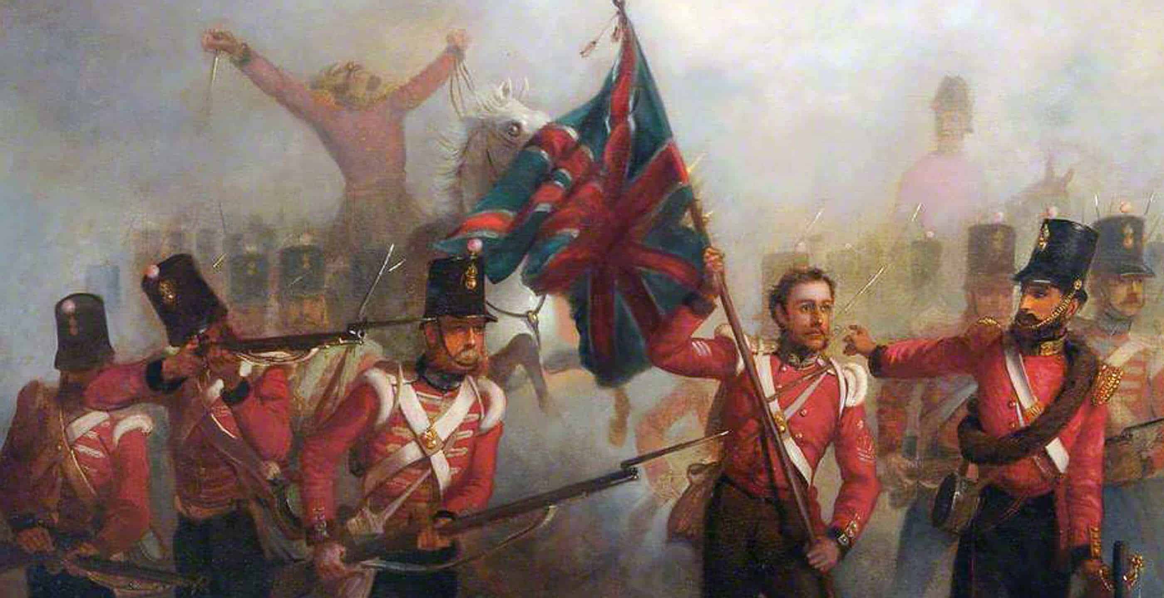
Event similarity
History repeats itself
Key words
Date and time
1850s Crimean war
21st century Ukraine War
Notes:
How is event similarity currently determined
Hope is we can track history repeating itself by plotting

Slide 4

GSG: GDELT
Notes:
This has been explored before but was used by focusing nouns, which, for specific stories makes sense. But I believe verbs also contribute if we want to cluster events themselves later.
Also, a brute force approach was used and only looked at in 15 minute intervals. So news sources from 15. minutes of eachother would be the only ones compared.

Slide 5
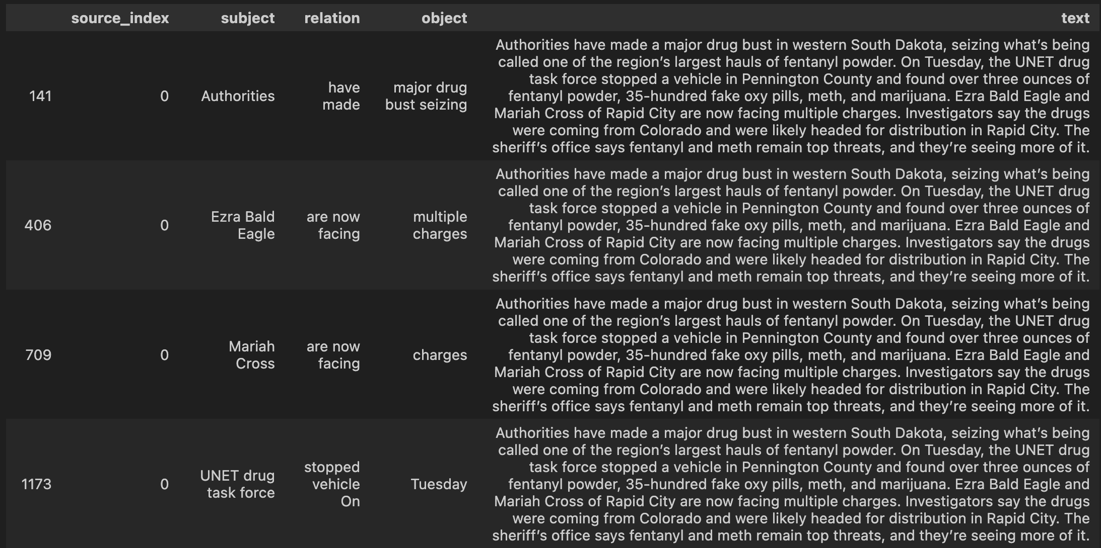
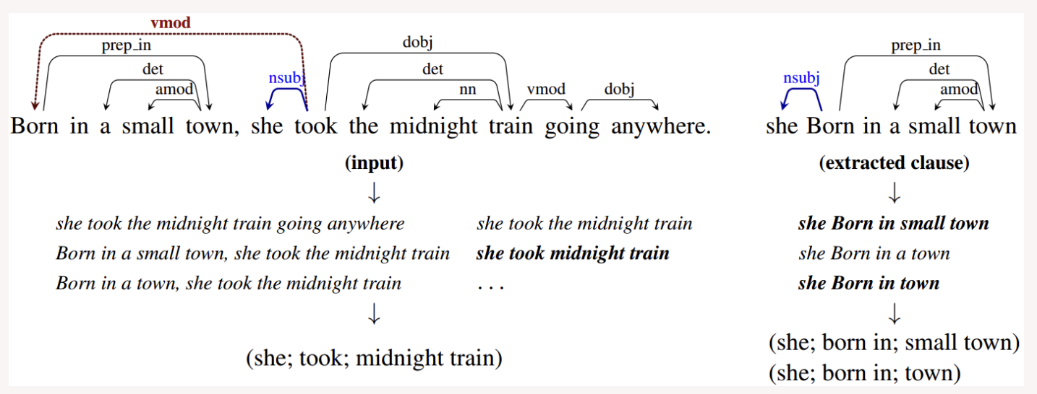
Summarize articles
https://pypi.org/project/stanford-openie/
Notes:
https://pypi.org/project/stanford-openie/

Slide 6

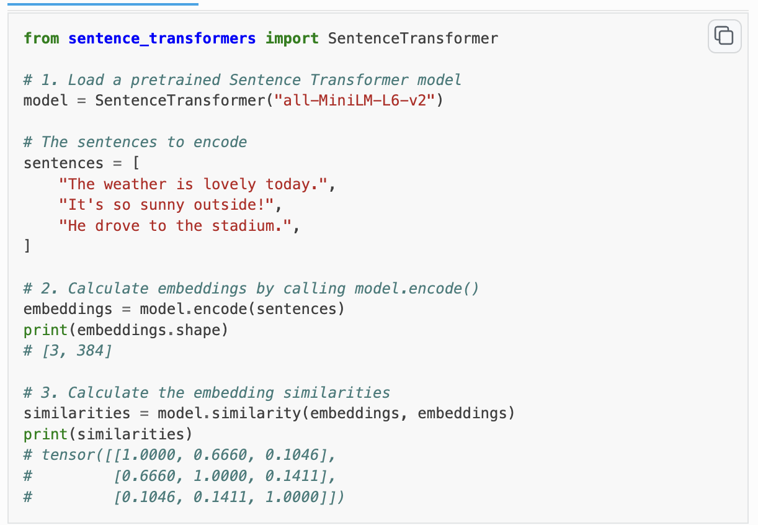
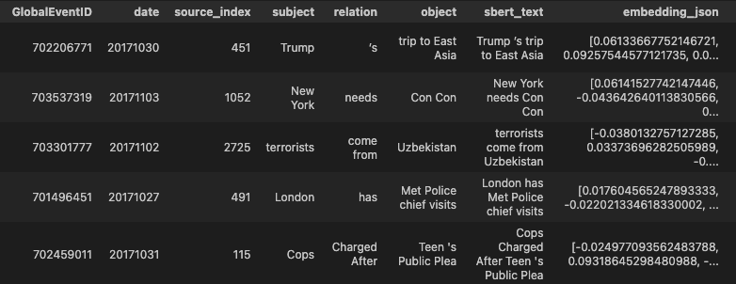

Slide 7
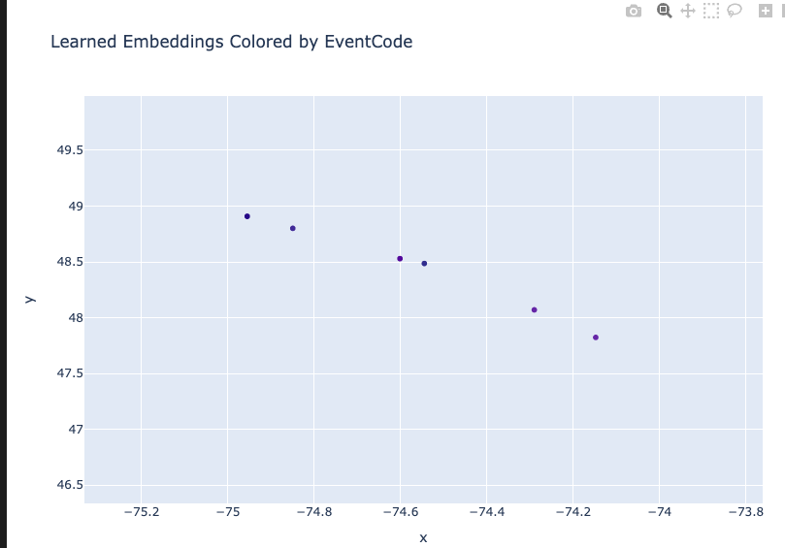
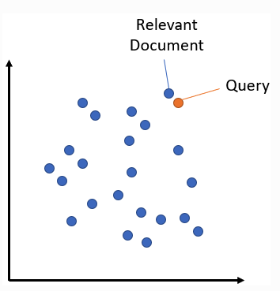

Slide 8
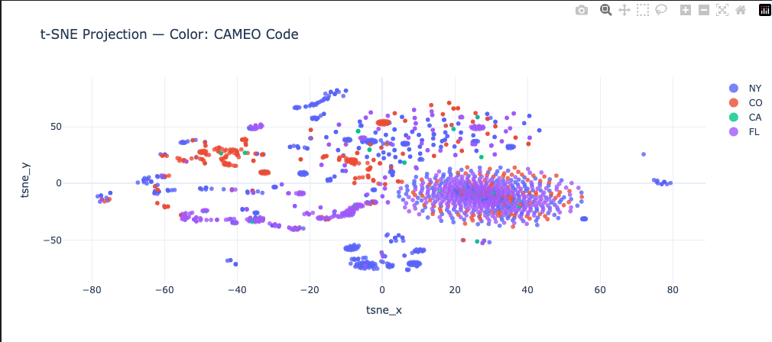
DBSCAN (Density-Based Spatial Clustering of Applications with Noise)
Finds dense regions separated by low density
Notes:
DBSCAN is a density-based clustering algorithm that groups data points into clusters based on regions of high local point density, rather than distance to a center.
Why DBSCAN is Used
✅ Automatically finds the number of clusters
✅ Detects arbitrarily shaped clusters
✅ Explicitly identifies noise and outliers
✅ Robust to outliers because isolated points in low-density regions are labeled as noise instead of being forced into a cluster
Unlike centroid-based methods (e.g., k-means), DBSCAN does not pull clusters toward extreme values. Outliers remain separate, which makes it especially effective for real-world, noisy data.

Slide 9
DBSCAN (Density-Based Spatial Clustering of Applications with Noise)
Finds dense regions separated by low density
Overlap of clusters
Notes:
This visualization shows spectral collapse caused by an over-connected affinity graph and/or insufficient embedding dimension, making all clusters geometrically indistinguishable and forcing DBSCAN to overlap them.
Too much noise
Too little correlation, brick wall

Slide 10
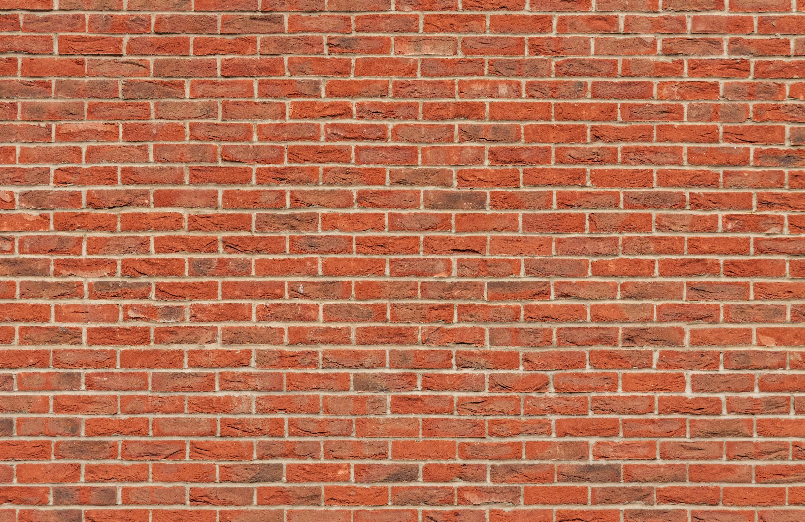

Slide 11
Summarize articles
https://pypi.org/project/stanford-openie/
Notes:
https://pypi.org/project/stanford-openie/

Slide 12
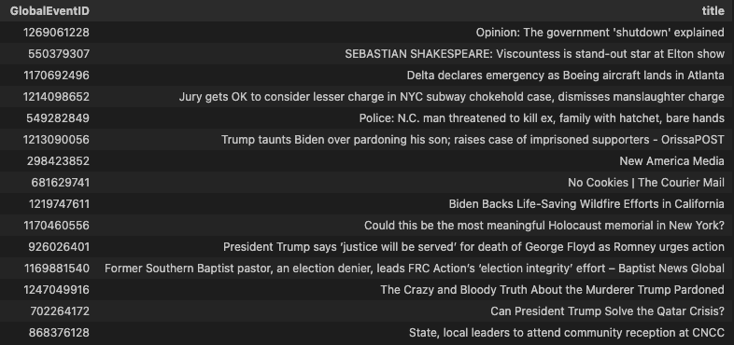
Summarize titles
https://pypi.org/project/stanford-openie/
Notes:
https://pypi.org/project/stanford-openie/

Slide 14
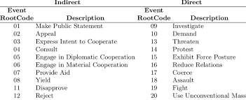
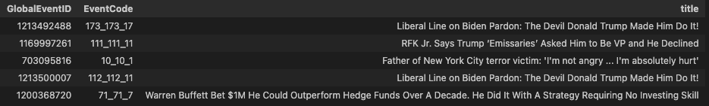
Conflict and Mediation Event Observations (CAMEO)
Coerce
disapprove
public Statement
disapprove
Provide Aid
Notes:
Conflict and Mediation Event Observations (CAMEO) is a framework for coding event data (typically used for events that merit news coverage, and generally applied to the study of political news and violence)
News text is processed with NLP to extract actors and actions, which are then mapped to standardized CAMEO event codes to produce structured conflict data.
This gives us information of the news article without ever having to read it

Slide 15
Semi-supervised
The model learns from what it knows (labeled data) and what it can infer (unlabeled data).
labeled data
unlabeled data
Conflict and Mediation Event Observations (CAMEO)
Sbert embedding vectors
Notes:
Semi-Supervised Learning (SSL)
A semi-supervised model is trained using a small amount of labeled data together with a large amount of unlabeled data to improve learning accuracy and generalization.
✅ Labeled data is expensive or limited
✅ Unlabeled data is abundant
✅ Improves performance over purely supervised learning
✅ Common in NLP, vision, graph learning, and anomaly detection

Slide 16
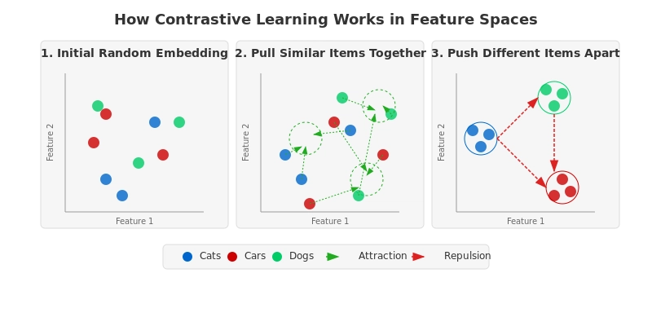
Contrastive Loss
https://dev.to/satwik_mishra_4db19c395ae/contrastive-learning-in-feature-spaces-your-practical-guide-to-better-representations-52jk
Notes:
Contrastive loss is a training objective that learns relationships between data points by operating on pairs of examples rather than individual samples. Each pair is labeled as either similar or dissimilar, and both items in the pair are passed through the same neural network to produce their embeddings. The distance between these embeddings is then computed, and the loss function is applied in a way that pulls similar pairs closer together in the embedding space while pushing dissimilar pairs farther apart up to a defined margin. Through repeated optimization, the model reshapes the embedding space so that geometric distance directly reflects semantic or relational similarity, making the learned representations well-suited for tasks such as clustering, semantic search, and retrieval.

Slide 17
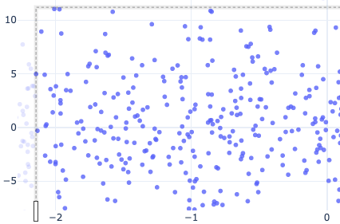
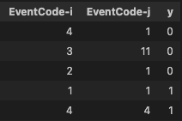
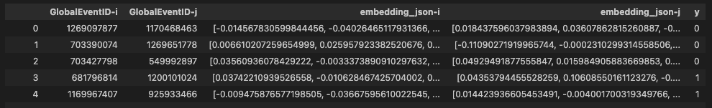
Contrastive Loss
0: dissimilar
1 : similar
Notes:
We start with the initial semantic sbert embeddings and pull together according to similar/dissimilar event codes
From a dataset of 5000 points,
Randomly sample 1000 for x and
Sample 1000 for y and compare if similar or not
Affectively going into the black box of data and seeing what we randomly pull

Slide 18


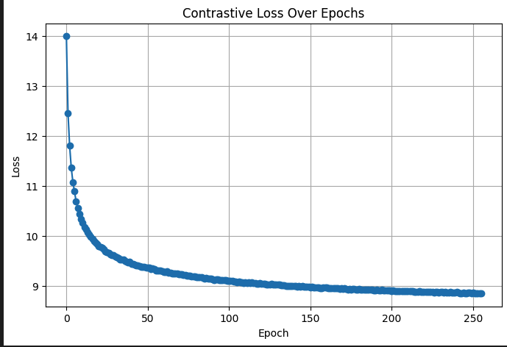
Before training
After training
Notes:
The model learns quickly at first and then converges smoothly, indicating stable training but limited additional improvement after convergence.
Represents distance,
We see the avg distance between articles of similar and dissimilar event codes are the same before training
After training, we see a significant gap meaning the model is learning well

Slide 19
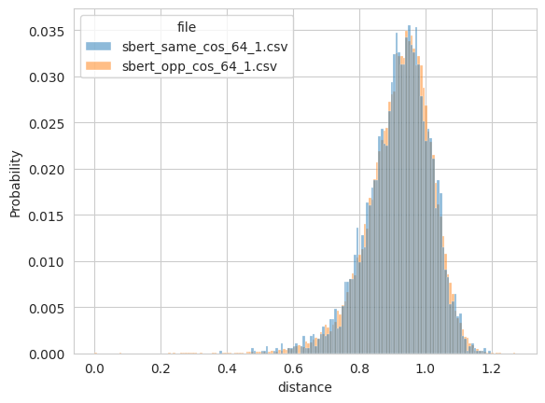
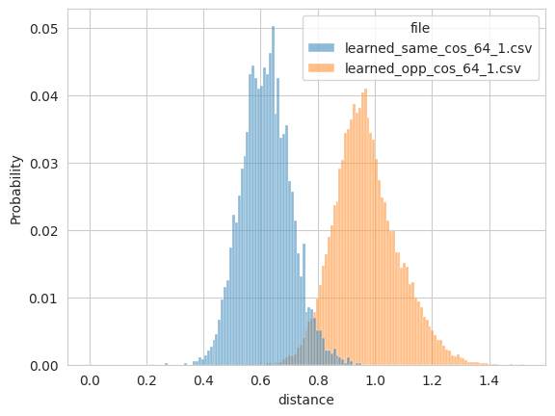
Before training
After training
Notes:
Separation between similar and opp in learned model

Slide 20
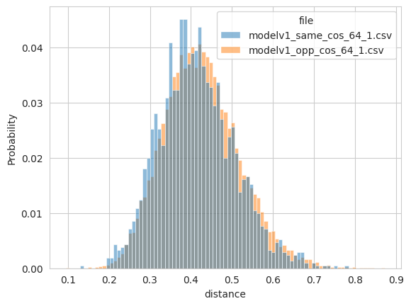
validate
{'avg_same': 0.41344153881073, 'avg_opposite': 0.42540600895881653,
'n_same': 2103,
'n_opposite': 17897}

Slide 21

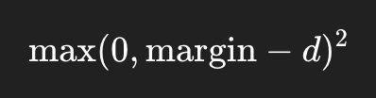
Margin parameter
Positive pair y=1
Negative pairs y=0

Slide 22
Margin parameter
Positive pair y=1
Negative pairs y=0
Margin > d
Pushed apart
Margin = d
stays
Margin < d
Zero loss

Slide 23
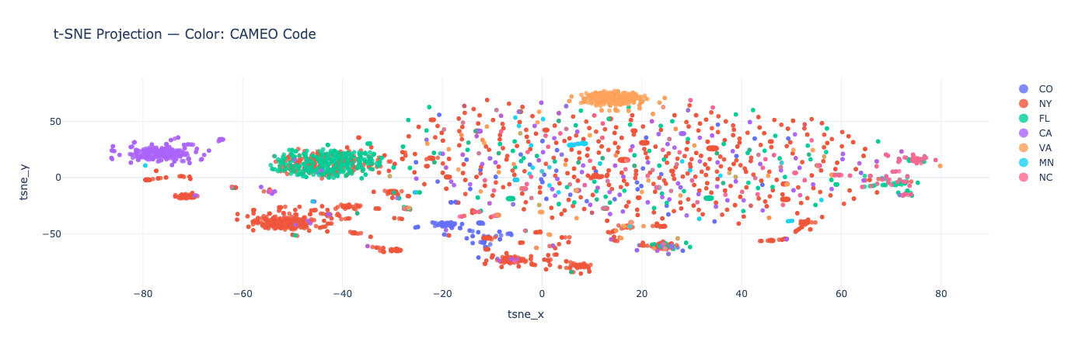
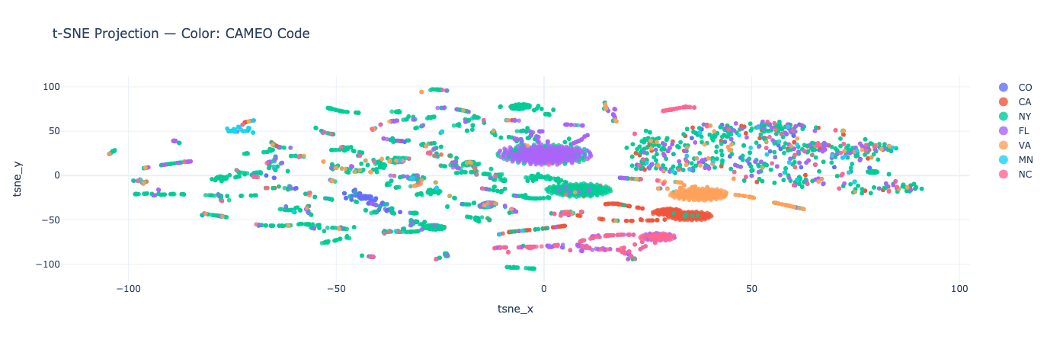
Embedding parameter
15 dimensions
20 dimensions

