Slide 1
Event Similarity in GDELT via Semantic Search
Emily Lugos, Dr. Mauricio Gruppi

Slide 2
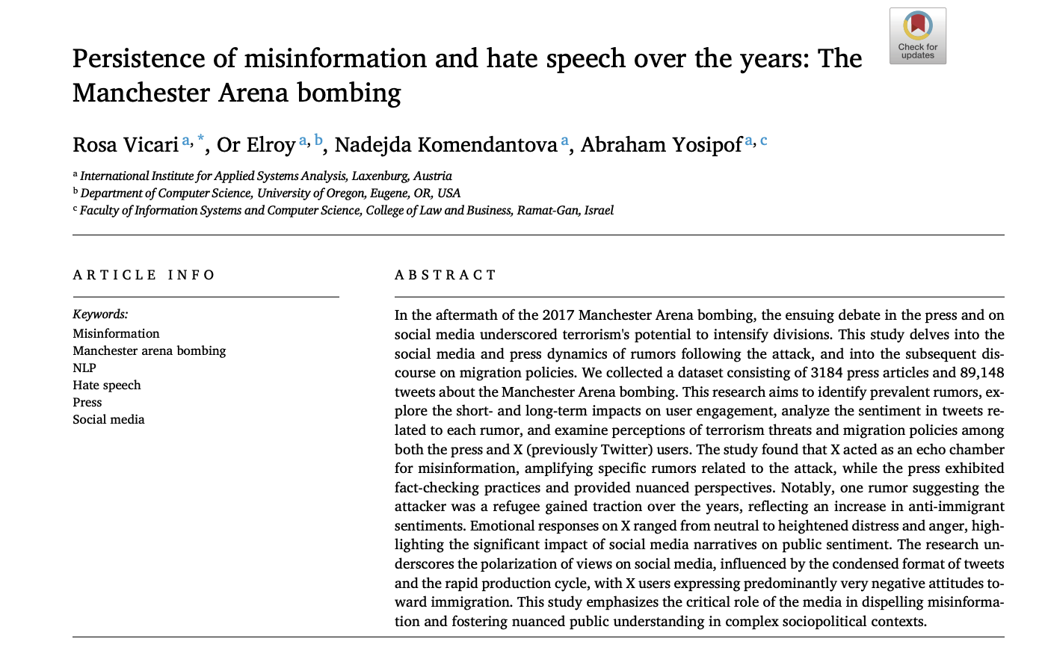
Characterize Hate Speech & Misinformation with ML
Notes:
This paper examined the Manchester bombing in 2017. The false misinformation spread over twitter that an illegal alien refugee from Libya was responsible for the attack. This resulted in a lot of negative sentiment towards immigrants. Now whatever you feel Bout the subject, this was false, but widely believed in the coming hours of the event occurring. This study suggested that hatespeech and misinformation went hand in hand. I wanted to explore that and I used the GDELT database to look at other events where hatespeech and misinformation.

Slide 3
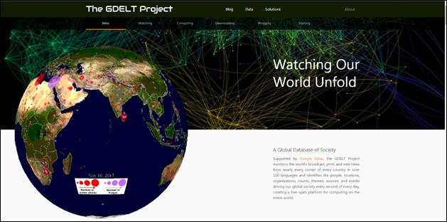
GDELT Database
Notes:
The GDELT Project (Global Database of Events, Language, and Tone) is an open database that continuously monitors the world’s news media in over 100 languages and transforms it into structured data for analysis.
It grabs news sources every 15 minutes and reports events, actors, location, tone, and news sources. It is a very large database.

Slide 4
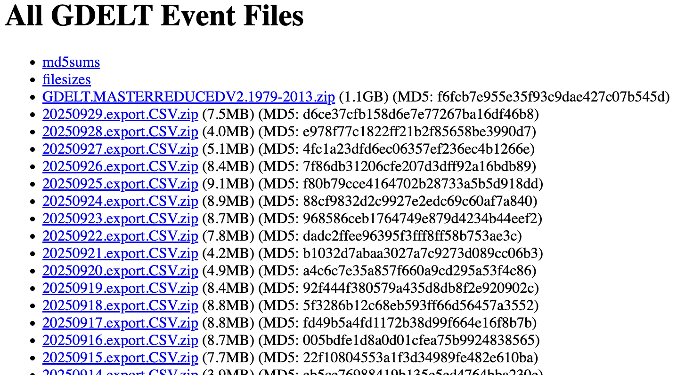
Events
2014 Isla Vista killings
2016 Pulse Nightclub shooting
2017 Charlottesville car attack
2017 New York City truck attack
2025 Boulder Terror Attack
Notes:
To spare you the boring data workup- I essentially narrowed down the large csv into the location, tone, event type. Gdelt tries to keep it as consistent as possible, but it is impossible with breaking news and unverified reporting. I grabbed the news article and extracted the text data. Even with narrowing it down, I was looking at a lot of random data that didn’t have to do with the event.

Slide 5
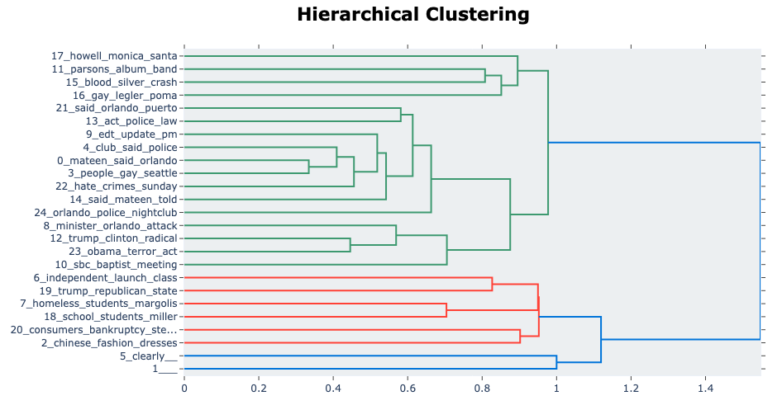
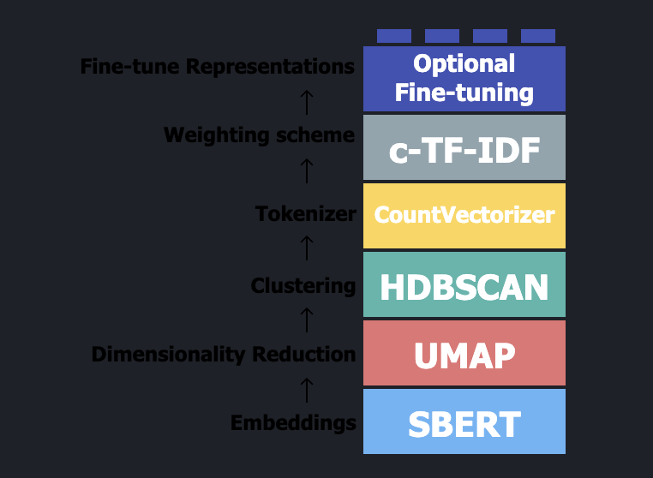
BERTopic
Notes:
Ran it through berttopic. For filtering. Which is a great since I didn’t know what any of these words meant in May when I started. It did 4 of the steps for me. Remmeber we are looking for Orlando nightclub, but a lot of other topics bubbled to the surface. These are the topics out of a 6000 articles.

Slide 6
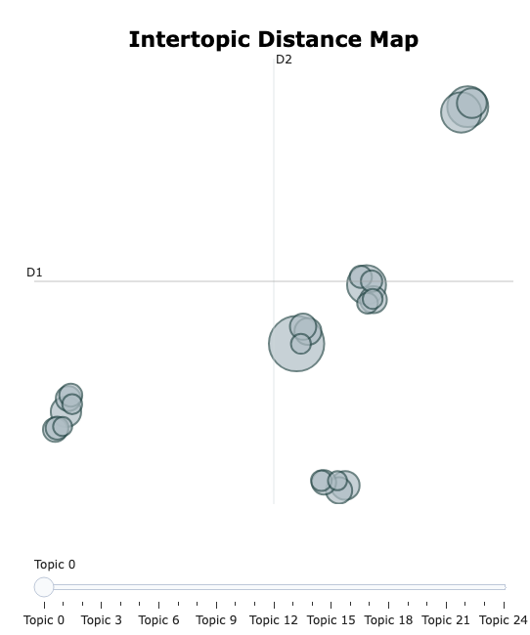
Notes:
Event map of where the topics were placed in space. However, the issue was these topic coordinates, did not match to the hierarchal clustering. There was no way for me to filter using this.

Slide 7
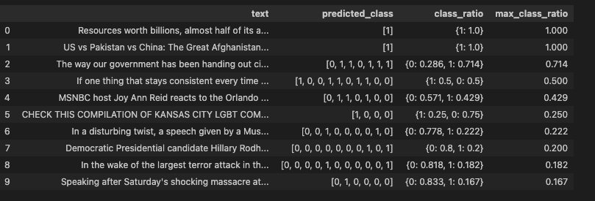
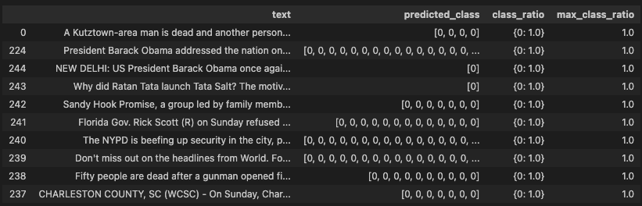
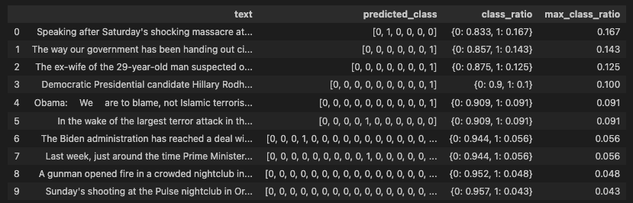
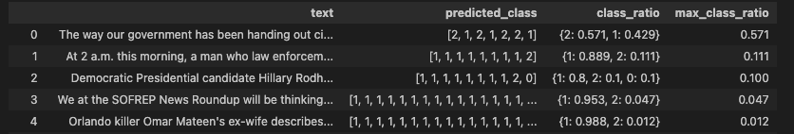
FL
fb
bertispoop
twitter
hateexplain
Notes:
Okay so lets ignore the filtering and run it through models to detect hatespeech. Widely different results for the same dataset.
This is kinda where we called it quits on this matter for several reasons,
The data we needed wasn’t there. The original paper used twitter for sources but since twitter became X, all api to collect data has been closed off. No Scientists can grab any twitter data in any form since it was bought out.
The hate speech models were outdated. All of these were made to detect hatespeech in tweets or social media posts. I wasn’t running it on tweets I was running it on long lengthy news articles. Explicit hate speech is a lot rarer and biased is a lot more nuanced.
No filtering. I could filter by keywords but to do this for every news event. The goal of the research was to do this at a much larger scale and that isn’t efficient.

Slide 8
Event Similarity in GDELT via Semantic Search
Emily Lugos, Dr. Mauricio Gruppi
How do you search for related articles?

Slide 9
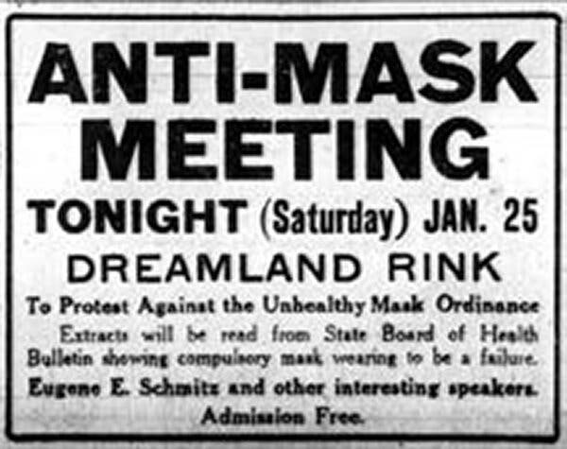

Event similarity
History repeats itself
Key words
Date and time
Notes:
How is event similarity currently determined
Hope is we can track history repeating itself by plotting

Slide 10

GSG: GDELT
Notes:
This has been explored before but was used by focusing nouns, which, for specific stories makes sense. But I believe verbs also contribute if we want to cluster events themselves later.
Also, a brute force approach was used and only looked at in 15 minute intervals. So news sources from 15. minutes of eachother would be the only ones compared.

Slide 11
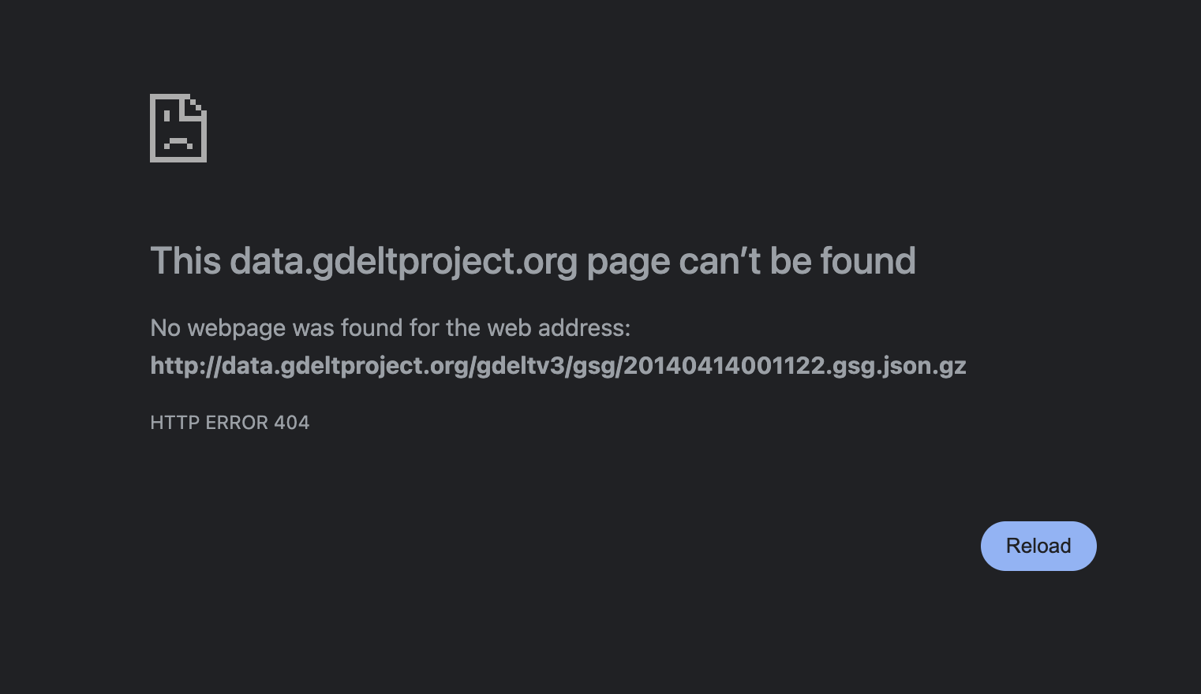

Slide 12
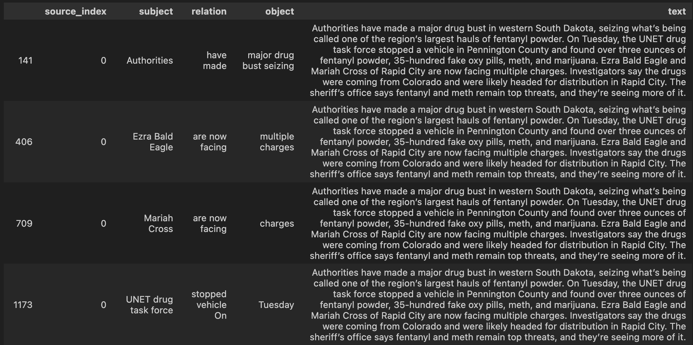
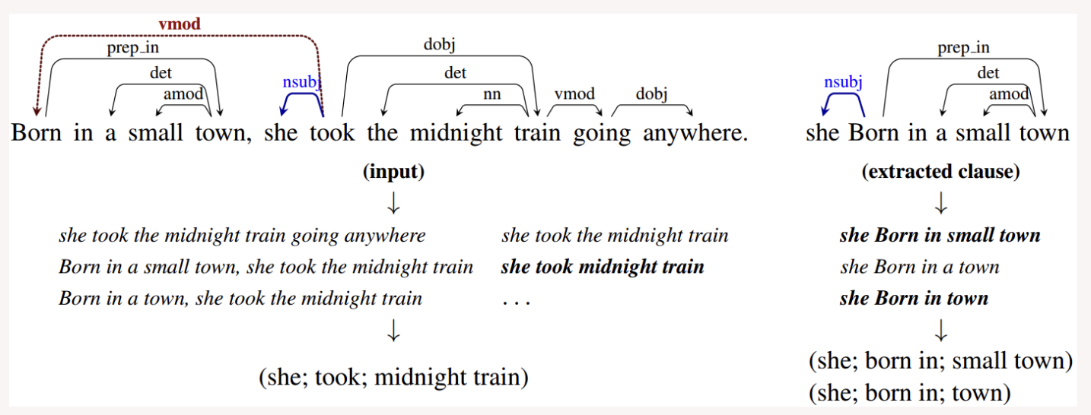
Summarize articles
https://pypi.org/project/stanford-openie/
Notes:
https://pypi.org/project/stanford-openie/

Slide 13

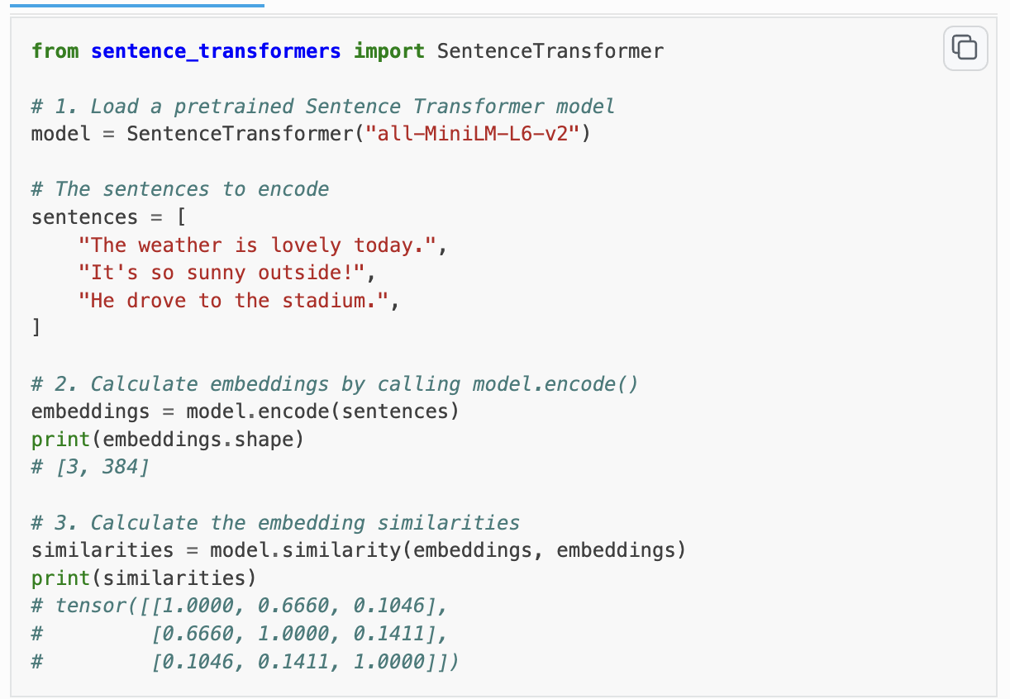

Slide 14
DBSCAN
https://scikit-learn.org/stable/modules/generated/sklearn.cluster.DBSCAN.html

Slide 15
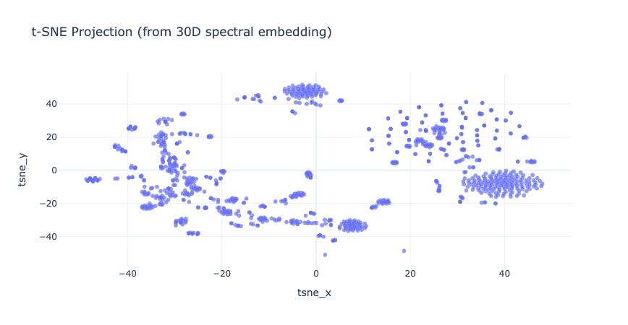
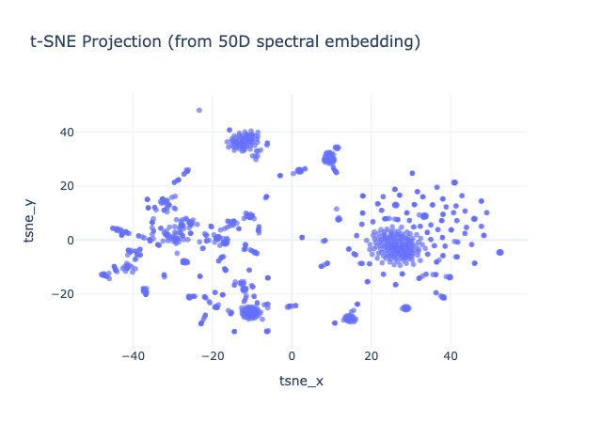
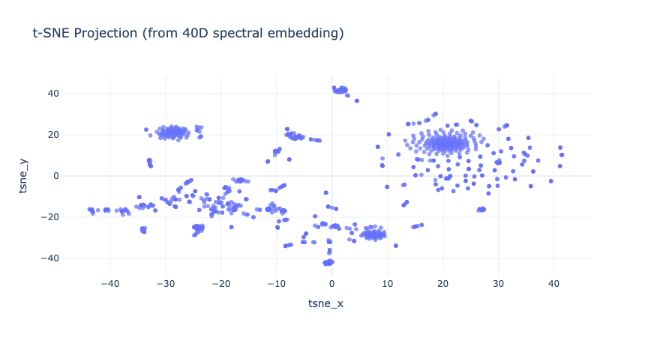
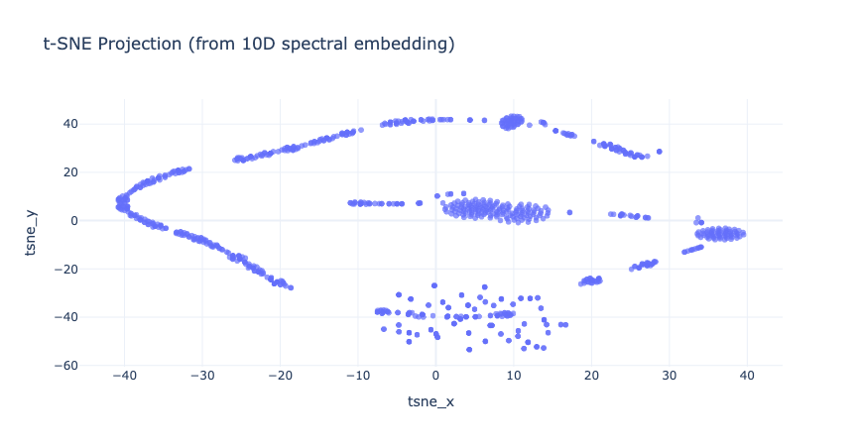
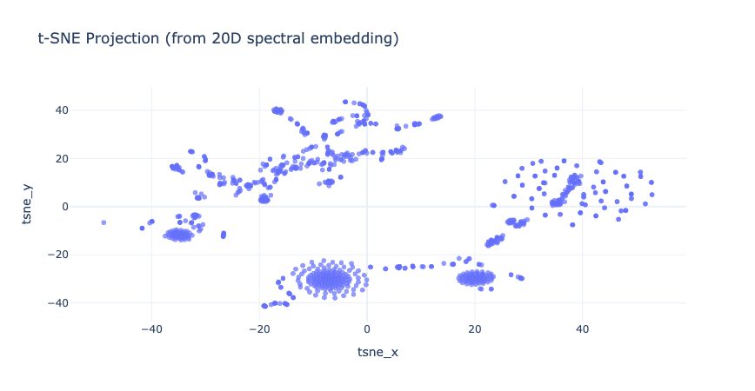
SpectralEmbedding

