Slide 1
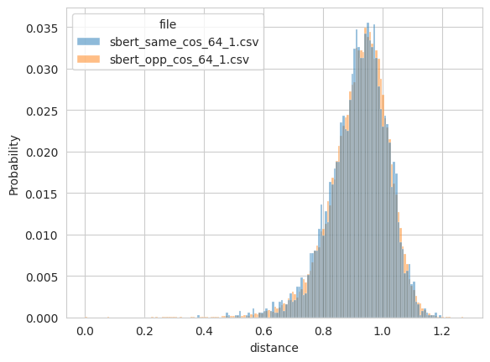
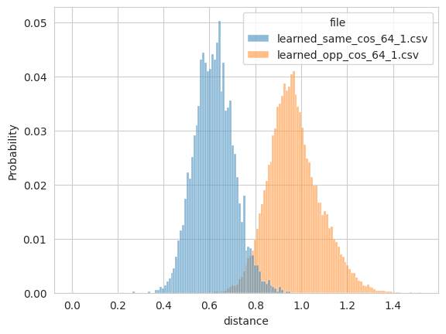


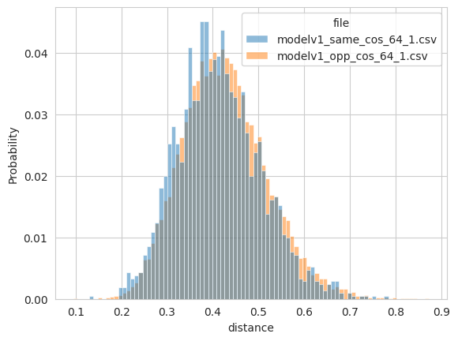
Before training
After training
validate
Emb=64
Margin 1
{'avg_same': 0.41344153881073, 'avg_opposite': 0.42540600895881653,
'n_same': 2103,
'n_opposite': 17897}

Slide 2

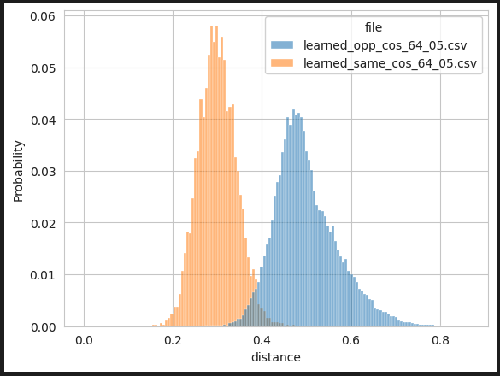
Before training
After training
Emb=64
Margin 0.5
Earth mover's distance: d_learned=0.1989
validate
{'avg_same': 0.4749191403388977, 'avg_opposite': 0.4838806986808777, 'n_same': 2103, 'n_opposite': 17897}

Slide 3
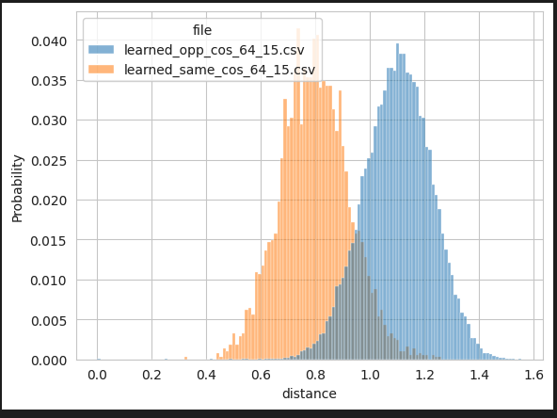
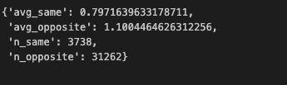
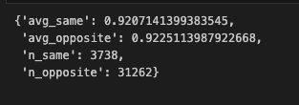
After training
Emb=64
Margin 1.5
Earth mover's distance: d_learned=0.3033
validate
{'avg_same': 0.9940177798271179, 'avg_opposite': 0.9989833235740662, 'n_same': 2103, 'n_opposite': 17897}

Slide 4


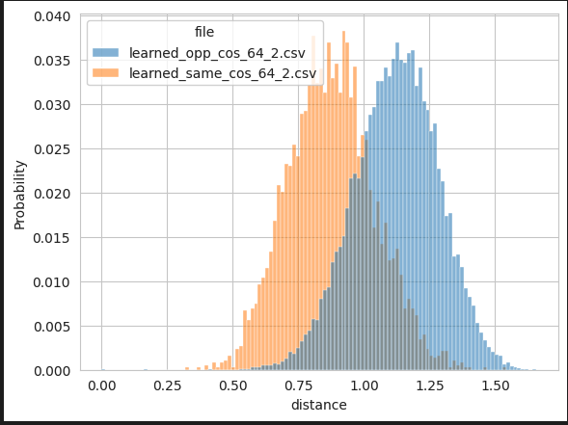

Before training
After training
Emb=64
Margin 2.0
Earth mover's distance: d_learned=0.2479
validate

Slide 5
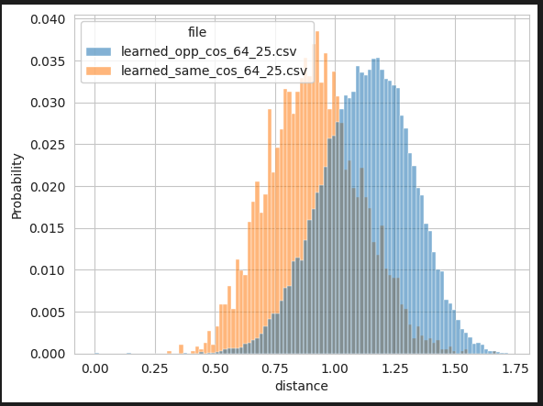


Before training
After training
validate
Emb=64
Margin=2.5
Earth mover's distance: d_learned=0.2189

Slide 6
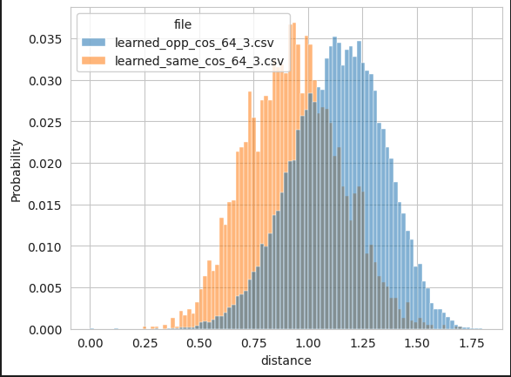


Before training
After training
validate
Emb=64
Margin=3.0
Earth mover's distance: d_learned=0.2028

Slide 7
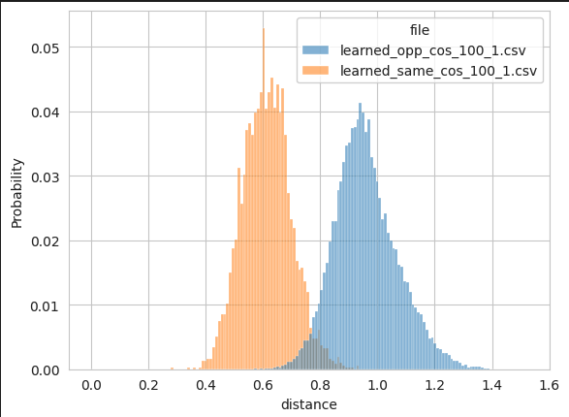


Before training
After training
validate
Emb=100
Margin 1
Earth mover's distance: d_learned=0.3457

Slide 8

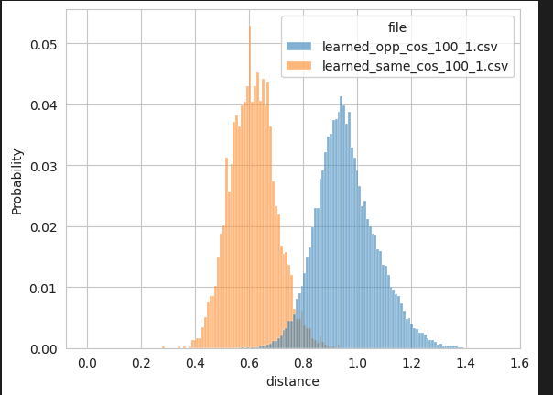

Before training
After training
validate
Emb=100
Margin 0.5
Earth mover's distance: d_learned=0.3457

Slide 9
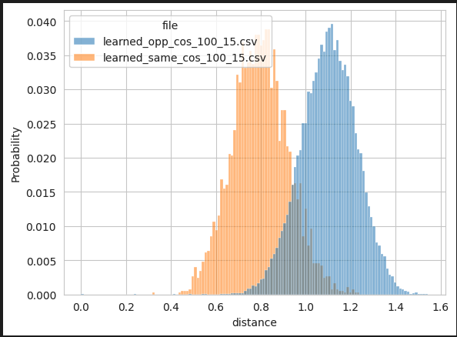



Before training
After training
Emb=100
Margin 1.5
Earth mover's distance: d_learned=0.3033
validate

Slide 10
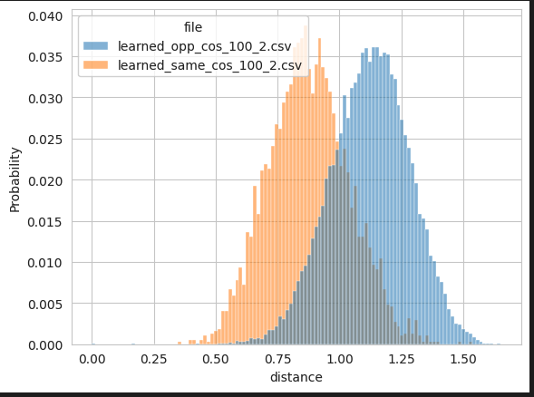



Before training
After training
Emb=100
Margin 2.0
Earth mover's distance: d_learned=0.2477
validate

Slide 11
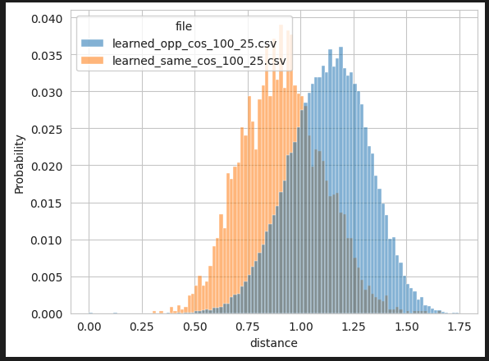


Before training
After training
Emb=100
Margin=2.5
earth mover's distance: d_learned=0.2192
validate

Slide 12


Before training
After training
validate
Emb=100
Margin=3.0

Slide 13


Before training
After training
validate
Emb=200
Margin 1
{'avg_same': 0.9317876100540161, 'avg_opposite': 0.938356876373291, 'n_same': 2103, 'n_opposite': 17897}

Slide 14


Before training
After training
validate
Emb=200
Margin 0.5

Slide 15


Before training
After training
validate
Emb=200
Margin 1.5

Slide 16


Before training
After training
validate
Emb=200
Margin 2.0

Slide 17
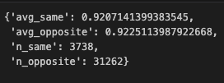

Before training
After training
validate
Emb=200
Margin=2.5

Slide 18


Before training
After training
validate
Emb=200
Margin=3.0

Slide 19
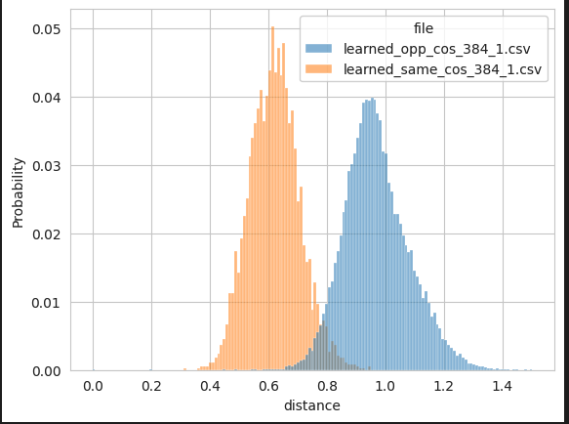



Before training
After training
Emb=384
Margin 1
Earth mover's distance: d_learned=0.3478
validate

Slide 20
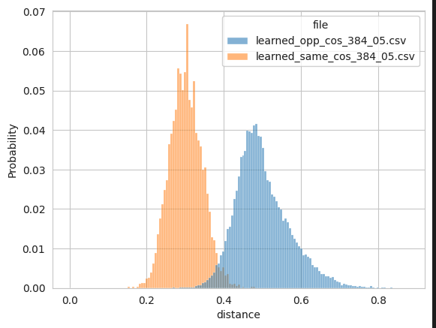


Before training
After training
validate
Emb=384
Margin 0.5
Earth mover's distance: d_learned=0.1987

Slide 21
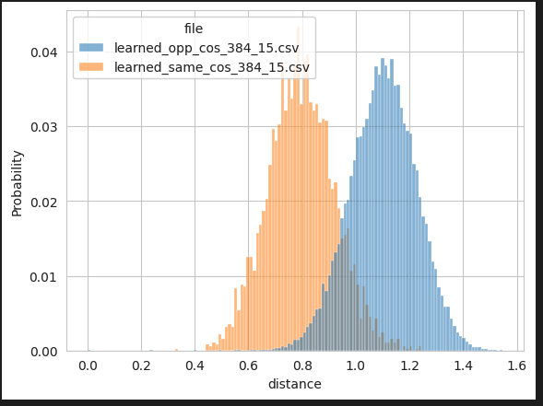



Before training
After training
Emb=384
Margin 1.5
Earth mover's distance: d_learned=0.3030
validate

Slide 22
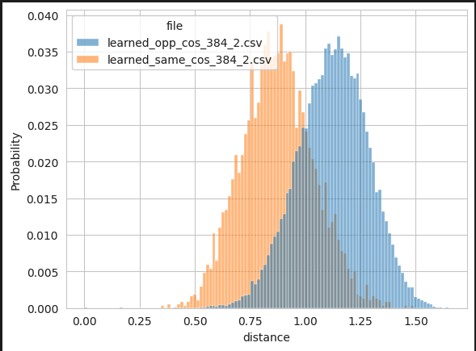


Before training
After training
validate
Emb=384
Margin 2.0
Earth mover's distance: d_learned=0.2477

Slide 23
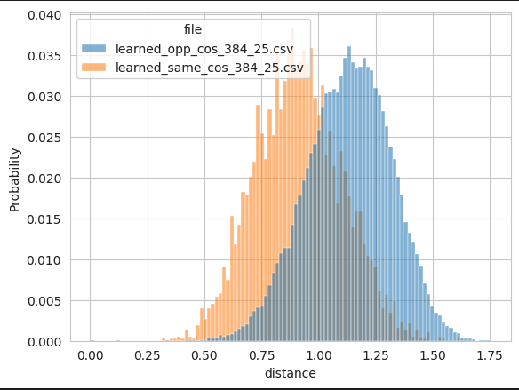


Before training
After training
validate
Emb=384
Margin=2.5
Earth mover's distance: d_learned=0.2186

Slide 24
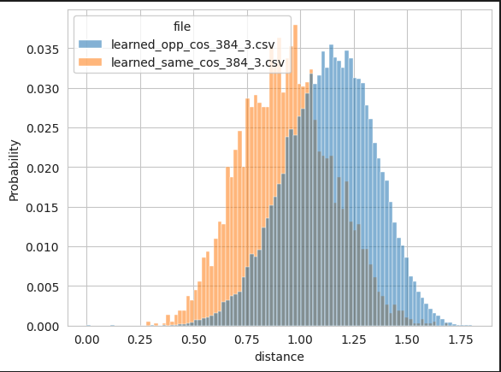


Before training
After training
validate
Emb=384
Margin=3.0
Earth mover's distance: d_learned=0.2019

Slide 25
Before training
After training
validate
Emb=400
Margin 1

Slide 26
Before training
After training
validate
Emb=400
Margin 0.5

Slide 27
Before training
After training
validate
Emb=400
Margin 1.5

Slide 28
Before training
After training
validate
Emb=400
Margin 2.0

Slide 29
Before training
After training
validate
Emb=400
Margin=2.5

Slide 30
Before training
After training
validate
Emb=400
Margin=3.0

Slide 31
Before training
After training
validate
Emb=500
Margin 1

Slide 32
Before training
After training
validate
Emb=500
Margin 0.5

Slide 33
Before training
After training
validate
Emb=500
Margin 1.5

Slide 34
Before training
After training
validate
Emb=500
Margin 2.0

Slide 35
Before training
After training
validate
Emb=500
Margin=2.5

Slide 36
Before training
After training
validate
Emb=500
Margin=3.0

