Slide 1





Group 02 · ISOM5240
HSBC Banking Query
Intent Router
Text Input
A Multimodal Prototype for
Banking Enquiry Classification and Review Support
Voice Input
Similar Enquiries
Group - 02
SHEN Jia(21158135) · TSAI Chungkai (21182344)
View Live Prototype
Academic prototype. Not affiliated with or approved by HSBC.

Slide 2
Business Problem
Customers speak naturally
Service systems need structured intents
01
Different wording, same need
Customer enquiry
Customers may describe the same issue
using different expressions.
“I do not recognize a card payment on my account.”
02
Similar wording, different intents
Declined, pending and unrecognised payments
require different categories.
Structured intent
03
Different channels, one reviewable format
Unrecognised card payment
Typed and spoken enquiries need a
consistent representation for review.
card_payment_not_recognised
Turn varied customer expressions into consistent, reviewable banking-intent information
Group 02 · ISOM5240
02

Slide 3
Project Objective & Strategy
Compare two intent-prediction approaches,
with text and voice interaction
Our Objective
Support consistent initial banking-enquiry handling by classifying English queries into 77 service intents, providing text and voice interaction, and comparing 2 intent-prediction approaches.
01 Classify
02 Retrieve & Vote
03 Speak
Fine-tuned DistilBERT
Pretrained MiniLM
Pretrained Whisper Tiny
Predict intent from a trained
77-class classifier.
Find five nearest enquiries;
use their labels to predict intent.
Transcribe browser-recorded
speech, then run DistilBERT.
Ranked intent scores
Similarity + intent vote
Voice-to-intent extension
Scope: intent triage and review support, not actual bank-service routing
Group 02 · ISOM5240
03

Slide 4
Application Workflow
Two text-based intent pipelines
Voice input feeds the DistilBERT route
Input
Prediction Method
Output
Query text
A Fine-tuned classifier
Ranked intents
Typed enquiry
DistilBERT
77-class sequence classification
Model probabilities
Recorded speech
B Pretrained retrieval
Whisper Tiny → transcript
Voted intent
MiniLM + five-neighbour vote
Reference examples
+ similarity scores
Cosine similarity; mean similarity breaks ties
Reference index: up to 25 training enquiries per intent; test examples excluded.
Retrieval predicts an intent; it is not only a reference-display layer
Group 02 · ISOM5240
04

Slide 5
Data & Models
One public banking dataset supports
classification and retrieval-based prediction
BANKING77
77 intents
13,083 queries
English banking enquiries
Single-label classification
Official: 10,003 train / 3,080 test
Component
Model
Project training
Output
Intent classifier
DistilBERT
Fine-tuned: 3 epochs
Intent + probability
Retrieval predictor
all-MiniLM-L6-v2
Pretrained; not fine-tuned
Voted intent + examples
Speech-to-text
openai/whisper-tiny
Pretrained; not fine-tuned
Transcript → DistilBERT
Project Split
Train: 9,002 · Validation: 1,001 · Test: 3,080 | Stratified split; seed 42
Retrieval index: up to 25 training examples per intent (up to 1,925); no test messages.
Public Banking77 reference enquiries, not HSBC customer records
Group 02 · ISOM5240
05

Slide 6
Experiments & Results
Retrieval leads the reported benchmark;
both approaches remain in the App
Common Test Set
All 3,080 official test enquiries · Two text-based intent-prediction methods
Method
Accuracy
Test total
Per message
What The Results Show
Fine-tuned
DistilBERT
83.18%
3.278 s
1.064 ms
87.18%
Retrieval test accuracy
Pretrained
MiniLM retrieval
87.18%
1.708 s
0.554 ms
Higher accuracy and lower
reported per-message time.
Trade-off: one-time
reference-index setup.
Setup / Index Time
DistilBERT: 0.189 s · MiniLM retrieval: 2.102 s
Reported benchmark averages, not measured interactive App latency. Voice accuracy was not tested separately.
Group 02 · ISOM5240
06

Slide 7
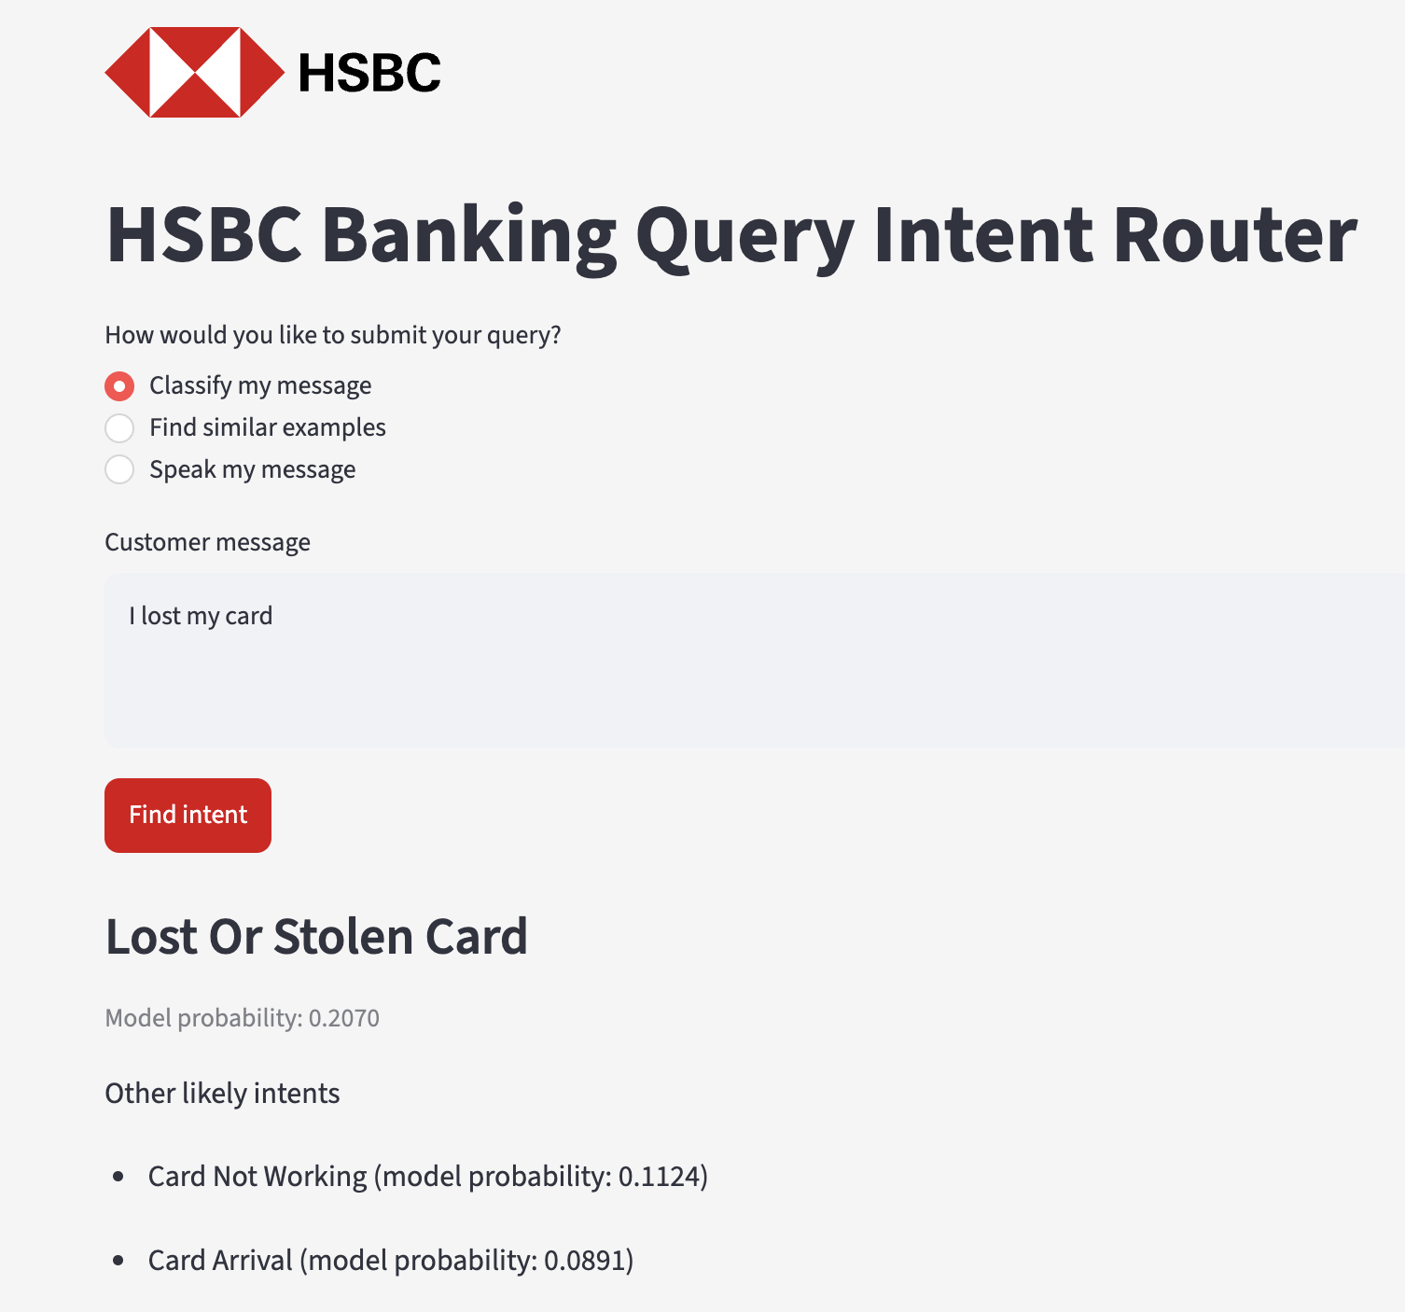
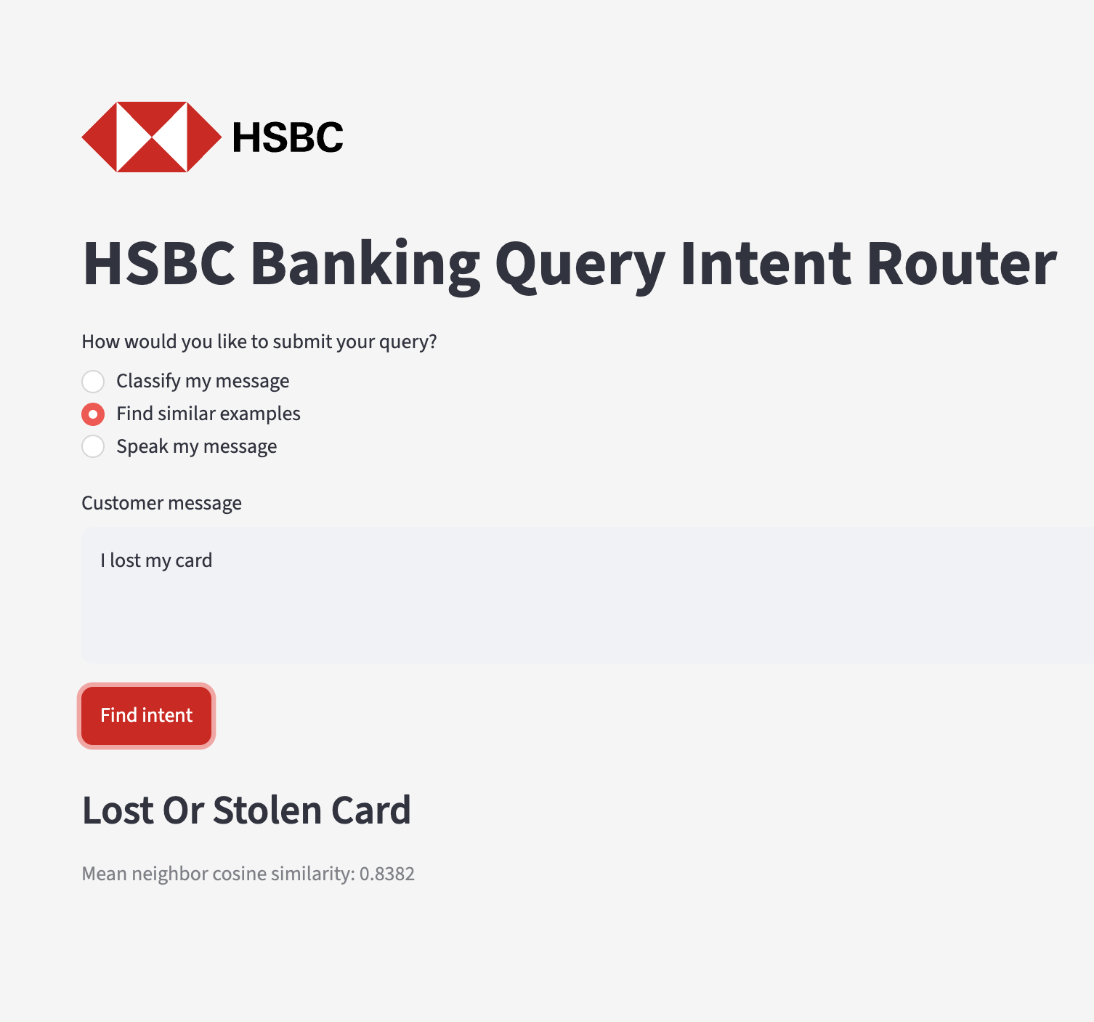
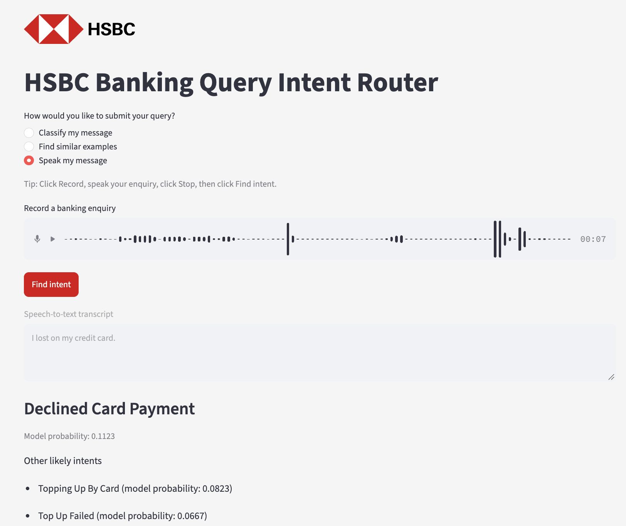
Streamlit Deployment & Demo
Three deployed modes expose predictions,
reference retrieval and voice transcription
Application Interface Screenshots
01 Classify My Message
02 Find Similar Examples
03 Speak My Message
“I lost my card” → Lost Or Stolen Card
“I lost my card” → Lost Or Stolen Card
Whisper transcript → DistilBERT
Model probability: 0.2070
Mean neighbour similarity: 0.8382
Voice accuracy not measured separately
Group 02 · ISOM5240
07

Slide 8
Conclusion & Business Value
From customer language
to structured banking-enquiry information
What We Deliver
Why It Matters
01
Two intent-prediction methods
Evidence-led model choice
Fine-tuned classifier + retrieval voting
Compare alternatives rather than assume
fine-tuning must perform best.
02
Voice-to-intent extension
Flexible enquiry input
Whisper transcript → DistilBERT
Provide speech input alongside typed
messages in a public prototype.
03
Reference-based inspection
Structured enquiry review
Present intent predictions and related
wording for user inspection.
Similar enquiries + similarity scores
Business Takeaway
Choose the approach supported by evidence; use the prototype to structure enquiries for review, not to claim production readiness
Group 02 · ISOM5240
08

