Slide 1
Case Study: Bank Loan

Slide 2
BUSINESS USER REQUIREMENT
To minimize loss, banks need to be able to create approval decisions to determine customers who will default if given a loan, and who will keep paying. An applicant’s demographic, socio-economic profiles, and past behaviours are considered by loan managers before a decision is taken regarding his/her loan application.
Objective: analyse the loan applicant’s data to know what is the current status of the applicants submitted to the bank and the insight you could get from the data.

Slide 3

BUSINESS QUESTIONS
What Parameters are affecting the loan credit default?
Is there any parameter that affects the default process the most (or no parameter at all)?
Is the available data and parameters enough to know what is affecting the credit default or not?

Slide 4
EXECUTIVE SUMMARY
There are no features that has high correlation with default.
The top 3 features are: account check status, duration, and amount of credit.
The current available data is still not enough to determine whether someone default or not.
Notes:
Note: use simpler terms.

Slide 5
KEY ACTIONS
We should get more data to analyze the correlation further.
Using machine learning, we can further explore the effects of each features (feature importance) to the target variable.
Notes:
Tambahkan slide suggestion di akhir.

Slide 6
1. WHAT PARAMETERS ARE AFFECTING LOAN CREDIT DEFAULT?

Slide 7
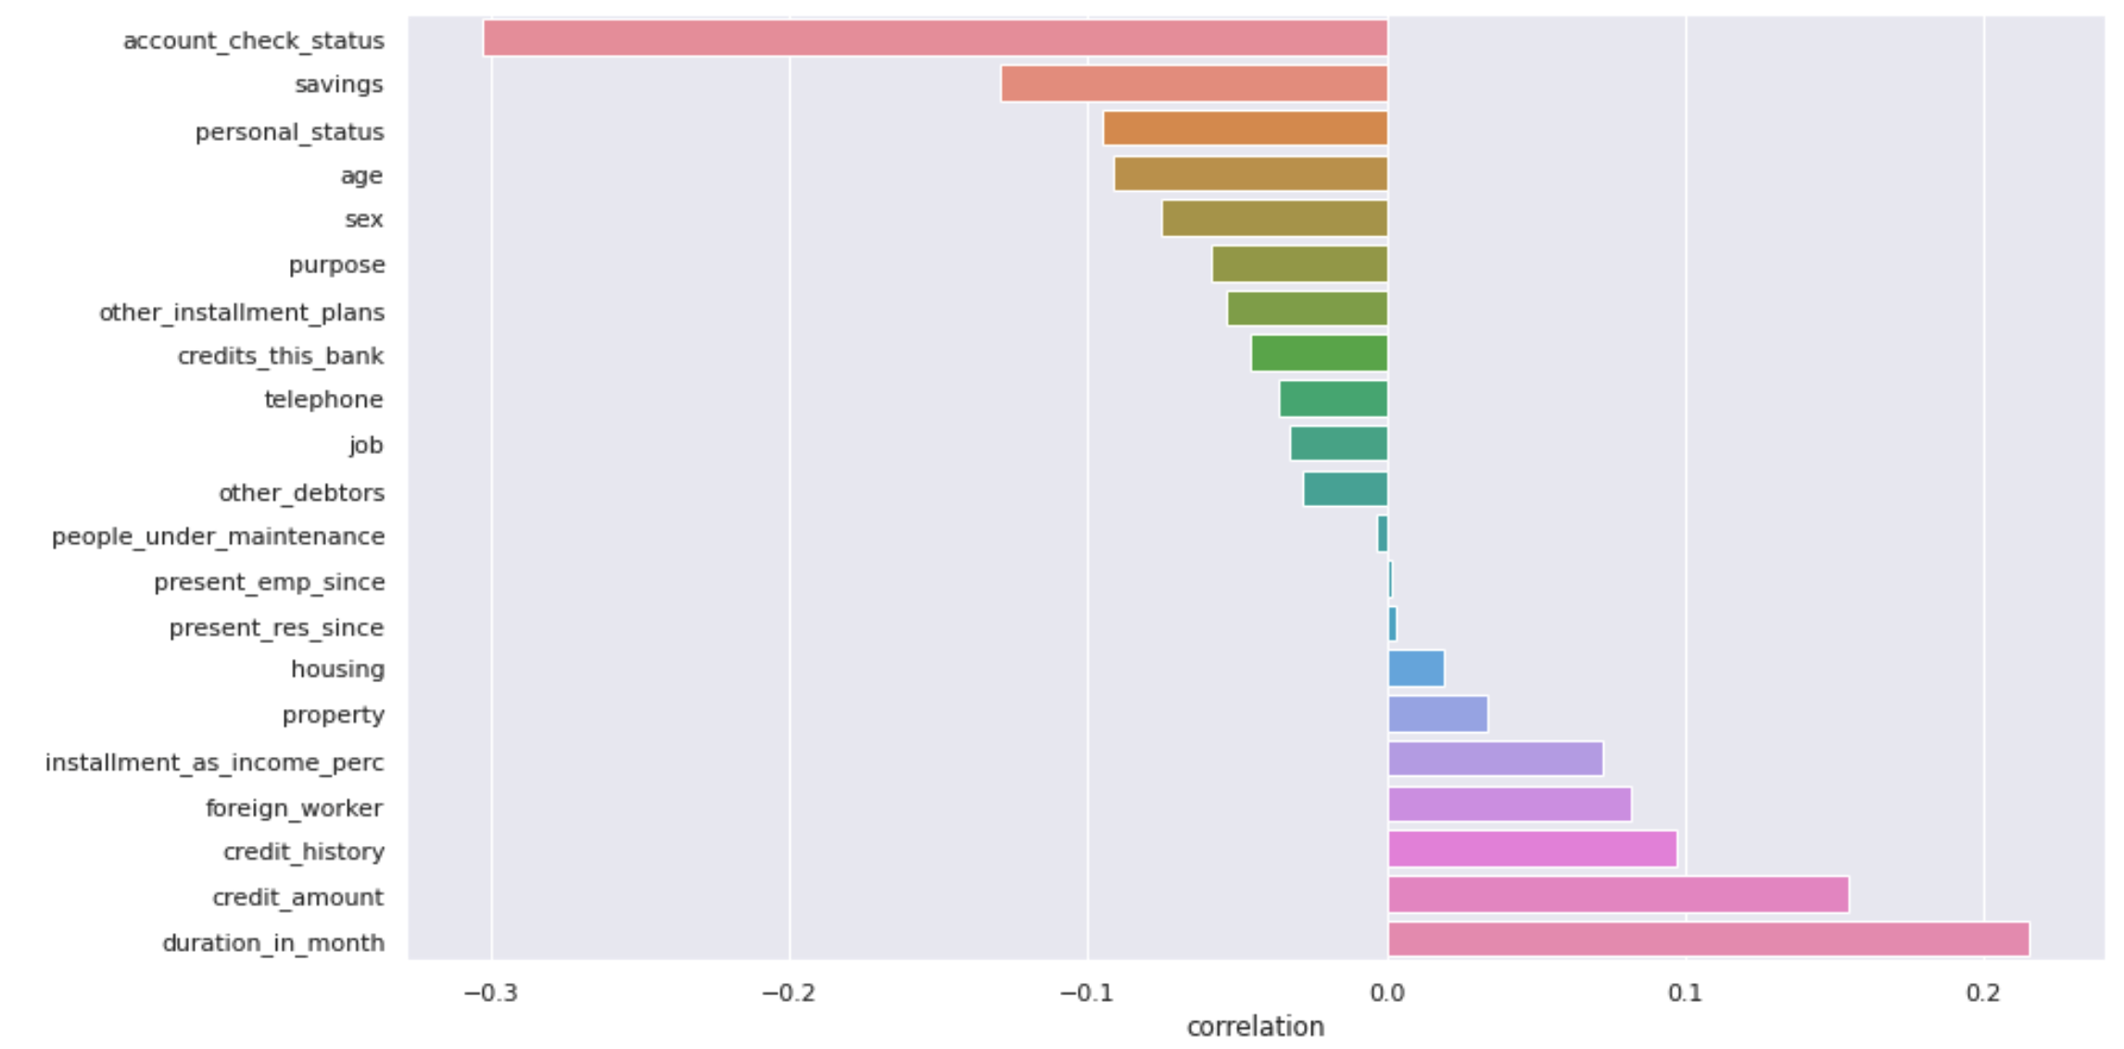
1. WHAT PARAMETERS ARE AFFECTING LOAN CREDIT DEFAULT?
All of the parameters has low correlation (below 0.4) with default.
Parameter with the highest correlation is account_check_status with 0.30 negative correlation and the lowest correlation is present_emp_since with 0.001 positive correlation.

Slide 8
2. IS THERE ANY PARAMETER THAT AFFECTS THE DEFAULT PROCESS THE MOST?

Slide 9
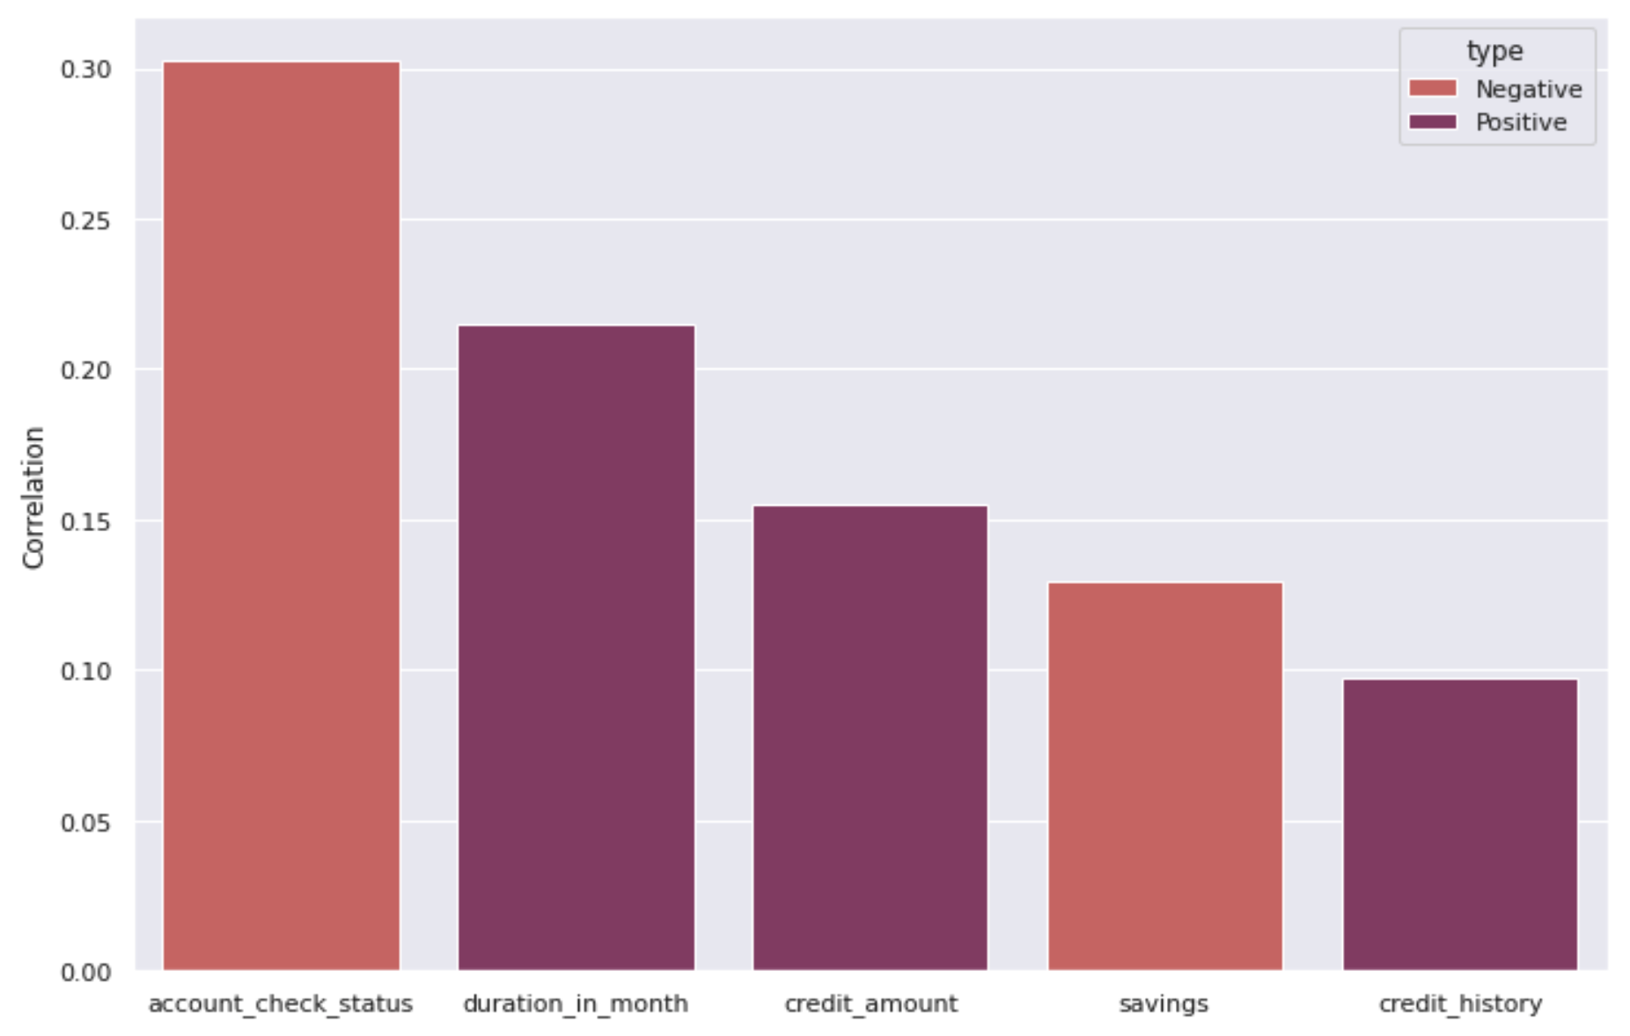
2. IS THERE ANY PARAMETER THAT AFFECTS THE DEFAULT PROCESS THE MOST?
From the top 5 features, 2 out of 5 has negative correlation while the rest has positive correlation.
The most positively correlated feature is account check status and the most negatively correlated feature is duration in month.

Slide 10
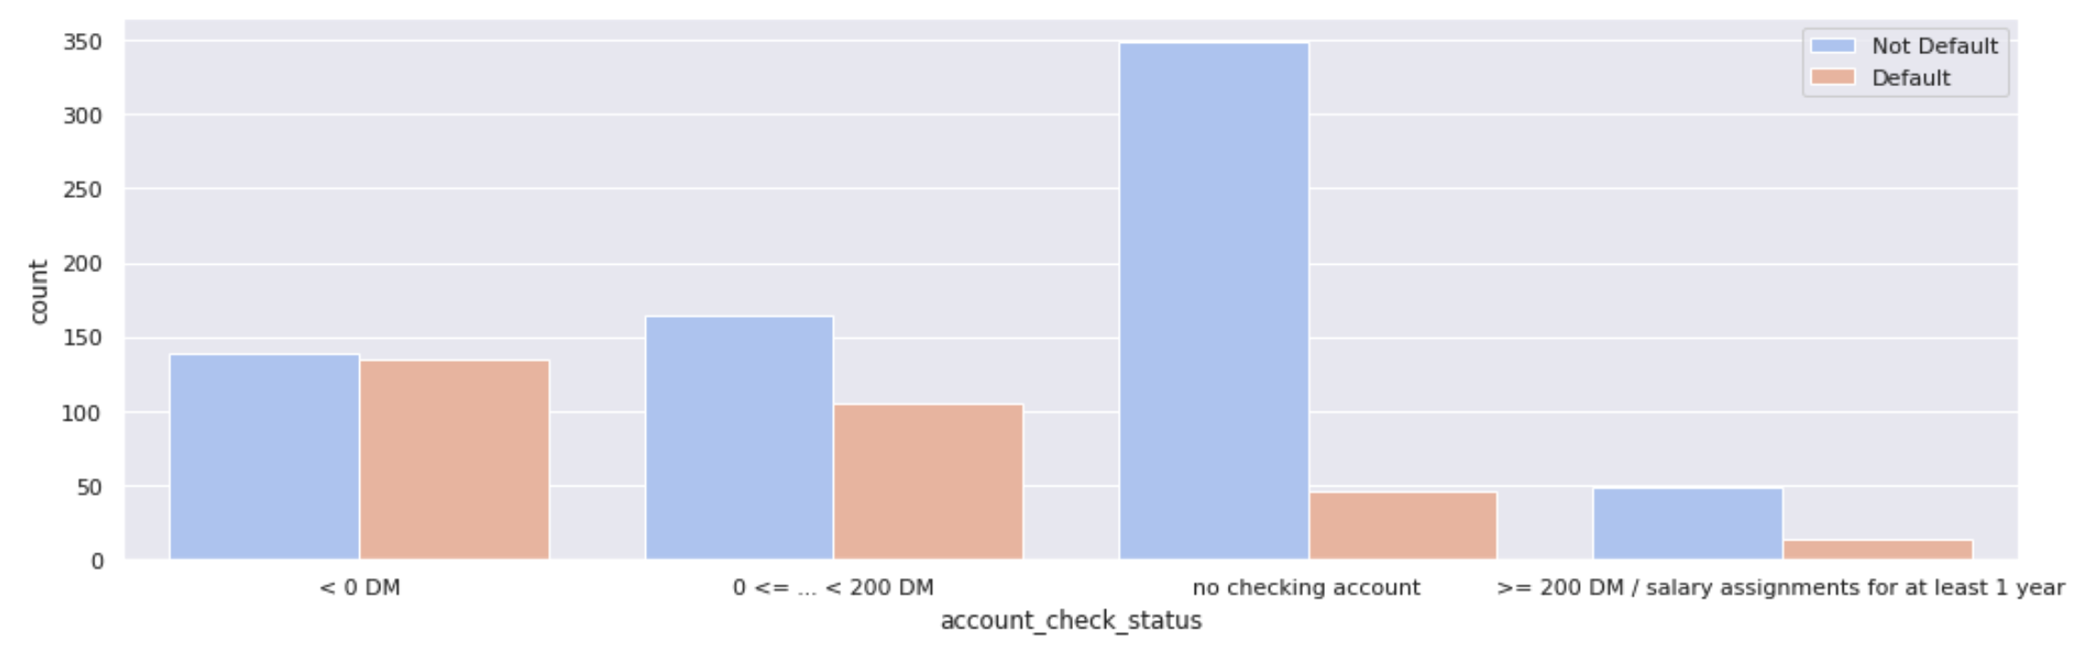
2.1 ACCOUNT CHECK STATUS
Most people who are not default don’t check their account while most people who are default has < 0 DM.

Slide 11
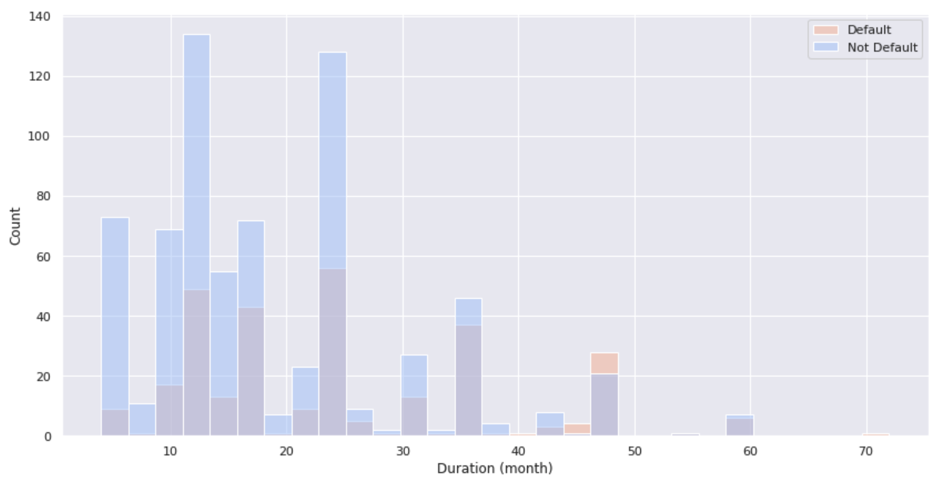
2.2 DURATION IN MONTH
Loan with longer duration tends to be default.
Notes:
Duration in month nya bagus banget karena di groupby per 12 bulan
Soalnya kalua 1 tahun engga seobvious ini

Slide 12
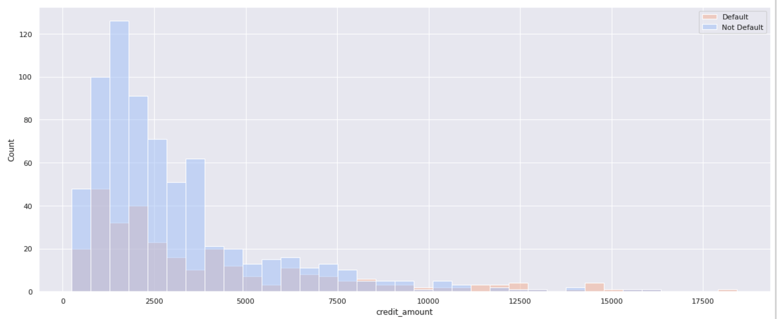
2.3 CREDIT AMOUNT
Higher credit amount tends to be default.

Slide 13
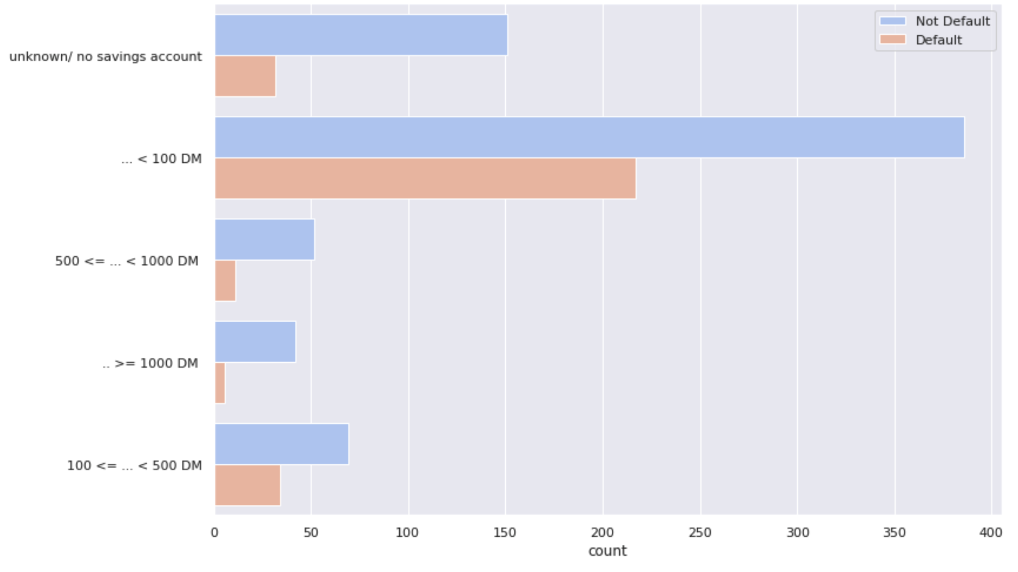
2.4 SAVINGS
Lower savings tends to be default.

Slide 14
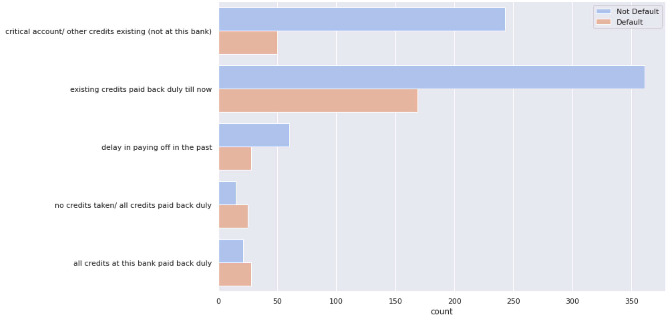
2.5 CREDIT HISTORY
People who has existing credits paid back duty till now is the category with the most default and not default.

Slide 15
3. IS THE AVAILABLE DATA ENOUGH TO DETERMINE DEFAULT OR NOT?

Slide 16
3. IS THE AVAILABLE DATA ENOUGH TO DETERMINE DEFAULT OR NOT?
We still can’t determine whether some default or not using the current data which none of the features has high correlation.
We don't take into account the complementarity of groups of features together.
Measures are based on linearity assumptions and it might be not suitable for the data.
Notes:
Tambahkan slide suggestion di akhir.

Slide 17
THANKS!
Any questions?
Notes:
Beberapa istilah technical harus lebih jelas.
Pakai stackbar/ratio bsa lebih jelas.

