Slide 1
Case Study: Sales Analysis

Slide 2
CASE SUMMARY
You're the Data Analyst of a retail company. The stakeholders want to get the insights from their historical purchases record between two types of products . You were given two datasets (Product1 & Product2) that represent the information about customers' historical purchases.
Objective: Create pitch deck to present your findings to the stakeholders (Presentation slides)

Slide 3

PROBLEM STATEMENTS
What is the most popular item?
How is the sales performance year to year?
What is the ratio between premium and regular users (year to year)?
What is the ratio between online and offline channels (year to year)?
When is the busiest time of the day?
What is our age segmentation?
When is the busiest day of the week?
Who are our top 5 customers?

Slide 4
EXECUTIVE SUMMARY
There is a decreasing trend in revenue since 2017. Both products A and B have seen significant decreased in total transactions.
Evaluate the current promotion method to increase the conversion rate from regular to premium users.
Focus on the channel that generate the most revenue with least expense.
Create promotions during weekends or at night to increase transactions.
Create new product to attract people from 18 to 25 years old and for people below 18 years old.
Give benefits for top customers that generate the most revenue.

Slide 5
1. WHAT IS THE MOST POPULAR ITEM?

Slide 6
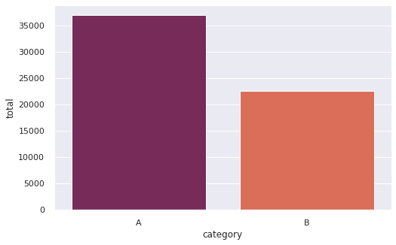
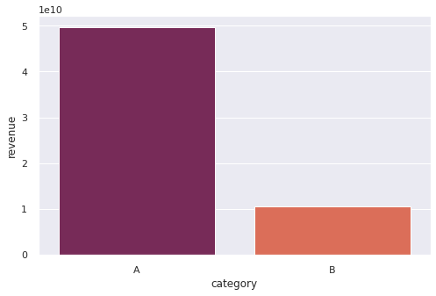
1. WHAT IS THE MOST POPULAR ITEM?
Product A sold for a total of 36966 (62.08%) while product B only sold for 22573 (37.91%).
Product A generate the most revenue from 2013 to 2019.
Keep product A in stock to generate the most revenue.

Slide 7
2. HOW IS THE SALES PERFORMANCE?

Slide 8
2. HOW IS THE SALES PERFORMANCE?
Both product A and B have seen decreased in sales since mid 2017.
In 2019, the sales have decreased significantly compared to the previous years.
Using more data, we can find out the reasons why the sales have dropped since 2017.

Slide 9
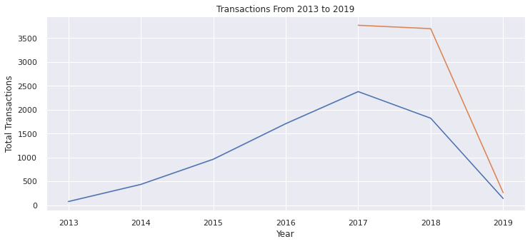
2. HOW IS THE SALES PERFORMANCE?

Slide 10
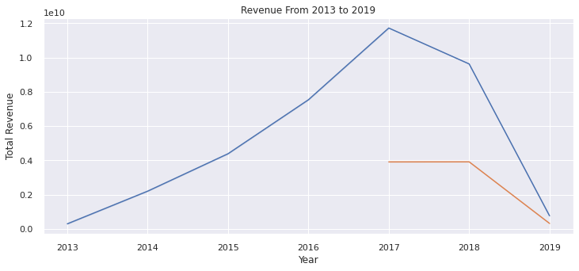
2. HOW IS THE SALES PERFORMANCE?

Slide 11
3. WHAT IS THE RATIO BETWEEN PREMIUM AND REGULAR USERS?

Slide 12
3. WHAT IS THE RATIO BETWEEN PREMIUM AND REGULAR USERS?
Percentage of premium users that bought product A have stayed mostly the same between the interval 50 to 60 percent. While for product B, the percentage of premium user is slightly higher.
Promotion team has sucessfully maintain the ratio between premium user and regular user despite the fact that the number of transactions keep increasing up to 2017.
Evaluate the current promotion method to increase the conversion rate from regular to premium users.

Slide 13
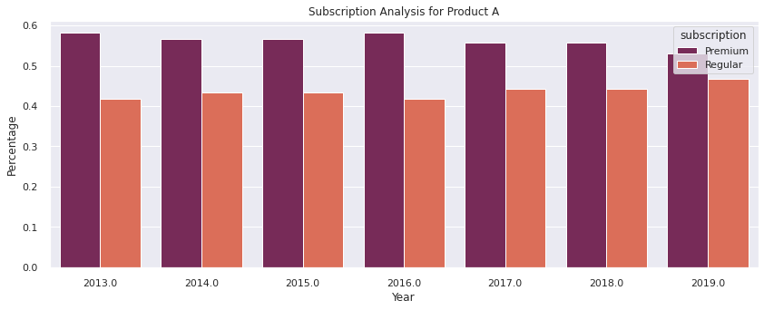
3. WHAT IS THE RATIO BETWEEN PREMIUM AND REGULAR USERS?

Slide 14
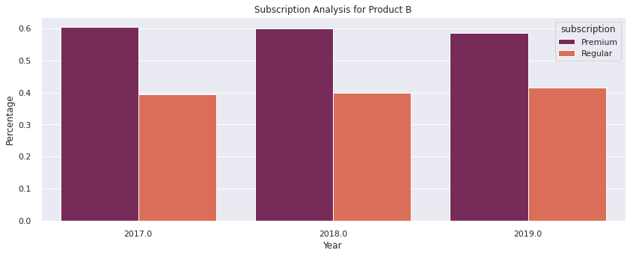
3. WHAT IS THE RATIO BETWEEN PREMIUM AND REGULAR USERS?

Slide 15
4. WHAT IS THE RATIO BETWEEN ONLINE AND OFFLINE CHANNELS?

Slide 16
4. WHAT IS THE RATIO BETWEEN ONLINE AND OFFLINE CHANNELS?
Offline channels for product A have dropped from 66% in 2013 to 54% in 2019.
Channels ratio for product B have seen 6% increase in offline sales from 2018 to 2019.
The company should focus on the channel that generate the most revenue with least expense.

Slide 17
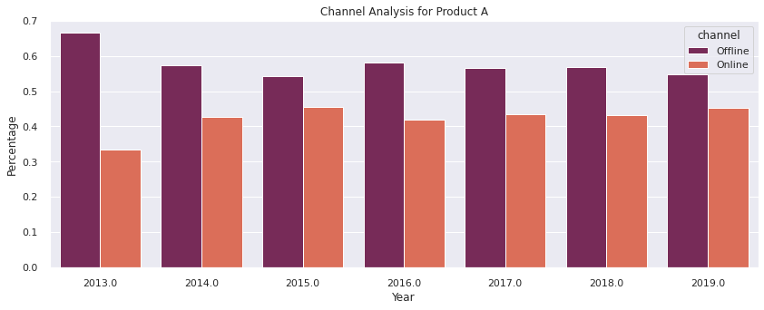
4. WHAT IS THE RATIO BETWEEN ONLINE AND OFFLINE CHANNELS?

Slide 18
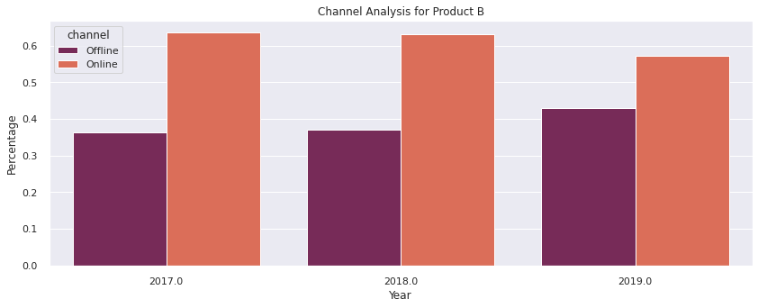
4. WHAT IS THE RATIO BETWEEN ONLINE AND OFFLINE CHANNELS?

Slide 19
5. WHEN IS THE BUSIEST TIME OF THE DAY?

Slide 20
5. WHEN IS THE BUSIEST TIME OF THE DAY?
The most popular time is during morning and early morning while the least popular is during evening and night.
Create promotions during evening and night to increase transactions.

Slide 21
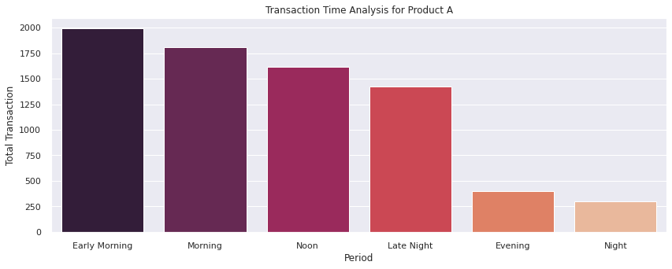
5. WHEN IS THE BUSIEST TIME OF THE DAY?

Slide 22
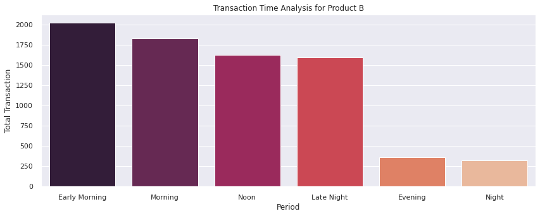
5. WHEN IS THE BUSIEST TIME OF THE DAY?

Slide 23
6. WHAT IS THE AGE SEGMENTATION?

Slide 24
6. WHAT IS THE AGE SEGMENTATION?
The category that has the most customers for product A is 26-25 with a total of 2091 customers while for product B is 46-55 with 2138 customers.
Both products are more appealing to people older than 25 years old.
Create new product to attract the 18-25 category.
Besides that, creating a new product to target people below 18 years old is also reasonable as long as it's still relevant for the company.

Slide 25
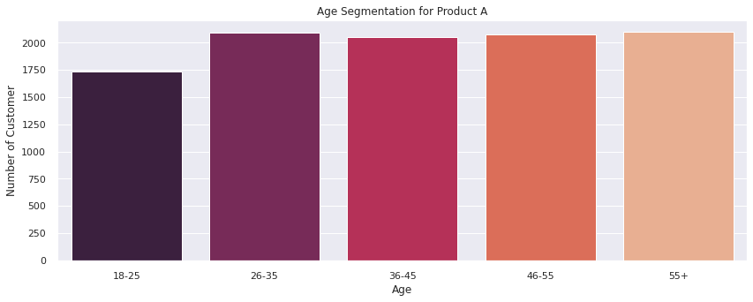
6. WHAT IS THE AGE SEGMENTATION?

Slide 26
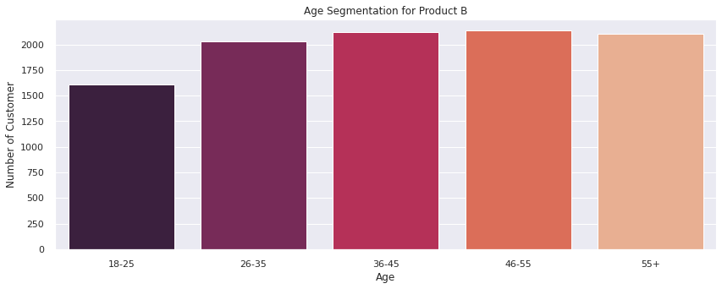
6. WHAT IS THE AGE SEGMENTATION?

Slide 27
7. WHEN IS THE BUSIEST DAY OF THE WEEK?

Slide 28
7. WHEN IS THE BUSIEST DAY OF THE WEEK?
We can see that the transactions are mostly done on weekday because there is a slight decrease in weekends.
Create promotions during weekends to attract more customers.

Slide 29
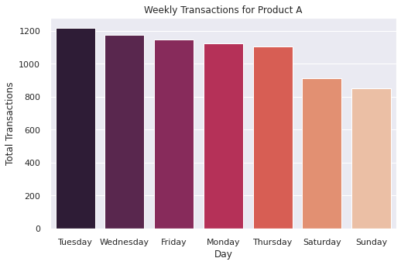
7. WHEN IS THE BUSIEST DAY OF THE WEEK?

Slide 30
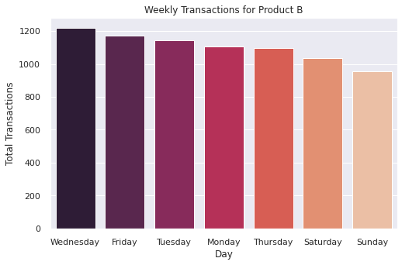
7. WHEN IS THE BUSIEST DAY OF THE WEEK?

Slide 31
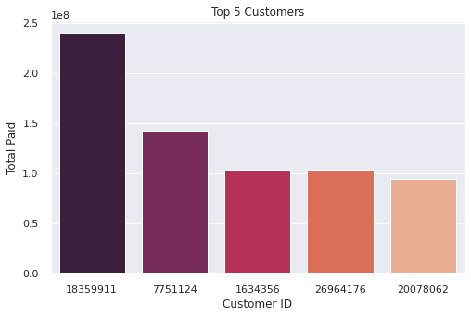
8. WHO ARE OUR TOP 5 CUSTOMERS?
There are 5 customers that generate the most revenue: 18359911, 7751124, 1634356, 26964176, and 20078062.
Create benefits for top customers to increase sales.

Slide 32
THANKS!
Any questions?

