Slide 1
Android Fundamentals 3
Elvedin Selimoski

Slide 2
Last class summary
Activity ← Actvity
Parcelable
Responsive Design
Handle configuration changes
CardView
ItemTouchHelper
Effective Java for Android

Slide 3
The plan
Dialogs
Pickers
Tabs and swipes
Navigation drawer
Bottom navigation

Slide 4
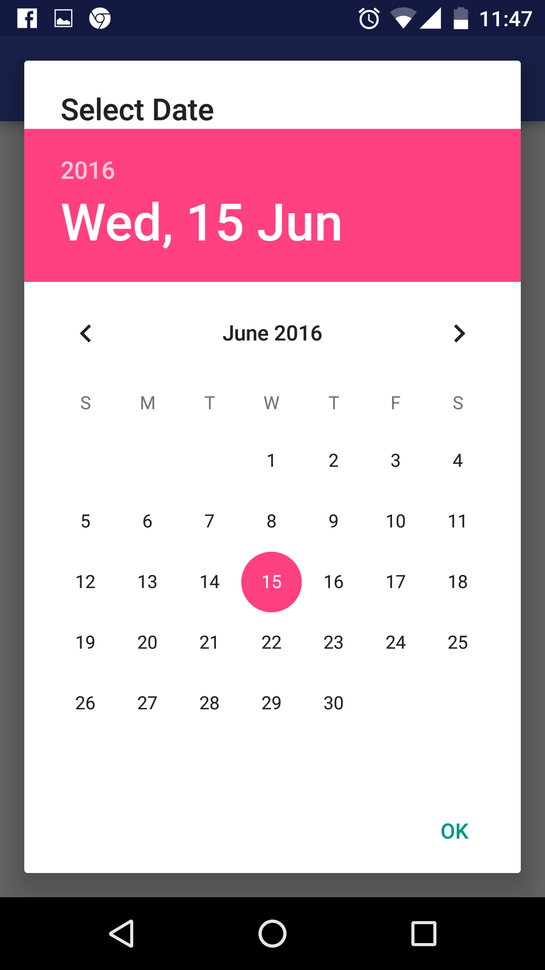
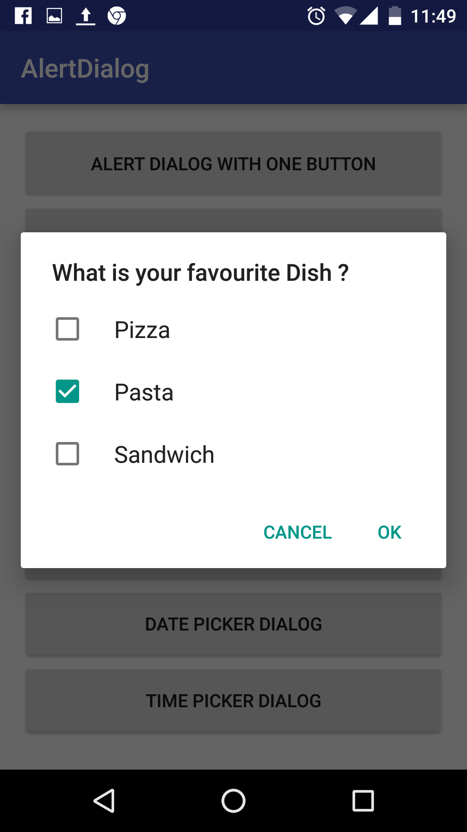
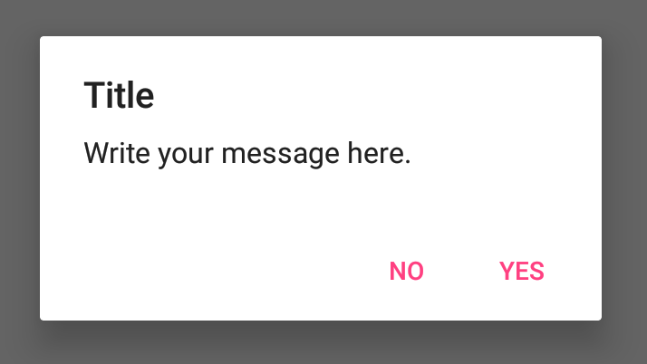
Dialogs
Dialog appears on top, interrupting flow of Activity
Requires user action to dismiss

Slide 5
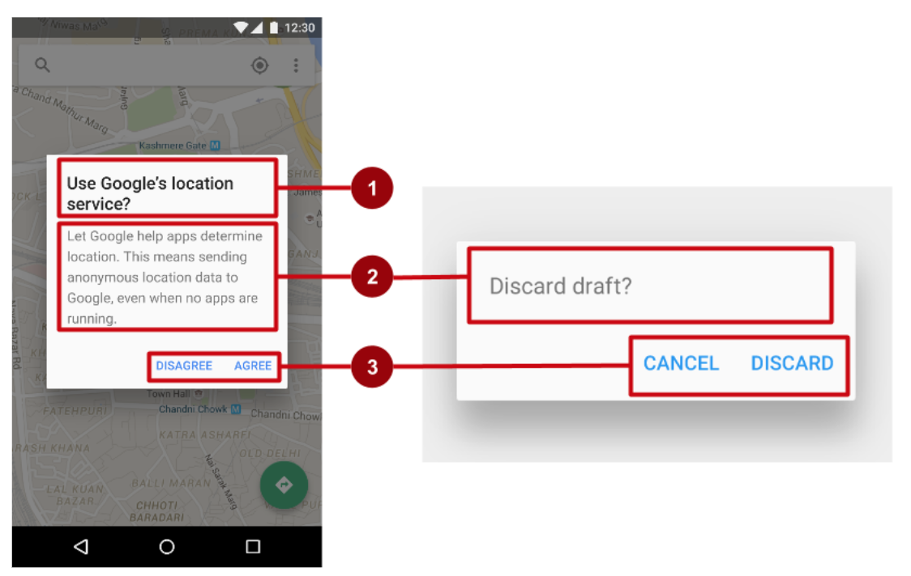
AlertDialog
AlertDialog can show:
  Title (optional)
  Content area
  Action buttons

Slide 6
AlertDialog
Use AlertDialog.Builder to build alert dialog and set attributes:
public void onClickShowAlert(View view) {
  AlertDialog.Builder alertDialog = new AlertDialog. Builder(MainActivity.this);
  alertDialog.setTitle("Connect to Provider");
  alertDialog.setMessage(R.string.alert_message);
  // ... Code to set buttons goes here.

Slide 7
AlertDialog
alertDialog.setPositiveButton()
alertDialog.setNeutralButton()
alertDialog.setNegativeButton()
alertDialog.setPositiveButton(
"OK", new DialogInterface.OnClickListener() {
public void onClick(DialogInterface dialog, int which) {
// User clicked OK button.
}
});
Same pattern for setNegativeButton() and setNeutralButton()

Slide 8
Pickers
Pickers use fragments
Use DialogFragment to show a picker
DialogFragment is a window that floats on top of Activity window

Slide 9
Creating a date picker dialog
Add a blank Fragment that extends DialogFragment and implements DatePickerDialog.OnDateSetListener
In onCreateDialog() initialize the date and return the dialog
In onDateSet() handle the date
In Activity show the picker and add method to use date

Slide 10
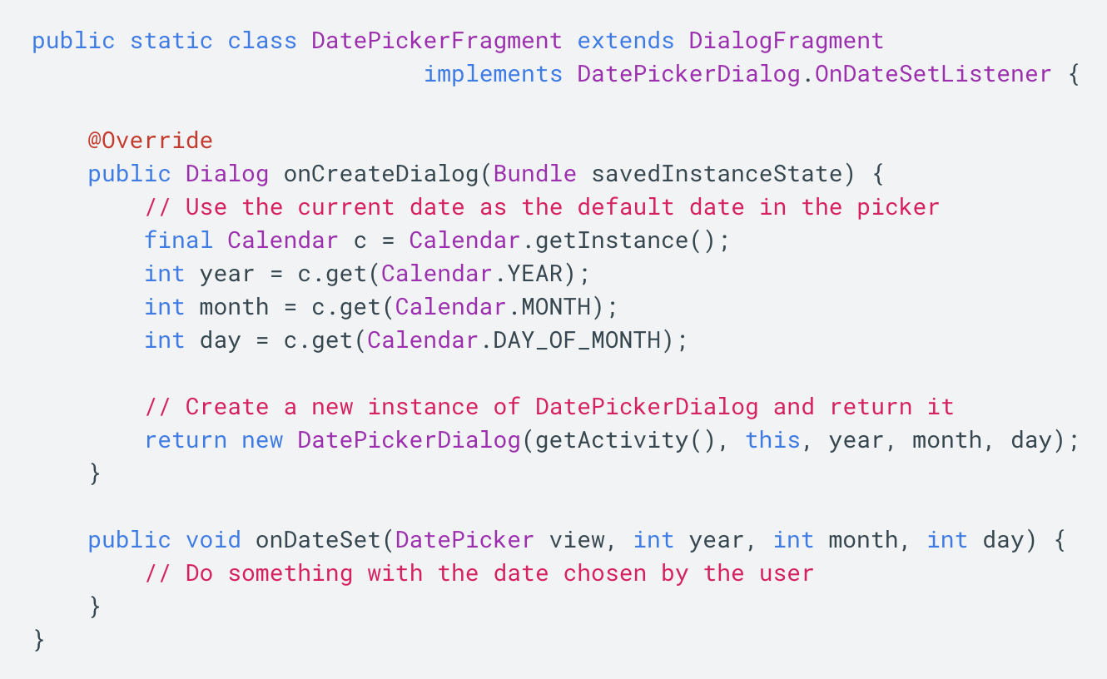
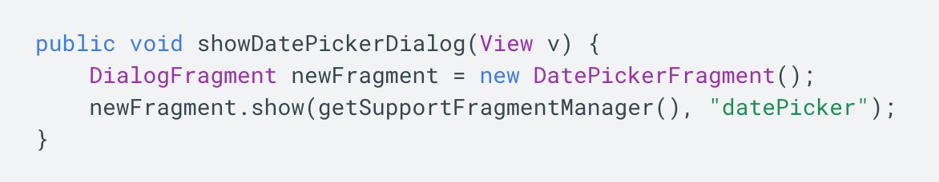
Creating a date picker dialog

Slide 11
Creating a time picker dialog
Add a blank Fragment that extends DialogFragment and implements TimePickerDialog.OnTimeSetListener
In onCreateDialog() initialize the time and return the dialog
In onTimeSet() handle the time
In Activity, show the picker and add method to use time

Slide 12
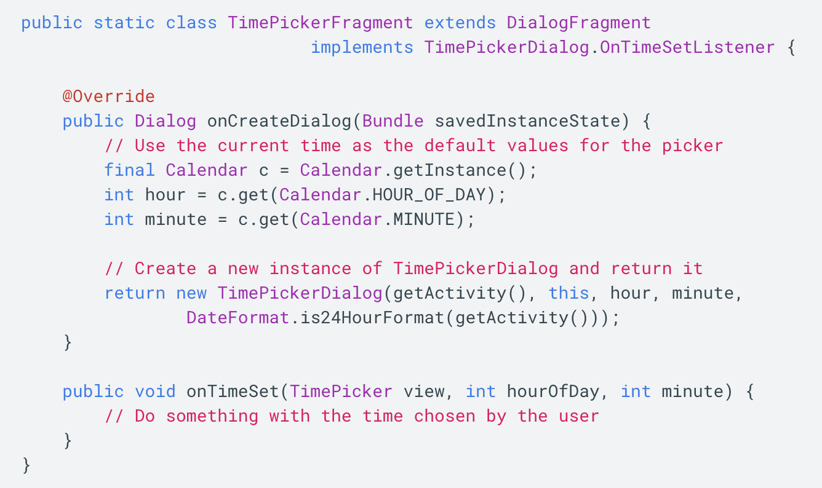
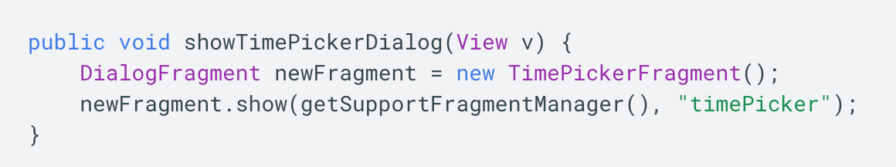
Creating a time picker dialog

Slide 13
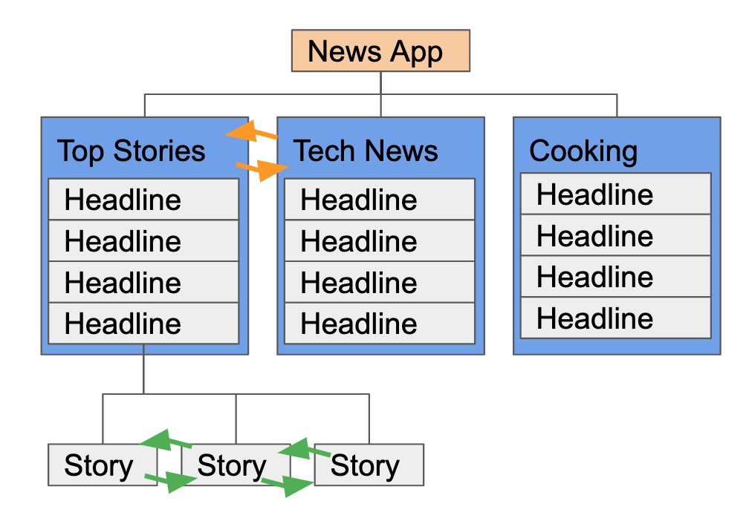
Tabs and swipes
Between siblings
From a list of stories to a list in a different tab
From story to story under the same tab

Slide 14
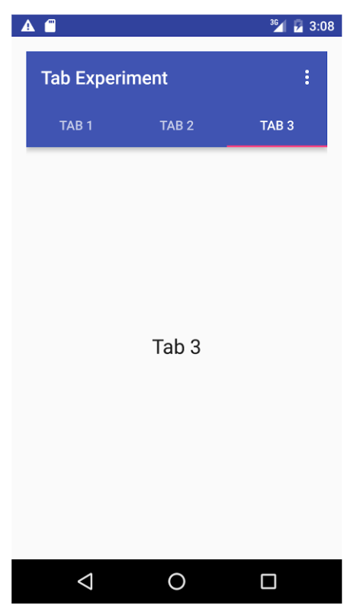
Benefits of using tabs and swipes
A single, initially-selected tab—users have access to content without further navigation
Navigate between related screens without visiting parent

Slide 15
Best practices with tabs
Lay out horizontally
Run along top of screen
Persistent across related screens
Switching should not be treated as history

Slide 16
Steps for implementing tabs
Define the tab layout using TabLayout
Implement a Fragment and its layout for each tab
Implement a PagerAdapter from FragmentPagerAdapter or FragmentStatePagerAdapter
Create an instance of the tab layout
Use PagerAdapter to manage screens (each screen is a Fragment)
Set a listener to determine which tab is tapped

Slide 17
Add tab layout below Toolbar
<android.support.design.widget.TabLayout android:id="@+id/tab_layout" android:layout_width="match_parent" android:layout_height="wrap_content" android:layout_below="@id/toolbar" android:background="?attr/colorPrimary" android:minHeight="?attr/actionBarSize" android:theme="@style/ThemeOverlay. AppCompat.Dark.ActionBar"/>

Slide 18
Add view pager below TabLayout
<android.support.v4.view.ViewPager
android:id="@+id/pager"
android:layout_width="match_parent"
android:layout_height="fill_parent"
android:layout_below="@id/tab_layout" />

Slide 19
Create a tab layout in onCreate()
TabLayout tabLayout = findViewById(R.id.tab_layout);
tabLayout.addTab(tabLayout.newTab().setText("Tab 1"));
tabLayout.addTab(tabLayout.newTab().setText("Tab 2"));
tabLayout.addTab(tabLayout.newTab().setText("Tab 3"));
tabLayout.setTabGravity(TabLayout.GRAVITY_FILL);

Slide 20
Add the view pager in onCreate()
final ViewPager viewPager = findViewById(R.id.pager);
final PagerAdapter adapter = new PagerAdapter (getSupportFragmentManager(),tabLayout.getTabCount());
viewPager.setAdapter(adapter);

Slide 21
Add the listener in onCreate()
viewPager.addOnPageChangeListener(
new TabLayout.TabLayoutOnPageChangeListener(tabLayout));
tabLayout.addOnTabSelectedListener(
new TabLayout.OnTabSelectedListener() {
@Override
public void onTabSelected(TabLayout.Tab tab) {
viewPager.setCurrentItem(tab.getPosition());
  }
@Override
public void onTabUnselected(TabLayout.Tab tab) {}
@Override
public void onTabReselected(TabLayout.Tab tab) {} });

Slide 22
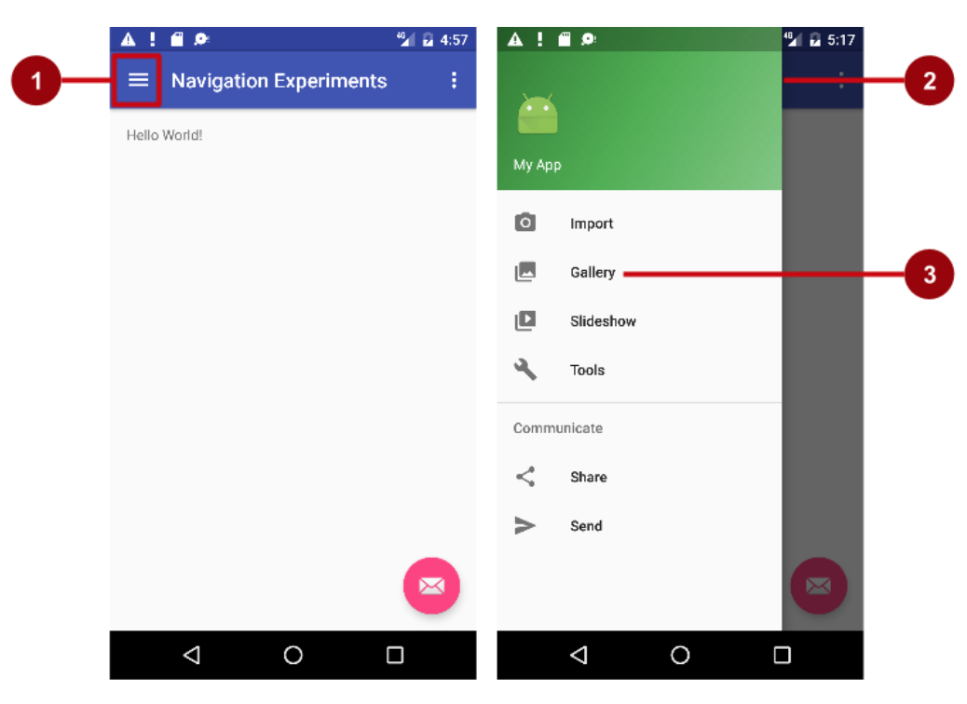
Navigation drawer
Icon in app bar
Header
Menu items

Slide 23
Layouts for for navigation drawer
Create layouts:
  A navigation drawer as the Activity layout root ViewGroup
  A navigation View for the drawer itself
  An app bar layout that includes room for a navigation icon button
  A content layout for the Activity that displays the navigation drawer
  A layout for the navigation drawer header

Slide 24
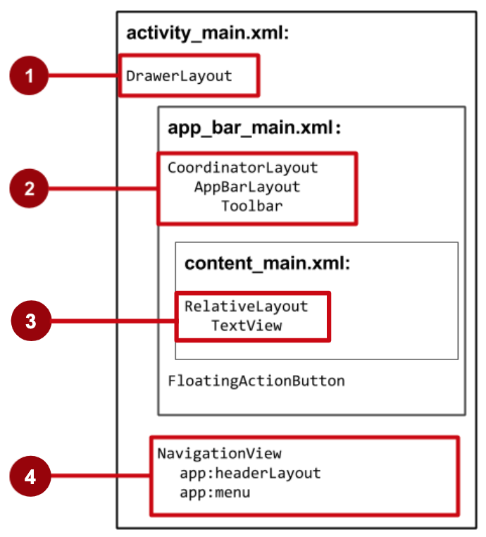
Navigation drawer Activity layout
DrawerLayout is root view
CoordinatorLayout contains app bar layout with a Toolbar
App content screen layout
NavigationView with layouts for header and selectable items

Slide 25
Steps to implement navigation drawer
Populate navigation drawer menu with item titles and icons
Set up navigation drawer and item listeners in the Activity code
Handle the navigation menu item selections
Actual implementation tutorial

Slide 26
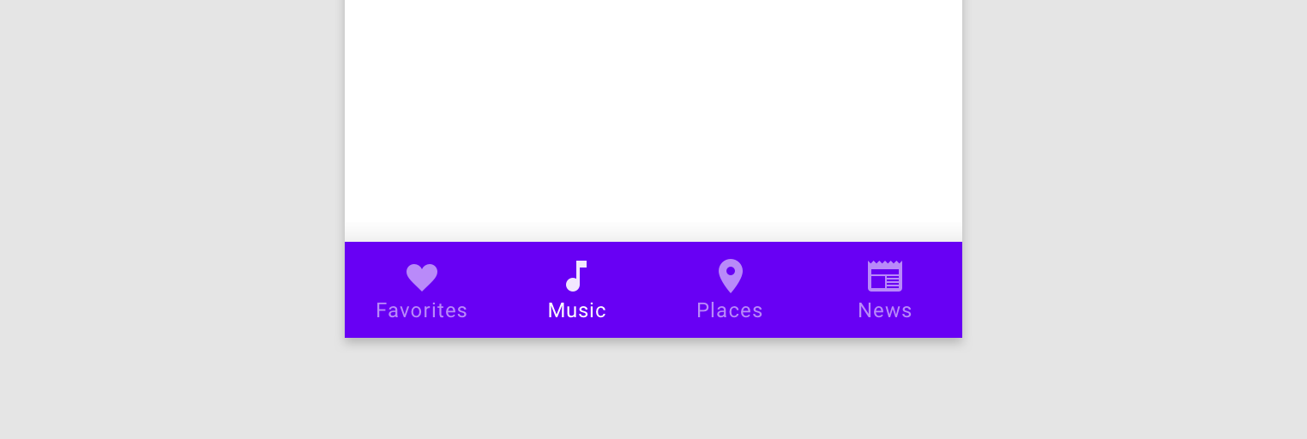
Bottom navigation
Populate bottom navigation menu with item titles and icons
Set up bottom navigation and item listeners in the Activity code
Handle the navigation menu item selections

Slide 27
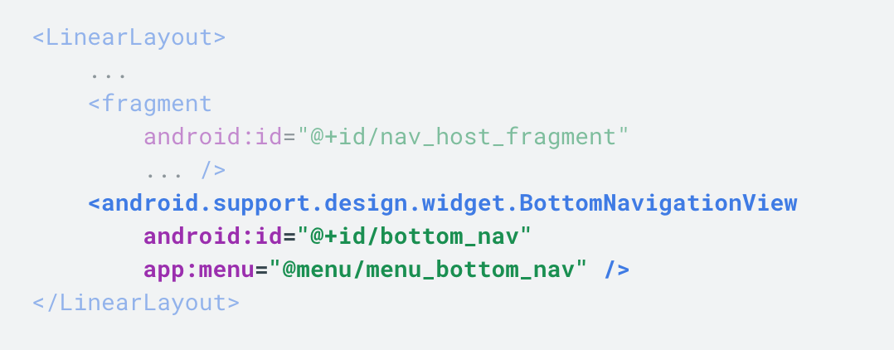
Bottom navigation
setOnNavigationItemSelectedListener(BottomNavigationView.OnNavigationItemSelectedListener listener)

