Slide 1
Android Fundamentals 2
Elvedin Selimoski

Slide 2
Last class summary
Passing data to fragment
Events
Custom Listeners
Mobile Screen Archetypes
Book Store App

Slide 3
The plan
Activity ← Actvity
Parcelable
Responsive Design
Handle configuration changes
CardView
ItemTouchHelper
Effective Java for Android

Slide 4
Component communication
Activity → Activity ✔
Activity ← Actvity ?
Activity → Fragment ✔
Activity ← Fragment ✔
Fragment → Fragment (Prefered Fragment → Actvity → Fragment) ✔

Slide 5
Activity ← Actvity
In the first activity
  startActivityForResult(intent, RESULT_CODE)
  onActivityResult() - has 3 arguments
    The request code passed in startActivityForResult()
    A result code specified by the second activity. (RESULT_OK or RESULT_CANCELED)
    Intent that carries the result data
In the second activity should return a result
  setResult(RESULT_OK, resultIntent)
  finish()

Slide 6
Parcelable
For passing composite/complex objects
Implement Parcelable interface
  writeToParcel()
  Creator
  Constractor with Parcel argument

Slide 7
Parcelable – implementation example
public class MyParcelable implements Parcelable {
private int mData;
public int describeContents() {
return 0;
}
public void writeToParcel(Parcel out, int flags) {
out.writeInt(mData);
}
public static final Parcelable.Creator<MyParcelable> CREATOR
= new Parcelable.Creator<MyParcelable>() {
public MyParcelable createFromParcel(Parcel in) {
return new MyParcelable(in);
}
public MyParcelable[] newArray(int size) {
return new MyParcelable[size];
}
};
private MyParcelable(Parcel in) {
mData = in.readInt();
}
}
Same write/read order

Slide 8
Responsive Design
Alternative layout files for different form factors (i.e phone vs tablet)
Alternative string resources for different languages (i.e Macedonian vs English)
Alternative drawable resources for different screen densities (shown below)
Alternate layout files for different screen orientations (i.e portrait vs landscape)

Slide 9
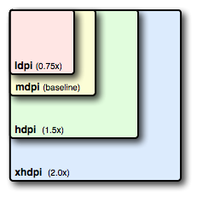
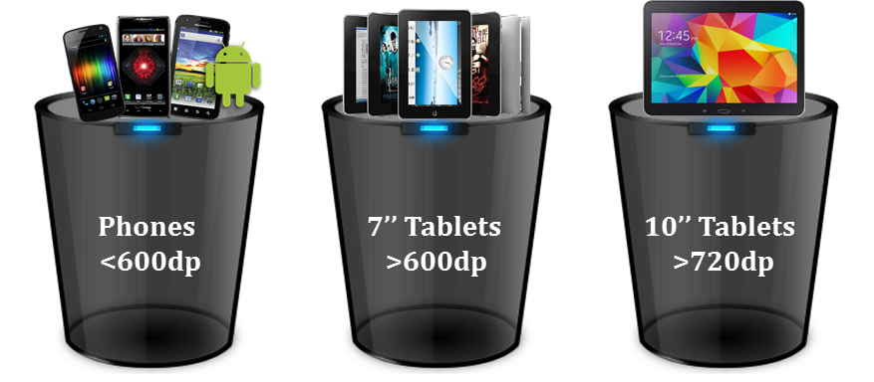
Responsive Design

Slide 10
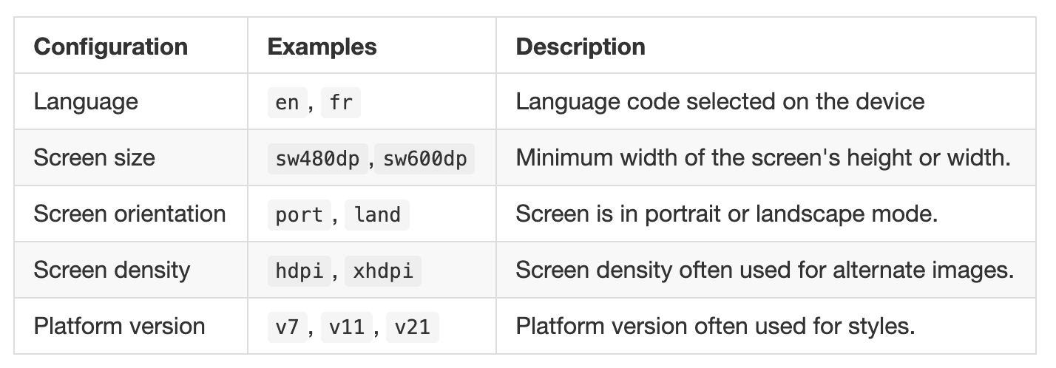
Understanding Qualifiers
Whole list of qualifiers.

Slide 11
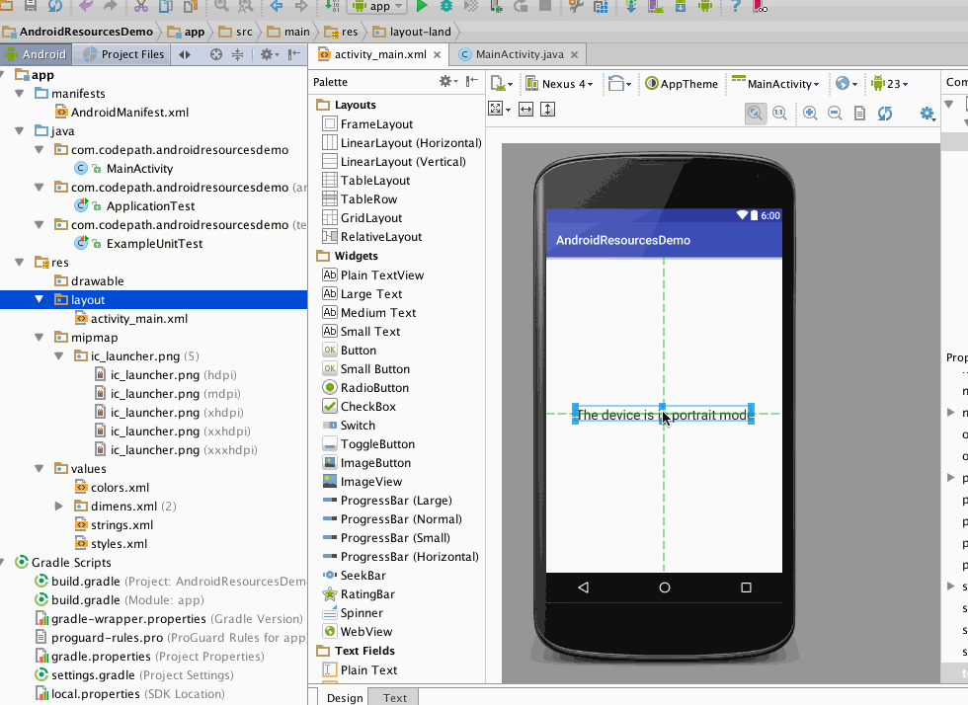
Creating Alternate Resources

Slide 12
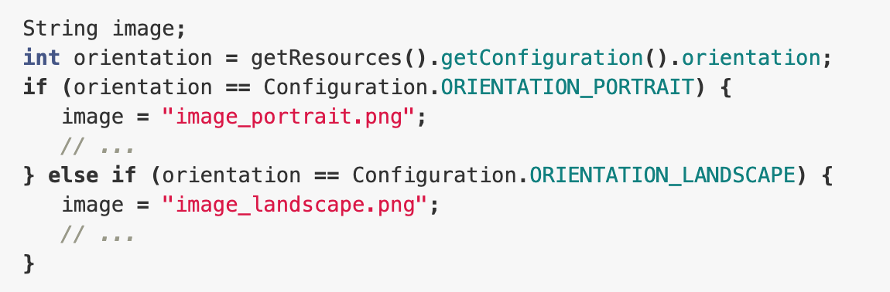
Determining Configuration at Runtime

Slide 13
Handle configuration changes
Retain an object during a configuration change
  activity restarts on configuration changes
  carry a stateful object to the new instance of your activity
Handle the configuration change yourself
  not recommended due to the hidden complexity of handling the configuration changes
  OnConfigurationChanged() callback, for manually updating the activity

Slide 14
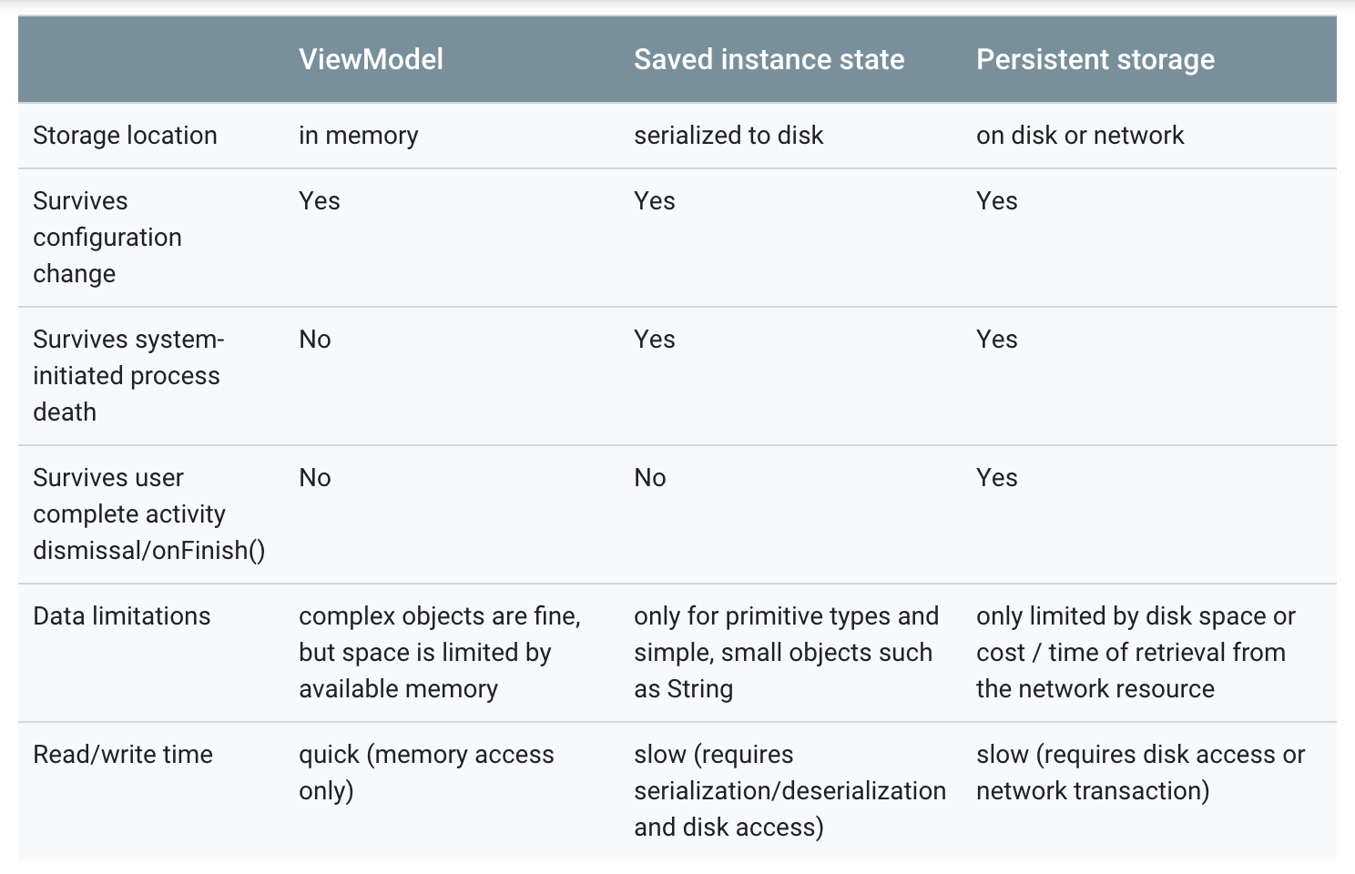
Retain an object during a configuration change

Slide 15
Retain an object during a configuration change
Use ViewModel to handle configuration changes
Use onSaveInstanceState() as backup to handle system-initiated process death, only for small data
Use local persistence to handle process death for complex or large data

Slide 16
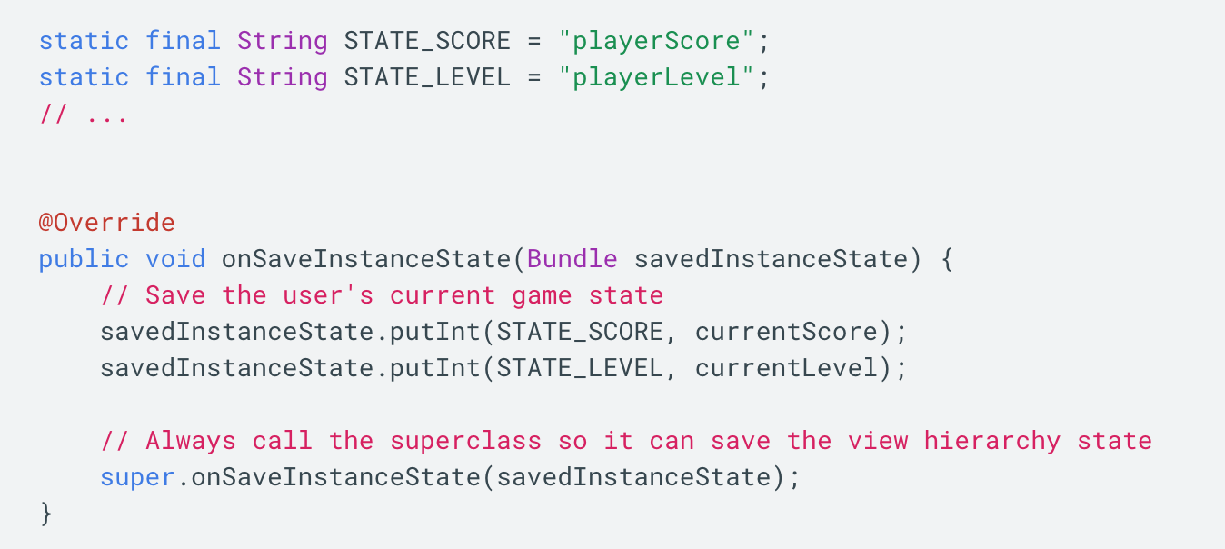
onSaveInstanceState()
Save simple, lightweight UI state using onSaveInstanceState()
onSaveInstanceState() is not called when the user explicitly closes the activity or in other cases when finish() is called.

Slide 17
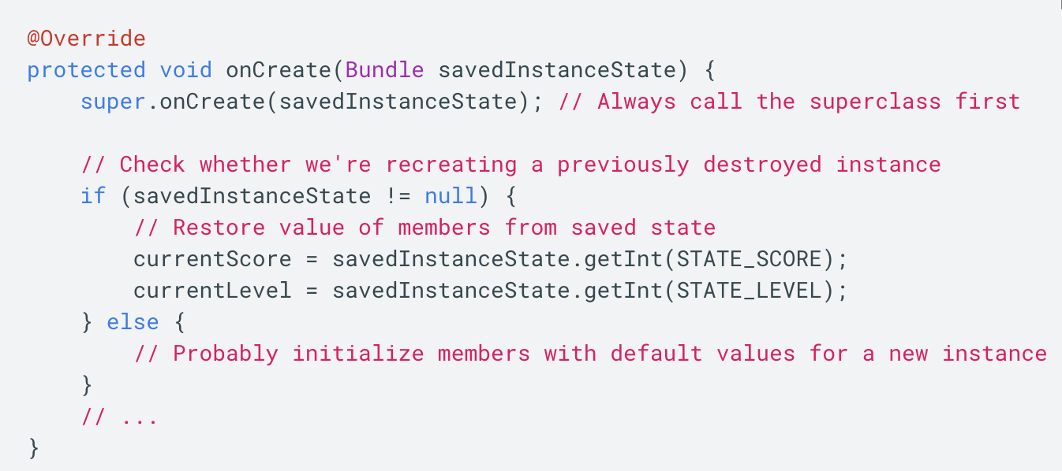
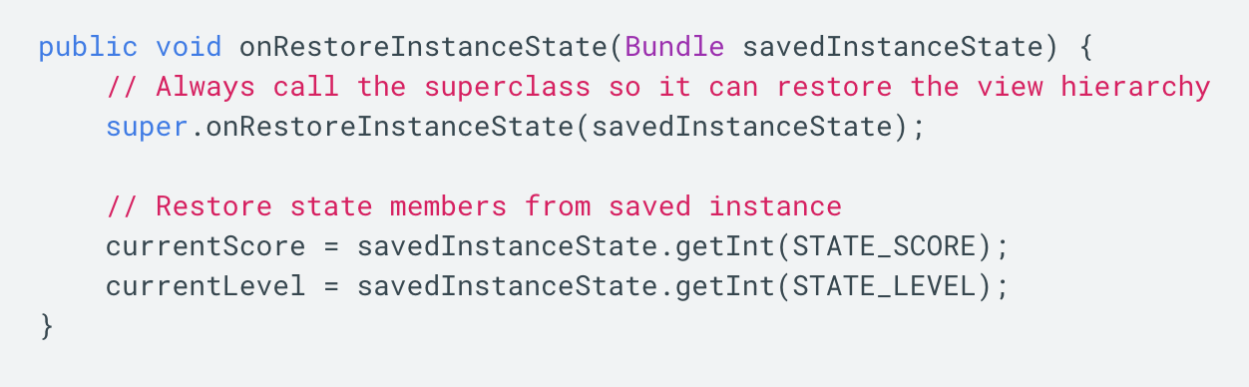
Restore activity UI state using saved instance state

Slide 18
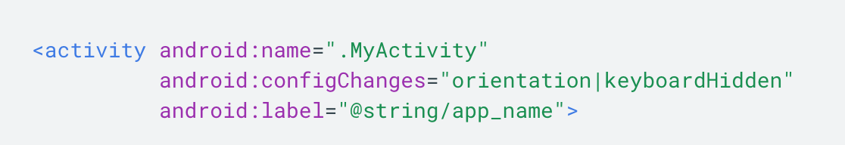
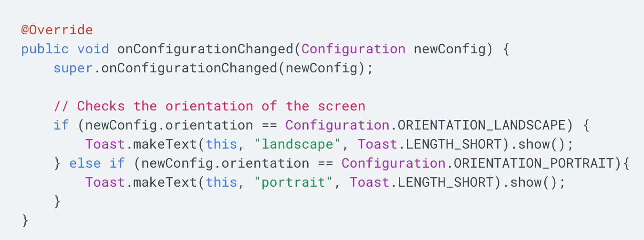
Handle the configuration change yourself

Slide 19
CardView
implementation 'com.android.support:cardview-v7:26.1.0'
Wrap the Layout with CardView
XML attributes:
  cardCornerRadius
  cardElevation
  contentPadding

Slide 20
Glide
implementation 'com.github.bumptech.glide:glide:3.7.0'
Glide.with(mContext).load(imageUrl).into(imageView);

Slide 21
Make your CardView swipeable, movable, and clickable
Material design guidelines:
  A card can be dismissed, usually by swiping it away.
  A list of cards can be reordered by holding down and dragging the cards.
  Tapping on card provides further details.

Slide 22
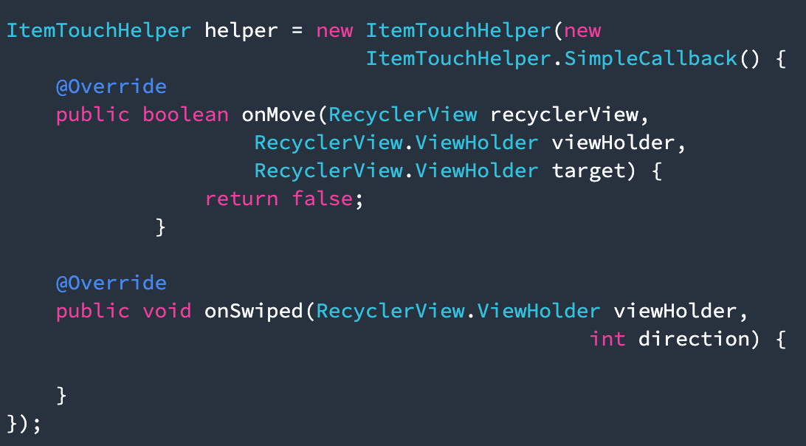
Implement swipe to dismiss
1. Create ItemTouchHelper

Slide 23
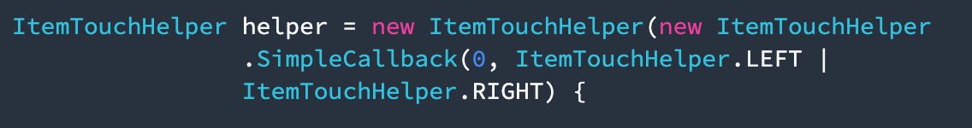
Implement swipe to dismiss
2. Implement correct ItemTouchHelper.SimpleCallback() constructor
  ItemTouchHelper.SimpleCallback(int dragDirs, int swipeDirs)
3. in onSwiped() method, remove the item on position viewHolder.getAdapterPosition() and notify the adapter for the removal.
4. Attach the recyclerView to the itemTouchHelper

Slide 24
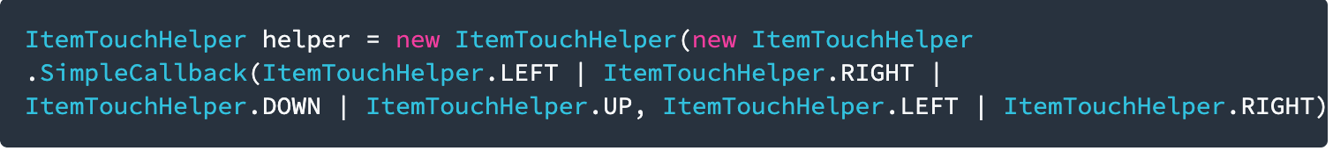
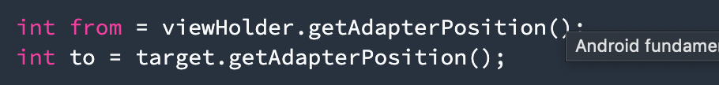


Implement drag and drop
Similar as swipe functionality
Implement correct ItemTouchHelper.SimpleCallback() constructor
Implement onMove() method using first viewHolder as source and second viewHolder as target. Also return true in the end.
Swap items in the adapter and notify the adapter

Slide 25
Effective Java for Android
Builder Pattern
Static Factory Methods
Static Inner Classes
Return Empty Collection
Use StringBuilder
Force No Instantiation
More Details

