Slide 1
Debugging
Elvedin Selimoski

Slide 2
Last class summary
Dialogs
Pickers
Tabs and swipes
Navigation drawer
Bottom navigation

Slide 3
The plan
All code has bugs
Android Studio logging
Android Studio debugger
Working with breakpoints
Changing variables
Stepping through code

Slide 4
Bugs
Incorrect or unexpected result, wrong values
Crashes, exceptions, freezes, memory leaks
Causes
  Human Design or Implementation Error > Fix your code
  Software fault, but in libraries > Work around limitation
  Hardware fault or limitation -> Make it work with what's available

Slide 5
Android Studio debugging tools
Android Studio has tools that help you
  identify problems
  find where in the source code the problem is created
  so that you can fix it

Slide 6
Add Log messages to your code
import android.util.Log;
// Use class variable with class name as tag
private static final String TAG =
MainActivity.class.getSimpleName();
// Show message in Logcat pane of Android Studio
// Log.<log-level>(TAG, "Message");
Log.d(TAG, “Hello World”);

Slide 7
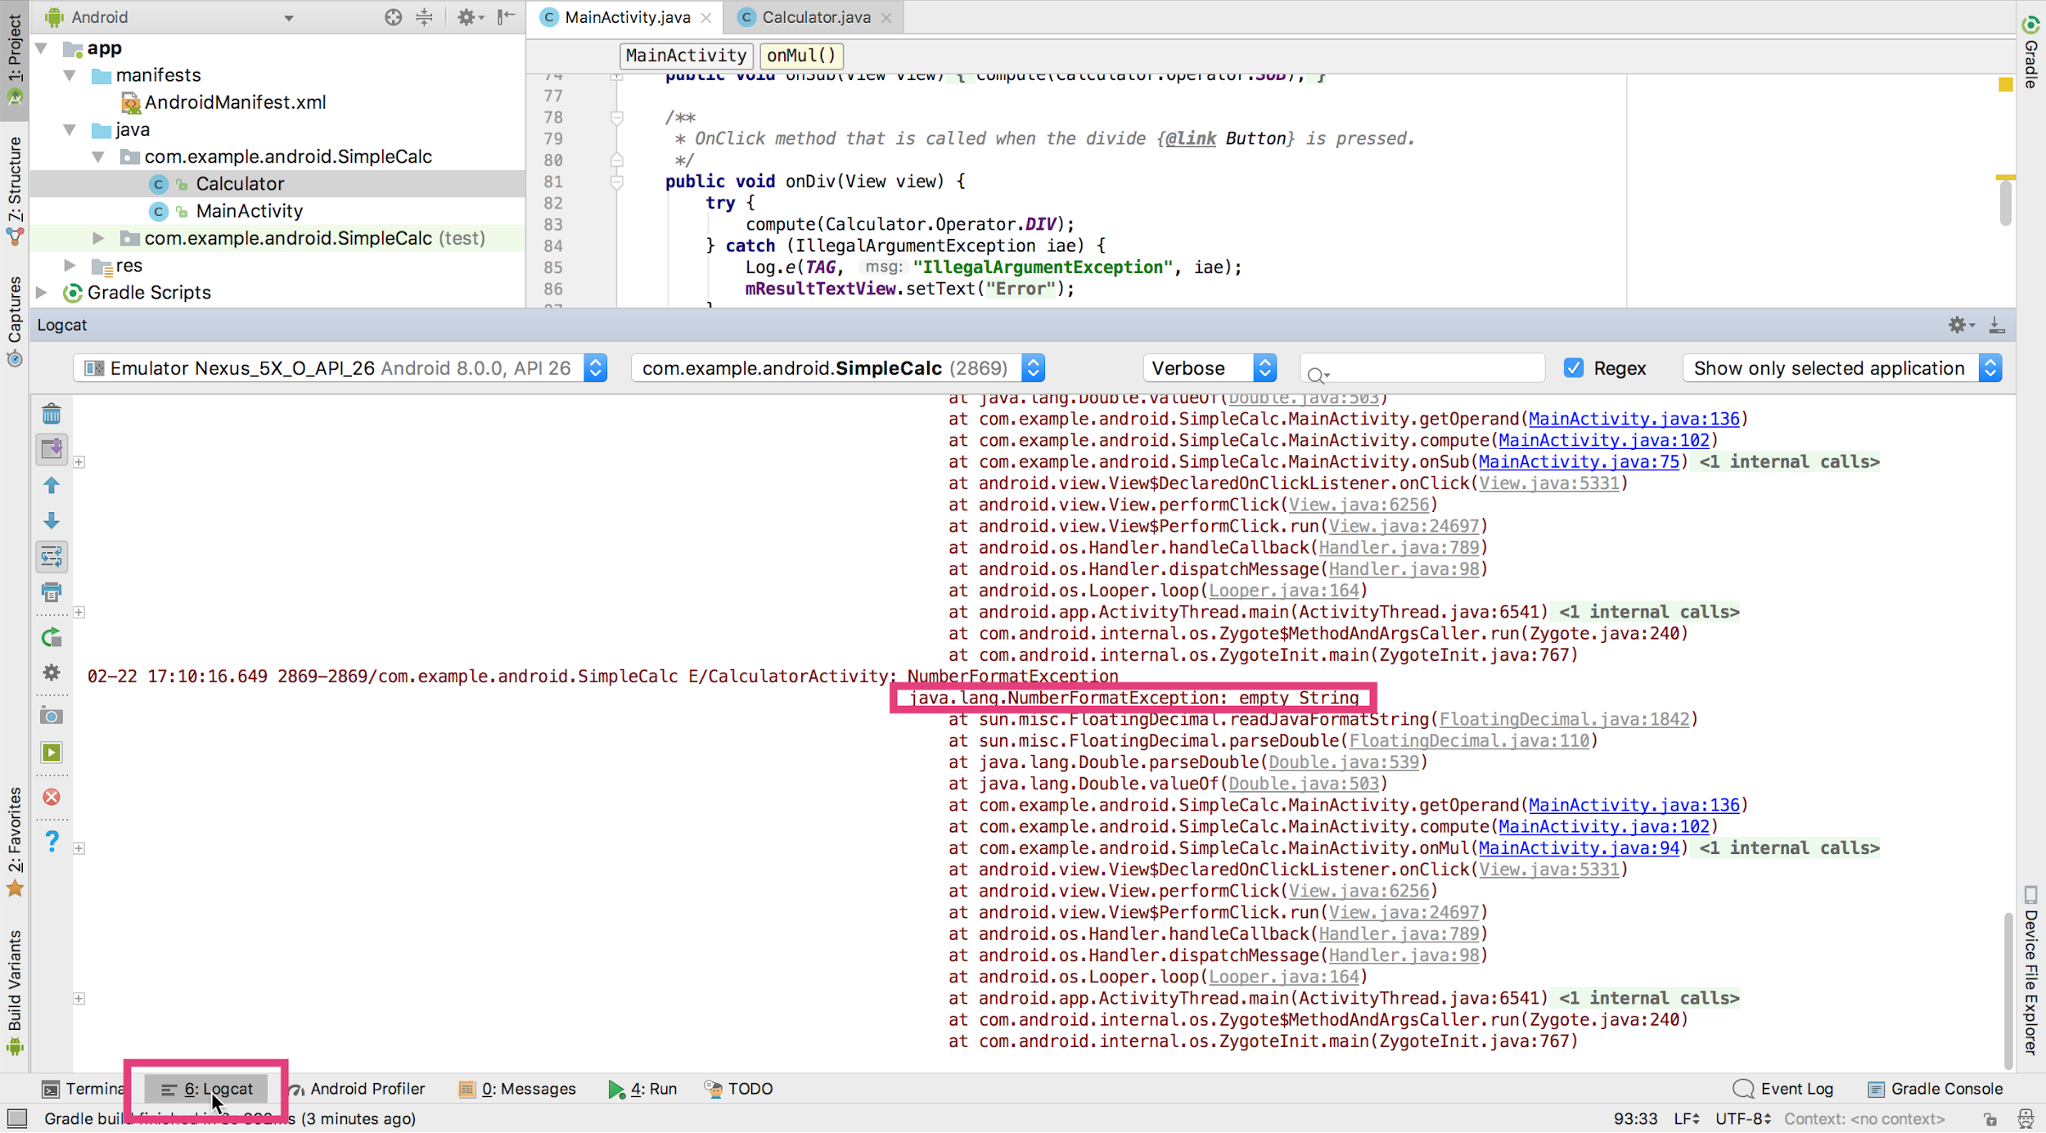
Open Logcat pane
Logcat
pane
Logcat tab

Slide 8
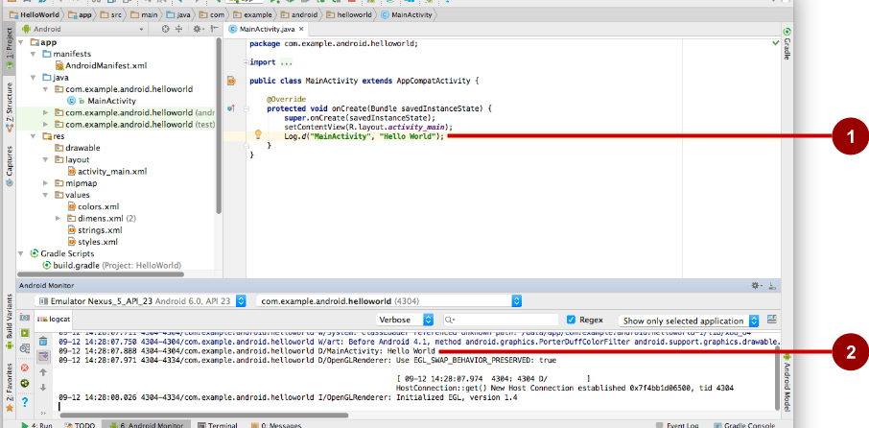
Inspect logging messages
Log.d("MainActivity", "Hello World");
09-12 14:28:07.971 4304 /com.example.android.helloworld D/MainActivity: Hello World

Slide 9
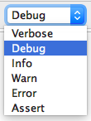
Choose visible logging level
Displays logs with levels at this level or higher

Slide 10
Log Levels
Verbose - All verbose log statements and comprehensive system
Debug - All debug logs, variable values, debugging notes
Info - Status info, such as database connection
Warning - Unexpected behavior, non-fatal issues
Error - Serious error conditions, exceptions, crashes only

Slide 11
What you can do
Run in debug mode with attached debugger
Set and configure breakpoints
Halt execution at breakpoints
Inspect execution stack frames and variable values
Change variable values
Step through code line by line
Pause and resume a running program

Slide 12
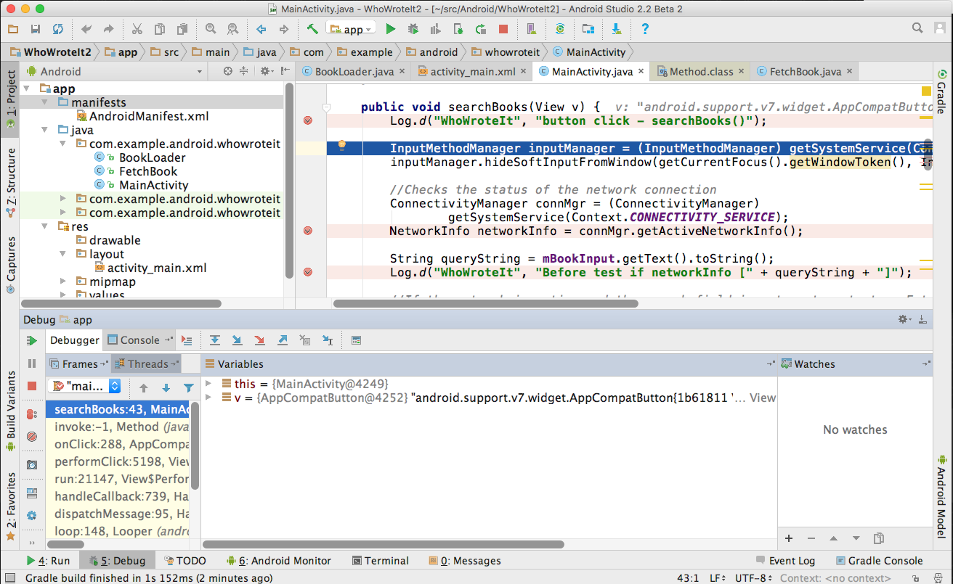
Run in debug mode
1
Debugger pane opens
Menu:
Run > Debug 'your app'
2

Slide 13
Set breakpoints
Click in the left margin next to executable line of code

Slide 14
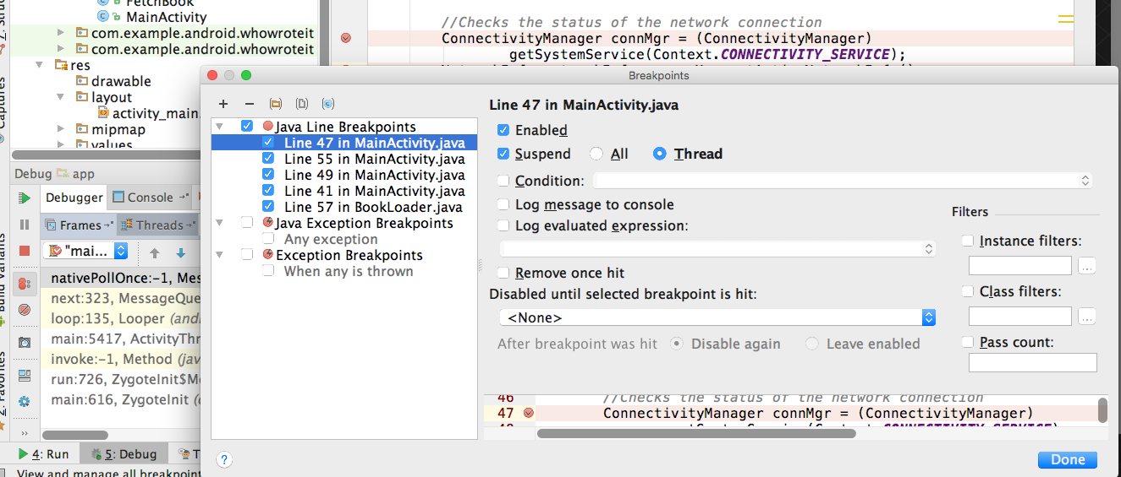
Edit breakpoint properties
2
1

Slide 15
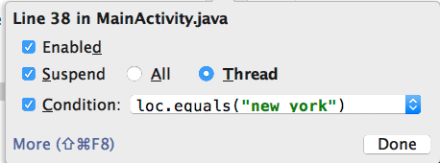
Make breakpoints conditional
In properties dialog or right -click existing breakpoint
Any Java expression that returns a boolean
Code completion helps you write conditions

Slide 16
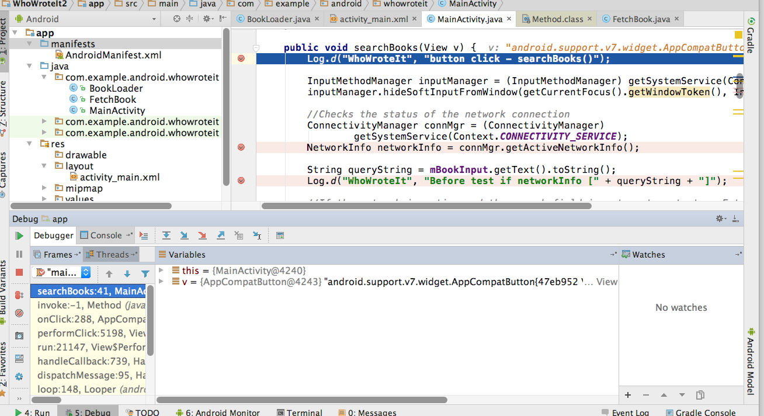
Run until app stops at breakpoint
First Breakpoint
Frames
Variables in scope
Watches (C/C++)

Slide 17
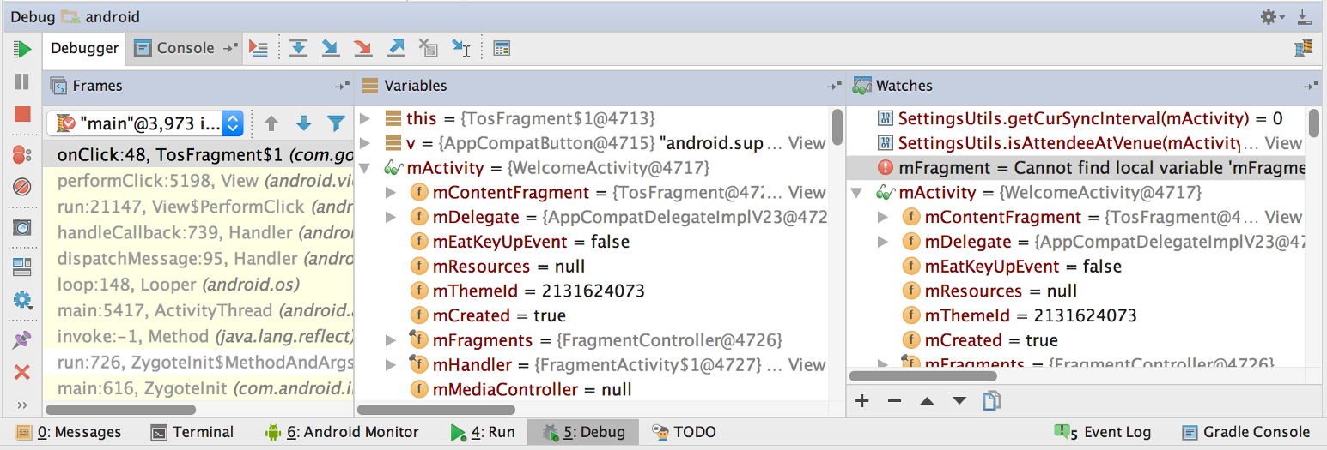
Inspect frames
Top frame is where execution is halted in your code

Slide 18
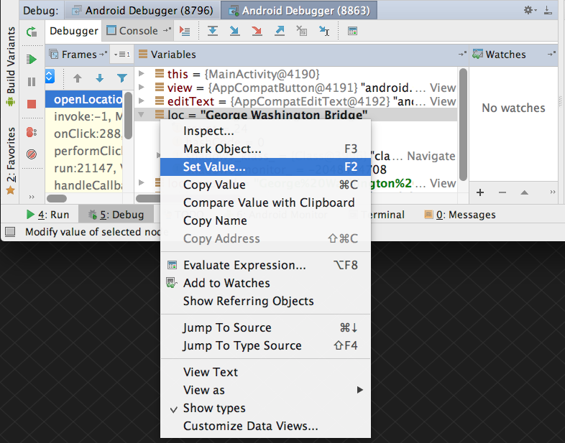
Inspect and edit variables
Right-click on variable for menu

Slide 19
Basic Stepping Commands
Step Over | F8 | Step to the next line in current file
Step Into | F7 | Step to the next executed line
Force Step Into | ⇧F7 | Step into a method in a class that you wouldn't normally step into, like a standard JDK class
Step Out | ⇧F8 | Step to first executed line after returning from current method
Run to Cursor | ⌥F9 | Run to the line where the cursor is in the file

Slide 20
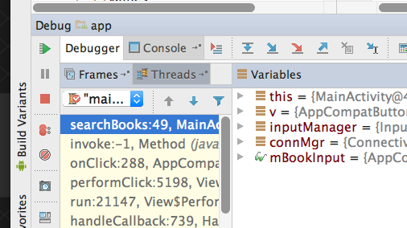
Resume and Pause
Resume
Pause
Mute all breakpoints
Menu:
Run->Pause Program…
Run->Resume Program...

Slide 21
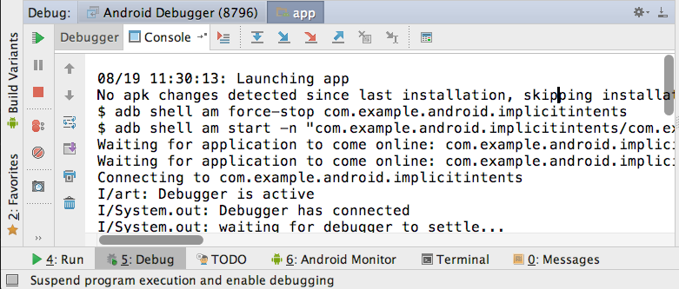
Stepping through code
Show execution point
Drop frame
Run to cursor
Step over
Step into
Step out
Force step into

Slide 22
END

