Slide 1
Android Fundamentals 1
Elvedin Selimoski

Slide 2
Last class summary
Create android application
Basic structure of an android application
Implement activity->activity communication
Create first fragment
Implement activity->fragment communication
Implement fragment->fragment communication!?

Slide 3
The plan
Passing data to fragment
Events
Custom Listeners
Mobile Screen Archetypes
Book Store App

Slide 4
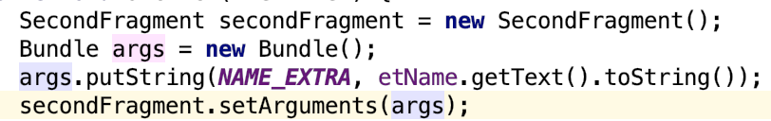
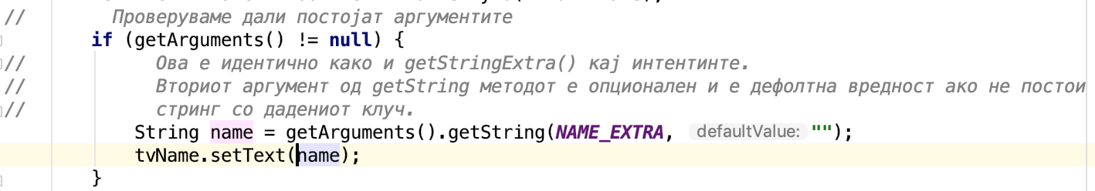
Passing data to fragment
When creating the fragment before being added/replaced with the fragment manager.
Reading data in the SecondFragment

Slide 5
Events – Common View Events
OnClick()
OnLongClick()
OnFocusChange()
OnKey()
onTouch()
Notes:
Zosto nekoi eventi baraat boolean vrednost da im se vrati?

Slide 6
Events – Other Common Events
CheckBox
  OnCheckedChange()
Spinner
  OnItemSelected()
EditText
  OnFocusChange()
  TextChanged()
Notes:
Nekoi listeneri se postavuvaat so set a nekoi so add

Slide 7
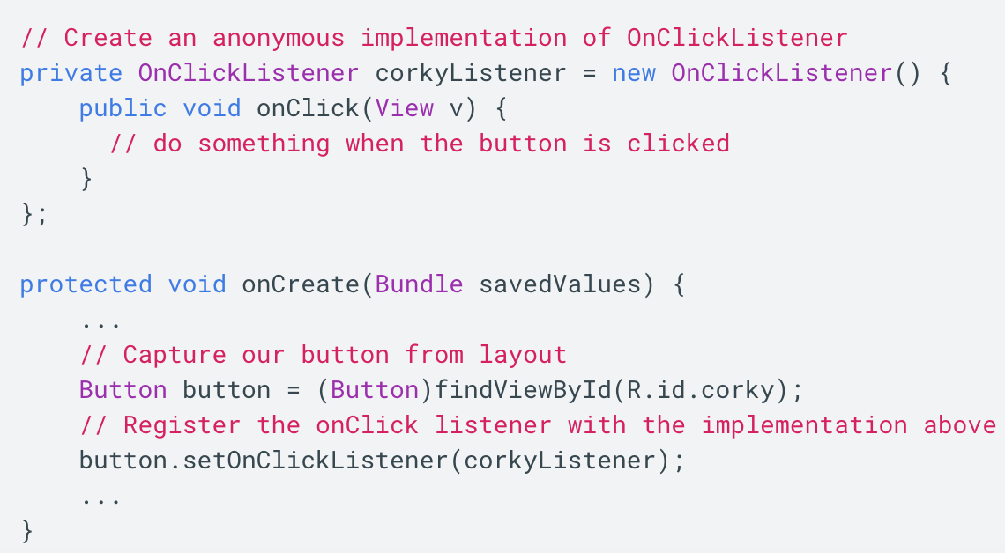
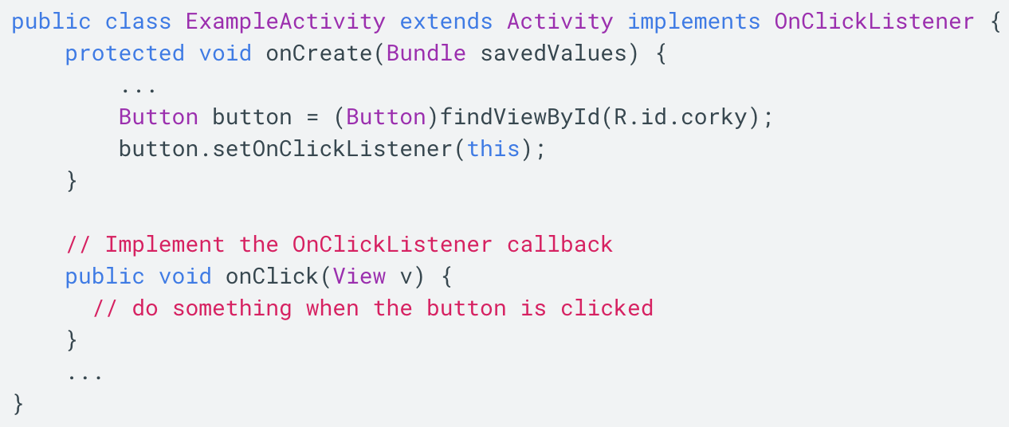
Events – Subscribe to events
Notes:
Da kreiram onLongClick listener kako primer.

Slide 8
Custom Listeners
The "listener" or "observer" pattern
Usefull when:
  Firing events from a fragment upwards to an activity.
  Firing events from list items upwards to an activity from within an adapter
  Firing async events from an abstraction (i.e networking library) to a parent handler.
Notes:
Da se naspomne deka pokraj za eventi ovoj pattern se koristi i za async taskovi.

Slide 9
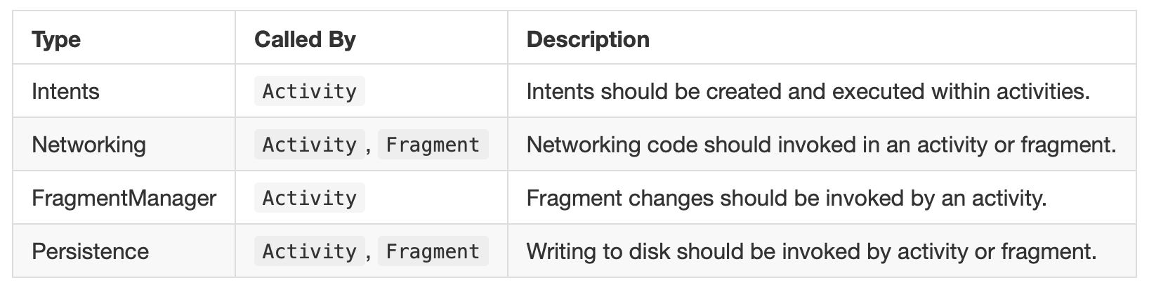
Why Listeners?
Powerful mechanism for properly separating concerns
Ensures that code is properly organized into the correct places

Slide 10
Using custom listeners
Define an interface
Setup a listener member variable in the child object
Owner passes in a listener which implements the interface
Trigger events on the defined listener when the object wants to communicate events to it's owner
Notes:
Da probam da go iscrtam ova

Slide 11
Implementaion!?
Using custom listeners

Slide 12
Callback Approaches
Pass the callback through a method call
Pass the callback through the constructor
Pass the callback through a lifecycle event

Slide 13
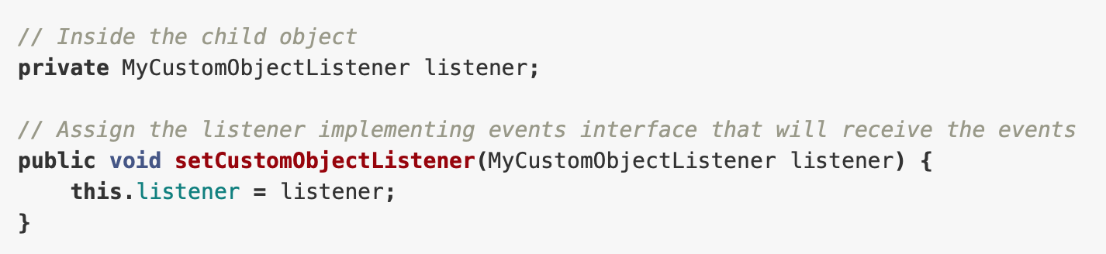
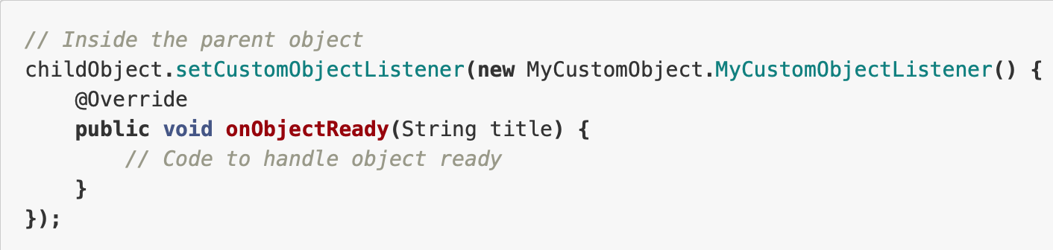
Passing via Method

Slide 14
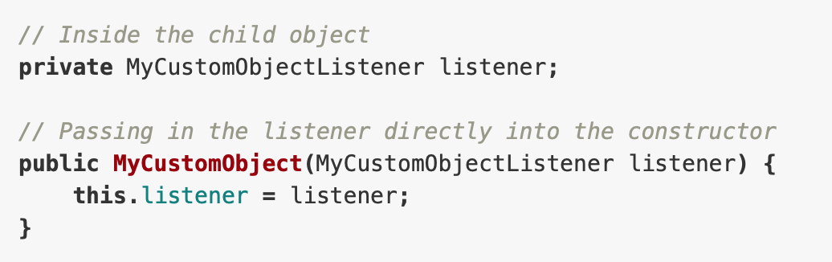
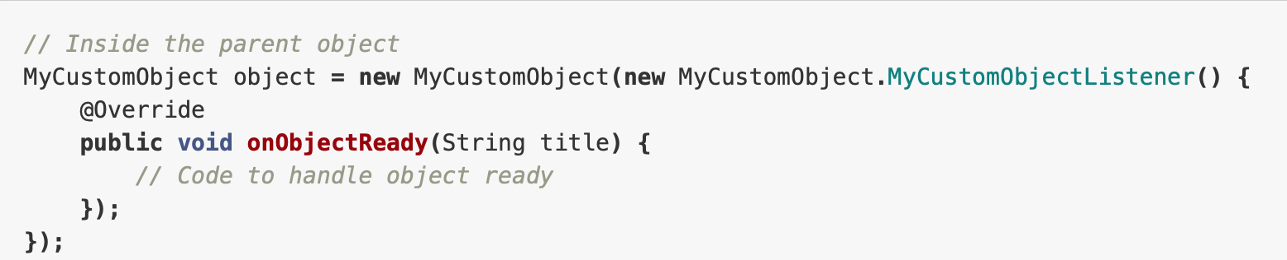
Passing via Constructor

Slide 15
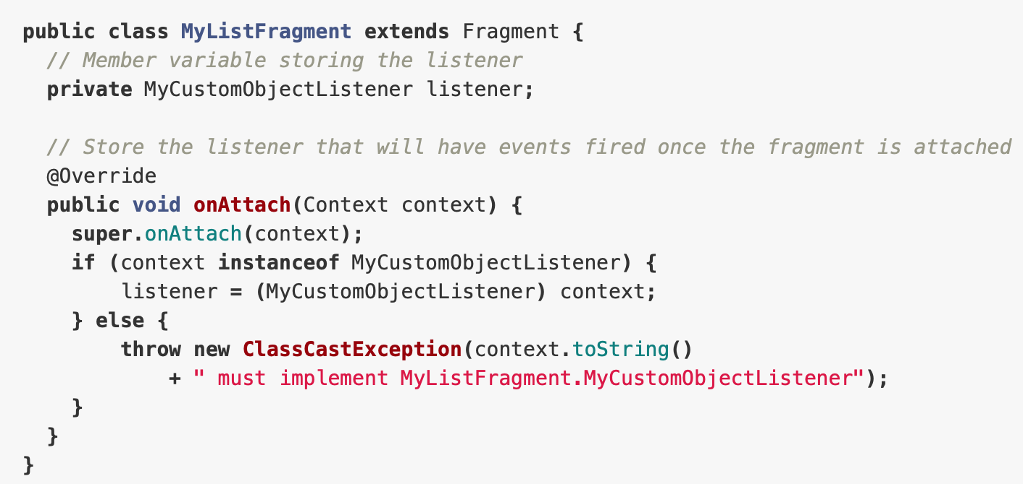
Pass via Lifecycle Event
Notes:
https://guides.codepath.com/android/Creating-Custom-Listeners#3-pass-via-lifecycle-event

Slide 16
Mobile Screen Archetypes
Login / Register - User signs up or logs into their account
Stream - User can scroll through important resources in a list
Detail - User can view the specifics of a particular resource
Creation - User can create a new resource
Profile - User can view their identity and stats
Settings - User can configure app options

Slide 17
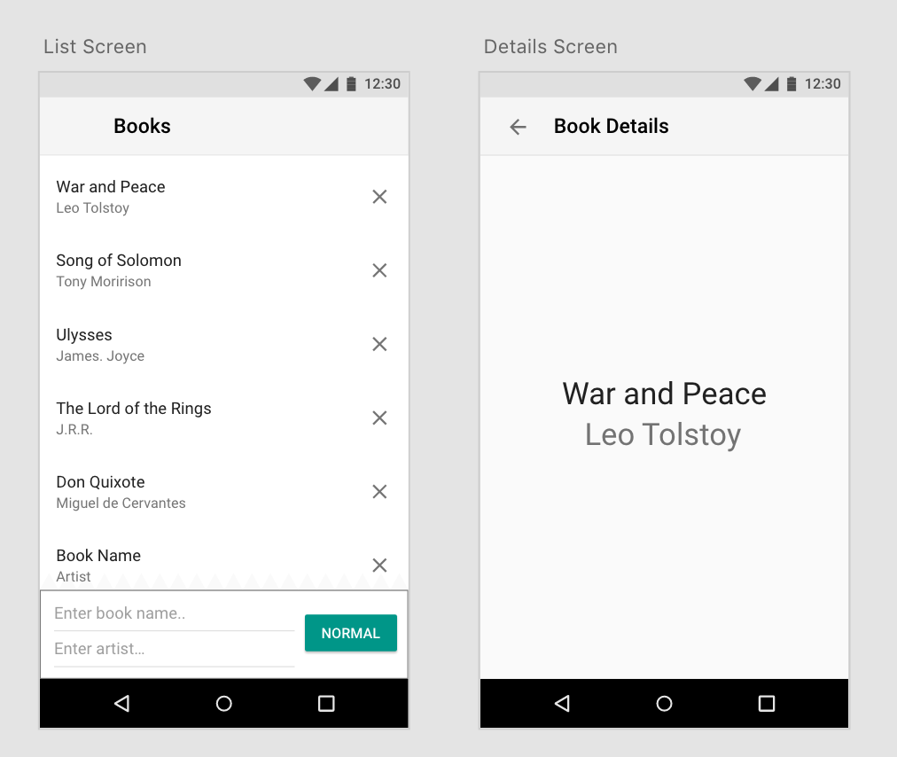
Book Store App

