Slide 1
Notifications
Elvedin Selimoski

Slide 2
Last class summary
Services for long tasks.
IntentService

Slide 3
The plan
What are notifications?
Notification channels
Creating a notification channel
Creating notifications
Tap action and action buttons
Expanded view notifications
Delivering notifications
Managing Notifications

Slide 4
Notifications
Elvedin Selimoski

Slide 5
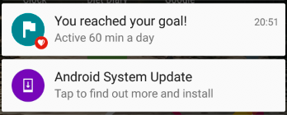
What is a notification?
Message displayed to user outside regular app UI
Small icon
Title
Detail text

Slide 6
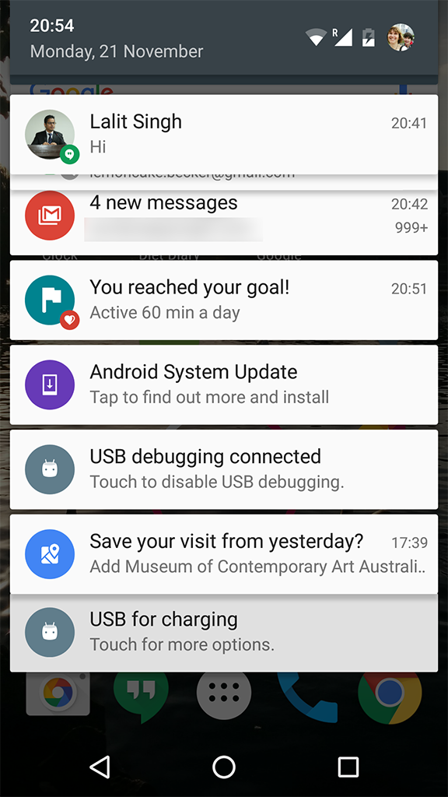
How are notifications used?
Android issues a notification that appears as icon on the status bar.
To see details, user opens the notification drawer.
User can view notifications any time in the notification drawer.

Slide 7
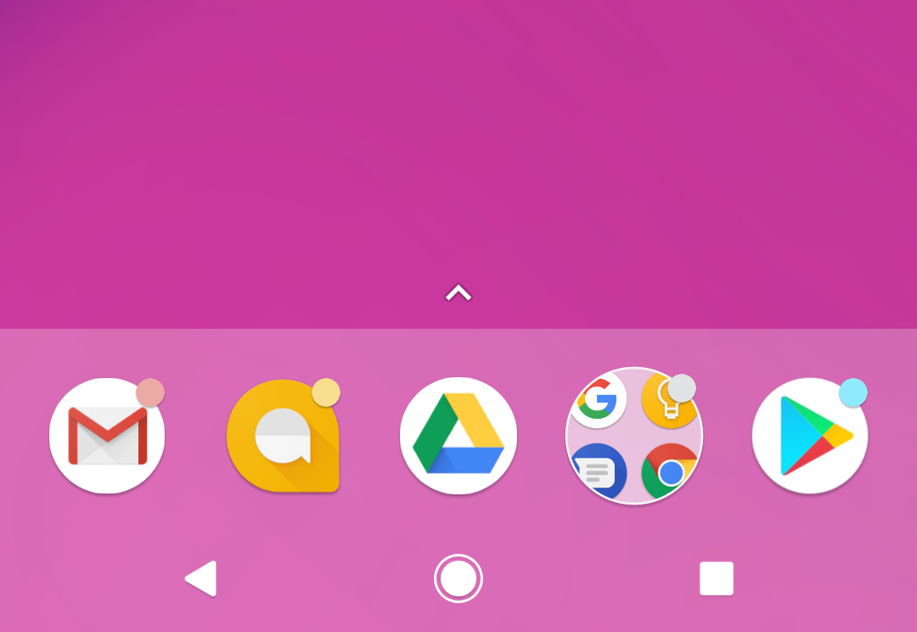
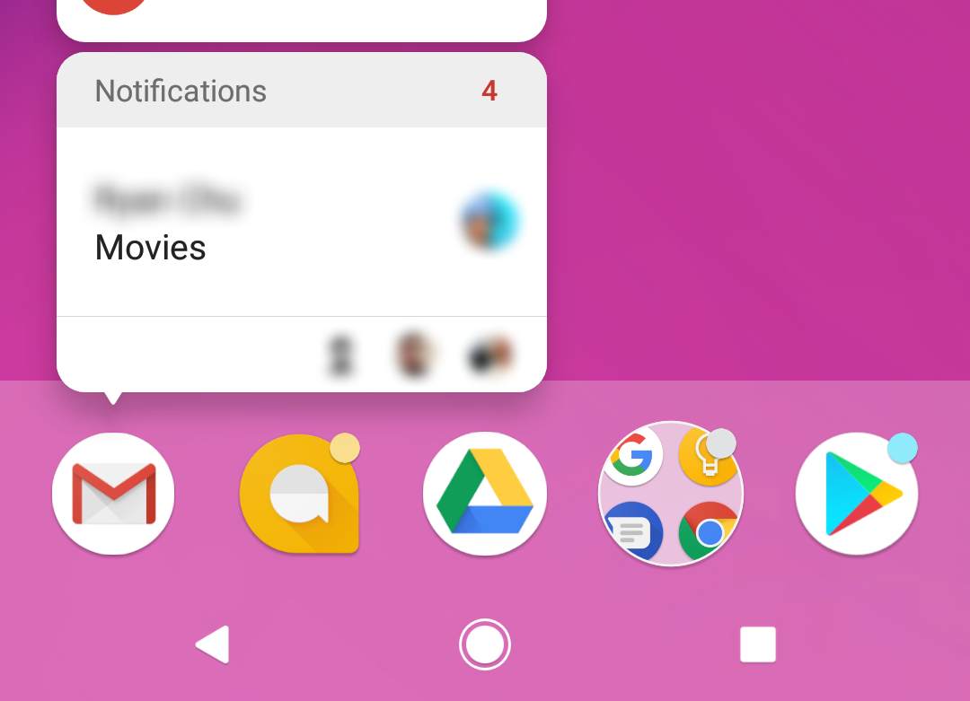
App icon badge
What are services good for?
Available only on the devices running Android 8.0 (API level 26) and higher.
New notifications are displayed as a colored "badge" (also known as a "notification dot") on the app icon.
Users can long-press on an app icon to see the notifications for that app. Similar to the notification drawer.

Slide 8
Notification Channels
Elvedin Selimoski

Slide 9
Notification
Channels
Used to create a user-customizable channel for each type of notification to be displayed.
More than one notification can be grouped in to a channel.
Set notification behavior like sound, light, vibrate and so on, applied to all the notifications in that channel.

Slide 10
Notification channels are mandatory
Notification channels are introduced in Android 8.0 (API level 26)
All notifications must be assigned to a channel starting from Android 8.0 (API level 26), else your notifications will not be displayed.
For the apps targeting lower than Android 8.0 (API level 26), no need to implement notification channels.
Notes:
If your app targets Android 8.0 (API level 26) or
higher, you must implement one or more notification
channels. If your targetSdkVersion is set to 25 or
lower, when your app runs on Android 8.0 (API level
26) or higher, it behaves the same as it would on
devices running Android 7.1 (API level 25) or lower.

Slide 11
Notification channels in Settings
Notification channels appear as Categories under App notifications in the device Settings.

Slide 12
Creating a Notification channel
Notification channel instance is created using NotificationChannel constructor.
You must specify:
  An ID that's unique within your package.
  User visible name of the channel.
  The importance level for the channel.

Slide 13
Creating a Notification channel
if (Build.VERSION.SDK_INT >= Build.VERSION_CODES.O) {
NotificationChannel notificationChannel =
new NotificationChannel(CHANNEL_ID, "Mascot Notification",
NotificationManager.IMPORTANCE_DEFAULT);
}

Slide 14
Importance level
Available in Android 8.0 (API level 26) and higher.
Sets the intrusion level, like the sound and visibility for all notifications posted in the channel.
Range from IMPORTANCE_NONE(0) to IMPORTANCE_HIGH(4)
To support earlier versions of Android (Lower than API level 26), set the priority.

Slide 15
Notification priority
Determines how the system displays the notification with respect to other notifications, in Android version Lower than API level 26.
Set using the setPriority() method for each notification.
Range from PRIORITY_MIN to PRIORITY_MAX.
setPriority(NotificationCompat.PRIORITY_HIGH)

Slide 16
Importance level and priority constants
User-visible importance level | Importance (Android 8.0 and higher) | Priority (Android 7.1 and lower)
Urgent Makes a sound and appears as a heads-up notification | IMPORTANCE_HIGH | PRIORITY_HIGH or PRIORITY_MAX
High Makes a sound | IMPORTANCE_DEFAULT | PRIORITY_DEFAULT
Medium No sound | IMPORTANCE_LOW | PRIORITY_LOW
Low No sound and doesn't appear in the status bar | IMPORTANCE_MIN | PRIORITY_MIN

Slide 17
Creating Notifications
Notification is created using NotificationCompat.Builder class.
Pass the application context and notification channel ID to the constructor.
The NotificationCompat.Builder constructor takes the notification channel ID, this is only used by Android 8.0 (API level 26) and higher, but this parameter is ignored by the older versions.
NotificationCompat.Builder mBuilder = new
NotificationCompat.Builder(this, CHANNEL_ID);

Slide 18
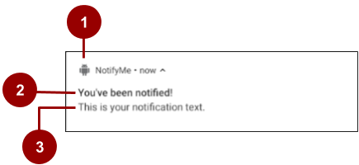
1. A small icon, set by setSmallIcon().
This is the only content that's required.
2. A title, set by setContentTitle().
3. The body text, set by setContentText(). This is the notification message.
Setting notification contents

Slide 19
Setting notification contents
NotificationCompat.Builder mBuilder =
new NotificationCompat.Builder(this, CHANNEL_ID)
.setSmallIcon(R.drawable.android_icon)
.setContentTitle("You've been notified!")
.setContentText("This is your notification text.");

Slide 20
Tap action and
Action buttons
Elvedin Selimoski

Slide 21
Add notification tap action
Every notification must respond when it is tapped, usually launching an Activity in your app.
Set an content intent using setContentIntent() method.
Pass the Intent wrapped in a PendingIntent object.

Slide 22
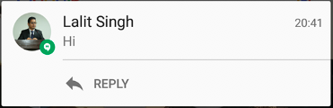
Notification action buttons
Action buttons can perform a variety of actions on behalf of your app, such as starting a background task, placing a phone call and so on.
Starting from Android 7.0 (API level 24) reply to messages directly from notifications.
To add an action button, pass a PendingIntent to the addAction() method.

Slide 23
Pending intents
A PendingIntent is a description of an intent and target action to perform with it.
Give a PendingIntent to another application to grant it the right to perform the operation you have specified as if the other app was yourself.

Slide 24
Methods to create a PendingIntent
To instantiate a PendingIntent, use one of the following methods:
PendingIntent.getActivity()
PendingIntent.getBroadcast()
PendingIntent.getService()

Slide 25
PendingIntent method arguments
Application context
Request code—constant integer id for the pending intent
Intent to be delivered
PendingIntent flag determines how the system handles multiple pending intents from same app

Slide 26
Step 1: Create intent
Intent notificationIntent =
new Intent(this, MainActivity.class);

Slide 27
Step 2: Create PendingIntent
PendingIntent notificationPendingIntent =
PendingIntent.getActivity(
this,
NOTIFICATION_ID,
notificationIntent,
PendingIntent.FLAG_UPDATE_CURRENT);

Slide 28
Step 3: Add to notification builder
To set tap action to the notification:
.setContentIntent(notificationPendingIntent);

Slide 29

Add action buttons
Use NotificationCompat.Builder.addAction()
— pass in icon, caption, PendingIntent
.addAction(R.drawable.ic_color_lens_black_24dp,
"R.string.label",
notificationPendingIntent);

Slide 30
Expanded view notifications
Elvedin Selimoski

Slide 31
Expandable notifications
Notifications in the notification drawer appear in two main layouts, normal view (which is the default) and expanded view.
Expanded view notifications were introduced in Android 4.1.
Use them sparingly -- they take up more space and attention.

Slide 32
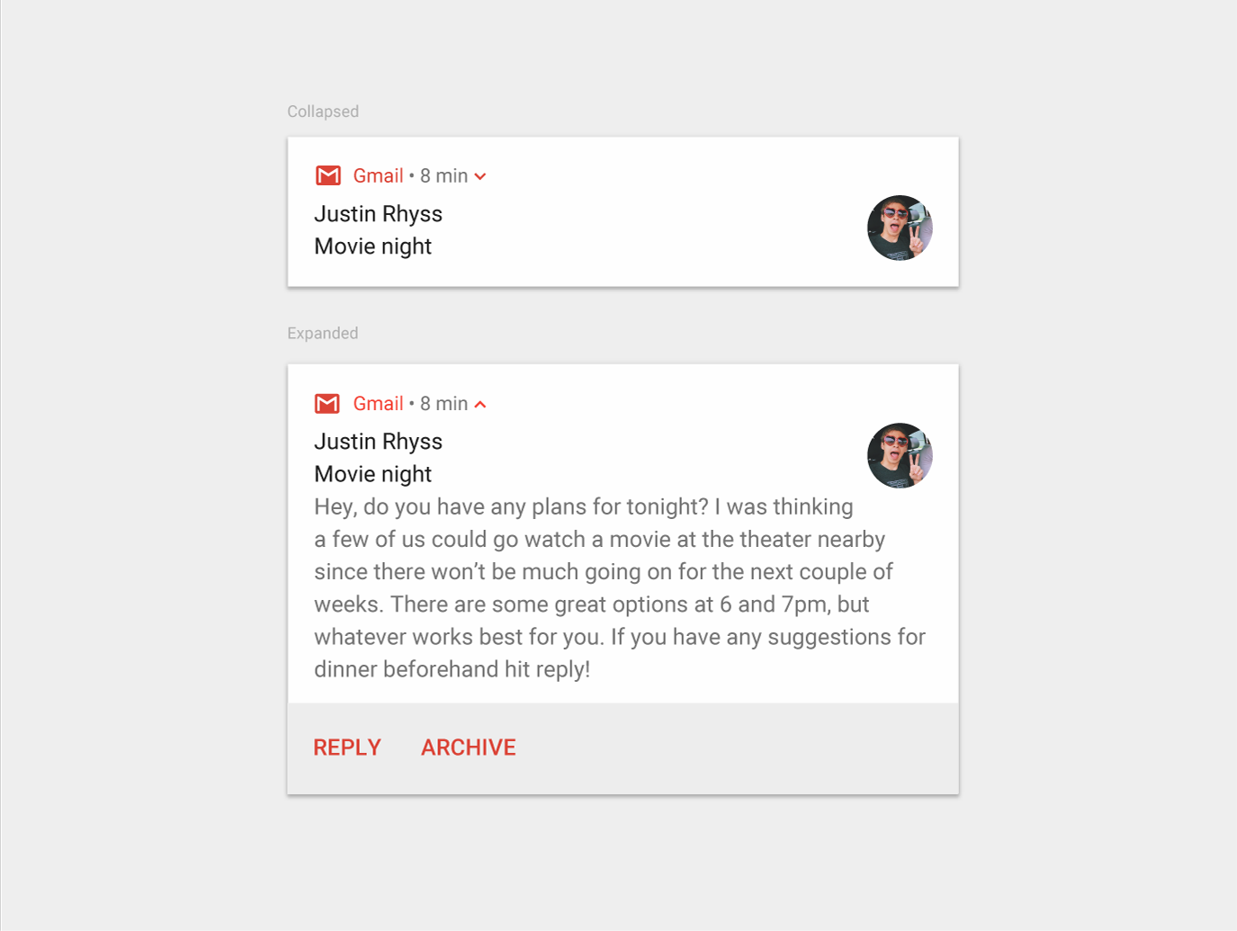
Big text
For large-format notifications that include a lot of text.
Fits more text than a standard view.
Use the helper class:
  NotificationCompat.BigTextStyle

Slide 33
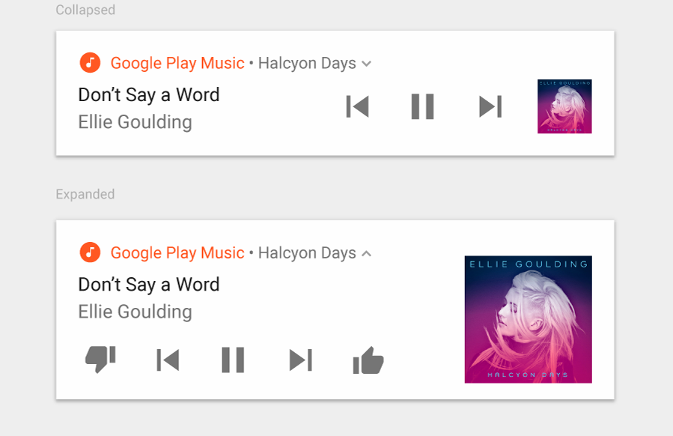
Media
For media playback notifications.
Actions for controlling media
such as music
Image for album cover
Use the helper class:
NotificationCompat.MediaStyle

Slide 34
Setting styles
To create expandable notification that appear, use one of the helper classes to set the style using the setStyle() method.
mNotifyBuilder
.setStyle(new NotificationCompat.BigPictureStyle()
.bigPicture(myBitmapImage)
.setBigContentTitle("Notification!"));

Slide 35
Delivering Notifications
Elvedin Selimoski

Slide 36
Delivering Notifications
Use the NotificationManager class to deliver notifications.
  Create an instance of NotificationManager
  Call notify() to deliver the notification.

Slide 37
Instantiate NotificationManager
Call getSystemService(), passing in the NOTIFICATION_SERVICE constant.
mNotifyManager = (NotificationManager)
getSystemService(NOTIFICATION_SERVICE);

Slide 38
Managing Notifications
Elvedin Selimoski

Slide 39
Updating notifications
Update a notification by changing and or adding some of its content.
Issue notification with updated parameters using builder.
Call notify() passing in the same notification ID.
  If previous notification is still visible, system updates.
  If previous notification has been dismissed, new notification is delivered.

Slide 40
Canceling notifications
Notifications remain visible until:
User dismisses it by swiping or by using "Clear All".
Calling setAutoCancel() when creating the notification, removes it from the status bar when the user clicks on it.
App calls cancel() or cancelAll() on NotificationManager.
mNotifyManager.cancel(NOTIFICATION_ID);

Slide 41
Expandable notifications
If your app sends too many notifications, users will disable notifications or uninstall the app.
Relevant: Whether this information is essential for the user.
Timely: Notifications need to appear when they are useful.
Short: Use as few words as possible.
Give users the power to choose -- Use appropriate notification channels to categorise your notifications.

Slide 42
END

