Slide 1


Elven Jr. | IBM Data Science Capstone | October 2026
Notes:
Source: https://github.com/elvenj/elvenj-ibm-data-science-professional-certificate

Slide 2

Outline
Executive Summary
Introduction
Methodology
Results
Conclusion
Appendix

Slide 3
Executive Summary
Objective: Predict Falcon 9 first-stage landing outcomes from historical launch records.
Analysis: 90 launches for EDA and modeling, 101 for SQL, and 56 for the dashboard.
Methods: SQL and visual exploration, Folium maps, Plotly Dash, and four classifiers.
Results: All models reached 83.33% test accuracy. Decision Tree led cross-validation at 87.68%.
Interpretation: All four models made identical predictions on only 18 test launches.
Notes:
Source: https://github.com/elvenj/elvenj-ibm-data-science-professional-certificate/blob/main/applied-data-science-capstone/notebooks/SpaceX_Machine%20Learning%20Prediction_Part_5.ipynb
Source: https://github.com/elvenj/elvenj-ibm-data-science-professional-certificate/blob/main/applied-data-science-capstone/notebooks/jupyter-labs-eda-sql-coursera_sqllite.ipynb
Source: https://github.com/elvenj/elvenj-ibm-data-science-professional-certificate/blob/main/applied-data-science-capstone/dashboard/spacex-dash-app.py
The report retains the published lab results. Additional checks use the same IBM CSV. Live collection errors and incomplete source notebook cells are disclosed. The sources remain unchanged.

Slide 4
Introduction
Context: First-stage recovery supports the reuse of Falcon 9 boosters.
Problem: Estimate whether a launch will have a successful landing outcome.
Research question: How do payload, orbit, launch site and flight history relate to success?
Scope: Explore historical IBM course datasets covering launches through 2020.
Use: Compare launch conditions and evaluate predictive models for decision support.
https://github.com/elvenj/elvenj-ibm-data-science-professional-certificate
Notes:
Source: https://github.com/elvenj/elvenj-ibm-data-science-professional-certificate/blob/main/applied-data-science-capstone/notebooks/labs-jupyter-spacex-Data%20wrangling.ipynb
Source: https://github.com/elvenj/elvenj-ibm-data-science-professional-certificate

Slide 5

Section 1

Slide 6
Methodology Overview
Data collection: SpaceX JSON and Wikipedia HTML exercises, with prepared IBM datasets for analysis.
Data wrangling: Inspect missing values, define the target and encode categorical features.
Exploratory analysis: Compare launch conditions using Pandas, charts and SQLite queries.
Interactive analytics: Map launch sites with Folium and filter outcomes in Plotly Dash.
Predictive modeling: Tune Logistic Regression, SVM, Decision Tree and KNN with 10-fold GridSearchCV.
Notes:
Source: https://github.com/elvenj/elvenj-ibm-data-science-professional-certificate/blob/main/applied-data-science-capstone/notebooks/jupyter-labs-spacex-data-collection-api.ipynb
Source: https://github.com/elvenj/elvenj-ibm-data-science-professional-certificate/blob/main/applied-data-science-capstone/notebooks/jupyter-labs-webscraping.ipynb
Source: https://github.com/elvenj/elvenj-ibm-data-science-professional-certificate/blob/main/applied-data-science-capstone/notebooks/edadataviz.ipynb
Source: https://github.com/elvenj/elvenj-ibm-data-science-professional-certificate/blob/main/applied-data-science-capstone/notebooks/jupyter-labs-eda-sql-coursera_sqllite.ipynb
Source: https://github.com/elvenj/elvenj-ibm-data-science-professional-certificate/blob/main/applied-data-science-capstone/notebooks/lab_jupyter_launch_site_location.ipynb
Source: https://github.com/elvenj/elvenj-ibm-data-science-professional-certificate/blob/main/applied-data-science-capstone/dashboard/spacex-dash-app.py
Source: https://github.com/elvenj/elvenj-ibm-data-science-professional-certificate/blob/main/applied-data-science-capstone/notebooks/SpaceX_Machine%20Learning%20Prediction_Part_5.ipynb

Slide 7
Data Collection
API exercise: Retrieve the IBM-hosted SpaceX JSON snapshot and normalize launch records.
Scraping exercise: Parse Wikipedia launch tables with BeautifulSoup. Row extraction encountered an error.
Analysis input: Use the prepared IBM CSV files to continue wrangling and analysis.
SpaceX JSON
Python extraction
and Pandas
CSV datasets
for analysis
Wikipedia HTML
Notes:
Source: https://github.com/elvenj/elvenj-ibm-data-science-professional-certificate/blob/main/applied-data-science-capstone/notebooks/jupyter-labs-spacex-data-collection-api.ipynb
Source: https://github.com/elvenj/elvenj-ibm-data-science-professional-certificate/blob/main/applied-data-science-capstone/notebooks/jupyter-labs-webscraping.ipynb
The schematic describes the collection exercises. The scraper output is empty, and analysis uses prepared IBM CSV files. It does not imply a completed merge of both sources.

Slide 8
Data Collection: SpaceX API
The IBM JSON snapshot returned HTTP 200.
Requests and Pandas normalized the launch records.
Live metadata endpoints returned HTTP 525 and blocked enrichment.
The analysis continued with 90 prepared Falcon 9 records.
IBM JSON snapshot
Pandas normalization
Live metadata API
HTTP 525
Prepared IBM CSV
90 Falcon 9 launches
Notebook: SpaceX API collection
Notes:
Source: https://github.com/elvenj/elvenj-ibm-data-science-professional-certificate/blob/main/applied-data-science-capstone/notebooks/jupyter-labs-spacex-data-collection-api.ipynb
The published notebook records HTTP 525, JSON decoding errors and failed metadata enrichment. Its final dataset contains 90 prepared launch records.

Slide 9
Data Collection: Web Scraping
Retrieve the Wikipedia launch-list HTML.
BeautifulSoup finds launch tables and their column headers.
The row loop extracts payload, orbit, site and outcome fields.
A NoneType error interrupted extraction. The published CSV has zero rows.
Wikipedia launch HTML
BeautifulSoup tables
Row extraction
AttributeError
Empty CSV output
Excluded from analysis
Notebook: Wikipedia web scraping
Notes:
Source: https://github.com/elvenj/elvenj-ibm-data-science-professional-certificate/blob/main/applied-data-science-capstone/notebooks/jupyter-labs-webscraping.ipynb
Source: https://github.com/elvenj/elvenj-ibm-data-science-professional-certificate/blob/main/applied-data-science-capstone/data/spacex_web_scraped.csv
The exported CSV has headers but no data rows. The report does not use it for any reported result.

Slide 10
Data Wrangling
Retain 90 Falcon 9 launch records.
Inspect data types and missing values. LandingPad has 26 null values.
Encode True outcomes as Class 1 and false or undefined outcomes as Class 0.
One-hot encode categories to produce 80 numeric predictors.
90 prepared launches
Outcome labeling
60 success, 30 other
Categorical encoding
90 rows by 80 features
Notebooks: data wrangling and EDA
Notes:
Source: https://github.com/elvenj/elvenj-ibm-data-science-professional-certificate/blob/main/applied-data-science-capstone/notebooks/jupyter-labs-spacex-data-collection-api.ipynb
Source: https://github.com/elvenj/elvenj-ibm-data-science-professional-certificate/blob/main/applied-data-science-capstone/notebooks/labs-jupyter-spacex-Data%20wrangling.ipynb
Source: https://github.com/elvenj/elvenj-ibm-data-science-professional-certificate/blob/main/applied-data-science-capstone/notebooks/edadataviz.ipynb
The lab target includes five True Ocean outcomes as Class 1. Class 1 is therefore a lab-defined landing outcome, not proof of reusable booster recovery. Mean payload replacement appears in the API notebook. Missing LandingPad values remain and do not create a separate dummy category.

Slide 11
EDA with Data Visualization
Scatter plots: Flight number and payload versus launch site and orbit show where success and failure occur.
Orbit chart: Mean Class estimates the observed success rate for each orbit.
Yearly trend: Annual mean Class tracks changes in recorded outcomes over time.
Feature preparation: Encode orbit, launch site, landing pad and booster serial with Pandas get_dummies.
Scope: 90 launches across three site labels. Associations support exploration, not causal conclusions.
Notebook: EDA with visualization
Notes:
Source: https://github.com/elvenj/elvenj-ibm-data-science-professional-certificate/blob/main/applied-data-science-capstone/notebooks/edadataviz.ipynb
Source: https://github.com/elvenj/elvenj-ibm-data-science-professional-certificate/blob/main/applied-data-science-capstone/notebooks/labs-jupyter-spacex-Data%20wrangling.ipynb

Slide 12
EDA with SQL
Database: Load 101 launch records into a SQLite table.
Filters: Find launch sites, customer subsets, booster versions and date ranges.
Aggregations: Use SUM, AVG, MIN, MAX and grouped counts to summarize missions.
Comparisons: Inspect drone-ship outcomes, maximum payloads and the 2015 failures.
Data audit: Trim outcome labels and compare exact-text filters with family-prefix filters.
Notebook: EDA with SQLite
Notes:
Source: https://github.com/elvenj/elvenj-ibm-data-science-professional-certificate/blob/main/applied-data-science-capstone/notebooks/jupyter-labs-eda-sql-coursera_sqllite.ipynb
Source: https://cf-courses-data.s3.us.cloud-object-storage.appdomain.cloud/IBM-DS0321EN-SkillsNetwork/labs/module_2/data/Spacex.csv
Additional SQL audit results explicitly compare query scopes on the same CSV.

Slide 13
Interactive Map with Folium
Location markers: Show four launch-site labels in the 56-record geospatial dataset.
Outcome markers: Green represents Class 1 and red represents Class 0.
MarkerCluster: Group overlapping launch records for interactive exploration.
Distance line: Connect CCAFS LC-40 to a selected coastline point using a Haversine distance.
Map controls: Use zoom, popups and MousePosition to inspect coordinates.
Notebook: Folium map exercise
Notes:
Source: https://github.com/elvenj/elvenj-ibm-data-science-professional-certificate/blob/main/applied-data-science-capstone/notebooks/lab_jupyter_launch_site_location.ipynb
Source: https://cf-courses-data.s3.us.cloud-object-storage.appdomain.cloud/IBM-DS0321EN-SkillsNetwork/datasets/spacex_launch_geo.csv
Maps for this report were reproduced using Folium and the IBM geospatial CSV. The published notebook retains unfinished TODO cells and has no saved map outputs. The selected coastline point comes from the lab example.

Slide 14
Dashboard with Plotly Dash
Site dropdown: Choose All Sites or one of four site labels.
Pie chart: All Sites compares successful-launch counts. A selected site shows success versus failure.
Payload slider: Filter the scatter plot over a selected payload range.
Scatter plot: Compare payload with binary outcomes, colored by booster version category.
Callbacks: Connect the site and payload inputs to the chart component IDs.
Python app: SpaceX dashboard
Notes:
Source: https://github.com/elvenj/elvenj-ibm-data-science-professional-certificate/blob/main/applied-data-science-capstone/dashboard/spacex-dash-app.py
Source: https://github.com/elvenj/elvenj-ibm-data-science-professional-certificate/blob/main/applied-data-science-capstone/data/spacex_launch_dash.csv
The payload slider filters only the scatter plot. The pie chart responds to the site dropdown.

Slide 15
Predictive Analysis: Classification
Use 90 labeled rows with 80 numeric features.
Standardize predictors, then split 72 train and 18 test rows with random_state=2.
Tune four models with 10-fold GridSearchCV.
Compare CV accuracy, test accuracy and confusion matrices.
Feature matrix and labels
StandardScaler
and 80/20 split
10-fold GridSearchCV
Four classifiers
18-row holdout
Accuracy and error analysis
Notebook: machine learning prediction
Notes:
Source: https://github.com/elvenj/elvenj-ibm-data-science-professional-certificate/blob/main/applied-data-science-capstone/notebooks/SpaceX_Machine%20Learning%20Prediction_Part_5.ipynb
As executed in the published notebook, StandardScaler is fitted before the split. Future validation should fit preprocessing within a Pipeline inside CV. A chronological test and grouped splits by booster would reduce temporal and reuse leakage.

Slide 16
Results
EDA: observed success rates differ by site, orbit and year.
SQL: launch history, payload summaries and outcome rankings.
Interactive analytics: launch locations, dashboard filters and payload comparisons.
Prediction: four models share 83.33% accuracy on the 18-row test set.
Notes:
Source: https://github.com/elvenj/elvenj-ibm-data-science-professional-certificate/blob/main/applied-data-science-capstone/notebooks/edadataviz.ipynb
Source: https://github.com/elvenj/elvenj-ibm-data-science-professional-certificate/blob/main/applied-data-science-capstone/notebooks/jupyter-labs-eda-sql-coursera_sqllite.ipynb
Source: https://github.com/elvenj/elvenj-ibm-data-science-professional-certificate/blob/main/applied-data-science-capstone/dashboard/spacex-dash-app.py
Source: https://github.com/elvenj/elvenj-ibm-data-science-professional-certificate/blob/main/applied-data-science-capstone/notebooks/SpaceX_Machine%20Learning%20Prediction_Part_5.ipynb

Slide 17

Section 2

Slide 18
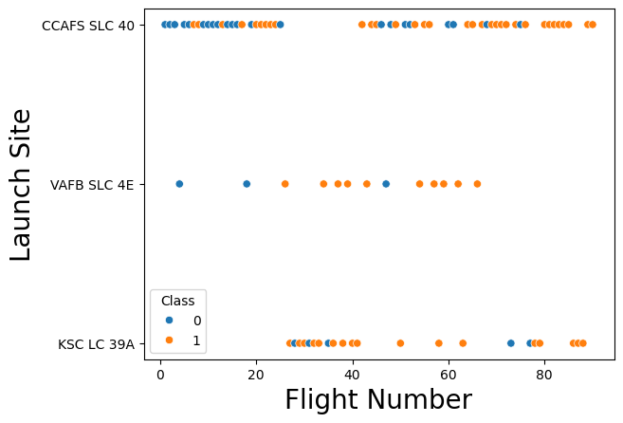
Flight Number vs. Launch Site
CCAFS SLC 40 has the most launches: 55 of 90.
KSC LC 39A records 17 successes in 22 launches.
Later flight numbers contain more successful outcomes.
Notes:
Source: https://github.com/elvenj/elvenj-ibm-data-science-professional-certificate/blob/main/applied-data-science-capstone/notebooks/edadataviz.ipynb
Source: https://github.com/elvenj/elvenj-ibm-data-science-professional-certificate/blob/main/applied-data-science-capstone/data/dataset_part_2.csv
Chart image extracted unchanged from the published notebook output. Class 1 is the lab-defined success label.

Slide 19
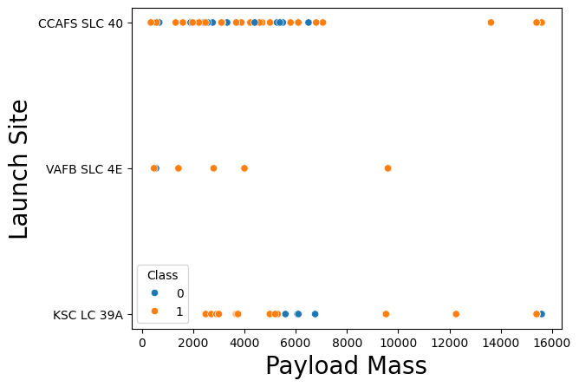
Payload vs. Launch Site
Success and failure overlap across payload ranges.
VAFB SLC 4E has no launch above 10,000 kg in this sample.
Payload alone does not separate outcomes.
Notes:
Source: https://github.com/elvenj/elvenj-ibm-data-science-professional-certificate/blob/main/applied-data-science-capstone/notebooks/edadataviz.ipynb
Source: https://github.com/elvenj/elvenj-ibm-data-science-professional-certificate/blob/main/applied-data-science-capstone/data/dataset_part_2.csv
Chart image extracted unchanged from the published notebook output. Class 1 is the lab-defined success label.

Slide 20
Success Rate vs. Orbit Type
SSO has 5 successes in 5 launches.
GTO records 14 successes in 27 launches, about 51.9%.
Three 100% orbit rates rely on one launch each.
Notes:
Source: https://github.com/elvenj/elvenj-ibm-data-science-professional-certificate/blob/main/applied-data-science-capstone/notebooks/edadataviz.ipynb
Native chart recreated from Class means. Sample counts are explicit to distinguish singleton 100% rates from larger groups.

Slide 21
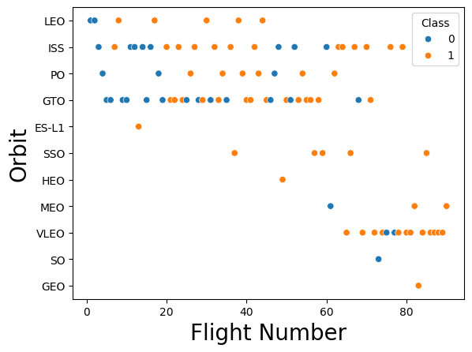
Flight Number vs. Orbit Type
GTO and ISS have the most records: 27 and 21 launches.
Later VLEO flights are mostly successful.
Flight number also reflects time and changing technology.
Notes:
Source: https://github.com/elvenj/elvenj-ibm-data-science-professional-certificate/blob/main/applied-data-science-capstone/notebooks/edadataviz.ipynb
Source: https://github.com/elvenj/elvenj-ibm-data-science-professional-certificate/blob/main/applied-data-science-capstone/data/dataset_part_2.csv
Chart image extracted unchanged from the published notebook output. Class 1 is the lab-defined success label.

Slide 22
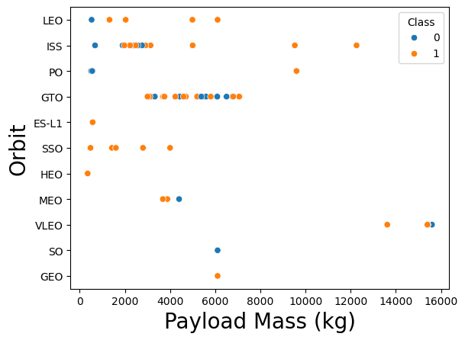
Payload vs. Orbit Type
VLEO includes the heaviest payloads in the modeling dataset.
GTO outcomes overlap at similar payload masses.
Payload ranges depend on orbit and mission requirements.
Notes:
Source: https://github.com/elvenj/elvenj-ibm-data-science-professional-certificate/blob/main/applied-data-science-capstone/notebooks/edadataviz.ipynb
Source: https://github.com/elvenj/elvenj-ibm-data-science-professional-certificate/blob/main/applied-data-science-capstone/data/dataset_part_2.csv
Chart image extracted unchanged from the published notebook output. Class 1 is the lab-defined success label.

Slide 23
Launch Success Yearly Trend
The observed rate rises from 0% in early years to 90% in 2019.
2020 records 16 successes in 19 launches, about 84.2%.
The trend includes dips and changes in the launch mix.
Notes:
Source: https://github.com/elvenj/elvenj-ibm-data-science-professional-certificate/blob/main/applied-data-science-capstone/notebooks/edadataviz.ipynb
Annual means from 90 launches. No launch appears in 2011, so 2011 is absent rather than a zero-success year.

Slide 24
All Launch Site Names
SELECT DISTINCT Launch_Site
FROM SPACEXTBL;
Launch site label
CCAFS LC-40
VAFB SLC-4E
KSC LC-39A
CCAFS SLC-40
The SQL dataset contains four distinct text labels.
CCAFS LC-40 and CCAFS SLC-40 are separate labels in this snapshot.
Notes:
Source: https://github.com/elvenj/elvenj-ibm-data-science-professional-certificate/blob/main/applied-data-science-capstone/notebooks/jupyter-labs-eda-sql-coursera_sqllite.ipynb

Slide 25
Launch Sites Beginning with 'CCA'
WHERE Launch_Site LIKE 'CCA%'
LIMIT 5
Date | Booster version | Site | Payload kg
2010-06-04 | F9 v1.0 B0003 | CCAFS LC-40 | 0
2010-12-08 | F9 v1.0 B0004 | CCAFS LC-40 | 0
2012-05-22 | F9 v1.0 B0005 | CCAFS LC-40 | 525
2012-10-08 | F9 v1.0 B0006 | CCAFS LC-40 | 500
2013-03-01 | F9 v1.0 B0007 | CCAFS LC-40 | 677
Notes:
Source: https://github.com/elvenj/elvenj-ibm-data-science-professional-certificate/blob/main/applied-data-science-capstone/notebooks/jupyter-labs-eda-sql-coursera_sqllite.ipynb
First five matching records, retaining the notebook row order.

Slide 26
Total Payload Mass: NASA Filters
SUM(PAYLOAD_MASS__KG_)
WHERE Customer = 'NASA (CRS)'
Customer filter | Payload mass
Exact 'NASA (CRS)' | 45,596 kg
Any label containing 'NASA' | 107,010 kg
The published query covers CRS only. The broader check also includes shared-customer missions.
Notes:
Source: https://github.com/elvenj/elvenj-ibm-data-science-professional-certificate/blob/main/applied-data-science-capstone/notebooks/jupyter-labs-eda-sql-coursera_sqllite.ipynb
45,596 kg reproduces the saved notebook result. 107,010 kg is an additional SUM with Customer LIKE %NASA% on the same 101-row IBM CSV. It is the total payload of NASA-tagged missions, including shared-customer missions, rather than payload exclusively attributable to NASA.

Slide 27
Average Payload Mass: F9 v1.1
AVG(PAYLOAD_MASS__KG_)
WHERE Booster_Version = 'F9 v1.1'
Booster filter | Rows | Average payload
Exact 'F9 v1.1' | 5 | 2,928.40 kg
Prefix 'F9 v1.1%' | 15 | 2,534.67 kg
The prefix check includes version labels with booster serial numbers. Query scope changes the average.
Notes:
Source: https://github.com/elvenj/elvenj-ibm-data-science-professional-certificate/blob/main/applied-data-science-capstone/notebooks/jupyter-labs-eda-sql-coursera_sqllite.ipynb
Exact equality reproduces the published result. The prefix average is an additional check of all 15 v1.1-family rows in the same CSV.

Slide 28
First Successful Ground Landing
SELECT MIN(Date)
FROM SPACEXTBL
WHERE Landing_Outcome = 'Success (ground pad)'
First recorded date
2015-12-22
The database records the first successful ground-pad landing on 22 December 2015.
Notes:
Source: https://github.com/elvenj/elvenj-ibm-data-science-professional-certificate/blob/main/applied-data-science-capstone/notebooks/jupyter-labs-eda-sql-coursera_sqllite.ipynb
Date follows the source CSV exactly, including its reporting convention.

Slide 29
Drone Ship Landings: 4,000-6,000 kg
Landing_Outcome = 'Success (drone ship)'
AND PAYLOAD_MASS__KG_ > 4000
AND PAYLOAD_MASS__KG_ < 6000
Booster version
F9 FT B1022
F9 FT B1026
F9 FT B1021.2
F9 FT B1031.2
Four booster-version records match.
The range excludes both endpoints.
Notes:
Source: https://github.com/elvenj/elvenj-ibm-data-science-professional-certificate/blob/main/applied-data-science-capstone/notebooks/jupyter-labs-eda-sql-coursera_sqllite.ipynb

Slide 30
Mission Outcomes
SELECT TRIM(Mission_Outcome), COUNT(*)
FROM SPACEXTBL
GROUP BY TRIM(Mission_Outcome);
Mission outcome | Count
Success | 99
Success (payload status unclear) | 1
Failure (in flight) | 1
Total | 101
TRIM merges the original Success and Success-with-space labels. Mission success differs from booster landing.
Notes:
Source: https://github.com/elvenj/elvenj-ibm-data-science-professional-certificate/blob/main/applied-data-science-capstone/notebooks/jupyter-labs-eda-sql-coursera_sqllite.ipynb
The saved notebook gives Success 98, Success with a trailing space 1, Success (payload status unclear) 1 and Failure (in flight) 1. This table normalizes whitespace and preserves the unclear-status category. Total 101.

Slide 31
Boosters Carrying Maximum Payload
Maximum recorded payload: 15,600 kg. Twelve matching booster-version entries.
Booster version | Booster version
F9 B5 B1048.4 | F9 B5 B1049.5
F9 B5 B1049.4 | F9 B5 B1060.2
F9 B5 B1051.3 | F9 B5 B1058.3
F9 B5 B1056.4 | F9 B5 B1051.6
F9 B5 B1048.5 | F9 B5 B1060.3
F9 B5 B1051.4 | F9 B5 B1049.7
Notes:
Source: https://github.com/elvenj/elvenj-ibm-data-science-professional-certificate/blob/main/applied-data-science-capstone/notebooks/jupyter-labs-eda-sql-coursera_sqllite.ipynb
The maximum comes from the 101-row SQL dataset. The 90-row modeling dataset has a different maximum (15,400 kg).

Slide 32
Drone Ship Landing Failures in 2015
Year = 2015 and Landing_Outcome = 'Failure (drone ship)'
Month | Booster version | Launch site
January | F9 v1.1 B1012 | CCAFS LC-40
April | F9 v1.1 B1015 | CCAFS LC-40
Both matching records launched from CCAFS LC-40.
Notes:
Source: https://github.com/elvenj/elvenj-ibm-data-science-professional-certificate/blob/main/applied-data-science-capstone/notebooks/jupyter-labs-eda-sql-coursera_sqllite.ipynb

Slide 33
Landing Outcomes: 2010-2017
Date range: 2010-06-04 to 2017-03-20, inclusive.
Landing outcome | Count
No attempt | 10
Success (drone ship) | 5
Failure (drone ship) | 5
Success (ground pad) | 3
Controlled (ocean) | 3
Uncontrolled (ocean) | 2
Failure (parachute) | 2
Precluded (drone ship) | 1
No attempt is the most frequent label. Outcomes retain distinct landing modes.
Notes:
Source: https://github.com/elvenj/elvenj-ibm-data-science-professional-certificate/blob/main/applied-data-science-capstone/notebooks/jupyter-labs-eda-sql-coursera_sqllite.ipynb
The SQL ranking reproduces the published result. Total 31 matching rows.

Slide 34

Section 3

Slide 35
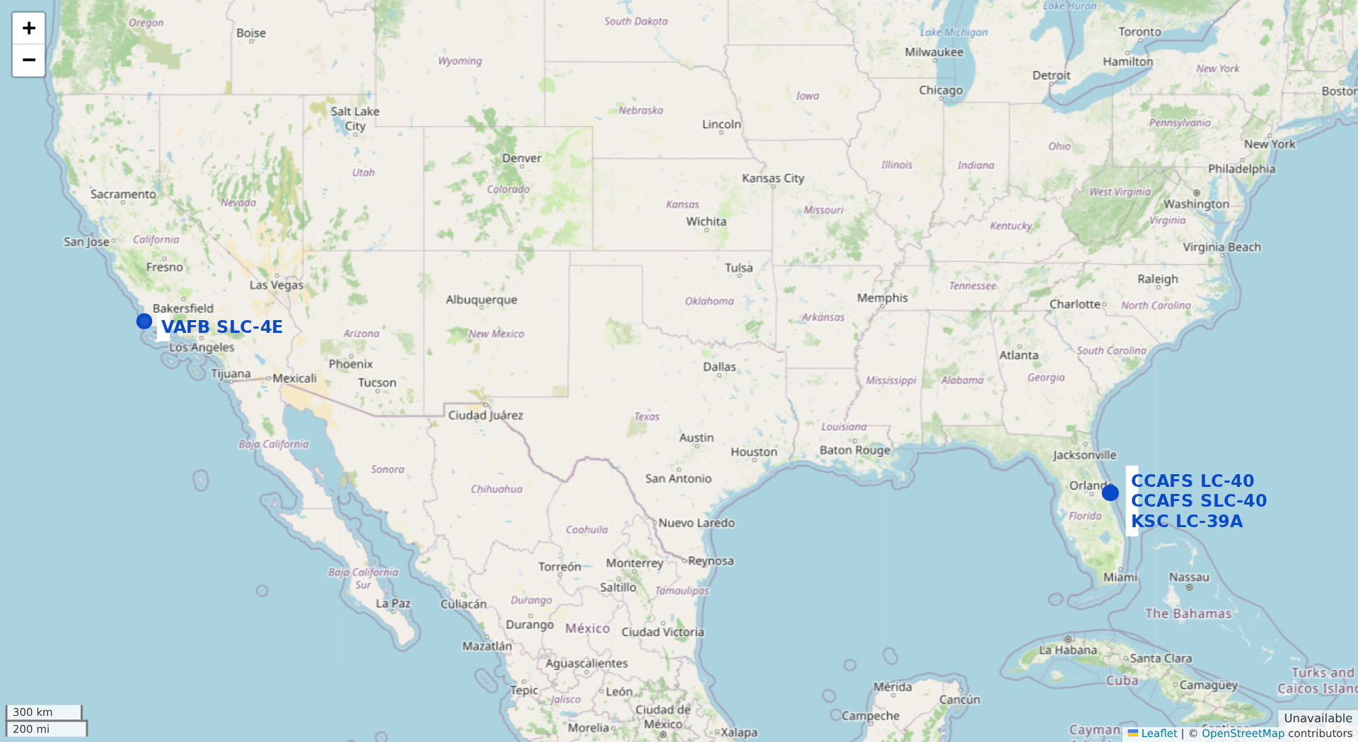
Launch Site Locations
Four site labels span Florida and California.
CCAFS LC-40 and SLC-40 sit close together in the source coordinates.
Geography supports site comparison, but does not establish landing success.
Notes:
Source: https://github.com/elvenj/elvenj-ibm-data-science-professional-certificate/blob/main/applied-data-science-capstone/notebooks/lab_jupyter_launch_site_location.ipynb
Source: https://cf-courses-data.s3.us.cloud-object-storage.appdomain.cloud/IBM-DS0321EN-SkillsNetwork/datasets/spacex_launch_geo.csv
Source: https://www.openstreetmap.org/copyright
Map reproduced for the report with Folium. Site locations use the source CSV as supplied.

Slide 36
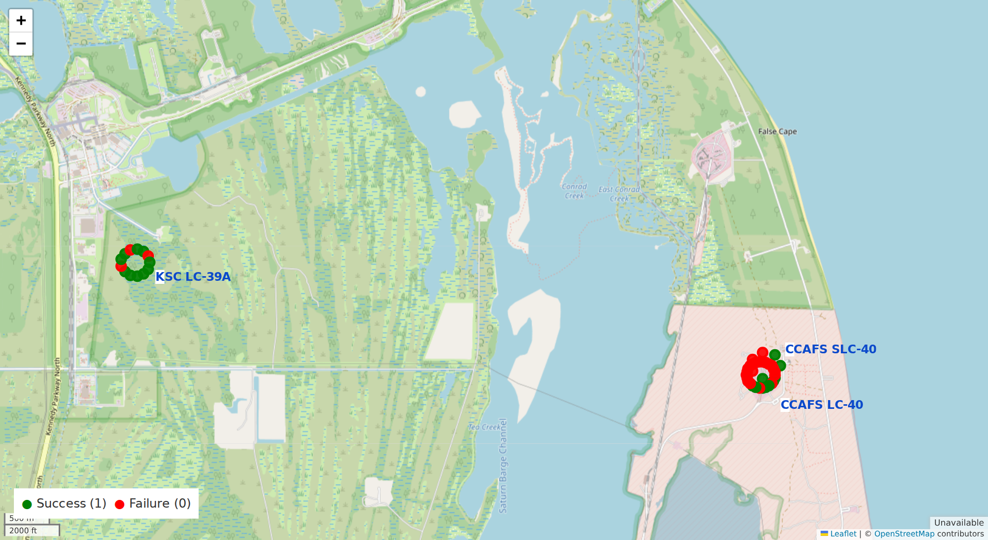
Launch Outcomes on the Map
Green points show success and red points show failure.
Florida sites contain both outcomes.
A small display offset exposes records that share coordinates.
Notes:
Source: https://github.com/elvenj/elvenj-ibm-data-science-professional-certificate/blob/main/applied-data-science-capstone/notebooks/lab_jupyter_launch_site_location.ipynb
Source: https://www.openstreetmap.org/copyright
Map reproduced for the report. Markers are offset by at most about 0.0016 degrees for legibility and are not additional launch locations. Class values follow the 56-row geospatial CSV.

Slide 37
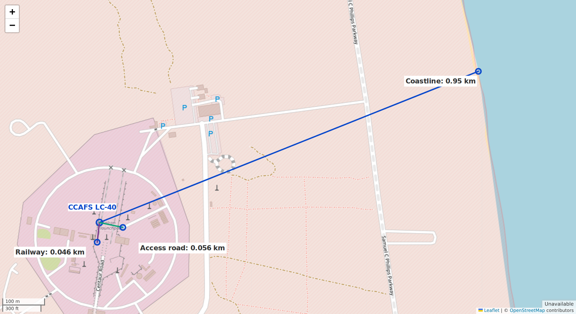
CCAFS LC-40: Nearby Features
Selected coastline point: 0.95 km.
Selected railway node: 0.046 km.
Selected access-road node: 0.056 km.
Haversine distances are straight-line estimates to mapped nodes.
Notes:
Source: https://github.com/elvenj/elvenj-ibm-data-science-professional-certificate/blob/main/applied-data-science-capstone/notebooks/lab_jupyter_launch_site_location.ipynb
Source: https://www.openstreetmap.org/copyright
Source: https://api.openstreetmap.org/api/0.6/map?bbox=-80.583,28.55,-80.543,28.574
Launch-site coordinates follow IBM geo CSV: 28.56230197, -80.57735648. Selected nearby OSM feature nodes and distances: [{"name":"Coastline","km":0.9508444974671244,"point":[28.5654777,-80.5683199],"way":"22322002"},{"name":"Railway","km":0.0459452821436568,"point":[28.5618912,-80.577406],"way":"96332348"},{"name":"Access road","km":0.05576623601074748,"point":[28.562197,-80.5767983],"way":"10766742"}]. Haversine radius 6373 km. Nearest nodes within the downloaded bounding box are used, not a surveyed minimum to the complete feature geometry.

Slide 38

Section 4

Slide 39
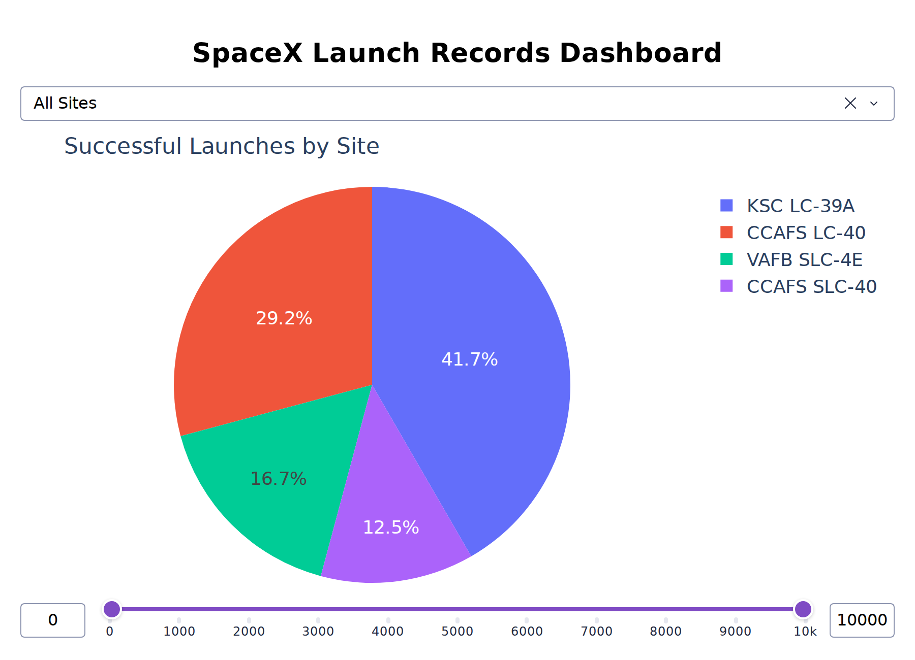
Dashboard: Success Counts by Site
KSC LC-39A contributes 10 of the 24 successful launches.
Its pie slice is 41.7% of all successes.
This share compares counts, not the success rate within each site.
Notes:
Source: https://github.com/elvenj/elvenj-ibm-data-science-professional-certificate/blob/main/applied-data-science-capstone/dashboard/spacex-dash-app.py
Screenshot reproduced from the published update_pie callback with All Sites. Display fonts enlarged for legibility. Dataset 56 launches, 24 successes. Site success counts: KSC 10, CCAFS LC-40 7, VAFB 4, CCAFS SLC-40 3.

Slide 40
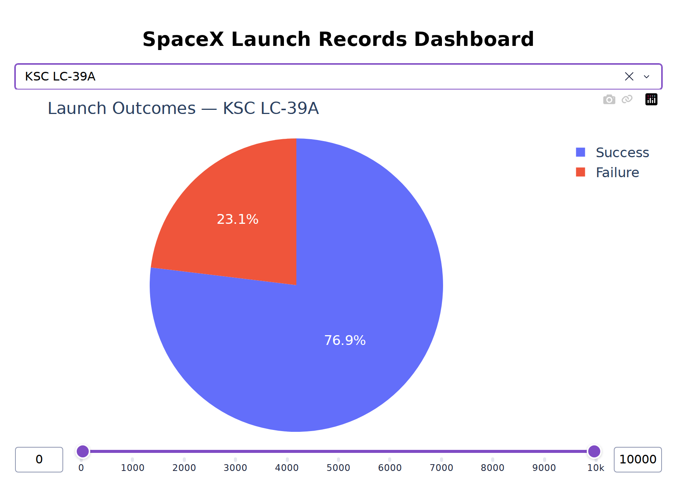
Dashboard: Highest Site Success Rate
KSC LC-39A has 10 successes in 13 launches.
Its 76.9% success rate is the highest among the four dashboard site labels.
The comparison describes this 56-launch snapshot.
Notes:
Source: https://github.com/elvenj/elvenj-ibm-data-science-professional-certificate/blob/main/applied-data-science-capstone/dashboard/spacex-dash-app.py
Screenshot reproduced from the published update_pie callback with KSC LC-39A. Display fonts enlarged for legibility. Rates in the dashboard dataset: KSC 76.92%, CCAFS SLC-40 42.86%, VAFB 40%, CCAFS LC-40 26.92%.

Slide 41
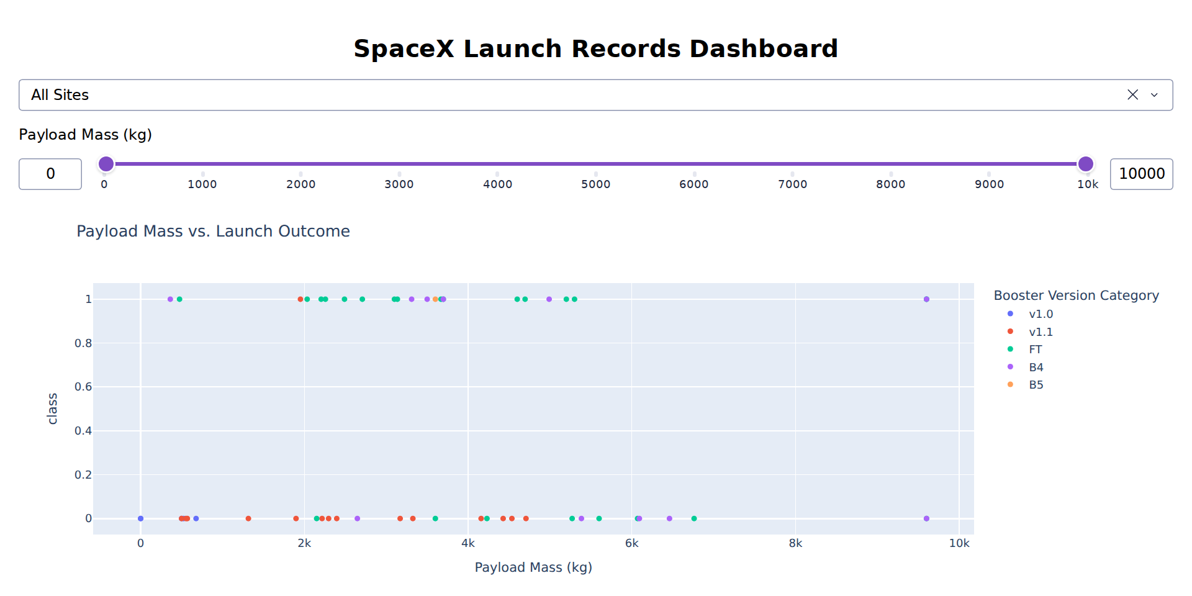
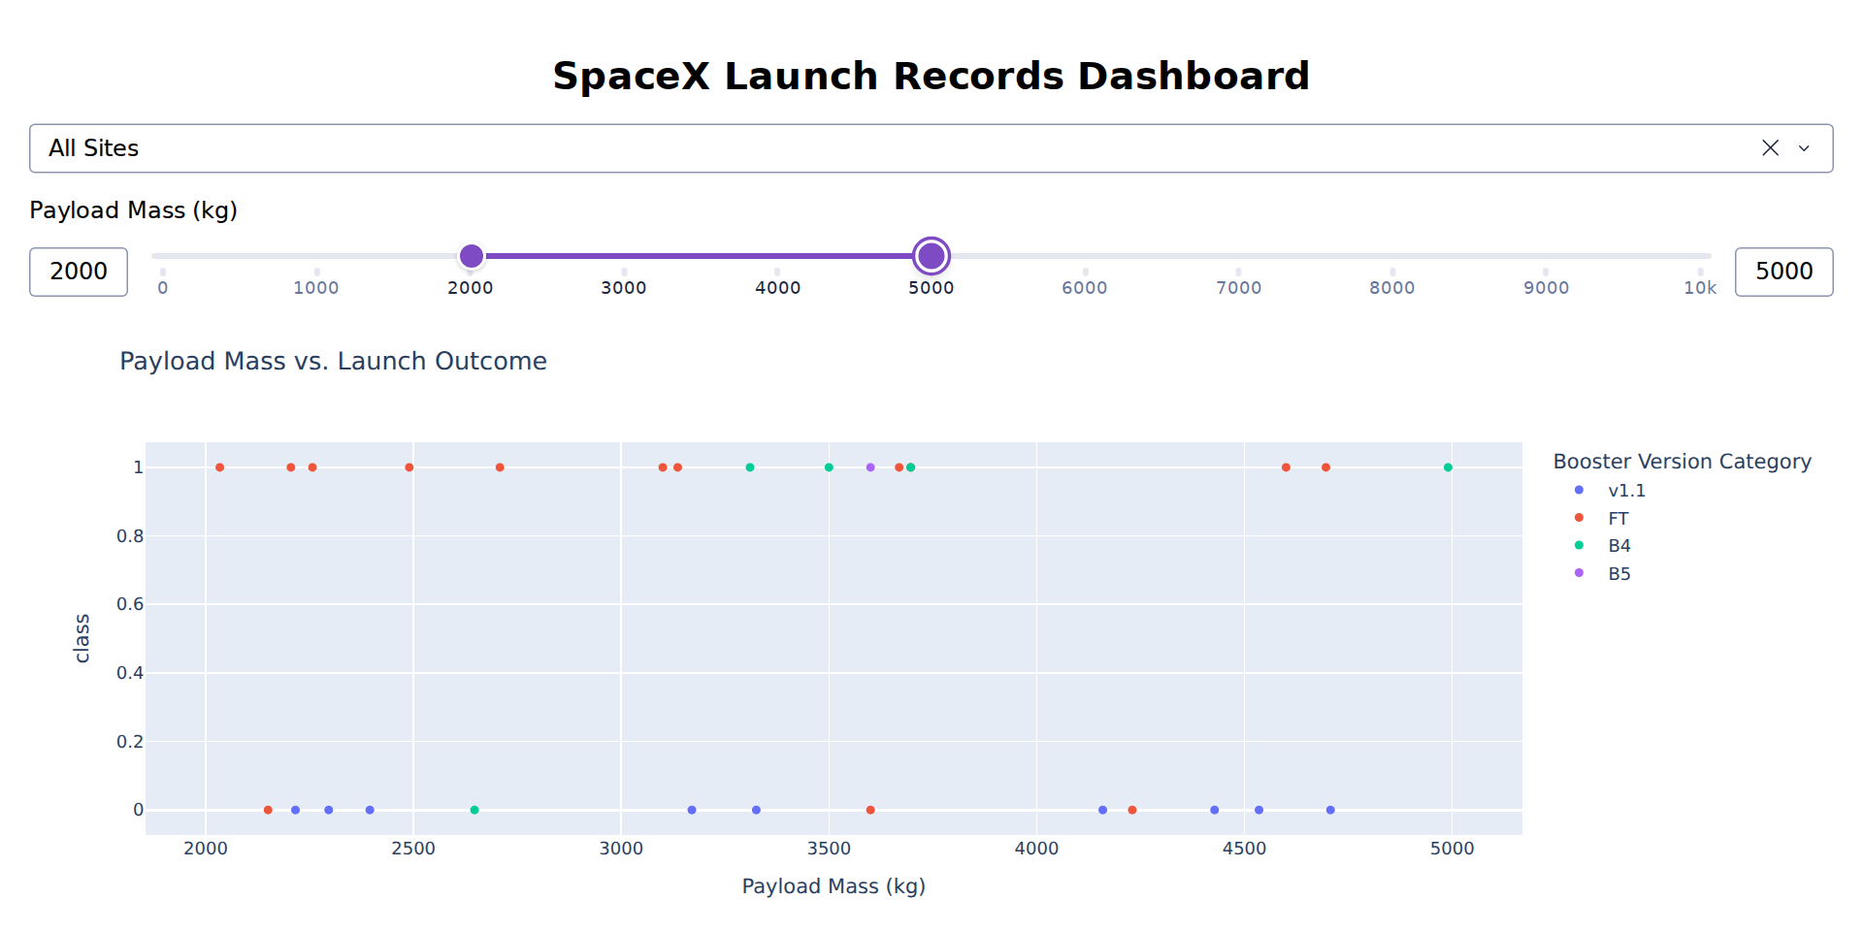
Dashboard: Payload Range Comparison
0-10,000 kg: 24/56 successes (42.9%).
2,000-5,000 kg: 16/29 successes (55.2%).
Success and failure overlap. The narrower range is an exploratory filter, not a causal advantage.
Notes:
Source: https://github.com/elvenj/elvenj-ibm-data-science-professional-certificate/blob/main/applied-data-science-capstone/dashboard/spacex-dash-app.py
Screenshots reproduce the exact published update_scatter callback with All Sites and payload selections [0,10000] and [2000,5000]. Inclusive between filtering yields 56 rows/24 successes and 29 rows/16 successes.

Slide 42

Section 5

Slide 43
Classification Accuracy
10-fold CV: Logistic 84.64%, SVM 84.82%, Tree 87.68%, KNN 84.82%.
Test accuracy: Each model scores 83.33%, or 15 correct predictions in 18.
Selection: Decision Tree leads CV. All four share the same test predictions.
Notes:
Source: https://github.com/elvenj/elvenj-ibm-data-science-professional-certificate/blob/main/applied-data-science-capstone/notebooks/SpaceX_Machine%20Learning%20Prediction_Part_5.ipynb
CV values come from stored notebook output. Decision Tree appears as 0.8768 in the summary cell and the chart retains that precision. Test accuracy is exactly 5/6 for all models.

Slide 44
Confusion Matrix: Decision Tree
12 successful outcomes are correctly identified.
3 other outcomes are correctly rejected.
3 false positives predict success for an actual Class 0 outcome.
No false negatives occur in this test sample.
Actual / predicted | Class 0 | Class 1
Class 0 | 3 | 3
Class 1 | 0 | 12
Accuracy: 83.33%
Success precision: 80%
Success recall: 100%
Notes:
Source: https://github.com/elvenj/elvenj-ibm-data-science-professional-certificate/blob/main/applied-data-science-capstone/notebooks/SpaceX_Machine%20Learning%20Prediction_Part_5.ipynb
Confusion matrix reconstructed from the saved predictions and the notebook random_state=2 test split: TN 3, FP 3, FN 0, TP 12. All four models have identical predictions. These test rates have low precision because n=18.

Slide 45
Conclusions
Models: Decision Tree leads CV at 87.68%. All four tie at 83.33% on 18 test launches.
Site insight: KSC leads the dashboard at 76.9% (10/13). Its 41.7% share (10/24) answers a different question.
SQL insight: NASA CRS payload is 45,596 kg. Including shared NASA-tagged missions gives 107,010 kg.
Prediction risk: Three false positives give 80% success precision. Recall is 100% on this small test set.
Next step: Fit preprocessing inside CV and test future launches chronologically before operational use.
Notes:
Source: https://github.com/elvenj/elvenj-ibm-data-science-professional-certificate/blob/main/applied-data-science-capstone/notebooks/edadataviz.ipynb
Source: https://github.com/elvenj/elvenj-ibm-data-science-professional-certificate/blob/main/applied-data-science-capstone/notebooks/jupyter-labs-eda-sql-coursera_sqllite.ipynb
Source: https://github.com/elvenj/elvenj-ibm-data-science-professional-certificate/blob/main/applied-data-science-capstone/notebooks/SpaceX_Machine%20Learning%20Prediction_Part_5.ipynb
Source: https://github.com/elvenj/elvenj-ibm-data-science-professional-certificate/blob/main/applied-data-science-capstone/dashboard/spacex-dash-app.py
The conclusion reports measured findings on the source datasets. KSC success rate uses 13 KSC launches, while its success share uses 24 successes across all sites. The NASA totals compare exact CRS labels with NASA-tagged missions including shared customers. Recommendations follow the observed limitations: small test sample, globally fitted scaler, temporal trend, booster reuse and mixed outcome definitions.

Slide 46
Appendix: Data Scope and Sources
Analysis | Rows | Primary input
EDA and ML | 90 | dataset_part_2 / part_3
SQL | 101 | IBM Spacex.csv
Dashboard and map | 56 | IBM dash / geo CSV
Scraping output | 0 | Excluded from analysis
Validation priorities: fit preprocessing inside CV, test future launches, and clarify whether success means controlled landing or recoverable hardware.
https://github.com/elvenj/elvenj-ibm-data-science-professional-certificate
Notes:
Source: https://github.com/elvenj/elvenj-ibm-data-science-professional-certificate
Source: https://github.com/elvenj/elvenj-ibm-data-science-professional-certificate/blob/main/applied-data-science-capstone/notebooks/jupyter-labs-spacex-data-collection-api.ipynb
Source: https://github.com/elvenj/elvenj-ibm-data-science-professional-certificate/blob/main/applied-data-science-capstone/notebooks/jupyter-labs-webscraping.ipynb
Source: https://github.com/elvenj/elvenj-ibm-data-science-professional-certificate/blob/main/applied-data-science-capstone/notebooks/lab_jupyter_launch_site_location.ipynb
Source: https://github.com/elvenj/elvenj-ibm-data-science-professional-certificate/blob/main/applied-data-science-capstone/notebooks/SpaceX_Machine%20Learning%20Prediction_Part_5.ipynb
The report retains the published lab results. Additional checks use the same IBM CSV. Live collection errors and incomplete source notebook cells are disclosed. The sources remain unchanged.
Current repository snapshot eb9dd939cff36e562264702ee6951b9d493327d5. Map outputs were reproduced for this report. The source map notebook has TODO cells.

Slide 47
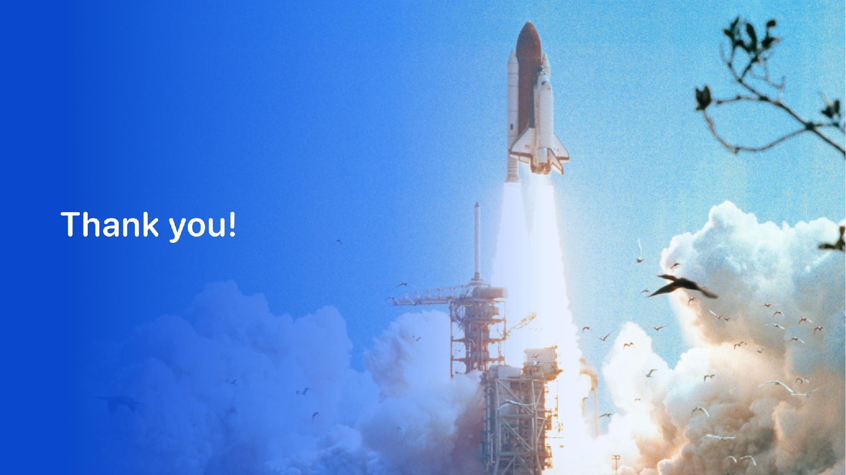
Project repository
Notes:
Source: https://github.com/elvenj/elvenj-ibm-data-science-professional-certificate

