Slide 1
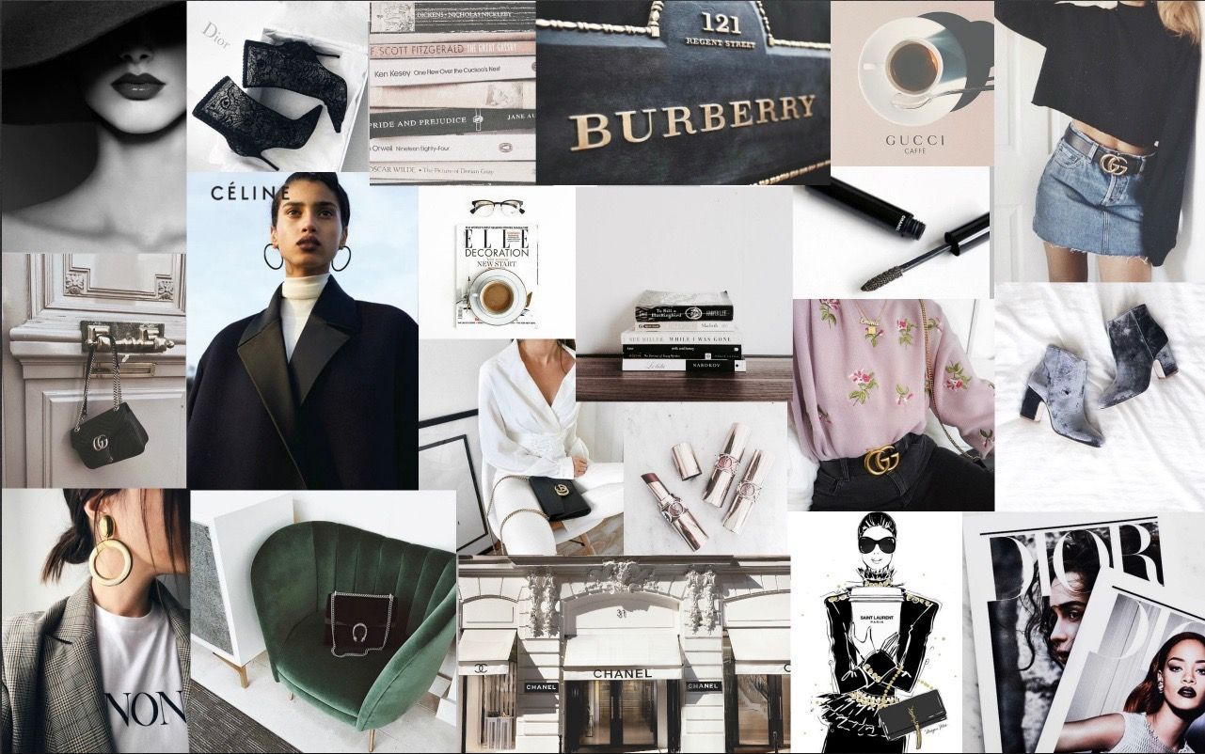
Analysing Fashion Brands by their attributes
~A Project by Elvia Dey
for AIDA (ENT-2017)

Slide 2

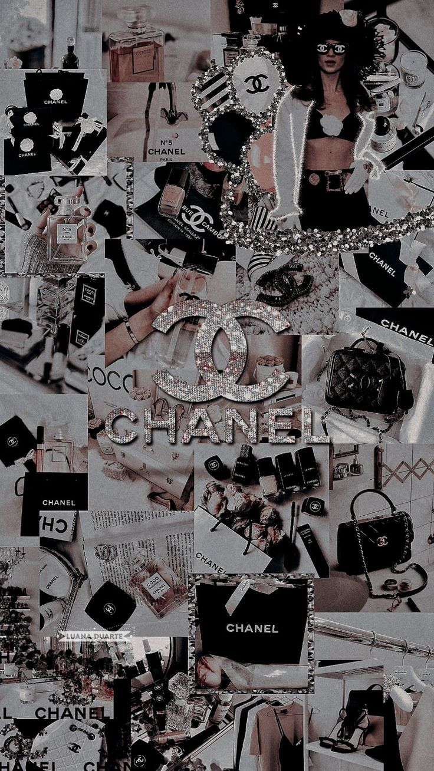
Describing the Data Set
The data set contains 11 brands: Chanel, Louis Vuitton, Christian Dior, Tiffany, Rolex, Burberry, Ralph Lauren, Benetton, Uniqlo, H&M, and GAP.
There are 9 attributes on which the brands are scored: luxurious, traditional, intellectual, brilliant, calm, youthful, friendly, simple, and energetic.
The scores are numerical, with higher scores indicating a stronger association between the brand and the attribute.
The range of scores varies across the attributes and the brands. For example, the highest score for the "luxurious" attribute is 449 (for Chanel), while the lowest score is 6 (for Uniqlo).

Slide 3
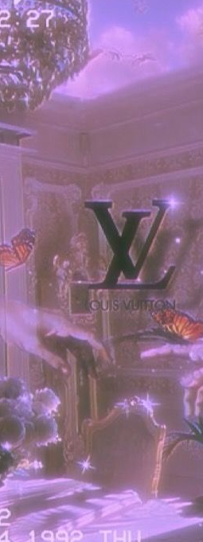
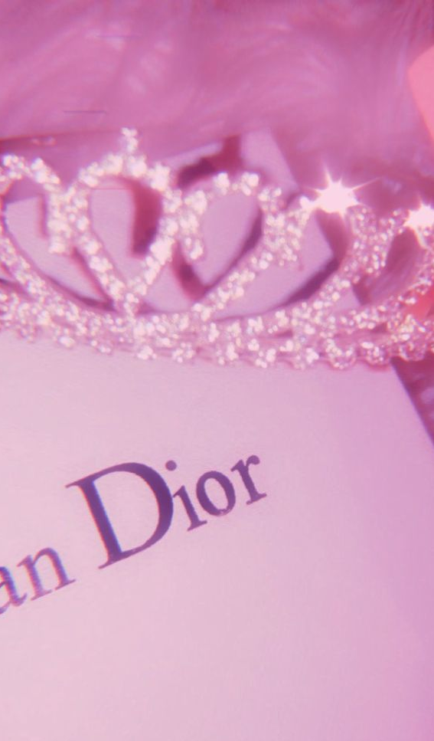
Various operations performed on the Data Set
Importing the data set into a Pandas Data Frame
Drawing a scatter plot of the brands and their attributes
Drawing a heatmap showing the correlation between different attributes
Using K-means clustering to “club” the brands into groups
Performing Multi-Dimensional Scaling
Conducting Principal Component Analysis

Slide 4
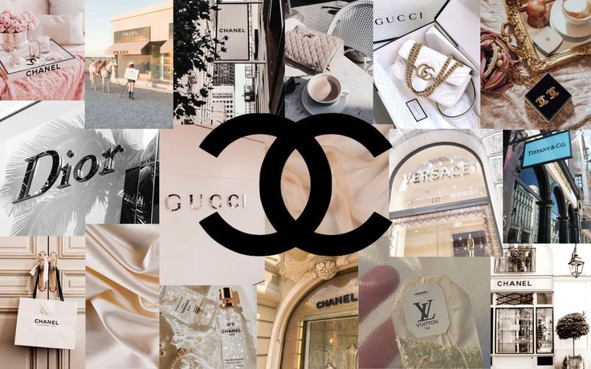
There is a lot of variability in the scores for each brand across the different attributes. For example, Louis Vuitton has a high score on the "traditional" attribute, but a relatively low score on the "youthful" attribute.
Initial Observation from reading the data
The scores for each attribute are higher for luxury brands like Chanel, Louis Vuitton, and Christian Dior, compared to more mainstream brands like Uniqlo, H&M, and GAP.
Uniqlo has very high scores on the "youthful," "friendly," and "simple" attributes, suggesting that the brand may be targeting a younger and more casual audience.

Slide 5

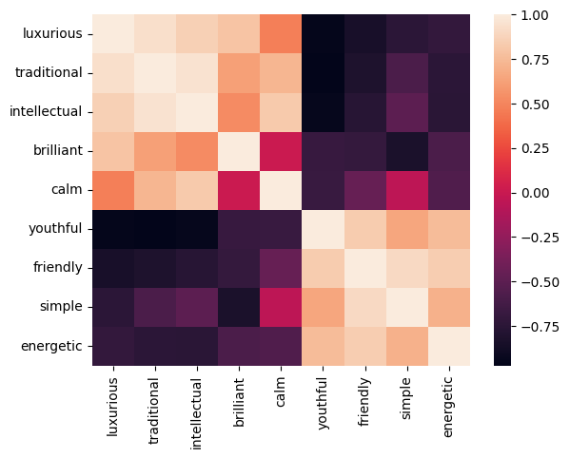
Correlation Analysis using heatmap

Slide 6
Attributes such as luxurious/traditional, simple/friendly have a positive correlation while luxurious/youthful and simple/brilliant have a negative correlation
Brands such as Chanel and Louis Vuitton are more luxurious and traditional, while Uniqlo and GAP are more simple and friendly.
Inference from the heatmap
Similarly, brands such as H&M and GAP are highly youthful but have a low value of luxury, and Christian Dior is brilliant but not simple.

Slide 7
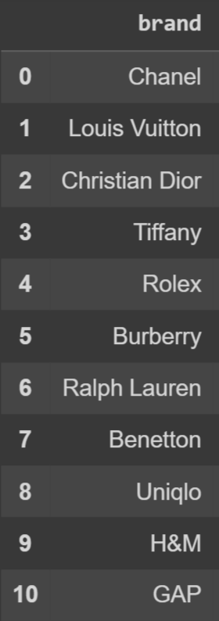
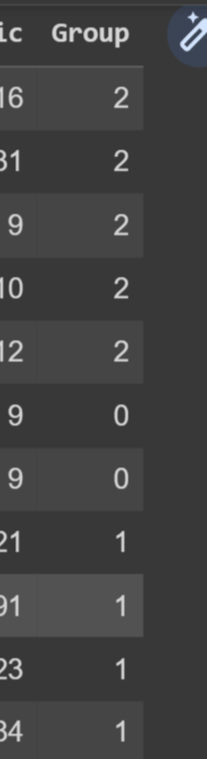
K-Means Clustering
Setting the number of clusters at 3, the groups got divided.
In the first group, there was Burberry and Ralph Lauran. After analyzing their data, we can see that neither of these brands has a high score in any attribute, indicating that compared to all the other brands, they are not extremely luxurious, youthful, etc.
In the second group, there was Uniqlo, H&M, and Gap. All these three brands have very low scores in attributes like luxury, intellect whereas are very simple, friendly, and energetic. These are also the brands that are mostly popular among the younger generation.
In the third group, exists the highly traditional, luxurious, and intellectual brands such as Chanel, Louis Vuitton, Christian Dior, and Tiffany. All these brands are expensive compared to the others and tend to be more popular among the older generation for their style.

Slide 8
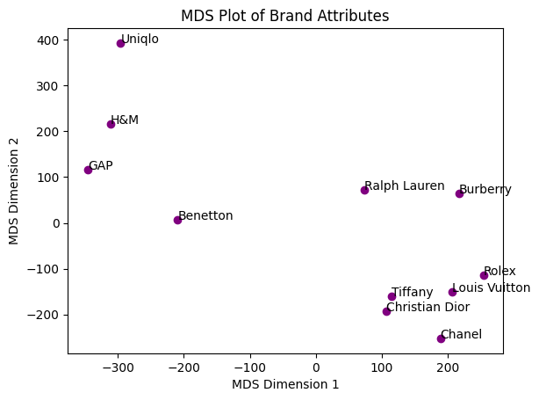
Scatter plot of Multi- Dimensional Scaling

Slide 9
Inference from MDS Scatter Plot
MDS (Multidimensional Scaling) provides a visualization of the similarity or dissimilarity between the different brands based on their scores on the different attributes. The closer two brands are in the MDS plot, the more similar they are in terms of their attribute scores. Conversely, the farther apart two brands are, the more dissimilar they are in terms of their attribute scores. The observations from MDS line up with our results from the K-means clustering since they both produce similar groups where Uniqlo, H&M and Gap, and Chanel, Louis Vuitton, and Dior are close to each other.

Slide 10
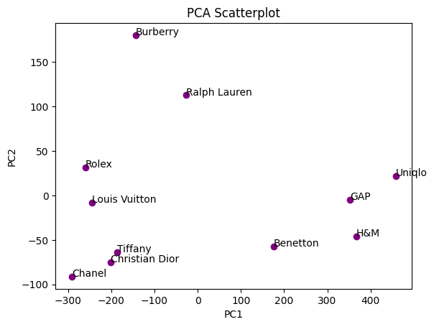
Scatter plot of Principal Component Analysis

Slide 11
Inference from the PCA Scatter plot
After analyzing the scatter plot and taking into consideration the other factors which are known about the brands, we infer that the x-axis represents the affordability of a brand, and y-axis represents the popularity. The higher the x value, the more affordable the brand is, and the lower the y value, the more popular the brand is. Chanel being a high-end luxury brand is one of the most popular ones, whereas Burberry, although not very expensive as compared to Chanel, is less popular. H&M being affordable is also among the more popular brands.

Slide 12
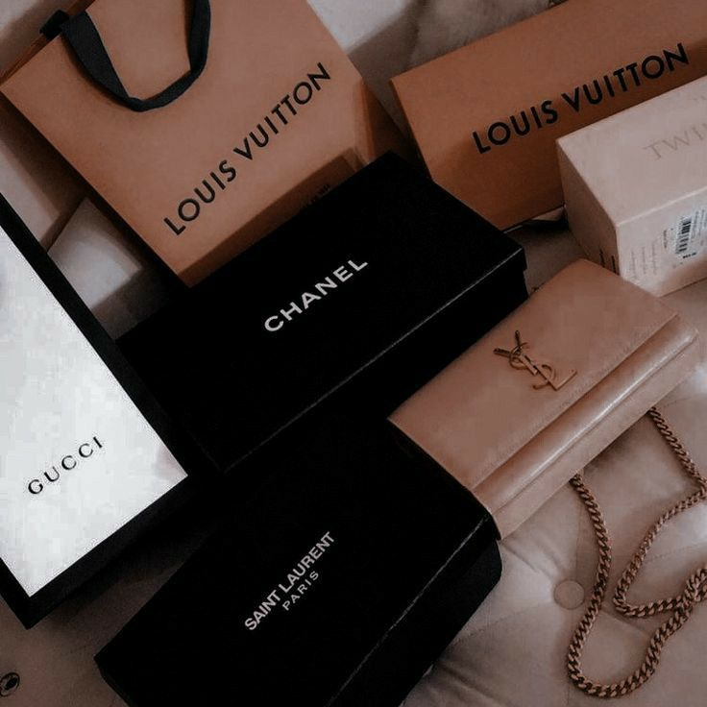
Customer Behaviour Analysis
Based on popularity, customers tend to be attracted to brands with a high value in attributes like luxury, youthfulness, and friendliness.
Brands with similar values in attributes attract similar customers, like GAP, H&M, and Uniqlo who attract the younger crowd, and Louis Vuitton, Rolex, and Burberry who attract a more mature crowd.
The blank space between Benetton and Tiffany indicates that within our data set, there isn’t a brand that is in a price range between the two and is popular.
A simple brand can only be popular if it is affordable, as seen in the case of Uniqlo. Burberry and Ralph Lauren although simple, are not popular due to their high cost.

Slide 13
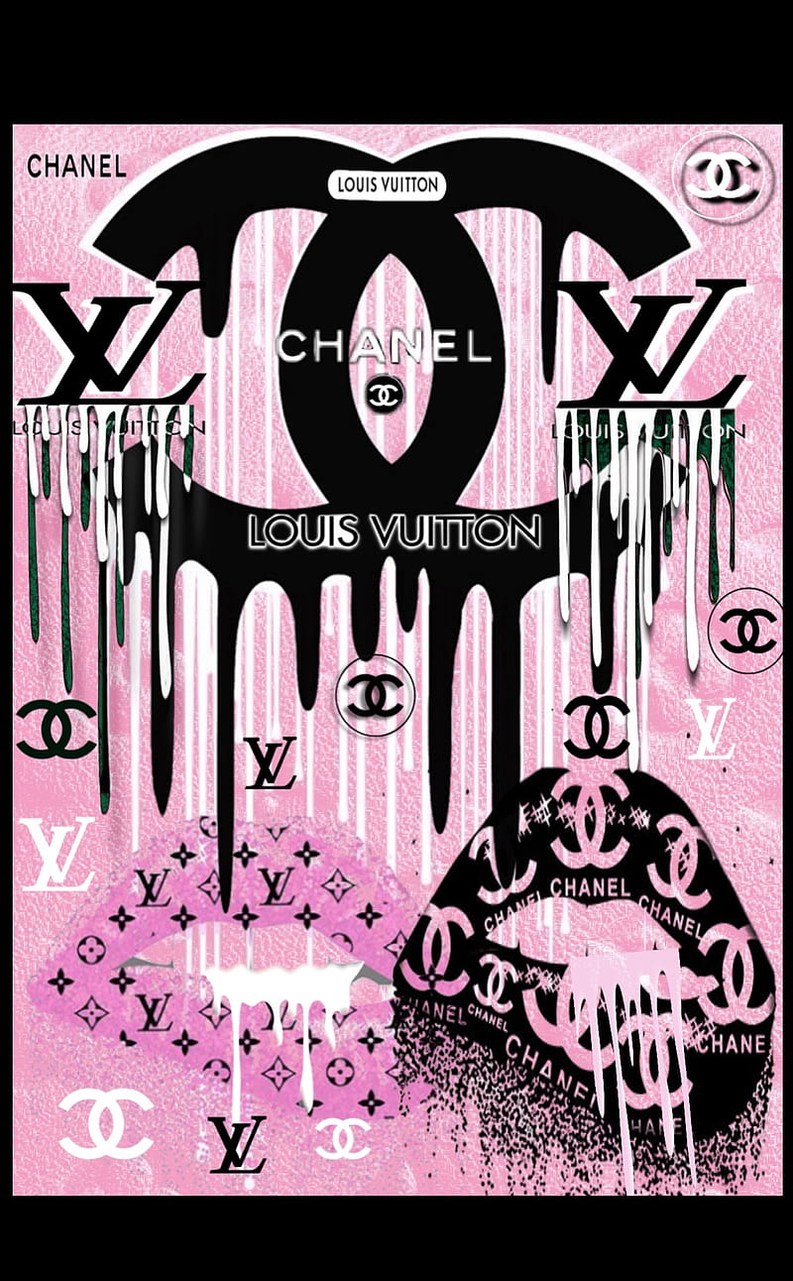
THANK YOU!

