Slide 1
PREDICTING RETURNS OF NIFTY50 BASED ON 10 STOCKS

Slide 2
List of Selected Stocks
1. Axis Bank
3. Dr. Reddy’s
5. ICICI Bank
7. Nestle India
9. TCS
2. Coal India
4. HDFC Bank
6. Infosys
8. Reliance
10. Wipro

Slide 3
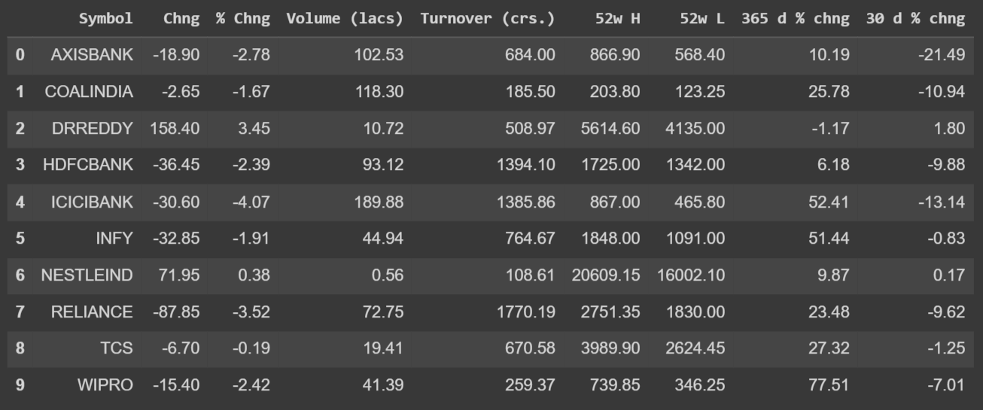
The Dataset Used:

Slide 4
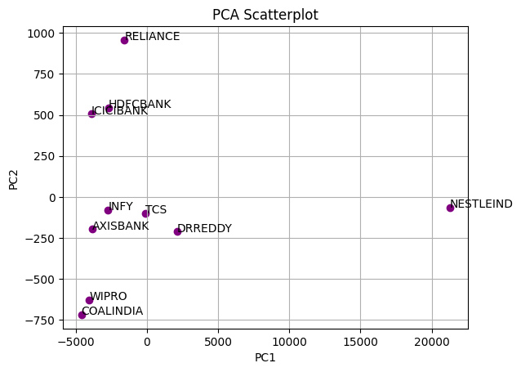
Principal Component Analysis

Slide 5
Analysis of PCA Scatterplot
After researching the chosen stocks, it was observed that the stocks are arranged along the x-axis on the basis of their p/e ratio (Coal India has the lowest ratio of 4.82 and Nestle India has the highest ratio of 82.8).
The stocks are arranged along the y-axis on the basis of their stock weightage (Currently Reliance has the highest weightage of 10.33% and Coal India has the lowest weightage of 0.59%)
So, the two principal components are price-to-earnings ratio and stock weightage

Slide 6
Analysis of PCA Scatterplot
A high % of stock weightage indicates the % of NIFTYs movement which can be attributed to that stock. For example, since the stock weightage of Reliance is 10.33%, that % of NIFTY’s movement can be attributed to Reliance
Historically, the lower the P/E, the higher the return. This indicates that the x-axis also indicates the returns on investments of the stocks. The higher the value of the p/e ratio, the lower the return, and hence stocks on the left-hand side of the graph have a high return.

