Slide 1
Intel® XDK Разработка мобильных приложений
Андрей Малышев, старший инженер по программному обеспечению, Intel
Игорь Калетурин, старший инженер по программному обеспечению, Intel
https://github.com/elvin-nnov/itforum2014

Slide 2
Знакомимся
Кто знаком с HTML5, JavaScript?
Кто разрабатывал приложения для мобильных платформ?
Как из HTML5 приложения сделать Android приложение?
Можно ли из HTML5 приложения сделать iPhone прложение?
Windows Phone 8?

Slide 3
Что отображает этот график?
Notes:
Worldwide Devices Shipments by Operating System (Thousands of Units)
Source: Gartner (April 2013)
In the shares of operating systems (OSs) in device sales, the shift to mobile and the fight for the third ecosystem becomes more evident. Android continues to be the dominant OS in the device market, buoyed by strong growth in the smartphone market. Competition for the second spot will be between Apple's iOS/Mac OS and Microsoft Windows.
Note: Devices include notebooks and desk-based PCs, tablets, ultramobiles and mobile phones.
Source: Gartner (April 2013)

Slide 4
Тренды использования мобильных платформ
Source: Gartner (April 2013)
www.gartner.com/newsroom/id/2408515
Notes:
Worldwide Devices Shipments by Operating System (Thousands of Units)
Source: Gartner (April 2013)
In the shares of operating systems (OSs) in device sales, the shift to mobile and the fight for the third ecosystem becomes more evident. Android continues to be the dominant OS in the device market, buoyed by strong growth in the smartphone market. Competition for the second spot will be between Apple's iOS/Mac OS and Microsoft Windows.
Note: Devices include notebooks and desk-based PCs, tablets, ultramobiles and mobile phones.
Source: Gartner (April 2013)

Slide 5
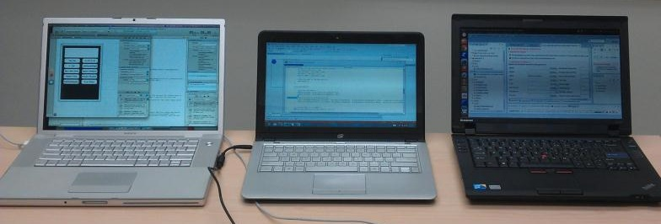


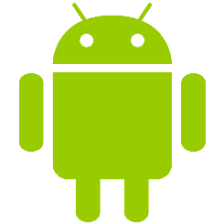
Создание приложений для разных платформ…
*Xcode logo is the property of Apple
*Visual Studio logo is the property of Microsoft
*Android logo is the property of Google
Notes:
For many developers, supporting multiple platforms means they must maintain multiple code source bases using multiple Software Development Kits (SDKs) on multiple development platforms. For example:
to develop iOS native applications you must use the Apple Xcode development system which runs only on a Mac OS X system and utilizes Objective C as the primary programming language
to develop Android native applications you must use the Android Eclipse development system (on Windows, Mac or Linux) and utilizes Java as the primary programming language
to develop Windows 8 native applications you must us Visual Studio 2012 on a Windows 8 system and utilizes C#, JavaScript or C/C++ as the primary programming language(s)

Slide 6



…Требует много времени и денег
Notes:
…working within these restrictions means having to work inside a set of walled gardens that prevent you from reaching the full potential of the mobile device market.

Slide 7
Что же общего среди платформ?
 | Apple* iOS* | BlackBerry* | Google* Android* | Microsoft* Windows* 8 | Mozilla* Firefox* OS | Tizen*
Development model | Controlled by Apple | Controlled by RIM | Code released to open source after first commercial device ships; key pieces are Google proprietary | Controlled by Microsoft | Open source, code released during development; controlled by Mozilla | Open source, code released during development. Controlled by Tizen TSG, co-chaired by Intel and Samsung
APIs | Objective C; HTML5 in browser and hybrid | C/C++; HTML5 in browser and hybrid; Java | Java; some C/C++; HTML5 in browser and hybrid | C/C++; C#, JavaScript; HTML5 in browser and hybrid | HTML5 only | HTML5 preferred; C/C++
Architecture support | ARM only | ARM only | ARM and x86 | ARM and x86 | ARM only | ARM and x86
Device categories supported | Smartphone, tablet, TV | Smartphone, tablet | Smartphone, tablet, TV | Smartphone, tablet | Entry smartphone | Smartphone, tablet IVI, TV, PC
Notes:
So how can developers reach the full spectrum of mobile devices without being trapped by “Walled Gardens”?
Look closely at this chart, there is a common theme, something that can be used to create applications using a single programming technology: HTML5 (HTML + CSS + JavaScript)!

Slide 8

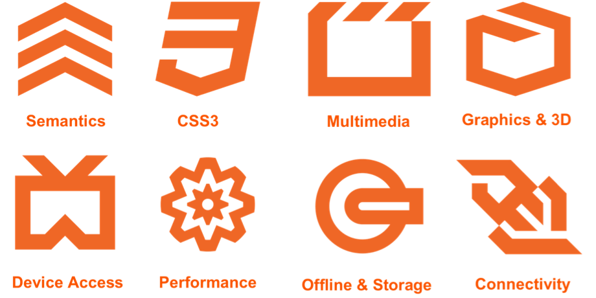
Об HTML5

Slide 9

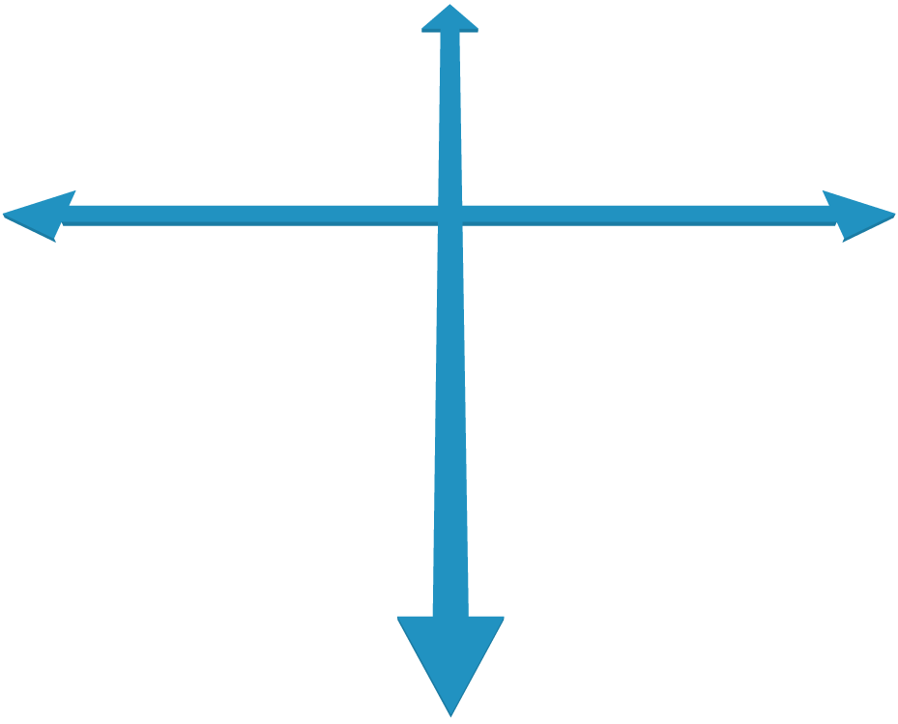








Native Versus Web Apps on Mobile
Native Apps
Advanced UI interactions
Fastest performance
App store distribution
Single Platform
Partial Capabilities
Full Capabilities
Web Apps
Web developer skills
Instant updates
Unrestricted distribution
Multiple Platforms
Notes:
Native Apps- Built using the native programming language for the platform (iPhone and iPad apps are built using Objective-C and Android are built with Java). Native apps are fast, provide a native user experience and interface and have access to all device features on the platform. The down side of native apps are their restricted reach: e.g., an android app cannot be run on an iPhone and vice versa. If you want to cover a larger target market, across all platforms, you must build separate native apps for each target.
Web Apps - A website built using HTML5, CSS3 and JavaScript which resembles an application and can be accessed through a browser is called a web app. The biggest advantage of web apps is that it can be used across all platforms and devices. However, web apps are not accepted in any of the native app stores thereby cutting off an important distribution channel for app developers. Also, web apps cannot access or use the native APIs or device specific hardware features.

Slide 10

Hybrid HTML5 App Advantage
Native Apps
Advanced UI interactions
Fastest performance
App store distribution
Single Platform
Partial Capabilities
Full Capabilities
Web Apps
Web developer skills
Instant updates
Unrestricted distribution
Hybrid HTML5 Apps
Web developer skills
Access to native platform
App store distribution
Multiple Platforms
Notes:
Native Apps- Built using the native programming language for the platform (iPhone and iPad apps are built using Objective-C and Android are built with Java). Native apps are fast, provide a native user experience and interface and have access to all device features on the platform. The down side of native apps are their restricted reach: e.g., an android app cannot be run on an iPhone and vice versa. If you want to cover a larger target market, across all platforms, you must build separate native apps for each target.
Web Apps - A website built using HTML5, CSS3 and JavaScript which resembles an application and can be accessed through a browser is called a web app. The biggest advantage of web apps is that it can be used across all platforms and devices. However, web apps are not accepted in any of the native app stores thereby cutting off an important distribution channel for app developers. Also, web apps cannot access or use the native APIs or device specific hardware features.
Hybrid Apps – A hybrid app is built using web technology and then “wrapped” in a platform specific container. The native container makes hybrid apps installable on a target device, just like a native app and, therefore, is eligible to be submitted to the platform’s app store. Developers can include hooks to native features in the container, in order to access native APIs and use device-specific hardware features. A hybrid app is basically an app developed in using a combination of HTML5 web technology and native platform technology. For cross-platform reach, developers would need to code the native part separately for each platform, but they can use the same HTML5 across all of their target platforms. Fortunately, technologies like Cordova (PhoneGap) and the Intel XDK make the process of developing the target container code a non-issue.

Slide 11
HTML 5 apps
Мобильные приложения, использующие возможности устройств, на которых они работают – акселерометр, GPS, гироскоп
Web apps
Требуют поддержки от производителей web browsers
Реализуют общую функциональность, нежели особенность какого-либо устройства
Hybrid apps
Используют интерфейсы расширения WebView
Intel XDK

Slide 12
Web vs. Hybrid vs. HTML5 Applications
Today
Tomorrow
 | Web App limited sensor input | Hybrid App full sensor input | HTML5 App full device access
Runs w/o network | Yes | Yes | Yes
Flexible Layout | Yes | Yes | Yes
Device APIs | Limited | Mostly | Complete
Distribution | URL | Native Binary | URL/WGT
Cross Platform | Yes | Yes & No | Yes
Runs in Web Browser | Yes | No | No
Runs in Web Runtime | No | Yes | Yes
The HTML5 standard is evolving to include device APIs
Notes:
Before we venture into the world of building HTML5 mobile device applications it is worth talking about the different kinds of HTML5 apps that exist today. Today there are primarily two types of HTML5 applications: “web apps” and “hybrid apps.”
Web apps are really just a web page that appears like an app on a device, but does not actually “install” on that device, it runs inside the mobile device’s browser and is served up by a web server over the Internet. On iOS (Apple) devices there are clever techniques available to hide the fact that you are viewing a web page, special “tags” can be used inside your HTML page(s) to place an icon on an iOS desktop that instructs the browser to load and run this web site. Also, pages within such a “web app” can be cached locally, on the device, in order to accommodate a faster startup that does not depend on a network connection. However, ultimately, these are nothing more than clever URL bookmarks saved on the device screen. These apps cannot be hosted in the Apple store nor are they every truly “installed” on the device.
And, unfortunately, this “web app bookmark” trick that works so nicely on iOS devices does not work on Android and other mobile devices. More importantly, these special “web apps” do not have access to device features like the accelerometer, compass, GPS, camera(s), contacts, etc. They are limited by browser security restrictions, and therefore are not considered to be “trusted” applications for the purpose of device and user data access.
“Hybrid apps” can be thought of as “web apps” that have been “wrapped” inside a native container so the application can actually be submitted to a device store (Apple store, Android store, etc.) and downloaded for installation on a user’s mobile device. In addition, because hybrid apps are installable apps they have access to device features, so they can more intimately interact with the end user.
An “HTML5 app” goes one step beyond a hybrid app. A true HTML5 app is a collection of the HTML5 files (HTML, CSS, JavaScript and related asset files, such as image files) that make up the application. In this case, the collection of files are delivered in a signed ZIP format that is recognized by the target system as a “runnable” application that can be “installed” on the device. Firefox OS applications and Tizen HTML5 applications are such HTML5 apps (of tomorrow). They do not require a special “wrapper” or “container” to turn them into native executables that can be installed and run on a device, they consist only of the HTML5 parts that are necessary to run as HTML5 applications. And the device platform (e.g., Firefox OS and Tizen) provides a complete JavaScript API that allows the applications access to device-specific features, such as sensors, cameras, contact databases, SMS messaging, etc. – access to features you cannot get from a typical browser.
The last two rows of this table are particularly important. Notice that hybrid apps and the HTML5 apps (of tomorrow) run inside a “web runtime” as opposed to inside a web browser. This is a very important distinction. The “web browser” is that agent you normally use to “browse the web.” It is Chrome or Firefox or IE or Opera or Safari… The “web runtime” or “webview” is a builtin native programming object that can be used by native applications to display web content within a window or “view” as part of the native application. The “native container” that “wraps” an HTML5 hybrid application uses this webview to run the HTML5 application on a device.
While the “web browser” on a device can be easily updated by redistributing and installing a new browser (for instance, by installing a new instance of the Chrome browser on your Android device), the builtin “web runtime” or “webview” is not so easily updated. It is generally built into the ROM of the device and will only be updated if the device OS is updated. Additionally, there may be features present in the mobile browser (e.g., Safari on iOS and Chrome on Android) that do not exist within the webview. It is important to understand this distinction because it can impact how you write your HTML5 application as well as how you debug that application. Some typical differences include a more limited memory footprint as well as more limited use of hardware acceleration (this especially impacts certain CSS features). In essence, you cannot assume that just because something works well in a browser that it will work equally well in a webview.
Web Apps:
‘Pure’ HTML/CSS/JavaScript. Typically, just a URL that will run in a browser
Universal across platforms
Limited or no access to device data and sensors (GPS, Accelerometer,…)
Hybrid Apps:
Mostly HTML5, but wrapped in a ‘native webview’
Must be build for each platform.
Distributed as native executable
Packaged as native apps
JavaScript APIs for access to device data
HTML5 Apps:
Web Apps with Device Data access through standardized APIs
App code stored locally

Slide 13
Как приложение работает на устройствах
App
WebView (WebKit/Chromium/IE)
Cordova API
HTML
CSS
JavaScript
Intel XDK API
XHR

Slide 14
Intel XDK
Инструмент крос-платформенной разработки HTML5 приложений для мобильных устройств.
Download Intel XDK NEW and sign up http://xdk-software.intel.com/download.html
Getting Started http://software.intel.com/en-us/html5/tools
Training http://software.intel.com/en-us/html5/training
Documentation Intel XDK New: http://software.intel.com/en-us/html5/articles/xdkdocs

Slide 15
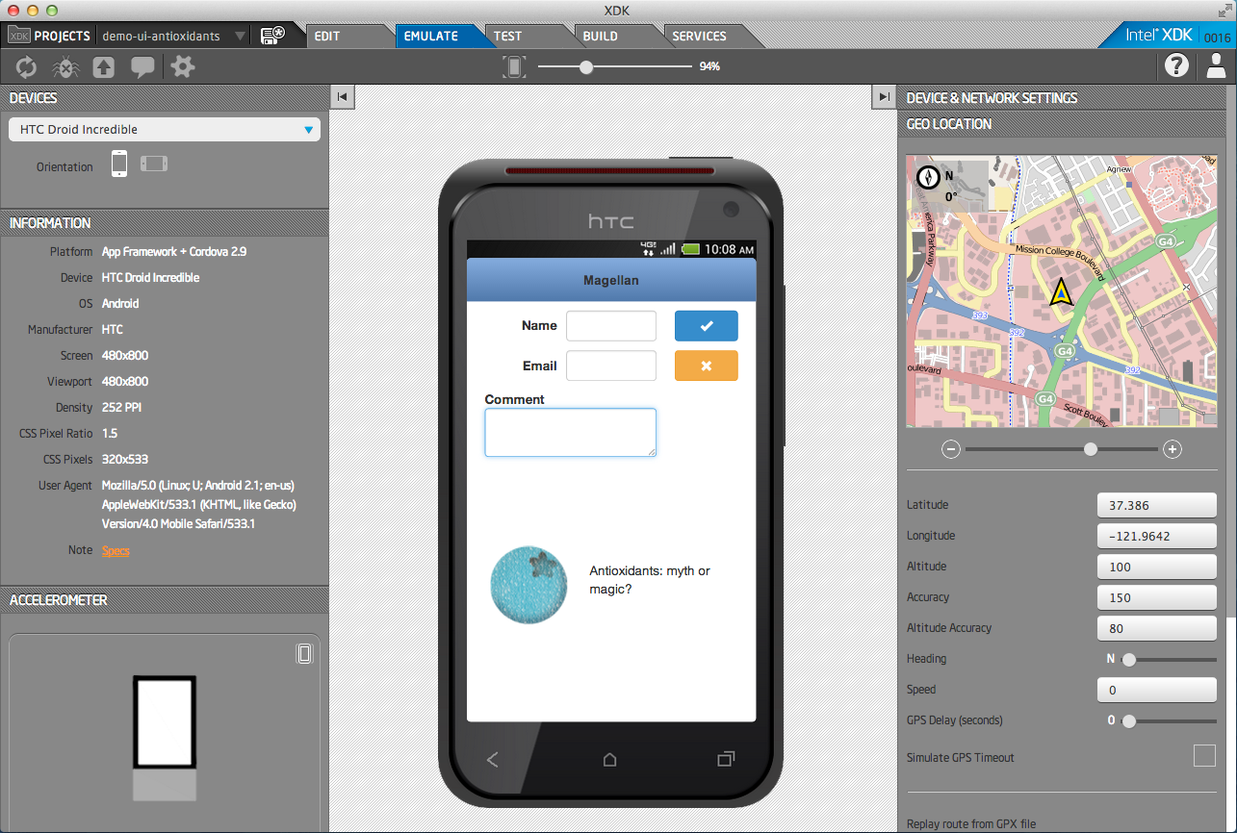

Intel® XDK – Tools for Hybrid HTML5 App Development
Develop
Debug, Test, Profile
Deploy
HTML5 Editor
Device
Emulator
JS Debugger
Cloud-Based Packaging Tool
App Designer
UI Layout
On-Device
App Tester
On-Device
App Debugger
Cordova Build
“Hybrid Apps“
Apple* AppStore
Google* Play*
Windows* Market
App Framework
Optimized JS libs
On-Device
App Profiler
HTML5 Build
“Web Apps“
Chrome* Store
Facebook*
Your Website
App Game I/F
Optimized Canvas
App Porter
Convert iOS to HTML5
Build cross-platform HTML5 hybrid applications.
*HTML5 logo is the property of World Wide Web Consortium (W3C)
Notes:
http://www.w3.org/html/logo/ -- HTML5 logos are released under Creative Commons Attribution 3.0 License.
You are free:
to Share — to copy, distribute and transmit the work
to Remix — to adapt the work
to make commercial use of the work
Under the following conditions:
Attribution — You must attribute the work in the manner specified by the author or licensor (but not in any way that suggests that they endorse you or your use of the work).

Slide 16
Intel XDK API
Наследованная от AppMobi библиотека для создания гибридных приложений
Обеспечивает доступ к
Акселерометр
Кэш
Камера
Game Canvas
Contacts
Свойства устройства
Дисковое хранилище
итд
https://software.intel.com/en-us/node/492826

Slide 17
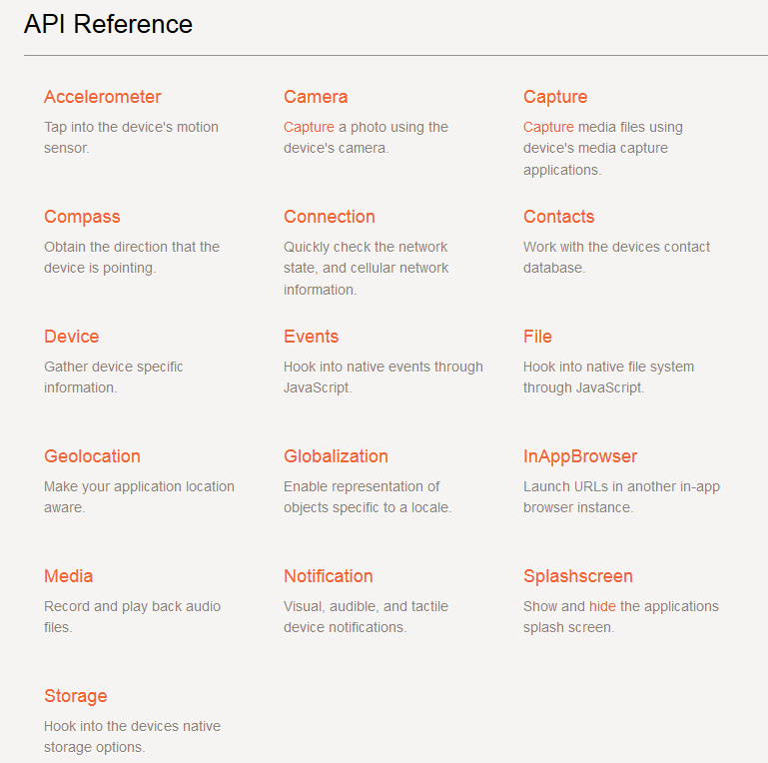
Cordova API
http://cordova.apache.org/docs/en/2.4.0/

Slide 18
Intel XDK containers
Тестовые контейнеры для пробы приложений и отладки
AppPreview
Использует Native WebView (WebKit/IE/WebKit+v8)
Функциональность WebView определяется версией ОС
Имеет все расширения для приложения созданного под XDK
APX – AppPreview Crosswalk
Использует Intel Crosswalk – Chromium based browser
Последняя версия Chromium, с лучшей поддержкой HTML5
Только Android/Tizen
Добавляет 30-40 Мб к apk и 35-60 в развернутом виде

Slide 19

Activity #1 Layout and Design

Slide 20
Develop: Mobile App Design Tools
Develop
Debug and Test
Deploy
HTML5 Editor
Device
Emulator
JS Debugger
Cloud-Based Packaging Tool
App Designer
UI Layout
On-Device
App Tester
On-Device
App Debugger
Cordova Build
“Hybrid Apps“
Apple* AppStore
Google* Play*
Windows* Market
App Framework
Optimized JS libs
On-Device
App Profiler
HTML5 Build
“Web Apps“
Chrome* Store
Facebook*
Your Website
App Game I/F
Optimized Canvas
App Porter
Convert iOS to HTML5
Build cross-platform HTML5 hybrid applications.
Notes:
http://www.w3.org/html/logo/ -- HTML5 logos are released under Creative Commons Attribution 3.0 License.
You are free:
to Share — to copy, distribute and transmit the work
to Remix — to adapt the work
to make commercial use of the work
Under the following conditions:
Attribution — You must attribute the work in the manner specified by the author or licensor (but not in any way that suggests that they endorse you or your use of the work).

Slide 21
Project
Несколько опций
Blank project <- xdk & index.html с инициализацие intel API
Demo <- полезно для изучения возможностей
Template
Import existing app
Use App Starter <- полностью покрывается App Designer
App Designer <- Включает 4 фрэймворка

Slide 22
App Framework & others
Делают look&fill приложения похоже на look&fill платформы
App Framework оптимизирован специально под WebKit
Содержит меньше кода
Испольует tips & tricks WebKit

Slide 23
Develop
Brackets
Полноценный JavaScript редактор разрабатываемый Adobe
Хорошие возможности настройки и плагинов
Designer
Легко набросать макет, добавить обработчик событий
Сделать многостраничное приложение
One way путь от Designer к JavaScript коду. Легко перейти в редактор, трудно вернуться обратно

Slide 24
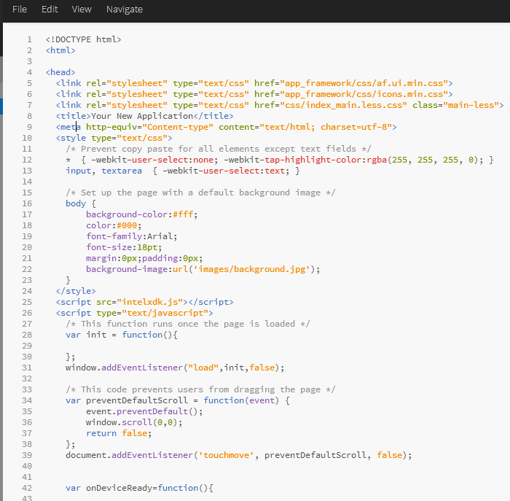
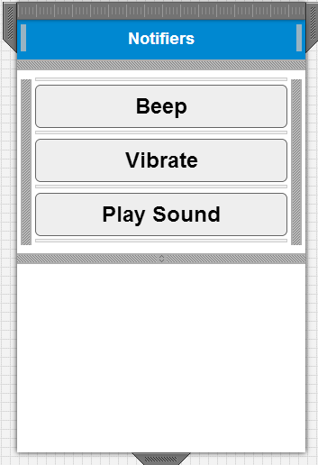
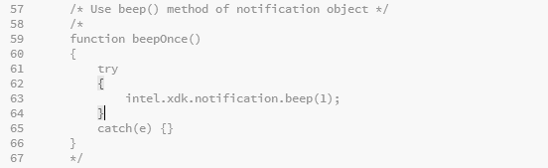
Пример 1

Slide 25
Activity #2 Test and Debug

Slide 26
Test: Emulate and On-Device Debug
Develop
Debug and Test
Deploy
HTML5 Editor
Device
Emulator
JS Debugger
Cloud-Based Packaging Tool
App Designer
UI Layout
On-Device
App Tester
On-Device
App Debugger
Cordova Build
“Hybrid Apps“
Apple* AppStore
Google* Play*
Windows* Market
App Framework
Optimized JS libs
On-Device
App Profiler
HTML5 Build
“Web Apps“
Chrome* Store
Facebook*
Your Website
App Game I/F
Optimized Canvas
App Porter
Convert iOS to HTML5
Build cross-platform HTML5 hybrid applications.
Notes:
http://www.w3.org/html/logo/ -- HTML5 logos are released under Creative Commons Attribution 3.0 License.
You are free:
to Share — to copy, distribute and transmit the work
to Remix — to adapt the work
to make commercial use of the work
Under the following conditions:
Attribution — You must attribute the work in the manner specified by the author or licensor (but not in any way that suggests that they endorse you or your use of the work).

Slide 27
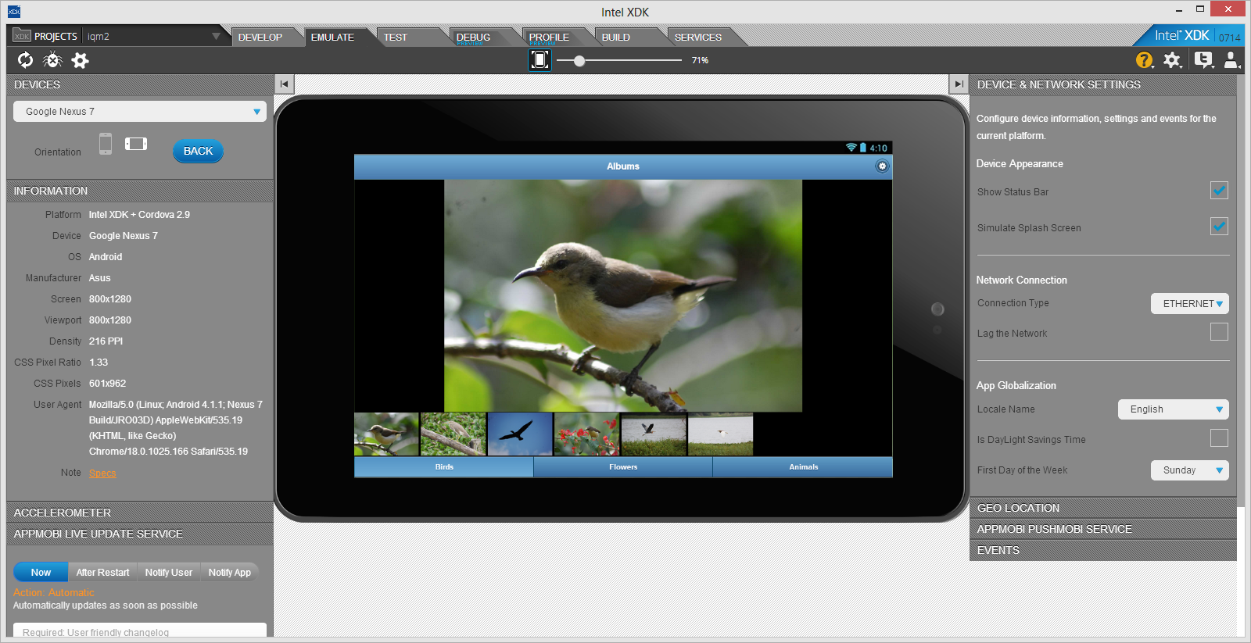
Emulate

Slide 28
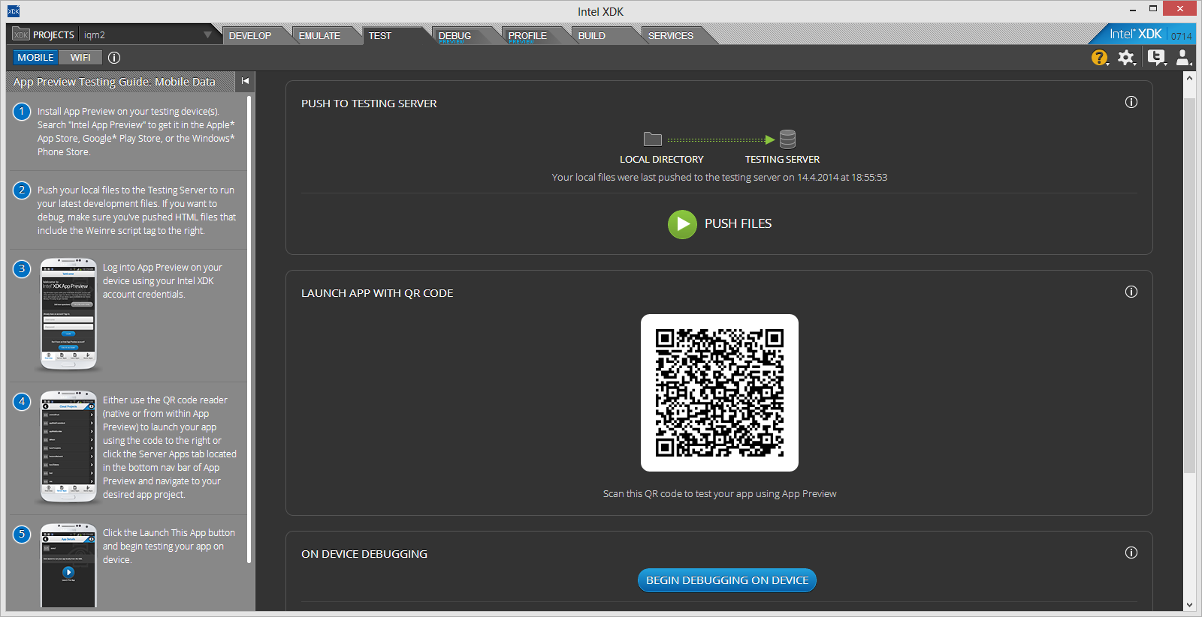
Test

Slide 29
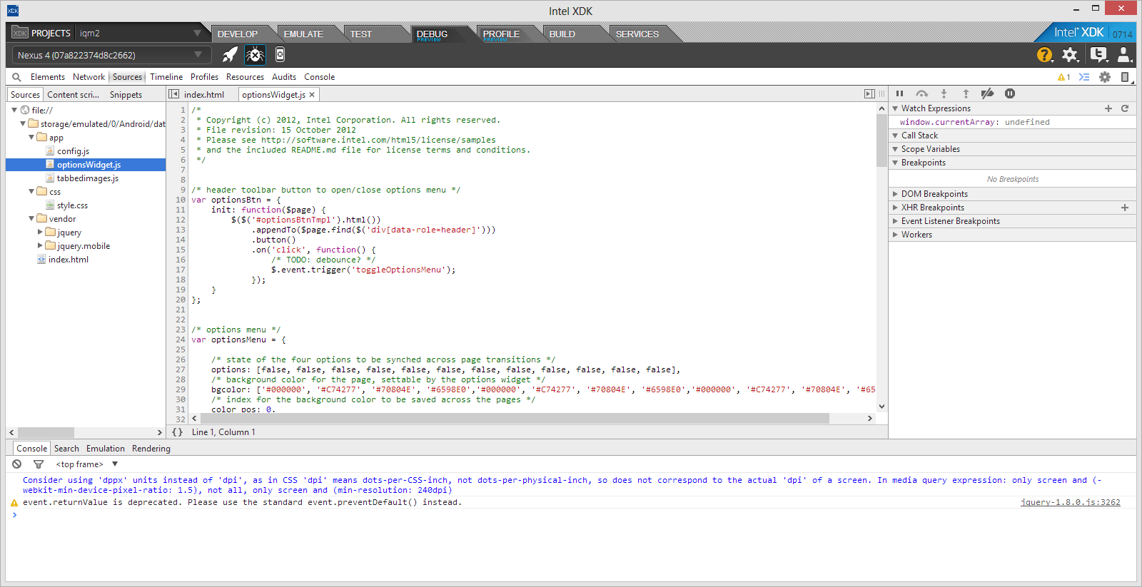
Debug

Slide 30
Activity #3 Package and Build

Slide 31
Deploy: Package and Build
Develop
Debug and Test
Deploy
HTML5 Editor
Device
Emulator
JS Debugger
Cloud-Based Packaging Tool
App Designer
UI Layout
On-Device
App Tester
On-Device
App Debugger
Cordova Build
“Hybrid Apps“
Apple* AppStore
Google* Play*
Windows* Market
App Framework
Optimized JS libs
HTML5 Build
“Web Apps“
Chrome* Store
Facebook*
Your Website
App Game I/F
Optimized Canvas
App Porter
Convert iOS to HTML5
Build cross-platform HTML5 hybrid applications.
Notes:
http://www.w3.org/html/logo/ -- HTML5 logos are released under Creative Commons Attribution 3.0 License.
You are free:
to Share — to copy, distribute and transmit the work
to Remix — to adapt the work
to make commercial use of the work
Under the following conditions:
Attribution — You must attribute the work in the manner specified by the author or licensor (but not in any way that suggests that they endorse you or your use of the work).

Slide 32
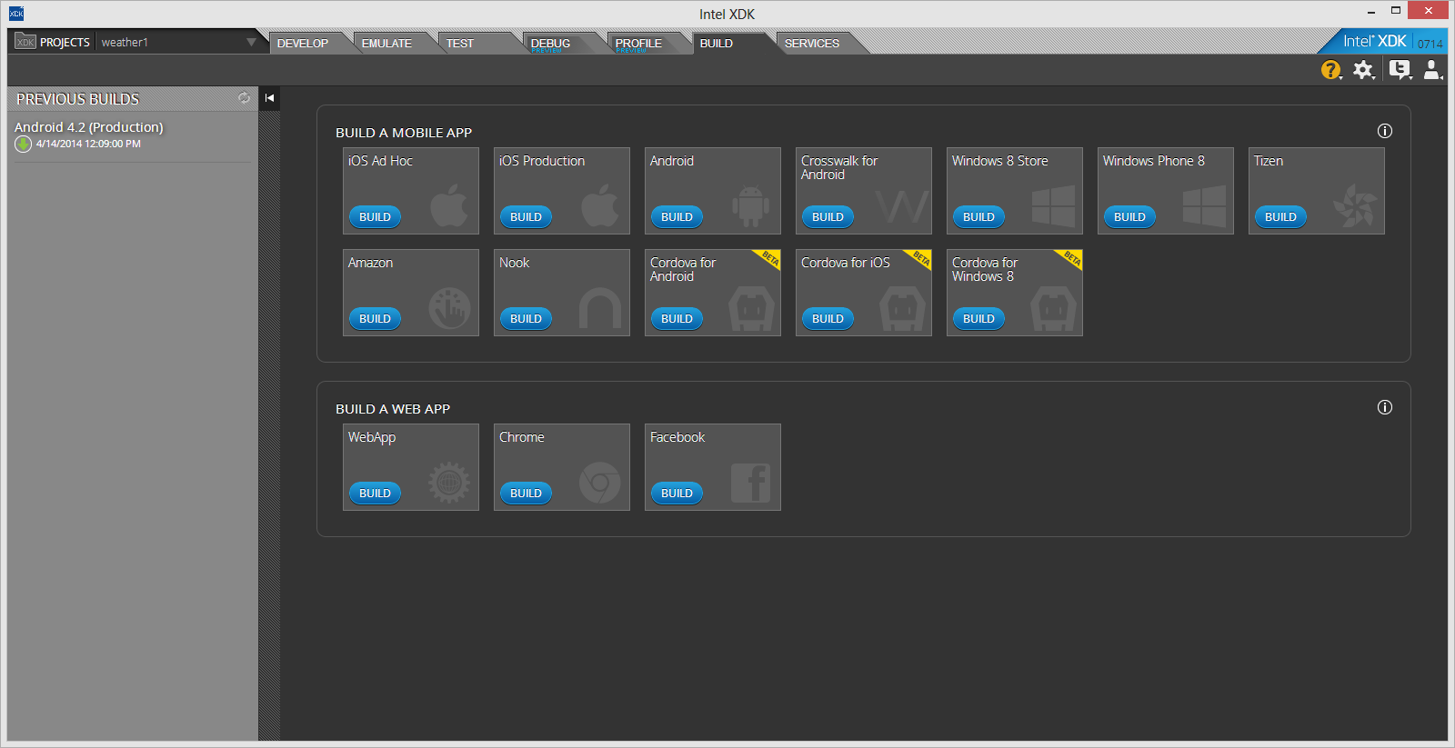
Build

Slide 33
Задание:
Собрать APK для Android
Скачать на laptop
Проинсталировать с помощью adb
C:\apps\intel\xdk\bin\adb\adb.exe install <yourapk>

Slide 34
Activity #4 Plug Acceleration Cordova API

Slide 35
Using Cordova acceleration
Возьмите пример игры змейка, создайте из него проект
Шаги для подключения cordova API
Включить “cordova.js” в index.html
document.addEventListener("deviceready", onCordovaReady, false);
function onCordovaReady(){
watchID = navigator.accelerometer.watchAcceleration(onSuccessAccel, onErrorAccel, { frequency: 300 });
}
function onSuccessAccel(acceleration) { // acceleration.x && acceleration.y};

Slide 36
Activity #5 Plug Geolocation Cordova API

Slide 37
Using Cordova geolocation
Включить GPS и WiFi позиционирование на устройстве
Создать приложение с помощью дизайнера, содержащего
2 элемента Text, присвоить id
1 элемент кнопка
Шаги для подключения cordova API
Включить “cordova.js” в index.html
document.addEventListener("deviceready", onCordovaReady, false);
Navigator.geolocation.getCurrentPosition(geolocationSuccess)
Подключить Google map API - пример
https://developers.google.com/maps/documentation/javascript/examples/icon-complex?hl=ru

Slide 38
Activity #5 Add web services

Slide 39
Web Services
http://openweathermap.org/API
Добавляем новый сервис
Закладка Services
Нажмите «Create New Web Service»
Файлы описания сервиса
Измените apiconfig.json
Измените <servicename>.json
Измените <servicename>.js
Закладка Services
Нажать Refresh
Service Binding
Выбрать сервиc

Slide 40
Activity #6 Profile the app

Slide 41
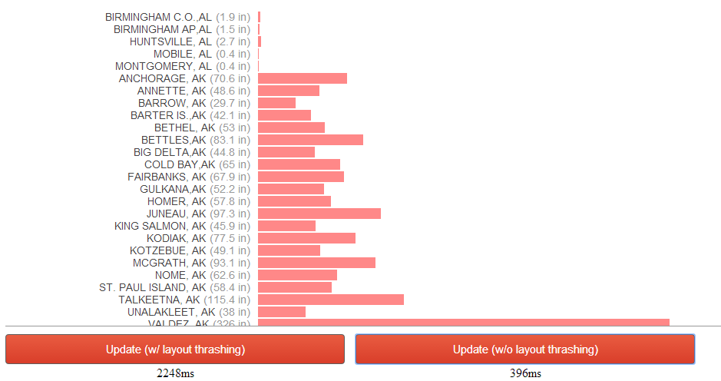
Найдите проблему производительности

