Slide 1
Improving businesses with topic modeling
on the Yelp dataset
Elvira Pupka-Lipinski
Notes:
Hello
Present you my choosen task on the yelp dataset for the Data Science Excercise

Slide 2
Content
Yelp
Possible tasks
Approach
Results
Discussion
Prospects

Slide 3
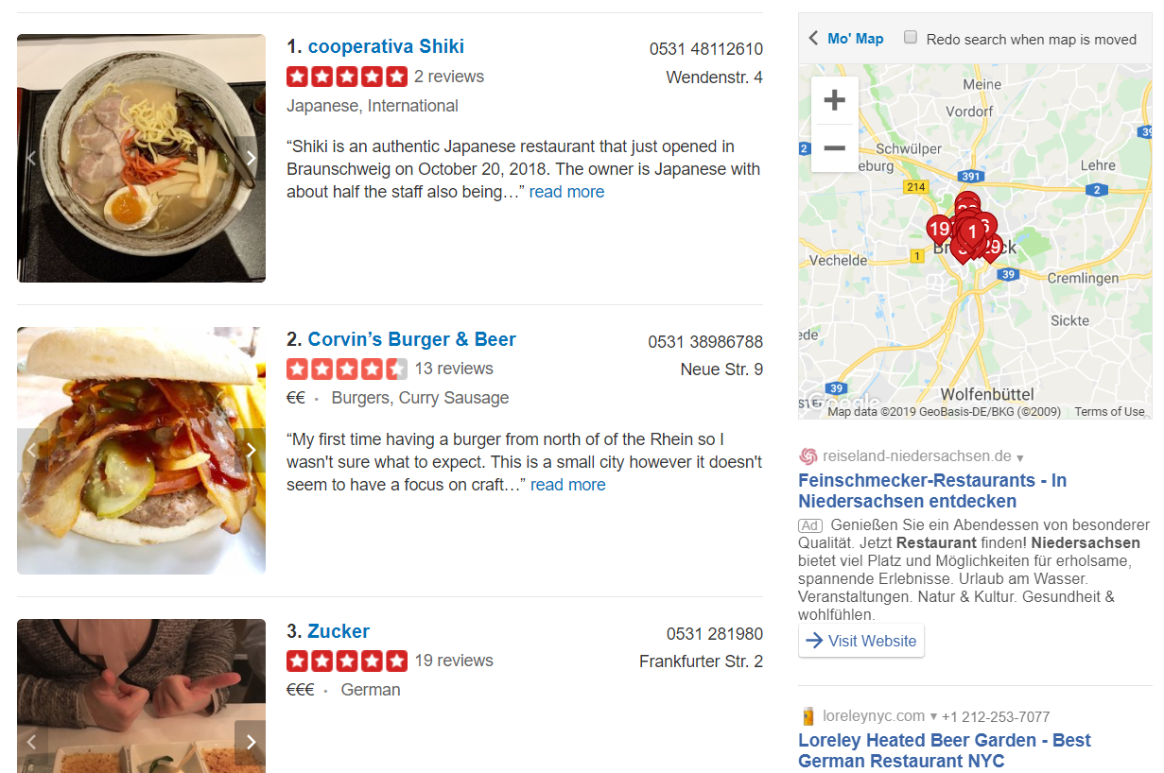
1. Yelp
Crowd-sourced review forum
Offers a recommendation portal for restaurants and shops
Short form of Yellow Pages
https://www.yelp.com/search?find_desc=Restaurants&find_loc=Braunschweig%2C+Niedersachsen%2C+Deutschland&ns=1
Notes:
Yelp is a US internet company and is founded in year 2005 in San Francisco
Offers a recommendation portal for restaurants and shops, such as Hotels and Travel, Spas, Nightlife, Shopping and more
Yellow pages are a telephone and address directory sorted by industry.
Extract of the yelp site for restaurants in braunschweig

Slide 4
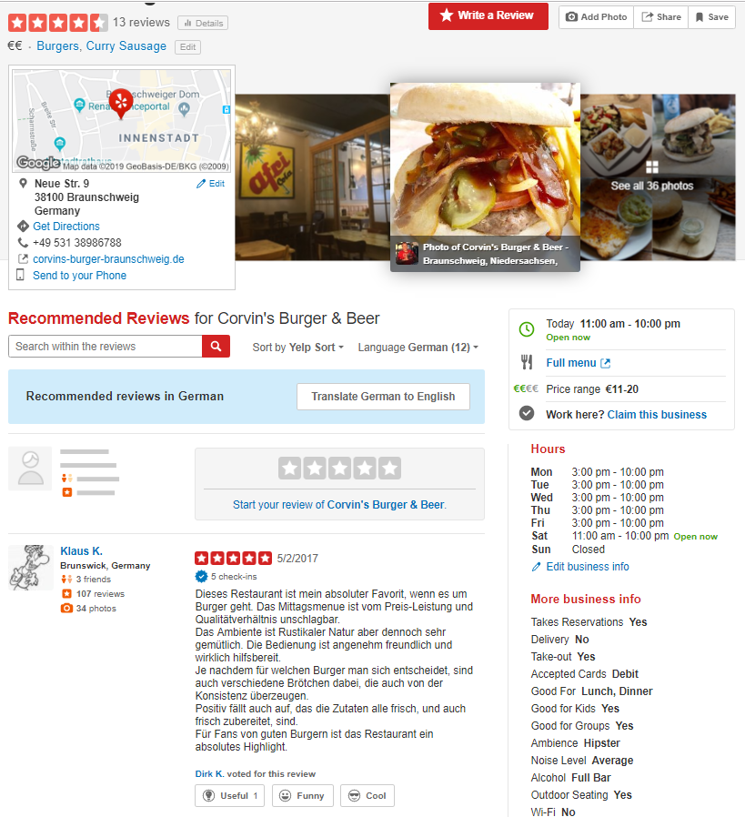
1. Yelp
Yelp: crowd-sourced review forum
Offers a recommendation portal for restaurants
and shops
Short form of Yellow Pages
Corvin‘s Burger & Beer in Braunschweig
https://www.yelp.com/biz/corvins-burger-und-beer-braunschweig-2?osq=Restaurants
Notes:
In this picture there is the yelp site for the restaurant Corvin‘s Burger & Beer in Braunschweig.
You can also see which restaurants other user also were interested in

Slide 5
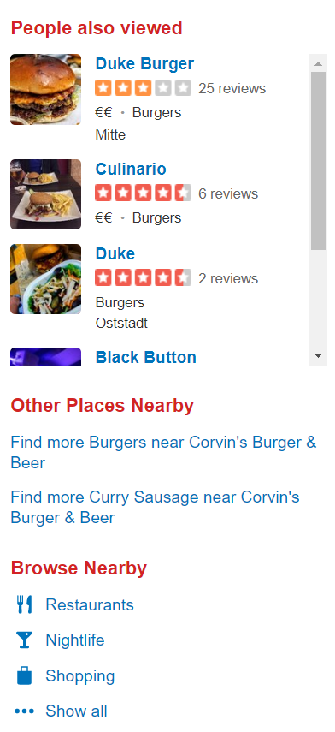
1. Yelp
Yelp: crowd-sourced review forum
Offers a recommendation portal for restaurants
and shops
Short form of Yellow Pages
Corvin‘s Burger & Beer in Braunschweig
https://www.yelp.com/biz/corvins-burger-und-beer-braunschweig-2?osq=Restaurants
Notes:
In this picture there is the yelp site for the restaurant Corvin‘s Burger & Beer in Braunschweig.
You can also see which restaurants other user also were interested in

Slide 6
1. Yelp
Yelp: crowd-sourced review forum
Offers a recommendation portal for restaurants and shops
Short form of Yellow Pages
Yelp offers their dataset for analyzing the data and sharing the discoveries
(https://www.yelp.com/dataset/challenge)
Notes:
Yelp offers their datasets for reachers to analyze the data and to share the discoveries.
There is a chance to win cash prices
And the data is used lot of academic papers

Slide 7
2. Possible tasks
Decision guidance for Users
Determination of the 3 best dishes in a Restaurant (already exists)
Suggestions for businesses due to users‘ previous patterns
Beneficial while traveling
Suggestions for business due to similar users (clustering)
Determination of the probability of closure of a business
Not possible due to the lack of needed data
Improvements for business
Opening new business? What do the citizen in Pittsburgh want? What is important to consider?
What can I as a business owner improve?

Slide 8
2. Possible tasks
Decision guidance for Users
Determination of the 3 best dishes in a Restaurant (already exists)
Suggestions for businesses due to users‘ previous patterns
Beneficial while traveling
Suggestions for business due to similar users (Clustering)
Determination of the probability of closure of a business
Not possible due to the lack of needed data
Improvements for business
Opening new business? What do the citizen in Pittsburgh want? What is important to consider?
What can I as a business owner improve?

Slide 9
3. Approach: What can I as a business owner improve?
Building a pipeline allowing business owners to answer this question
Suggesting improvements for business ID: 'c0yPNU-BqS65u0vIKP7P0w‘ as an example

Slide 10
3. Business improvements
Improvements for business
What can I as a business owner improve?
Idea: Extracting the topics the owner needs to improve
Approach: Topic modeling
→ Improvement in service is needed
Topic | Avg Stars
Food | 4.0
Service | 2.0
Location | 4.0

Slide 11
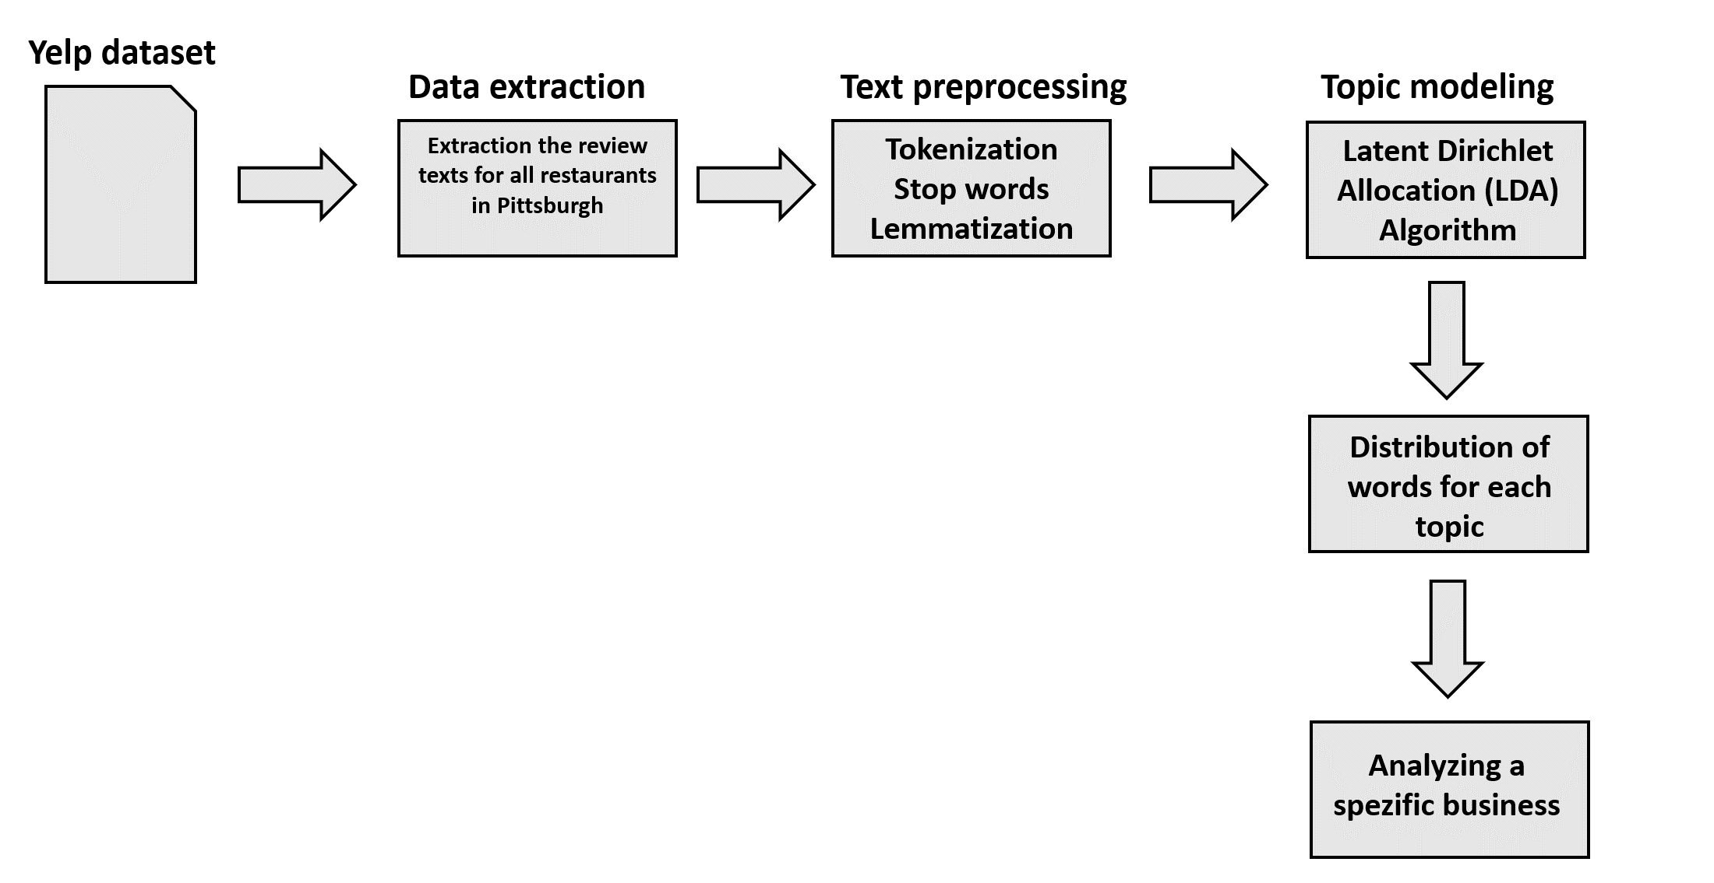
3. Workflow

Slide 12
3. Workflow

Slide 13
3. Yelp dataset – Data Extraction
Datasets
business.json: business data, location, attributes and categories (business_id)
review.json: full review data such as text, date and stars (review_id, user_id, business_id)
user.json: user information such as the average star rating and the users’ friends (user_id)
checkin.json: checkin data: the visits’ date and business (business_id)
tip.json: short text on a business (business_id, user_id)
photo.json: caption and classification (photo_id, business_id)

Slide 14
3. Yelp dataset – Data Extraction
Datasets
business.json: business data, location, attributes and categories (business_id)
review.json: full review data such as text, date and stars (review_id, user_id, business_id)
user.json: user information such as the average star rating and the users’ friends (user_id)
checkin.json: checkin data: the visits’ date and business (business_id)
tip.json: short text on a business (business_id, user_id)
photo.json: caption and classification (photo_id, business_id)
Notes:
I am training a model with only data for a specific business categorie and in a specific area. In my example ist pittsburgh

Slide 15
3. Workflow

Slide 16
3. Text preprocessing
“I definitely enjoyed my meal at avenue b, but with a meal that comes at a hefty price, I don't know if it's worth another trip. If I'm paying that much, the food BETTER be mind blowing.”
Lowering all characters:
“i definitely enjoyed my meal at avenue b, but with a meal that comes at a hefty price, i don’t know if it's worth another trip. if i'm paying that much, the food better be mind blowing.”
Removing all punctuation:
“i definitely enjoyed my meal at avenue b but with a meal that comes at a hefty price i don't know if it worth another trip if i paying that much the food better be mind blowing”
Tokenization: Tokenization is the process of splitting the given text into smaller pieces called tokens.
['i', 'definitely', 'enjoyed', 'my', 'meal', 'at', 'avenue', 'b', 'but', 'with', 'a', 'meal', 'that', 'comes', 'at', 'a', 'hefty', 'price', 'i', 'do', "n't", 'know', 'if', 'it', 'worth', 'another', 'trip', 'if', 'i', 'paying', 'that', 'much', 'the', 'food', 'better', 'be', 'mind', 'blowing’]

Slide 17
3. Text preprocessing
Tokenization: Tokenization is the process of splitting the given text into smaller pieces called tokens.
['i', 'definitely', 'enjoyed', 'my', 'meal', 'at', 'avenue', 'b', 'but', 'with', 'a', 'meal', 'that', 'comes', 'at', 'a', 'hefty', 'price', 'i', 'do', "n't", 'know', 'if', 'it', 'worth', 'another', 'trip', 'if', 'i', 'paying', 'that', 'much', 'the', 'food', 'better', 'be', 'mind', 'blowing‘]
Removing stop words:
['definitely’, 'enjoyed’, 'meal’, 'avenue’, 'b’, 'meal’, 'comes’, 'hefty’, 'price’, 'n't’, 'know’, 'worth’, 'trip’, 'paying’, 'food’, 'mind’, 'blowing']

Slide 18
3. Text preprocessing
Stop words:
['definitely’, 'enjoyed’, 'meal’, 'avenue’, 'b’, 'meal’, 'comes’, 'hefty’, 'price’, 'n't’, 'know’, 'worth’, 'trip’, 'paying’, 'food’, 'mind’, 'blowing’]
Lemmatization: reduce inflectional forms to a common base form
['definitely’, 'enjoy’, 'meal’, 'avenue’, 'b’, 'meal’, 'come’, 'hefty’, 'price’, 'n't’, 'know’, 'worth’, 'trip' 'pay’, 'food’, 'mind’, 'blow']
Notes:
Lemmatization: The aim of lemmatization, like stemming, is to reduce inflectional forms to a common base form. As opposed to stemming, lemmatization does not simply chop off inflections. Instead it uses lexical knowledge bases to get the correct base forms of words. The root word is called lemma

Slide 19
3. Workflow

Slide 20
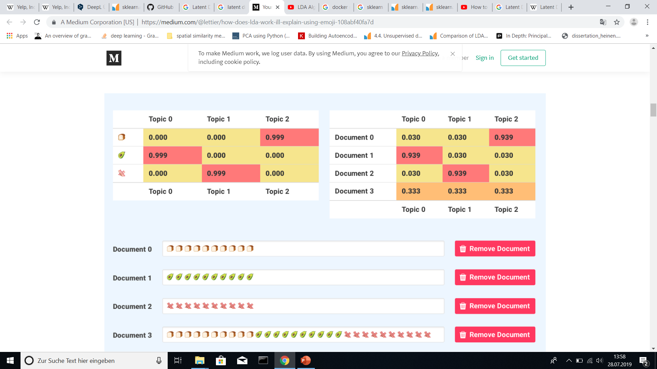
3. Approach: Latent Dirichlet Allocation
Generative statistical model for topic discovery
Unsupervised learning
https://medium.com/@lettier/how-does-lda-work-ill-explain-using-emoji-108abf40fa7d

Slide 21
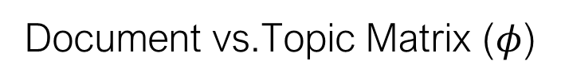
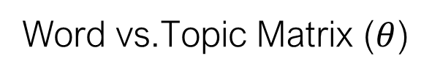
3. Approach: Latent Dirichlet Allocation
Word vs.Topic Matrix ($θ$)
Document vs.Topic Matrix ($φ$)
https://medium.com/@lettier/how-does-lda-work-ill-explain-using-emoji-108abf40fa7d
Notes:
Phi = probabilities for Topics per Document
Theta = probabilitiesfor words per Topic

Slide 22
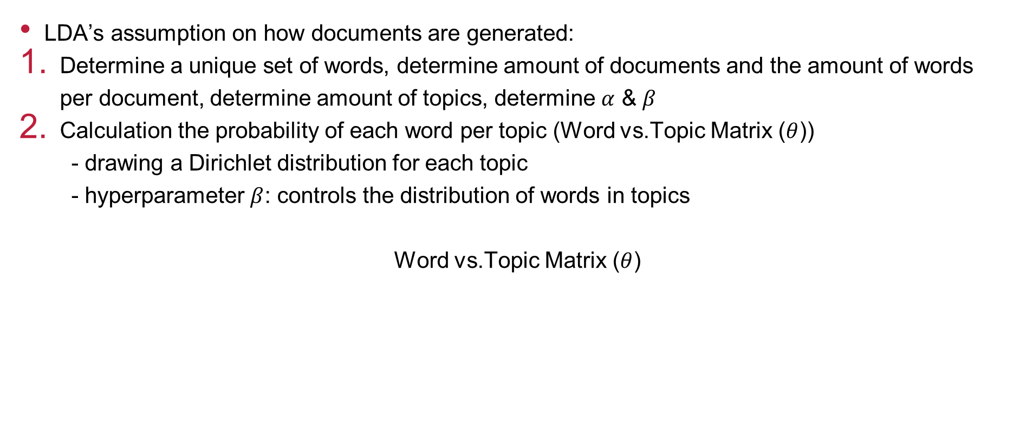
3. Approach: Latent Dirichlet Allocation
LDA’s assumption on how documents are generated:
Determine a unique set of words, determine amount of documents and the amount of words per document, determine amount of topics, determine $α$ & $β$
Calculation the probability of each word per topic (Word vs.Topic Matrix ($θ$))
- drawing a Dirichlet distribution for each topic
- hyperparameter $β$: controls the distribution of words in topics
Word vs.Topic Matrix ($θ$)
https://medium.com/@lettier/how-does-lda-work-ill-explain-using-emoji-108abf40fa7d
Notes:
Small beta --> topics will have less words
Big beta → topics will have more words

Slide 23

3. Approach: Latent Dirichlet Allocation
LDA’s Assumtion on how documents are generated:
Calculation the probability of each Topic per Document (Document vs.Topic Matrix ($φ$))
- drawing a Dirichlet distribution for each document
- hyperparameter $α$: controls the mixture of topics for any given document
Document vs.Topic Matrix ($φ$)
https://medium.com/@lettier/how-does-lda-work-ill-explain-using-emoji-108abf40fa7d
Notes:
Small alpha → documents will likely have less of mixture of topics
Big alpha → documents will have a more micture of topics

Slide 24

3. Approach: Latent Dirichlet Allocation
LDA’s Assumtion on how documents are generated:
Building the actual document
https://medium.com/@lettier/how-does-lda-work-ill-explain-using-emoji-108abf40fa7d
Notes:
1) look up its row in the ‘composites-versus-topics’ table, 2) sample a topic based on the probabilities in the row, 3) go to the ‘parts-versus-topics’ table, 4) look up the topic sampled, 5) sample a part based on the probabilities in the column, 6) repeat from step 2 until you’ve reached how many parts this composite was set to have.

Slide 25

3. How does LDA works for topic modeling?
$p\left(Topics,θ,φ \right|Documents)$
- variables depend on each other
- NP-hard problem
→ approximation of $p$ using variance inference
- distribution $q\left(Topics,θ,φ \right|Documents)$
- minimizing Kullback-Leibler divergence
Notes:
Infering the distribution of the hidden variables Topics, theta and phi give the evidence documents
Inferring these parameters is hard in general. They depend on each other and it is NP-hard

Slide 26
3. Workflow

Slide 27
4. Results
Top 10 words in topics for Pittsburgh and Restaurants:
Topic 0: ['food', 'place', 'service', 'try', 'restaurant', 'price', 'chicken', 'time', 'come', 'like']
Topic 1: ['pizza', 'burger', 'order', 'fry', 'cheese', 'like', 'sauce', 'wing', 'eat', 'place']
Topic 2: ['taco', 'dish', 'delicious', 'order', 'flavor', 'sauce', 'thai', 'restaurant', 'meal', 'dessert‘]
Topic 3: ['food', 'time', 'order', 'place', 'come', 'service', 'table', 'wait', 'drink', 'bar']
Topic 4: ['place', 'sandwich', 'beer', 'pittsburgh', 'coffee', 'love', 'like', 'breakfast', 'brunch', 'selection‘]

Slide 28
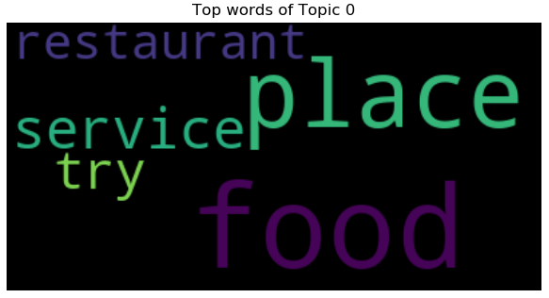
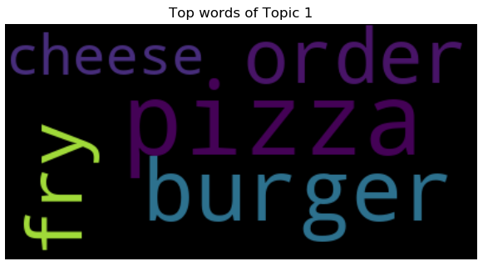
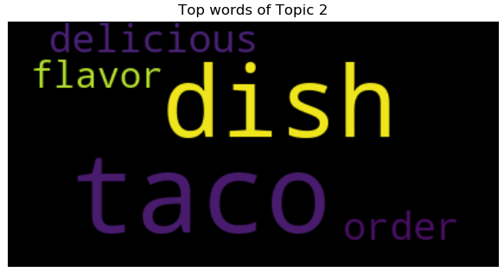
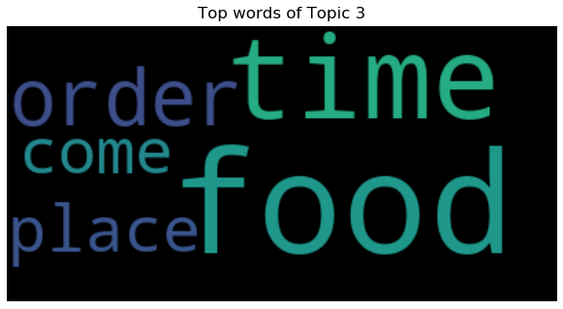
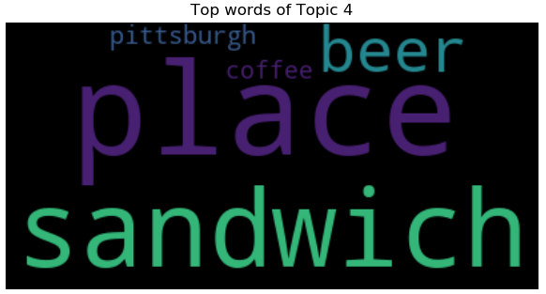
4. Results

Slide 29
4. Workflow

Slide 30
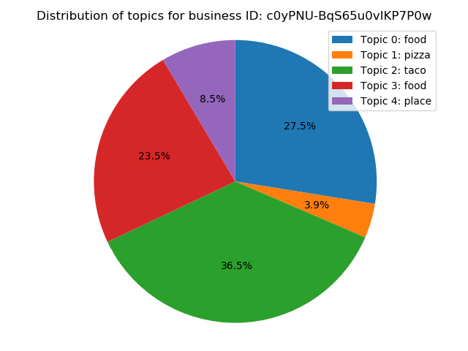
4. Results
Business ID: 'c0yPNU-BqS65u0vIKP7P0w‘
name: Avenue B
city: Pittsburgh
stars: 4.0
review_count: 228
categories: American (New), Restaurants
Prediction:
 | Topic 0 | Topic 1 | Topic 2 | Topic 3 | Topic 4
Review 1 | 0.884 | 0.029 | 0.029 | 0.029 | 0.029
Review 2 | 0.216 | 0.121 | 0.658 | 0.003 | 0.003
Review 3 | 0.0029 | 0.299 | 0.317 | 0.325 | 0.056
… | … | … | … | … | …

Slide 31
4. Results
Topic 0: ['food', 'place', 'service', 'try', 'restaurant', 'price', 'chicken', 'time', 'come', 'like’]
Topic 1: ['pizza', 'burger', 'order', 'fry', 'cheese', 'like', 'sauce', 'wing', 'eat', 'place’]
Topic 2: ['taco', 'dish', 'delicious', 'order', 'flavor', 'sauce', 'thai', 'restaurant', 'meal', 'dessert‘]
Topic 3: ['food', 'time', 'order', 'place', 'come', 'service', 'table', 'wait', 'drink', 'bar’]
Topic 4: ['place', 'sandwich', 'beer', 'pittsburgh', 'coffee', 'love', 'like', 'breakfast', 'brunch', 'selection‘]

Slide 32
4. Results
Topic 0: ['food', 'place', 'service', 'try', 'restaurant', 'price', 'chicken', 'time', 'come', 'like’]
Menu?
Topic 1: ['pizza', 'burger', 'order', 'fry', 'cheese', 'like', 'sauce', 'wing', 'eat', 'place’]
Fast food
Topic 2: ['taco', 'dish', 'delicious', 'order', 'flavor', 'sauce', ‘’thai', 'restaurant', 'meal', 'dessert‘]
Mexican and Thai food
Topic 3: ['food', 'time', 'order', 'place', 'come', 'service', 'table', 'wait', 'drink', 'bar’]
Restaurant / Diner?
Topic 4: ['place', 'sandwich', 'beer', 'pittsburgh', 'coffee', 'love', 'like', 'breakfast', 'brunch', 'selection‘]
Café

Slide 33
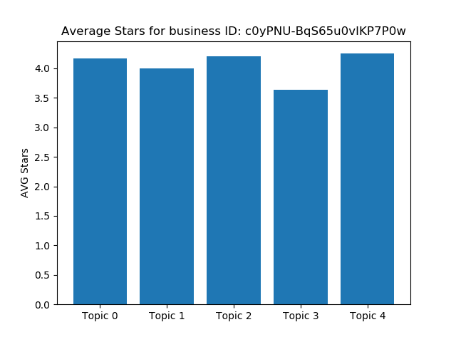
4. Results
Less average stars for Topic 3 ('food', 'time', 'order', 'place', 'come', 'service', 'table', 'wait', 'drink', 'bar’) Restaurant / Diner

Slide 34

5. Discussion
Working pipeline implemented
Topic 0 and 3 are pretty similar
5 topics for LDA are not optimal
Default values for $α$ and $β$
Only used 1-grams

Slide 35
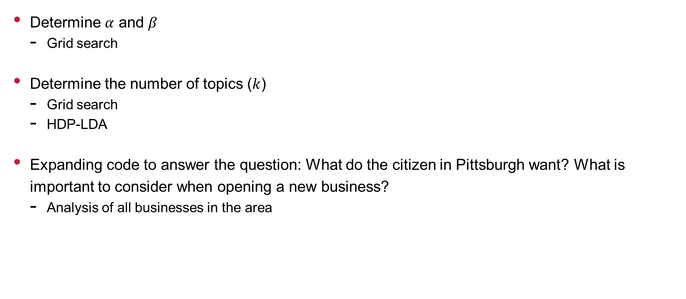
6. Prospects
Determine $α$ and $β$
Grid search
Determine the number of topics ($k$)
Grid search
HDP-LDA
Expanding code to answer the question: What do the citizen in Pittsburgh want? What is important to consider when opening a new business?
Analysis of all businesses in the area

Slide 36
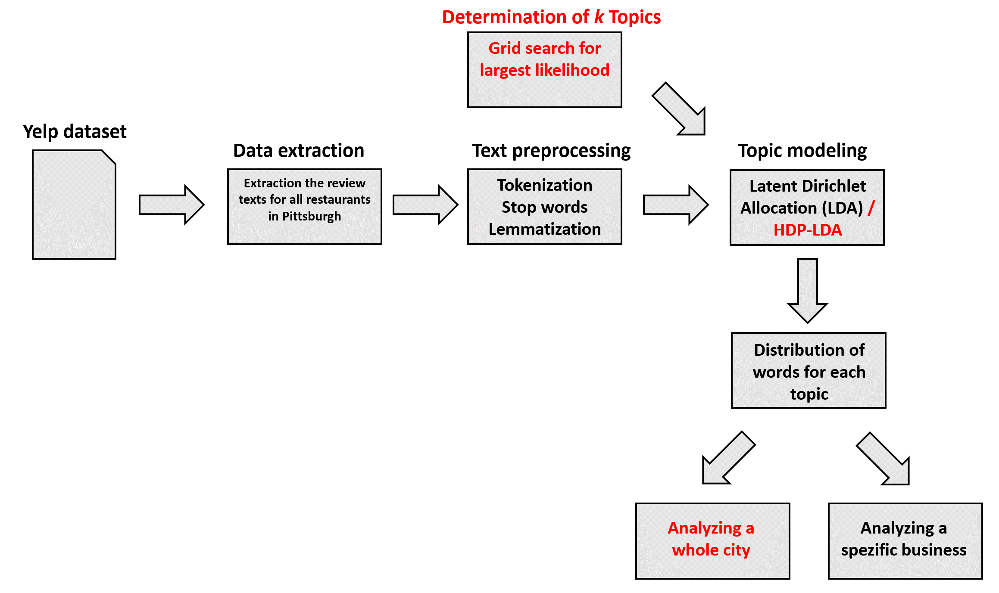
6. Prospects

Slide 37
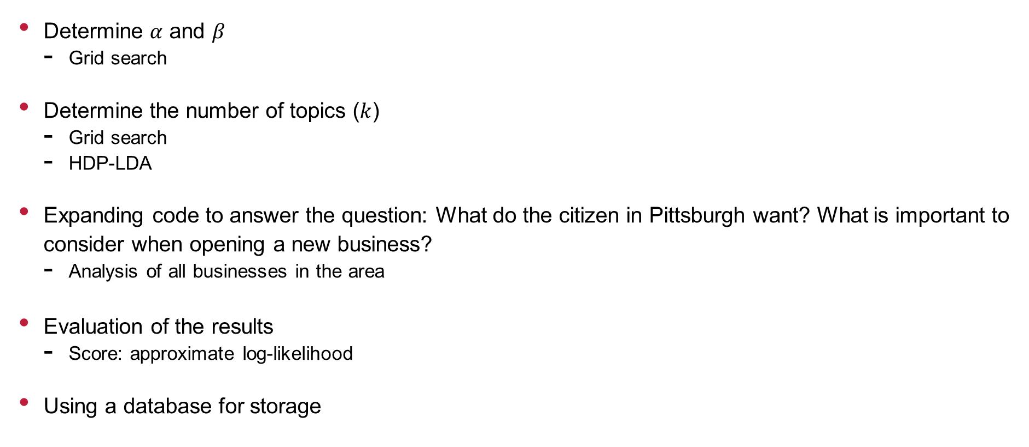
6. Prospects
Determine $α$ and $β$
Grid search
Determine the number of topics ($k$)
Grid search
HDP-LDA
Expanding code to answer the question: What do the citizen in Pittsburgh want? What is important to consider when opening a new business?
Analysis of all businesses in the area
Evaluation of the results
Score: approximate log-likelihood
Using a database for storage

Slide 38
Thank you for your attention

