Slide 1
Improving businesses with Topic Modelling
Yelp Dataset
Elvira Pupka-Lipinski

Slide 2
Content
Yelp Dataset
Possible tasks
Approach
Results
Prospects

Slide 3
1. Insight into Yelp Dataset
Yelp: crowd-sourced review forum
Datasets
business.json: business data, location, attributes and categories (business_id)
review.json: full review data such as text, date and stars (review_id, user_id, business_id)
user.json: user information such as the average star rating and the users’ friends (user_id)
checkin.json: checkin data: the visits’ date and business (business_id)
tip.json: short text on a business (business_id, user_id)
photo.json: caption and classification (photo_id, business_id)

Slide 4
1. Possible tasks
Decision guidance for Users
Determination of the 3 best dishes in a Restaurant (already exists)
Suggestions for businesses due to users‘ previous patterns
Beneficial while traveling
Suggestions for business due to similar users (Clustering)
Determination of the probability of closure of a business
Not possible due to the lack of needed data
Improvements for business
Opening new business? What do the citizen in Pittsburgh want? What is important to consider?
What can I as a business owner improve?

Slide 5
1. Possible tasks
Decision guidance for Users
Determination of the 3 best dishes in a Restaurant (already exists)
Suggestions for businesses due to users‘ previous patterns
Beneficial while traveling
Suggestions for business due to similar users (Clustering)
Determination of the probability of closure of a business
Not possible due to the lack of needed data
Improvements for business
Opening new business? What do the citizen in Pittsburgh want? What is important to consider?
What can I as a business owner improve?

Slide 6
1. Business improvements
Improvements for business
What can I as a business owner improve?
Idea: Extracting the topics the owner needs to improve
Approach: Topic Modelling
→ Improvement in Service is needed
Topic | Avg Stars
Food | 4.0
Service | 2.0
Location | 4.0

Slide 7
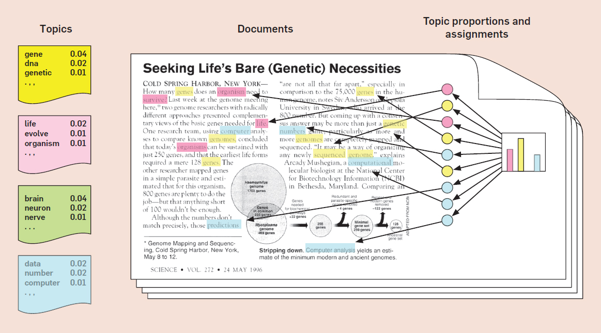
Approach:Latent Dirichlet Allocation
Unsupervised learning
Variables to determine number of topics
https://medium.com/@connectwithghosh/topic-modelling-with-latent-dirichlet-allocation-lda-in-pyspark-2cb3ebd5678e
Alternatives: NMF, Autoencoder

Slide 8
Results
Top words in topics
Topic 0: ['food', 'place', 'service', 'try', 'restaurant', 'price', 'chicken', 'time', 'come', 'like']
Topic 1: ['pizza', 'burger', 'order', 'fry', 'cheese', 'like', 'sauce', 'wing', 'eat', 'place']
Topic 2: ['taco', 'dish', 'delicious', 'order', 'flavor', 'sauce', 'thai', 'restaurant', 'meal', 'dessert‘]
Topic 3: ['food', 'time', 'order', 'place', 'come', 'service', 'table', 'wait', 'drink', 'bar']
Topic 4: ['place', 'sandwich', 'beer', 'pittsburgh', 'coffee', 'love', 'like', 'breakfast', 'brunch', 'selection‘]

Slide 9
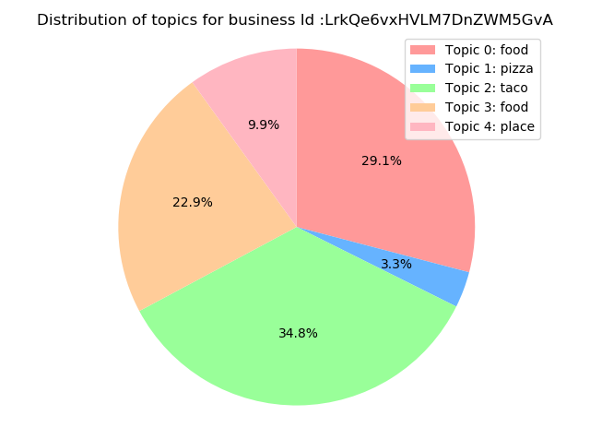
Results
Business ID: 'c0yPNU-BqS65u0vIKP7P0w', ‚
name: Avenue B
city: Pittsburgh,
stars: 4.0
review_count: 228
categories: American (New), Restaurants
Prediction:
 | Topic 0 | Topic 1 | Topic 2 | Topic 3 | Topic 4
Review 1 | 0.884 | 0.029 | 0.029 | 0.029 | 0.029
Review 2 | 0.216 | 0.121 | 0.658 | 0.003 | 0.003
Review 3 | 0.0029 | 0.299 | 0.317 | 0.325 | 0.056
… | … | … | … | … | …

Slide 10
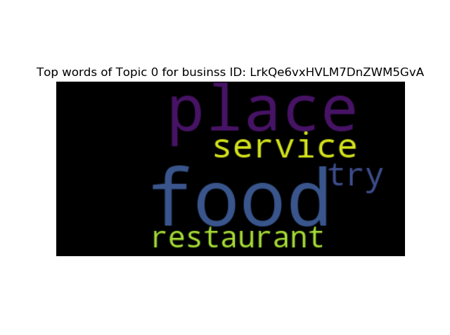
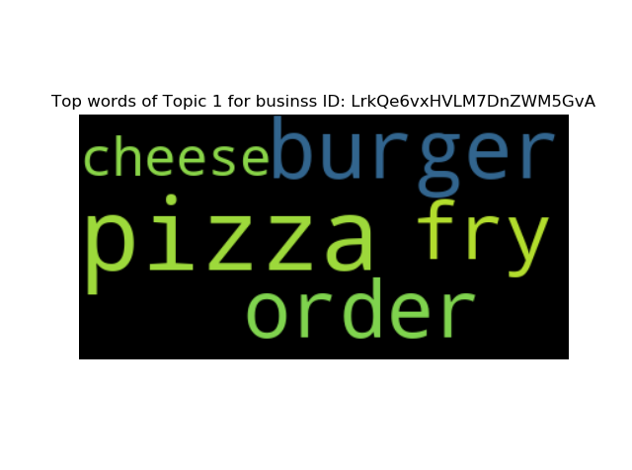
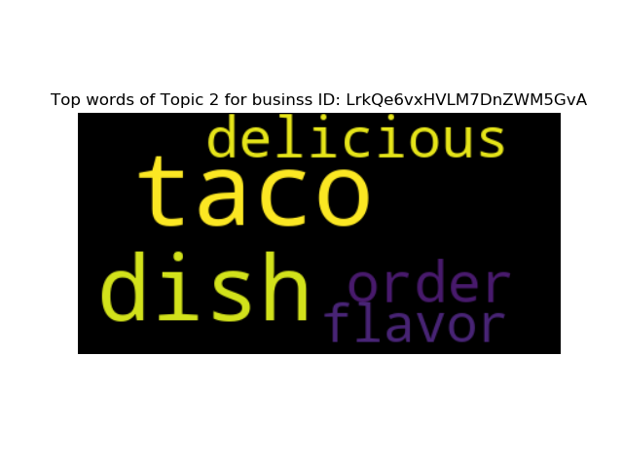
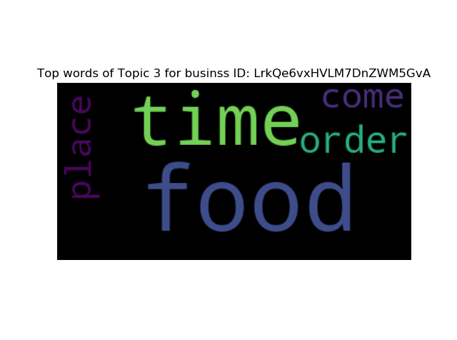
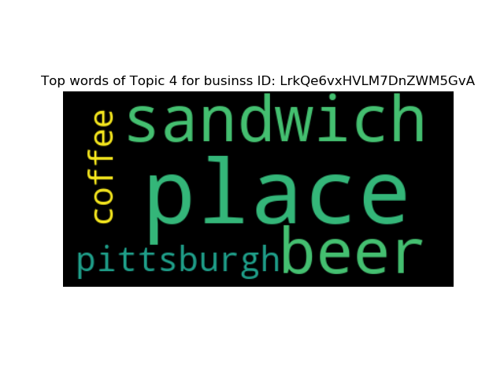
Results

Slide 11
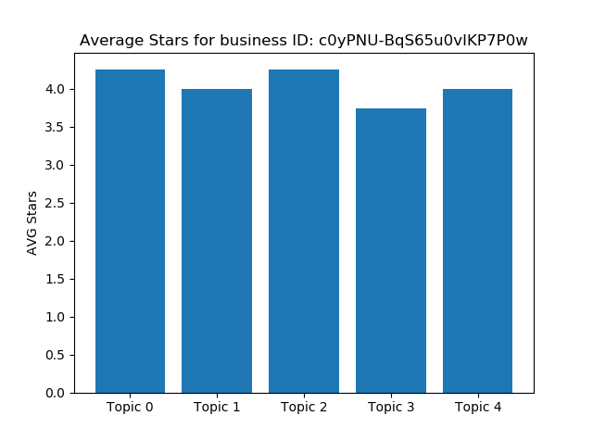
Results

Slide 12
Prospects
Determine the number of topics (k) for LDA with an Algorithm
Re-training LDA with more data
Changing code to answer the question: What do the citizen in Pittsburgh want? What is important to consider when opening a new business?
Analysis of all businesses in the area

