Slide 1
Notes:
Assessment 1B student submission slide. Recreate the target on this blank slide.

Slide 2
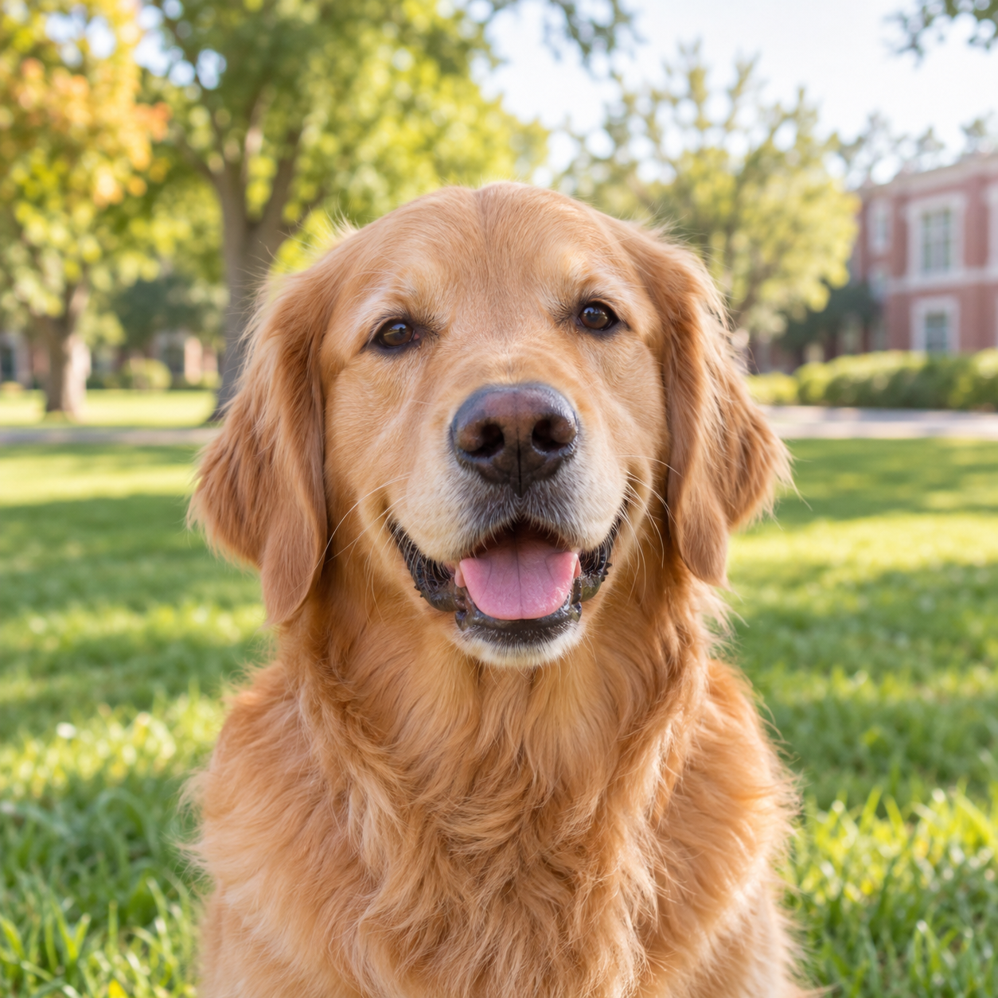
ASSET SLIDE — DO NOT SUBMIT
Copy the raw photo to Slide 1. Get the Pets icon from the assessment page, set its color, and import it separately.
Notes:
Assessment 1B non-submission asset slide. Assets remain raw and unformatted.

