Slide 1
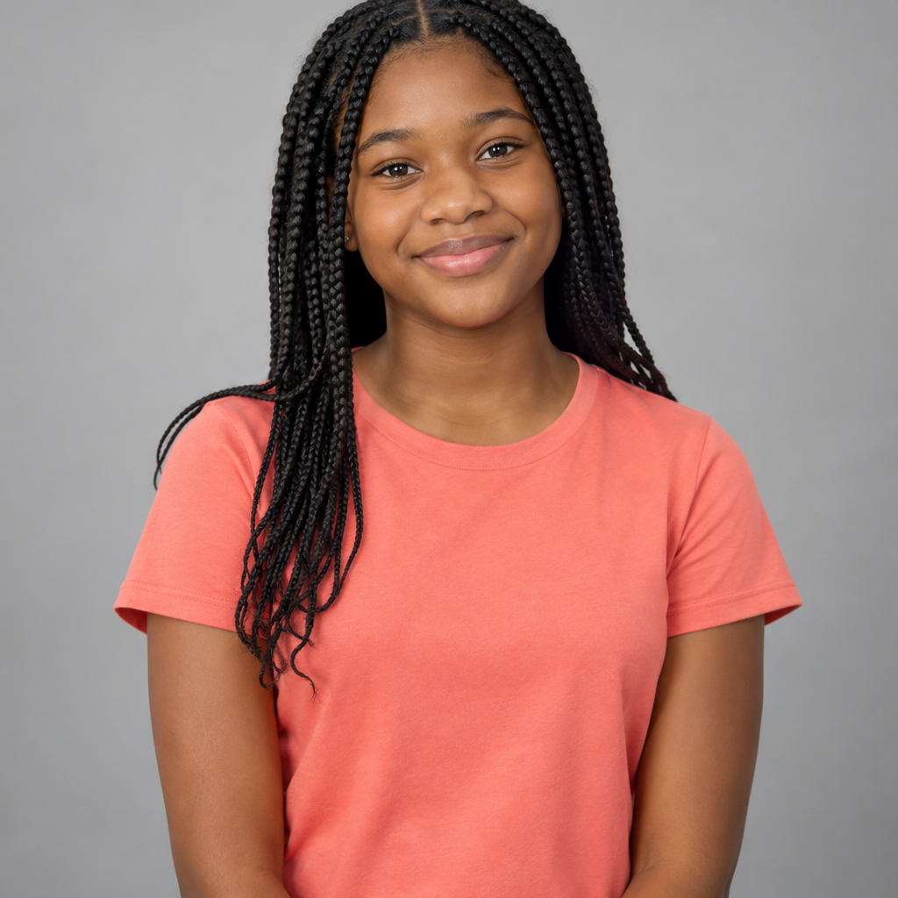
BCJA MEDIA TEAM
MAYA CARTER
STUDENT REPORTER
2026–2027
Notes:
Assessment 1B teacher reference. The portrait is a true circular image mask with a separate coral border and an offset coral circle behind it. All text, shapes, image, and icon remain editable.

