Slide 1
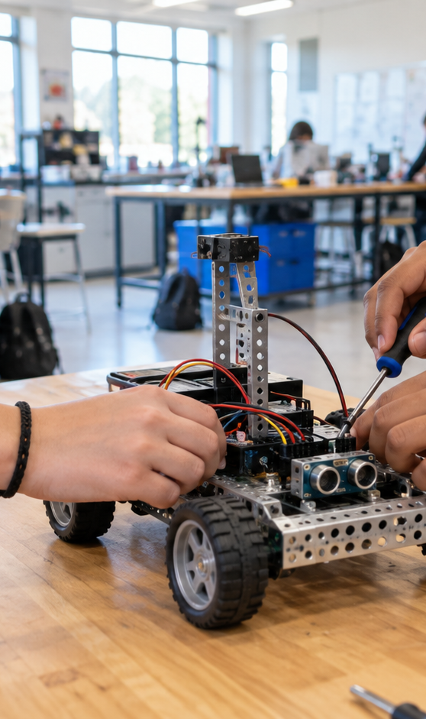
BUILD • TEST • DISCOVER
ROBOTICS
OPEN HOUSE
THURSDAY • 4:30 PM
TECH LAB
SEE WHAT WE'RE BUILDING
Notes:
Assessment 1D teacher reference. The photo is cropped to the right third without distortion. The blue panel overlaps the photo and title region. Four equal lime circles remain separate editable objects.

