Slide 1


A PROPOSAL DEFENSE: BCA 4th SEM PROJECT I
TRAFFIC-AWARE SHORTEST ROUTE
MANAGEMENT SYSTEM
Prepared by: Elvish Shrestha

Slide 2
Table of Content
Introduction
Problem Statement
Objectives
Methodology
Gantt Chart
Expected Outcomes
References

Slide 3
INTRODUCTION
Traffic congestion is a major problem in urban areas.
Travelers often face delays due to traffic jams, accidents, and road blockages.
Traditional route planning mainly focuses on distance.
This project provides traffic-aware route recommendations for efficient travel.

Slide 4
PROBLEM STATEMENT
Traffic jams cause delays and increase travel time.
I personally experienced delays while traveling to college due to traffic congestion.
The shortest route is not always the fastest route.
There is a need for a traffic-aware route management system that considers both distance and
traffic conditions.

Slide 5
OBJECTIVE
The main objective of the traffic-aware shortest route management system are as follows:
To find the shortest and most efficient route between two locations.
To analyze traffic conditions and identify congested roads.
To provide alternative routes when traffic congestion occurs.
To reduce travel time and fuel consumption.
To improve the accuracy and efficiency of route planning.
To help users make better travel decisions based on current road conditions.

Slide 6
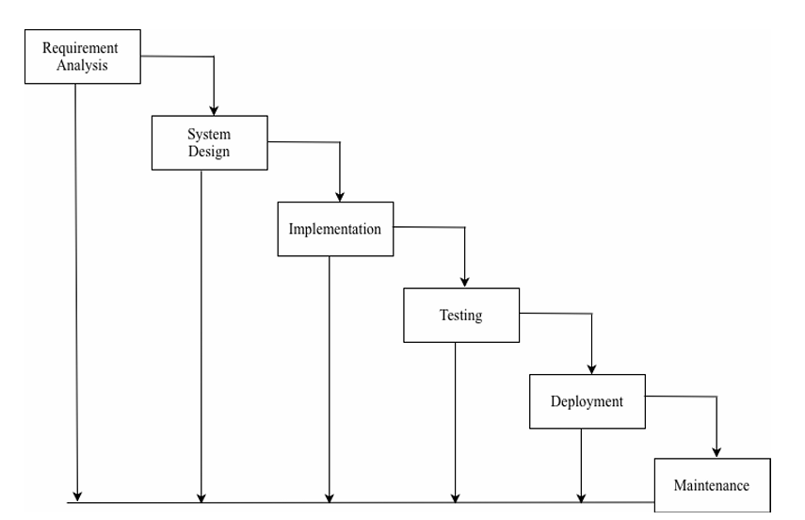
Methodology
Waterfall Model of Traffic-Aware Shortest Route Management System

Slide 7
Requirement Identification
i. Study of Existing System
Reviewed navigation systems such as Google Maps and Waze.
Studied route calculation and traffic management features.
Identified route optimization and traffic-aware routing concepts.
ii. Requirement Collection
Based on personal experience and observation.
Identified major issues such as traffic jams, accidents, and road blockages.
Collected functional and non-functional requirements.

Slide 8
Functional Requirement
The user shall be able to enter a source location and destination.
The user shall be able to view the shortest available route.
The user shall be able to view route distance and estimated travel information.
The system shall detect traffic jams, accidents, and road blockages.
The system shall avoid congested routes automatically.
The system shall suggest alternative routes when necessary.
The admin shall be able to log in to the system.
The admin shall be able to add, update, view, and delete route information.
The admin shall be able to manage traffic status and road conditions.
The admin shall be able to manage locations and distances between locations.
The system shall display the reason for avoiding a route.

Slide 9
Non Functional Requirement
The system must be user-friendly.
The system must provide accurate route information.
The system must be secure and reliable.
The system must respond quickly to user requests.
The system must be easy to maintain and update.

Slide 10
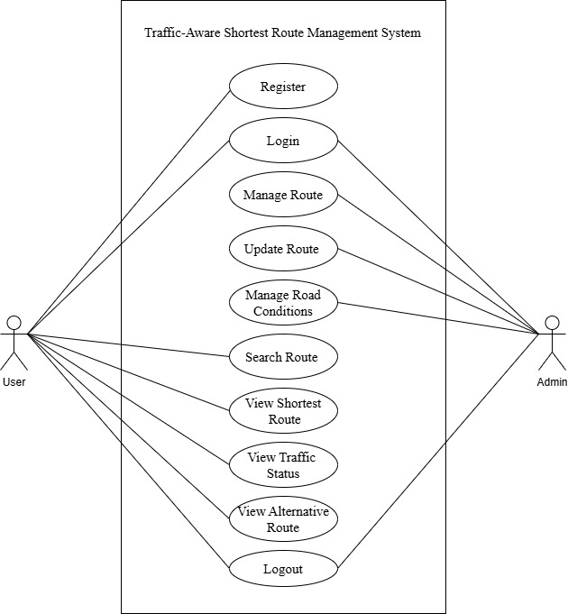
USE CASE
Use Case Diagram of Traffic-Aware Shortest Route Management System

Slide 11
Feasibility Study
i. Technical Feasibility
Technologies: HTML, CSS, JavaScript, PHP, MySQL
Runs on XAMPP local server
ii. Operational Feasibility
Easy to use and manage
User-friendly interface
iii. Economic Feasibility
Uses free and open-source tools
No additional hardware/software required

Slide 12
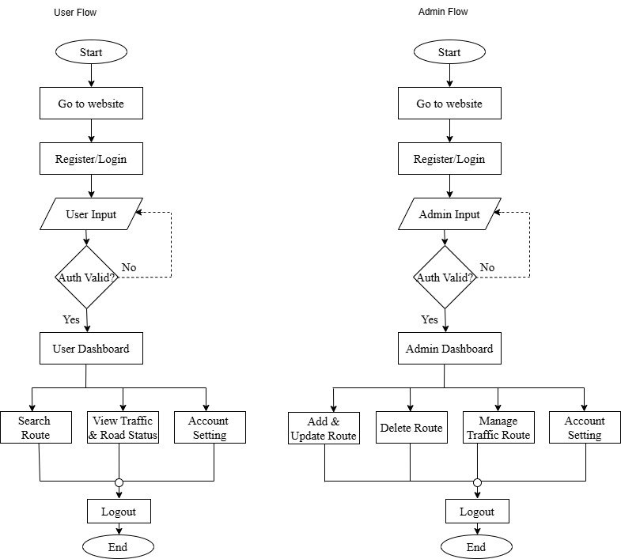
SYSTEM FLOWCHART
System Flowchart of Traffic-Aware Shortest Route Management System

Slide 13
GANTT CHART
Gantt chart of Traffic-Aware Shortest Route Management System

Slide 14
EXPECTED OUTCOME
Shortest route calculation
Traffic-aware navigation
Alternative route suggestions
Efficient route management
Reduced travel time
Improved travel planning
User-friendly interface

Slide 15
REFERENCE
[1] | arthapranali, "Kathmandu’s Traffic Jam Crisis: The Escalating Urban Gridlock in Nepal’s Capital," 03 08 2025. [Online]. Available: https://arthapranali.com/2025/08/17422/. [Accessed 26 06 2026].

