Slide 1
NLP recommendation system for SävsjöAppen
Group 1

Slide 2
Table of contents
Pre-processing
LDA
TF-IDF
Sentence Embedding
Conclusion

Slide 3
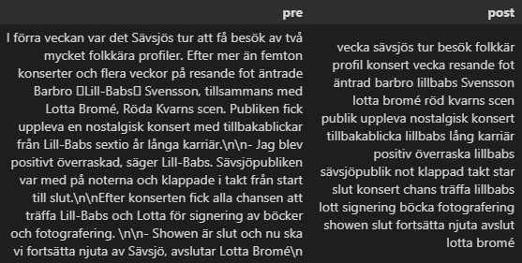
Pre-processing
Remove HTML
Remove numbers
Lowercase
Punctuations
Stopwords
Lemma

Slide 4
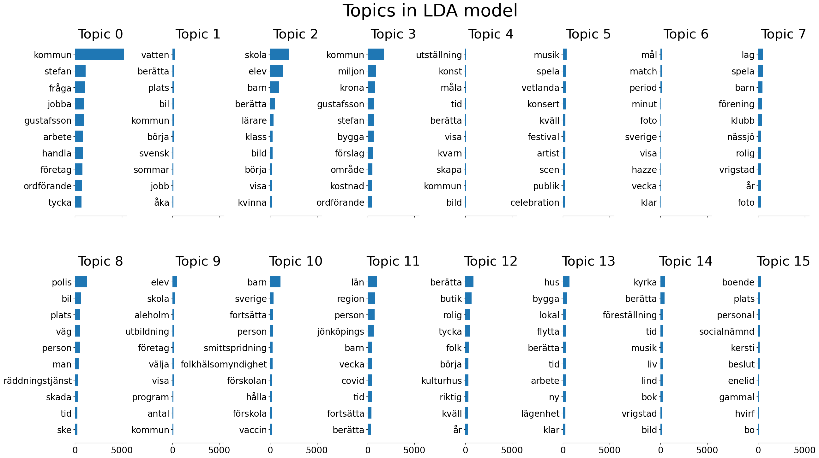
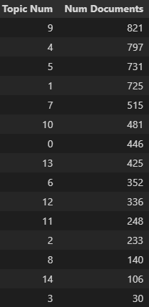
Latent Dirichlet Allocation (LDA)
Notes:
One approach we used was LDA, this is an unsupervised topic classification method. The idea is that you give LDA a set number of topics, and it then determines what words a topic could have generated. So, if a document uses certain words that are contained in a topic, you could say the document is about that topic.
And LDA then cluster words to different topics as seen here on the side. Some words are recurrent for multiple topics but weigh differently. We can also see the distribution of articles to the 18 topics. These range from 30 to 800 articles per topic.

Slide 5
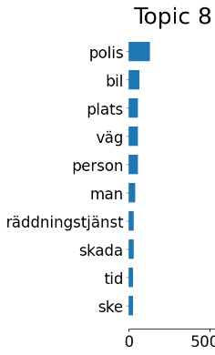
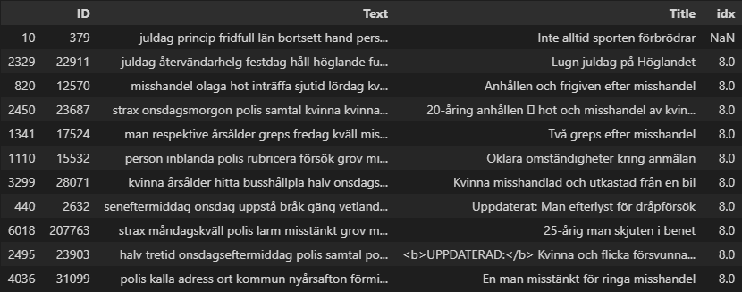
Latent Dirichlet Allocation Result
Notes:
We used LDA to label all the articles and then used it as a cross evaluation for the cosine similarity. Here we have an example of articles recommended from cosine similarity, and as we can see all of them are labeled as topic 8 by the LDA. If we look at which words are in topic 8, we can assume its somewhat about law enforcement, which all these articles are about.
There are only 140 articles that have this label, which makes this a small group of articles.
For evaluation, this is two untested models’ evaluation each other, so it is not the best evaluation method to run. But this result gives some confidence that this approach should be further investigated. And since we choose the nr of topics manually, we need to know how many different topics are required by sävsjöAppen.

Slide 6
TF-IDF and cosine similarity - background
TF-IDF
Each term in a document given a weight, the higher the weight the more relevant the term in the document
Terms that appear often in a specific document, but scarcely in the rest of the document collection get high weights
Effectively does stop word removal for the context of the document collection
Cosine similarity
A measure of the similarity of two sequences of numbers
By considering the sequences as vectors, the similarity score is calculated as cosine of the angle between the vectors
Ranges from 0-1 where higher is better

Slide 7
TF-IDF and cosine similarity - method
Preprocessing
Stop word removal perhaps unnecessary due to TF-IDF but reduces dimensionality
Different tests
Compare full-text documents
Extract named entities and compare the sequences of entities
Using Swedish model from spaCy, results questionable

Slide 8
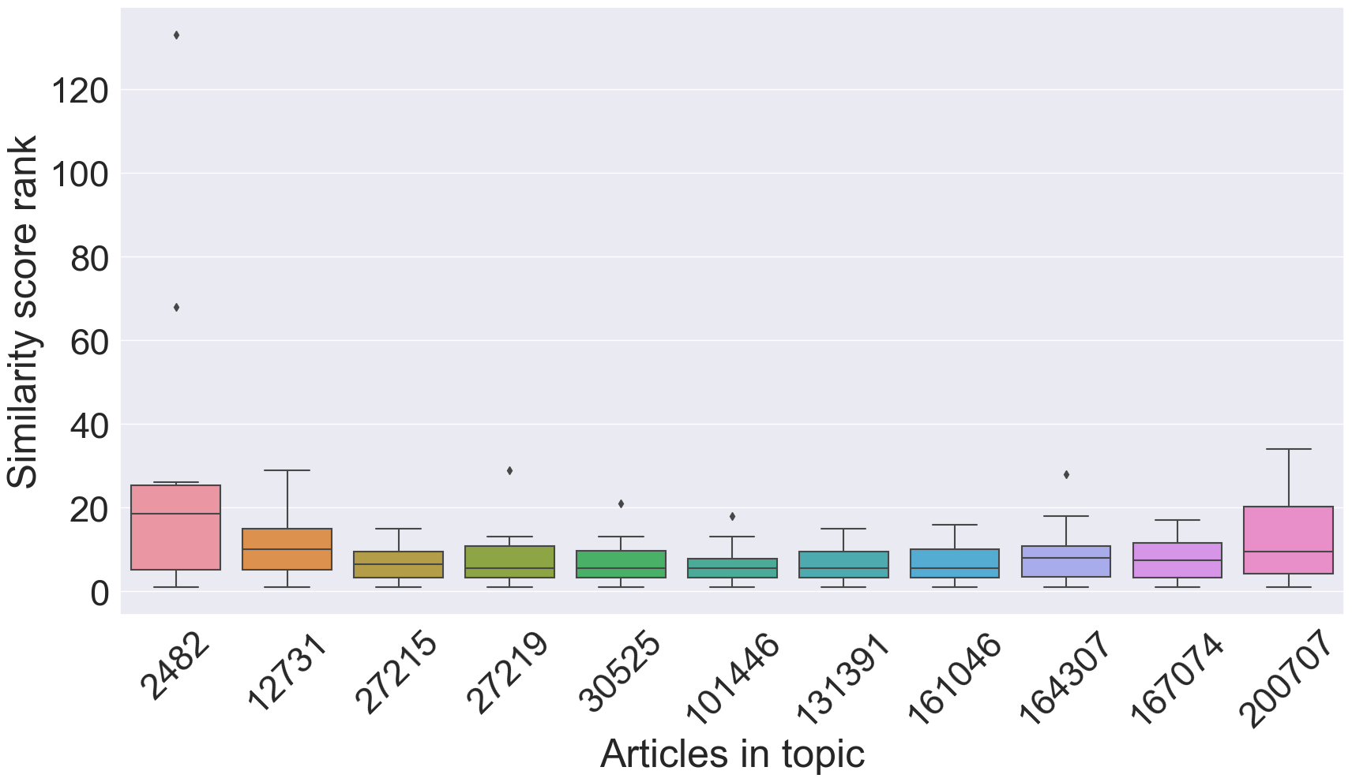
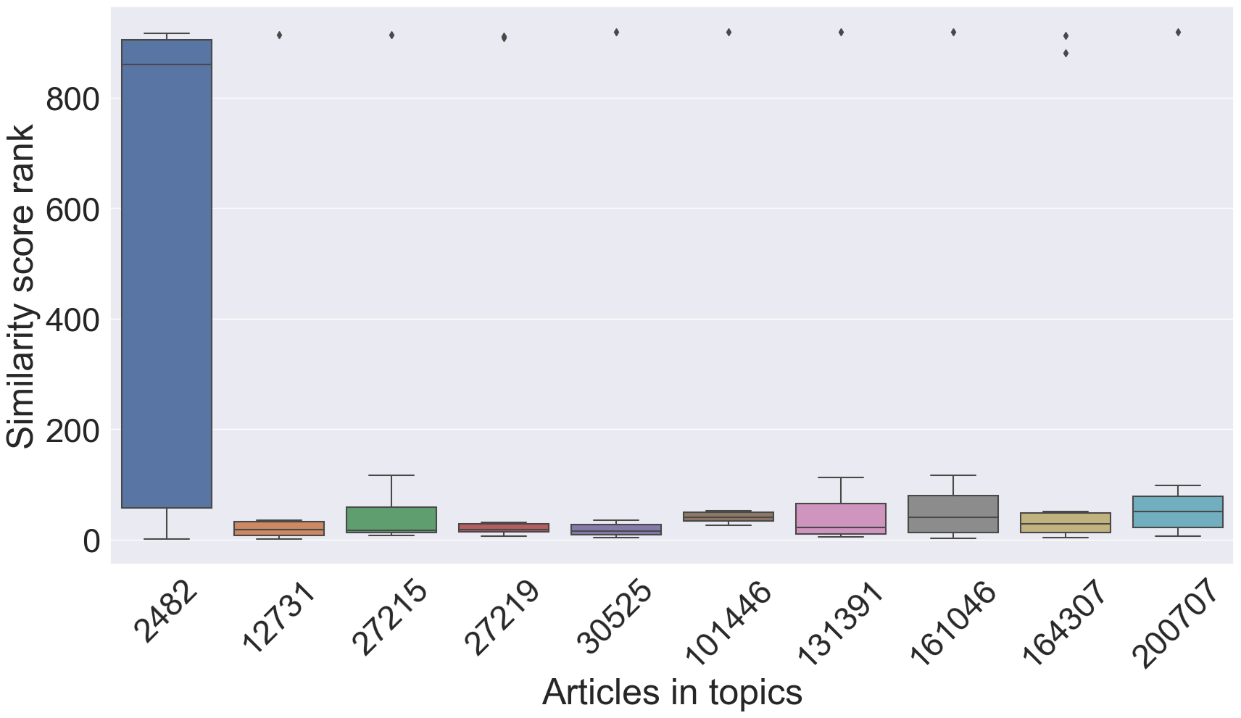
TF-IDF and cosine similarity – results
Full-text comparison, third topic
Named entity comparison, third topic

Slide 9
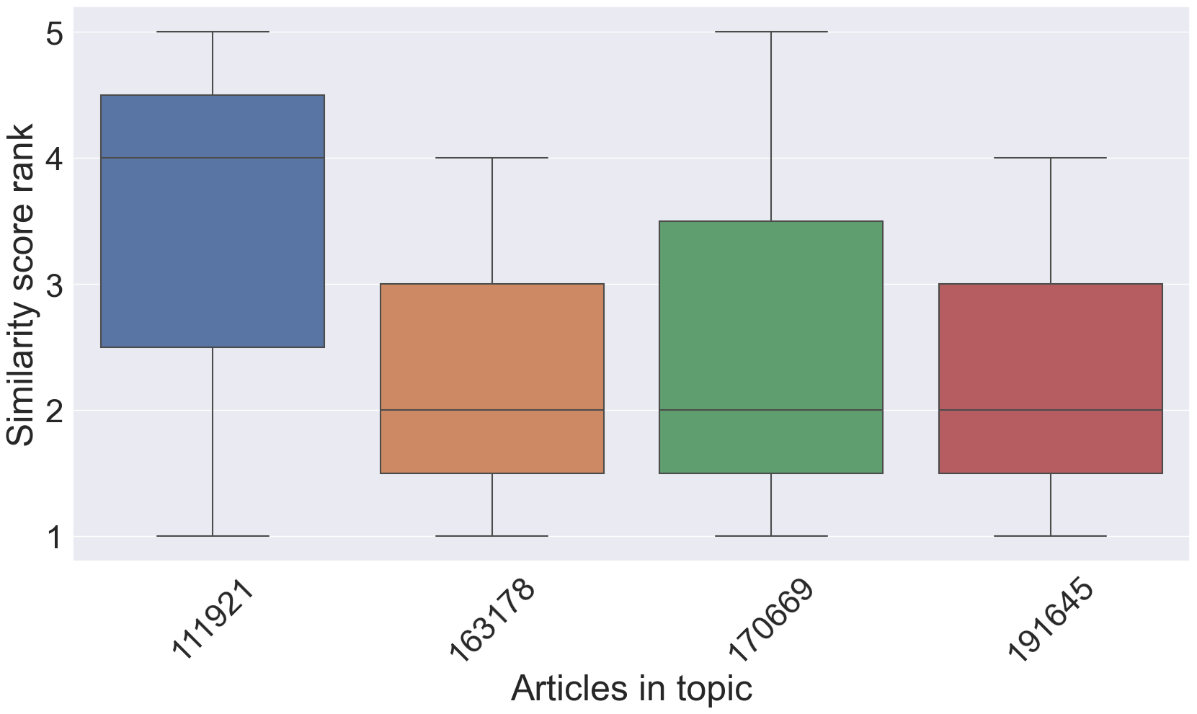
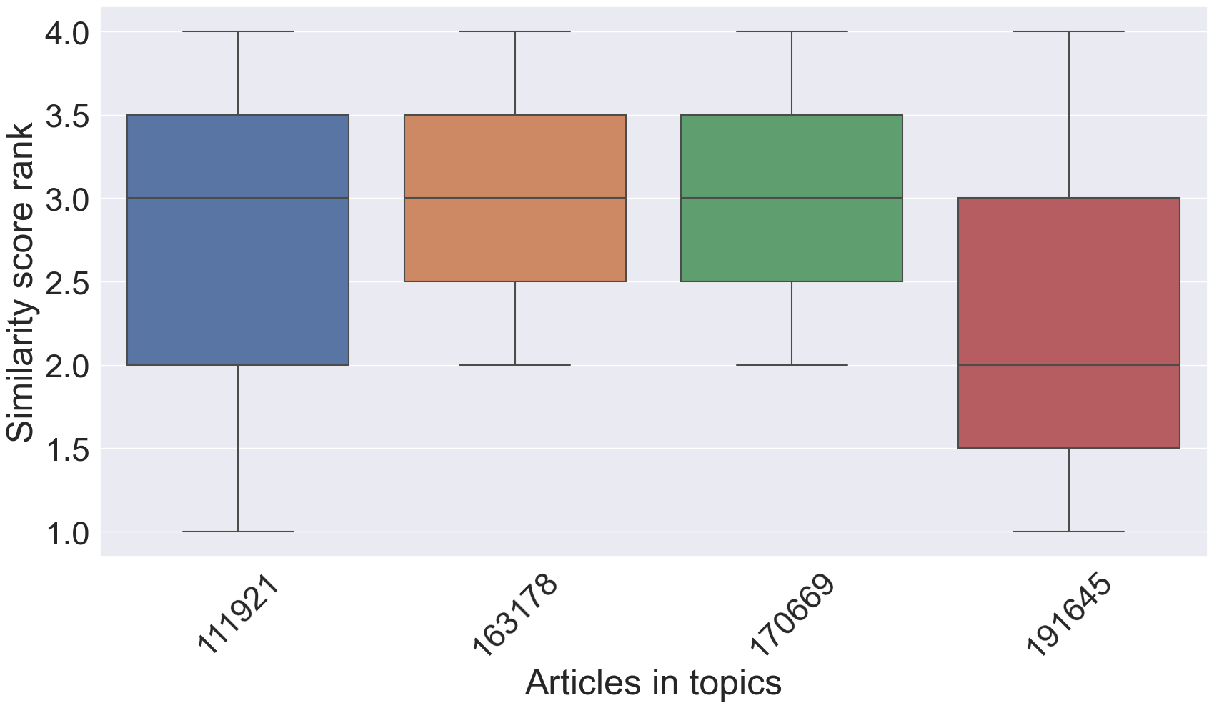
TF-IDF and cosine similarity – results
Full-text comparison, fourth topic
Named entity comparison, fourth topic

Slide 10
Sentence Embeddings and cosine similarity
Large Language Models
Efficient
No need to retrain a new model every time
bert-based-swedish-cased
Sentence Embeddings
No data preprocessing
Obtained word embeddings from pre trained model
Average word embeddings in an article to obtain sentence embeddings

Slide 11
Sentence Embeddings and cosine similarity
Sentence Embeddings without data preprocessing
Extremely high cosine similarity scores for all articles
Too much noise, such as stopwords and punctuation
Sentence Embeddings with data preprocessing
Only removal of stopwords and punctuations to preserve context
Much better range of cosine similarity scores

Slide 12
Initial Evaluation
Desired Result: Higher Cosine similarity scores between relevant articles and vice versa
Average Percentile of averaged cosine similarity scores for articles grouped by tag
High percentile -> Tagged articles are more relevant to one another as compared to untagged articles

Slide 13
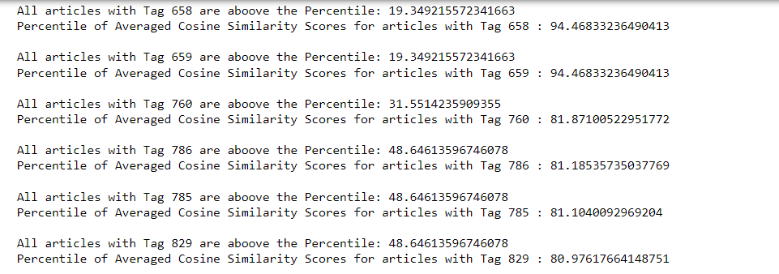
Initial Evaluation
Find percentile of averaged cosine similarity scores for each tag
The percentile of the tagged article with the lowest cosine similarity score is also displayed
Average all obtained percentiles of averaged cosine similarity scores

Slide 14
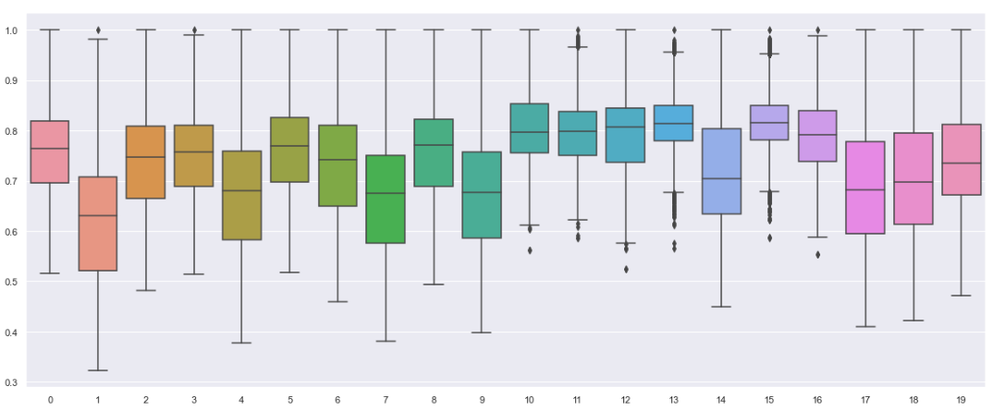
Initial Evaluation
Cosine Similarity Scores Boxplot for 20 articles
Score
Index

Slide 15
Conclusion
Promising results for all the explored approaches
Lemmatization possibly sketchy, further work might improve results
Named Entity Recognition same as above, possibly better results using a better/another Swedish model
Sentence embeddings could be better if we could test and compare with alternative pre-trained models

Slide 16
Thanks for listening

