Slide 1
HisTag Smart history and bookmark management
Young Hackathon 2017
Intern
Yuncong Wu(t-yunw), Tianyi Ma(t-tima)
Fan Wu(t-fawu), Yang Zhou(t-zhoyan)
Jia Shi(t-jiashi)

Slide 2
Outline
History tags
History search by title, tag
Tags visualization
Url recommendation
Product prospects

Slide 3
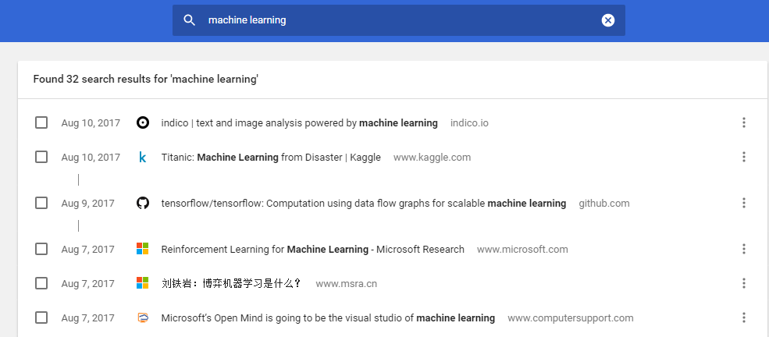
Current History
Only can search by word that appears in the url or title.
Some general topic cannot be classified well.
Some word just appears but not dominates in the passage.
Increasing demands on history/bookmark management

Slide 4
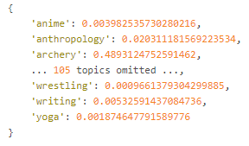
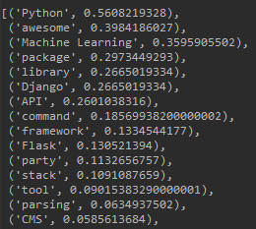
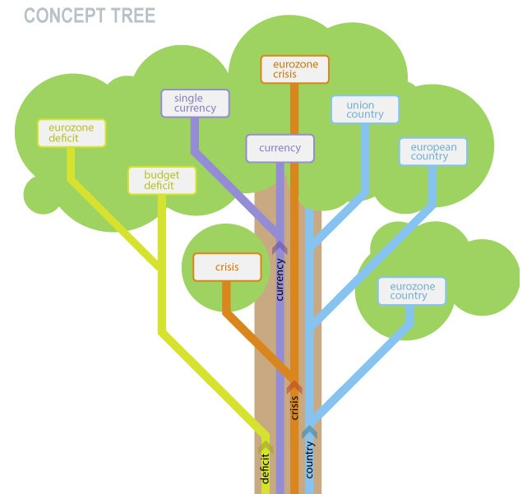
History tags
Tags = [topic, keyword1, keyword2, keyword3]
Image
Topic
Url
extracts terms (concepts and noun phrases)
detects semantic relations (e.g.VSO)
Clusters in WordNet
Keyword extraction
Text
Keywords
API:
Indico
support custom training
Given [Text, tags]
Notes:
anime, anthropology, archery, architecture, art, astronomy, atheism, aviation, baseball, beer, bicycling, biology, books, boxing, buddhism, business, cars, christianity, climbing, comedy, comics, conspiracy, cooking, crafts, cricket, design, dieting, diy, drugs, economic_discussion, education, electronics, energy, entertainment_news, environmental, fashion, fiction, film, fishing, fitness, gaming, gardening, gender_issues, general_food, golf, guns, health, history, hockey, hunting, individualist_politics, investment, islam, jobs, judaism, left_politics, lgbt, math, medicine, military, music, nba, news, nfl, nostalgia, nutrition, parenting, personal, personal_care_and_beauty, personalfinance, pets, philosophy, photography, poetry, poker, political_discussion, programming, psychology, realestate, relationships, religion, right_politics, romance, rugby, running, sailing, school, science, scuba, singing, skateboarding, soccer, sports, startups_and_entrepreneurship, surfing, swimming, tattoo, technology, television, tennis, travel, ultimate, vegan, vegetarian, weather, wedding, weight_training, wine, wrestling, writing, yoga

Slide 5
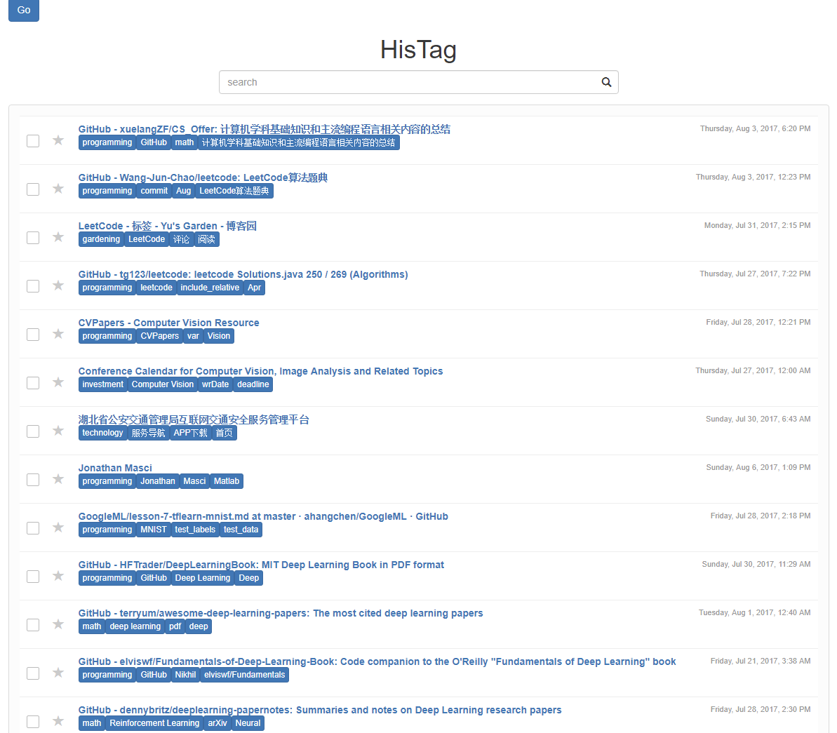
History tags demo

Slide 6
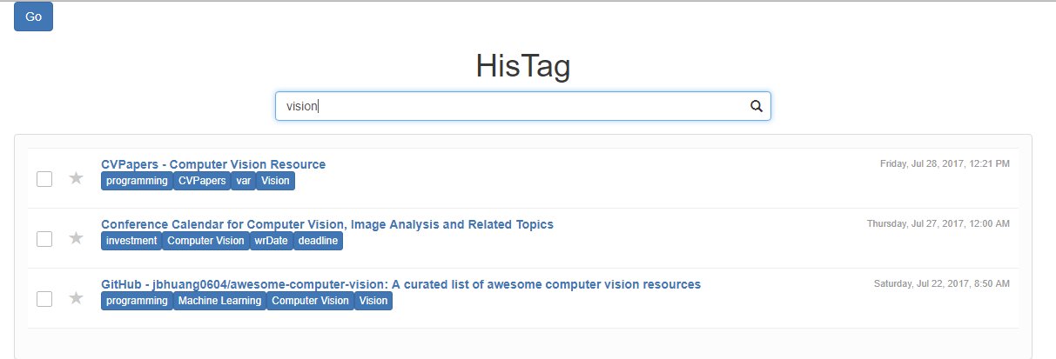
History search by title, tag

Slide 7
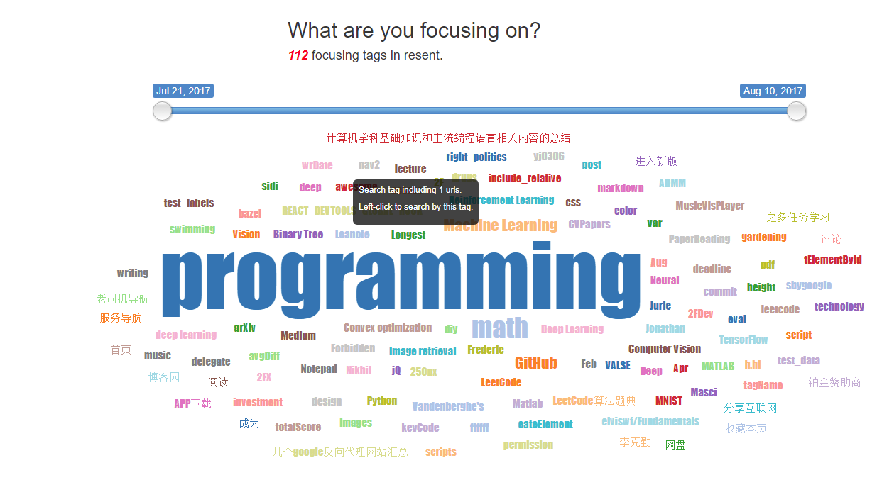
Tags visualization

Slide 8
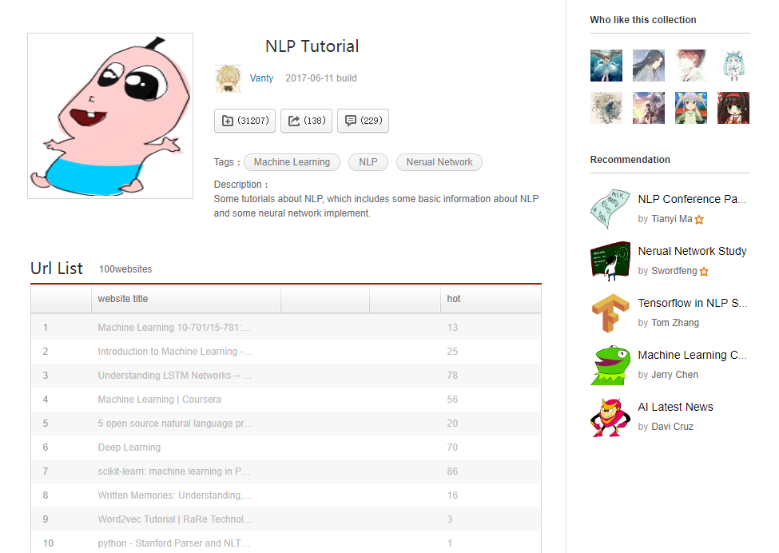
Product prospects
Same topic, shared keywords

Slide 9
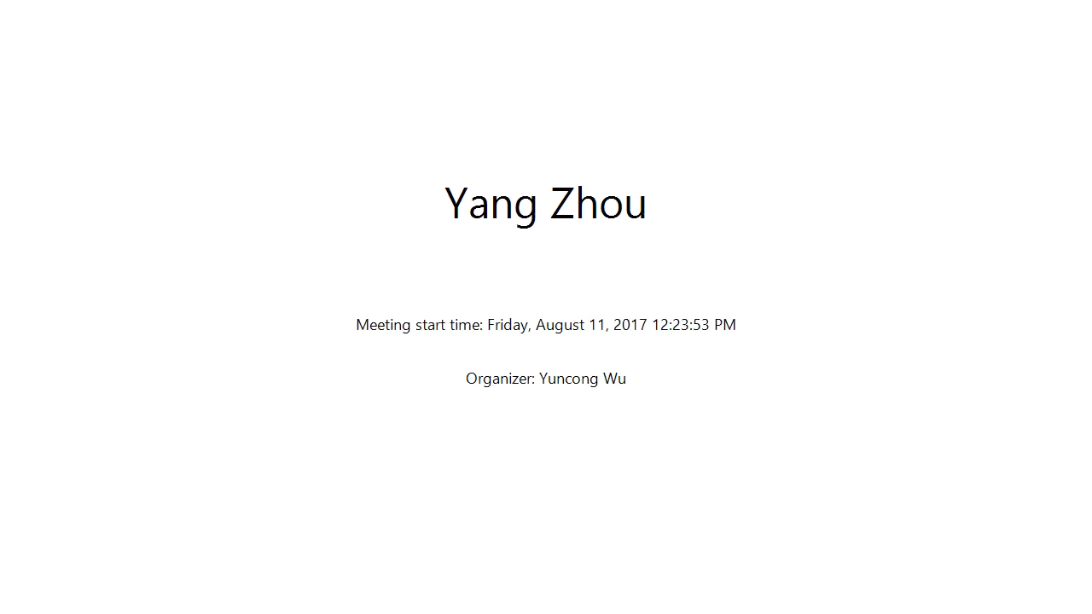

Slide 10
Summary
What We have done:
Build a model to tag your history urls
Develop a chrome extension to help you manage your history
Support search and visualization by tag
Future Work:
Bookmark recommendation and sharing
Optimize tagging model (considering images in feature)
Explore business application
Notes:
(can be easily imported in Edge)

Slide 11
THANKS For your Attention!

